Slide 1
Olist Revenue Intelligence
What drives revenue and customer satisfaction across Brazil?
Steven Siciliano · Data Analyst · github.com/Stezee96

Slide 2
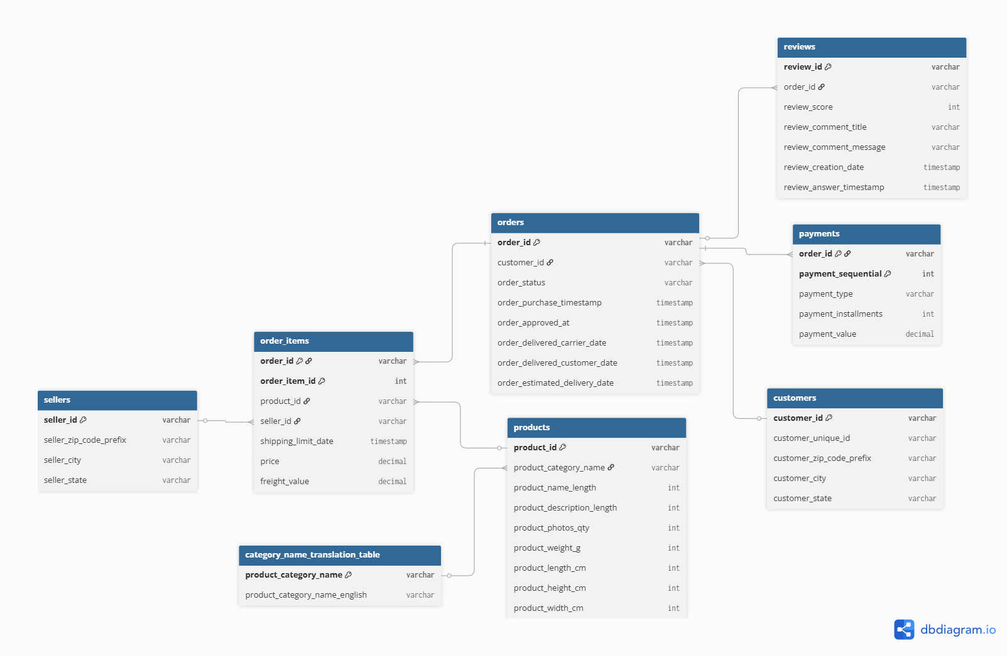

The Data
~99K orders · ~340K rows of Brazilian e-commerce data
8 relational tables (PostgreSQL schema, foreign keys)
Time span: Sept 2016 – Sept 2018
Cleaned & validated in SQL — zero rows deleted
Revenue locked at R$13.59M — every query verified against it

Slide 3
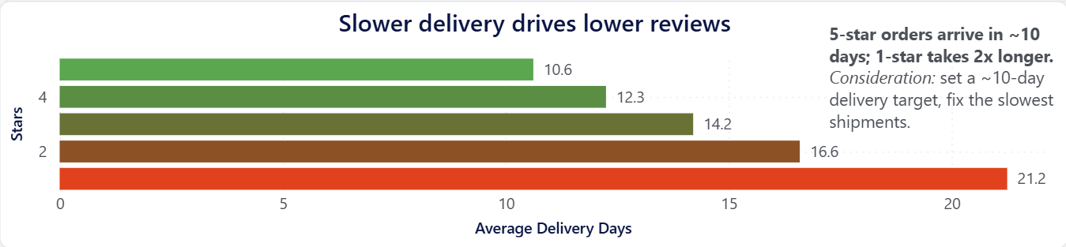
Delivery speed decides your rating
The clearer a shipment's speed, the higher its rating.

Slide 4
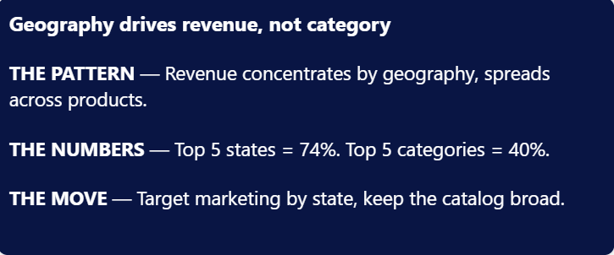
Geography drives revenue, not category

Slide 5
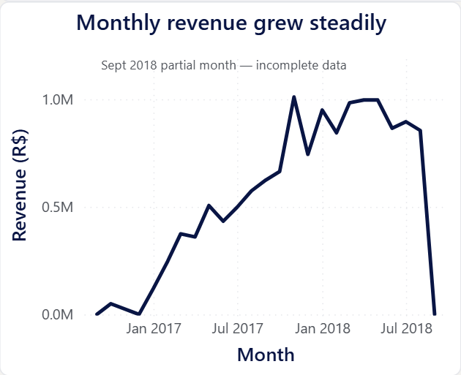
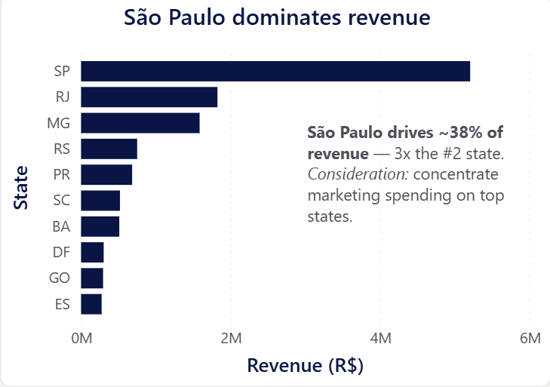
Where and when the revenue happens
• Revenue is geographically concentrated — SP alone drives ~38%
• Growth was steady, peaking each November (holiday demand)
• Decision: focus marketing on top states, stock up before Q4

Slide 6
From findings to action
1. Fix delivery speed
Set a ~10-day delivery target and fix the slowest shipments. 1-star orders take 2x longer to arrive than 5-star — delivery drives satisfaction.
2. Market by geography
Concentrate marketing spend on top states. Just 5 states drive 74% of revenue; São Paulo alone is ~38%.
3. Keep the catalog broad
Maintain a wide product range. Revenue spreads across categories — top 5 are only 40%, so no product dominates.
4. Plan for the peak
Plan inventory around the Q4 holiday peak. Revenue peaks every November (Black Friday demand).

Slide 7
Questions? Let's talk
Built with: PostgreSQL · Power BI (DAX) · Power Query · Excel
Steven Siciliano · Data Analyst 🔗 github.com/Stezee96 💼 linkedin.com/in/stevensiciliano ✉️ stevenjsiciliano@gmail.com

