Slide 1
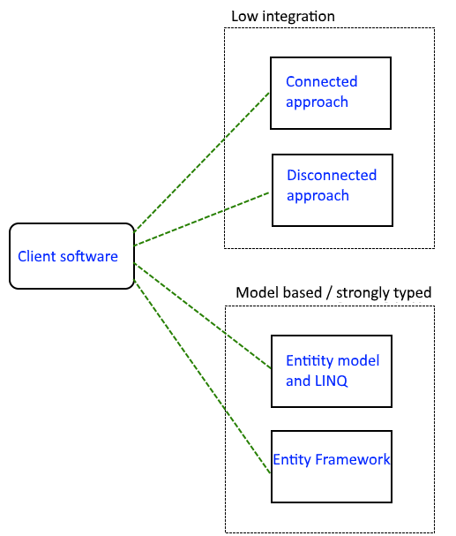
ADO.NET – overall approaches
Accessing a relational database (RDBMS) using ADO.NET.
4 distrinct apporaches.
Low integration.
Client software has no knowledge of tables, attributes and types.
Model based / strongly typed.
A model of the db tables are created, and client software knows that model that is knows the tables, attributes and ther types.
y

Slide 2
ADO.NET – connected
When you use the connected layer .. Your code base explicitly connects to and disconnects from the underlying data store. When you use ADO.NET in this manner, you typically with the data store using connection objects, command objects and data reader objects.

Slide 3
ADO.NET – connected
ADO.NET tasks
Connect to a database using .NET Framework 4.5 data providers
Execute commands
Retrieve results
ADO.NET Data Sources
Access relational databases
Access resources using drivers

Slide 4
ADO.NET
System.Data assembly
System.Data.SqlClient namespace
System.Data.SqlClient
SqlConnection
SqlCommand
SqlDataReader

Slide 5
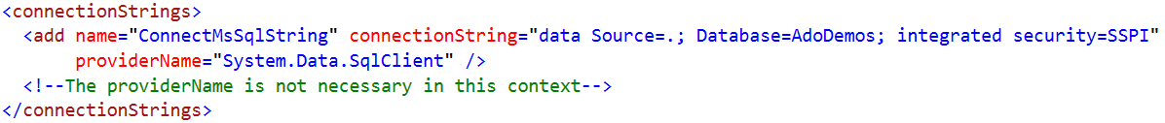
ADO.NET
System.Data.SqlClient
SqlConnection, options
Windows / SQL Server Authentication
Connectionstring in configuration file
Many other configuration options

Slide 6
ADO.NET
System.Data.SqlClient
SqlCommand Used to prepare SQL statement or StoredProcedure that we want to execute on a SQL server database. Methods:
ExecuteReader
ExecuteNonQuery
ExecuteScalar

Slide 7
ADO.NET
System.Data.SqlClient
SqlReader Used to prepare SQL statement or StoredProcedure that we want to execute on a SQL server database. Methods:
ExecuteReader
ExecuteNonQuery
ExecuteScalar

Slide 8
ADO.NET
System.Data.SqlClient - Template for simple read
// Setup connection to database
// Instantiate SqlConnection object with connectionstring
// Write SQL query
// Instantiate SqlCommand object with query string and SqlConnection object
// Open connection
// Execute SqlCommand and assign read data to a SqlDataReader object
// Use data for the reader
// E.g. convert read "rows" to domain object
// Close used resources

Slide 9
ADO.NET
System.Data.SqlClient - Template for simple read
// Setup connection to database
// Instantiate SqlConnection object with connectionstring
con = new SqlConnection(connectionString);
// Write SQL query
// Instantiate SqlCommand object with query string and SqlConnection object
string queryString = "select * from tblProduct Order by name";
SqlCommand readCommand = new SqlCommand(queryString, con);
// Open connection
con.Open();
// Execure SqlCommand and assign read data to a SqlDataReader object
SqlDataReader productReader = readCommand.ExecuteReader();
// Use data for the reader
// E.g. convert read "rows" to domain object
int foundRows = PopulateProductList(productReader);
// Close used resources
productReader.Close();

Slide 10
ADO.NET
System.Data.SqlClient – some options
CRUD
Get results back from query
Parameterized query
Stored Procedure
Exception handling
Close resources by finally or using
ConnectionString

