Slide 1
NETWORKS & DISTRIBUTED SYSTEMS
SESSION 6
Introduction to Security
Cryptography

Slide 2
OBJECTIVES
After the next three sessions, you should...
  Understand the principles of encryption
  Know the most important security threats, and how to defend against them
  Know about security technology in the form of firewalls, virtual private networks, secure payment solutions and wireless security
  Know how to select security solutions for specific systems.

Slide 3
SECURITY BASICS
2 Major areas
  Cryptography / Crypotology
    Assymetric
    Symetric
  Crypto analysis
Very old concept
Lets start with the simple problem area
Notes:
Word definitions
- Cryptopgraphy – secret writing
Cryptology – the science of secrets

Slide 4
Everyday Cryptology
Playing poker
Logging into facebook
Searching google
Opening a door to your house
Notes:
Logging into facebook
Talk about password storing, the pw is ”really there”
Searching google
Https tls
Opening a door
Key

Slide 5
SECURITY BASICS
Problem: Communication over insecure channels.
  Internet, LAN, WAN, MAN, WIFI, GSM…..
  All open
Notes:
Draw it..
We cant be sure if anyone wiretaps the connection

Slide 6
Security Basics
Should cryptosystems be public knowledge, or secret?
Custom-made or standardized?
...our intuitions about these things may be wrong.
Notes:
Private : well if people doesnt know the algorithm, it shuold be safe
Public – only way to know the algorithms are safe

Slide 7
Kerckhoffs principle
A cryptosystem should be secure, even if the attacker knows all implementation details about the system.
In other words: Even if the encryption algorithm falls in the hands of the enemy, it should still be secure.
There’s plenty of historical precedent for such systems.
Notes:
We want experienced cryptographers to tell us if its insecure
What if the algorithm is leaked?
What if it turns out it is insecure?
False feel of safety

Slide 8
SECURITY BASICS
When working with networks, the central security challenge is the fact that traffic isn't invisible.
The local network may be compromised, and a clever cracker can monitor traffic using a packet sniffer.
Routers in remote networks may be compromised by crackers, owned by hostile organizations, or simply faulty.

Slide 9
A TERMINOLOGICAL SIDE NOTE
Hacker (RFC 1392):
  A person who delights in having an intimate understanding of the internal workings of a system, computers or computer networks in particular.
Cracker (RFC 1392):
  Someone whose purpose is to break or circumvent or break security measures. Some use their powers for good, some for evil.
Of black, white and grey hats.

Slide 10
SECURITY BASICS
In distributed systems,
  The local network may be compromised
  Routers may be compromised
  Networks may be open
  The server may be compromised (or not the server we expect)
  The client may be compromised (or not the client we expect)

Slide 11
SECURITY BASICS
On a local network,
  Packet traffic is usually visible
  Anybody can install a packet sniffer
  On wireless networks, radio waves may be intercepted by people not on the network

Slide 12
SECURITY BASICS
On remote networks,
  Routers may be compromised
  ...or the owner of the router might be a shady type
  We have no way of controlling which routers “see” our packets as they travel along the Internet.
  Routers are just computers. There's nothing stopping them from saving a copy of incoming packets to a hard drive. In some countries, they may be legally required to do so.

Slide 13
SECURITY BASICS
Servers...
  May be attacked by shady characters and taken over
  May have a variety of bugs
  Or may be transparently “replaced” with a rogue duplicate
  Responses we get from the network might be from a rogue system masquerading as the server

Slide 14
SECURITY BASICS
Clients...
  Might not even be the client we wrote!
  In Web applications (eg. with JavaScript and AJAX), it is trivially easy to handwrite AJAX requests. In fact, any Web requests are easy to write.
  So by definition, anything the client sends cannot be trusted.
  Rule of thumb: The Devil wrote the client.
    If you don’t believe in the Devil, then I wrote the client.

Slide 15
SECURITY BASICS
We can roughly divide these issues into the following broad groups of concerns:
  Securing confidentiality
  Securing authenticity
  Defending against attack
In these sessions, we will look at data security and network/host security. Today's topic is data security.
There is only one reliable form of data security, namely...

Slide 16
CRYPTOGRAPHY
The art and science of encoding and decoding data so that it can only be interpreted by the intended recipient
A form of data transformation, usually referred to as a cypher or a cryptosystem.
  Modern cryptosystems usually operate on blocks of bits in binary data, rather than alphabetic letters. But for our examples, we shall use alphabetic ciphers to keep things readable.

Slide 17
CRYPTOGRAPHY
Cryptosystems typically have encryption keys, which are bitstrings (runs of binary digits) of some given length.
When certain literature refers to “4096-bit encryption”, this typically means a cryptosystem that uses a 4096-bit encryption key. Whether or not 4096 bits is “enough” depends on the cryptosystem.
Notes:
RSA can use 4kbits
Can we brute force this?

Slide 18
CRYPTOGRAPHY
Secret-key cryptography
  Also known as symmetric cryptography
  Relies on a secret key known only to the involved parties in the communication.
  Sender
    Encrypts a message using the secret key
    Sends the message to the recipient
  Recipient
    Decrypts the message using secret key
Notes:
Twofish, AES, BlowFish, DataEncryptionStandard →3DES

Slide 19
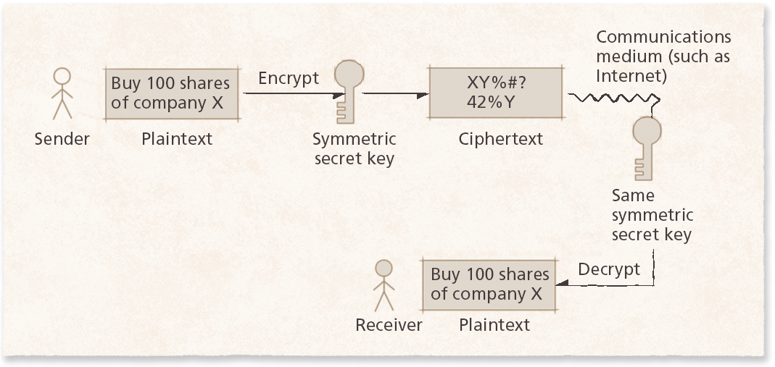
CRYPTOGRAPHY
Secret-key cryptography

Slide 20
CRYPTOGRAPHY
Examples: DES, 3DES, AES
Benefits
  Very simple, and consequently also very fast.
Problems
  Before two parties can communicate, they both have to know the secret key.
  ...and how can they send it to each other over an untrusted network?
Notes:
For more on AES, watch this lecture: https://www.youtube.com/watch?v=NHuibtoL_qk
Advanced Encryption Standard (AES) by Proffessor Christof Paar
He has also done a lecture on DES+3DES
AES 128 – 192 – 256 ..

Slide 21
CRYPTOGRAPHY
Public-key cryptography
  An alternative solution to the key sharing problem is to use two keys per participant.
  Also sometimes called asymmetric cryptography.
  Makes use of two inversely related keys:
    A freely-distributed public key
    A closely-guarded private key known only to its owner
  If something is encrypted using one key, it can only be decrypted by the matching private key.
    Not even the sender can decrypt it

Slide 22
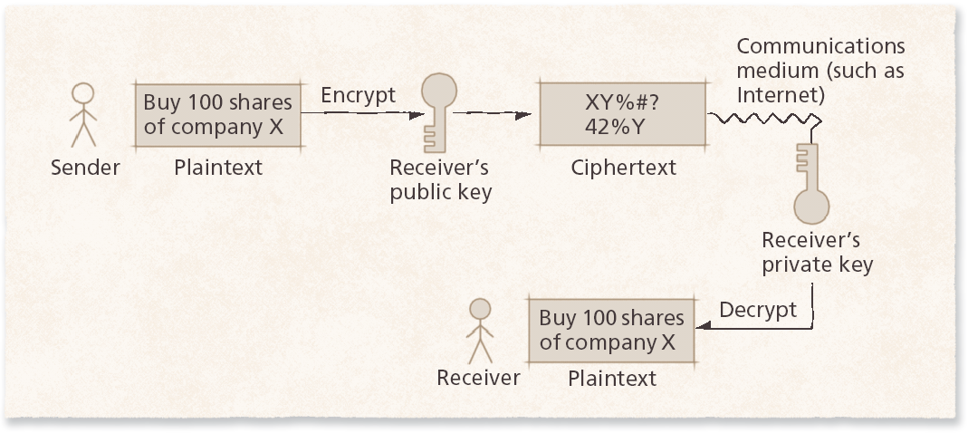
CRYPTOGRAPHY
Public-key cryptography
Notes:
https://www.youtube.com/watch?v=3QnD2c4Xovk

Slide 23
CRYPTOGRAPHY
Public-key cryptography
  Note that public-key cryptography can both be used for authentication and for confidentiality.
  Encrypting something with someone else's public key ensures that only they can read it.
  Encrypting something with my own private key ensures that it was me who sent it.
Notes:
Authentication: Encrypt your own private key first, then recievers public key.
If you publish a message, say online, YOU have to be the a

Slide 24
CRYPTOGRAPHY
Public-Key Cryptography
  Examples: RSA, PGP, GPG
    RSA is used in TLS
      Uses DH exchange
      Where? – you’ve probably seen it
  Benefits
    Handily defeats the key sharing problem
    Gives both confidentiality and authentication
  Problems
    Computationally intensive, and hence quite slow.
Notes:
Overfladisk forklaring på 1.5 time
Ron Rivest, Adi Shamir og Len Adleman i 1977.
RSA 2048 bits = 617 digits long key

Slide 25
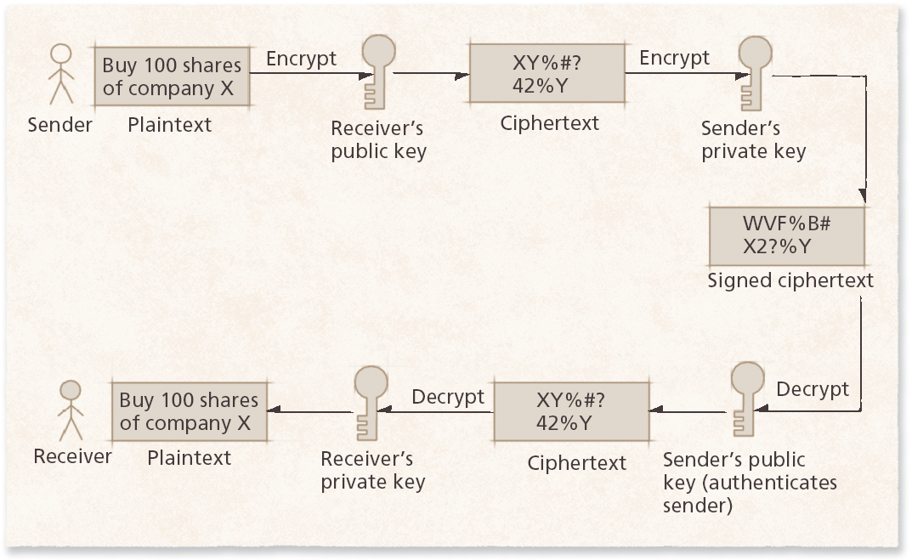
CRYPTOGRAPHY
Public-key cryptography

Slide 26
CRYPTOGRAPHY
Note:
  A private key is NOT the same thing as a secret key!
  They are concepts from two completely different kinds of cryptosystems! Secret keys are from symmetric cryptography, private keys are half of a key pair in asymmetric cryptography.

Slide 27
Diffie Hellman Key Exchange
Relies on the the mathematical properties of multiplication
  In exponents and multiplication
1. Select a large random prime number p (23)
2. Select a ”primitive root” of p called g(5) (the generator)
  For all numbers x in Z there exists a number such that g^k=x
3. Alice selects a random number(a) = 6
4. Alice computes her public key A = g^a mod p = 8
  Sends to bob
5. Bob selects a random number(b) = 15
6. Bob computes his public key B = g^b mod p = 19
  Bobs sends this to Alice
Alice can now calculate a secret key S by S=B^a mod p = 2
Bob can do the same inversely: S= A^b mod p = 2
Use this key in eg. AES(k→S)
Notes:
They are inverse related!
So this gives the parties a way of secretly agreeing on a encryption key.
But it DOESNT ensure that the sender, is who he might say he is. Diffie hellman cannot be used for this; it is a key exchange algorithm
By using the most prevalent assymetric scheme RSA, signing can be done by hashing the message,encrypting it with the senders private key, and attaching it as a signature (RSA uses digital signatures)
When bob recieves the message, he can then do the inverse function, and agree that the sender is who she says she are.

Slide 28
A GRAB BAG OF CYPHERS
Cryptography has a long history, and has been used for both military and civilian purposes.
The earliest known use of cryptography is from ancient Mesopotamia (modern-day Iraq). Clay tablets have been found with a variety of encrypted trade secrets on them.
Many ancient civilizations also used cryptography to prevent enemies from learning military secrets.

Slide 29
A GRAB BAG OF CYPHERS
Substitution cypher (replacement cyphers)
  Historical
  Operates on letters
  One of the simplest possible cryptosystems.
  Replace plaintext letters by fixed cyphertext letter
  We decide a new substitution alphabet.
  a becomes x
  b becomes r
  c becomes q etc.
Notes:
Historical mostly defines insecure cyphers
Substitution cypher has a large keyspace 28! (you only use the same alphabeth and characters once)

Slide 30
A GRAB BAG OF CYPHERS
Shift Cypher
  The alphabet is encoded with numbers for letter positions, and then we simply add some number to each letter in the string before writing it back as letters.
  Example: The Caesar Cypher (guess who used that)
    K=3
    A->D
    B->E
    W->Z
    X->A
    Wraparound
  Fubswrjudskb lv ixq
  E(x) = x+k mod 26 (alphabet length)
  D(x) = x-k mod 26 (alphabet length)
Notes:
Historical mostly defines insecure cyphers
Which attacks will work on this? What is the keyspace(hint in algorithm)

Slide 31
A GRAB BAG OF CYPHERS
Substitution cyphers are not very secure.
  The key in the Caesar cipher was 3.
  ...but Caesar also relied on the enemy not knowing the algorithm used (and using illiterate messengers).
  This is “security through obscurity”, and it never works. It is frequently worse than no security at all.
  The moment anybody figured out Caesar's algorithm, they could just try keys until they got something that worked.

Slide 32
Pick one and present!
Transposition cyphers
Vigenére (polyalphabetic cyphers)
Keyword cyphers
45minutes research and presentation preparation
5-10 mins presentation per group
Use google and/or the slides that are provided below (down to ”modern cyphers”).

Slide 33
A GRAB BAG OF CYPHERS
Transposition cyphers
  Encodes the alphabet using numbers and multiplies with some known value.
  Example:
    Ci = E(pi) = 5*pi + 3
  Many variations: Rail fence cypher, column transpositions, etc.
  ENIGMA was a very complicated transposition-type cypher. Its primary mode of security was the about 169 quintillion different possible settings of the ENIGMA machine.

Slide 34
A GRAB BAG OF CYPHERS
Keyword cyphers
  We write the keyword before the alphabet, omitting repeat characters. Then we write the rest of the alphabet after it, without those in the key.
  Keyword: FUTURAMA
  FUTRAMBCDEGHIJKLNOPQSVWXYZ
  ABCDEFGHIJKLMNOPQRSTUVWXYZ

Slide 35
A GRAB BAG OF CYPHERS
Mono- and polyalphabetic cryptosystems
  The preceding examples were monoalphabetic. In other words, all characters are encoded in the same alphabet.
  But all monoalphabetic cyphers have the same weakness! If we know the alphabet and the language, we can exploit statistical letter frequency distribution and figure out the keys and the algorithm.
  See http://www.cs.virginia.edu/~cmt5n/Classwork/Crypt/Chris/monocrypt.html

Slide 36
A GRAB BAG OF CYPHERS
A solution is using polyalphabetic encryption, where there are several alphabets organized in a table. The cypher then describes how to choose which alphabet to choose from.
Invented in the 1400s – and was very secure back then. Vigenére's “chiffre indechiffrable” (literally “unbreakable cypher”) from 1585 was thought unbreakable until well into the 1800s.

Slide 37
A GRAB BAG OF CYPHERS
Vigenére's cypher works using a “keyphrase” used to decide which alphabet to use for each character. If I use “CAT”, for instance, then the sequence will be 3, 1, 20 repeated.
Typically, makes use of a table to perform the actual substitutions. See the next slide. :-)
Unfortunately, if the plaintext is sufficiently long compared to the cyphertext, statistics still beat it.
The key repeats
  Plain: HELLODUDE
  Key: LOLLOLLOL
Notes:
Eg.
Key is LOL
Text to encrypt is: HELLO
To encrypt: look at the top of the table(plain text-letters)
Find the first letter in your text(H)
Go down and stop when you are next to your KEY’s first letter in the vertical side; the intersection is the cyphertext
The letter is: S
Repeat with E(in hello) and O(in LOL) = S
To decrypt.
You have the key(LOL) and a cyphertext (SSAAO)
Go to the letters in the key, in the top of the table.. Go down to the letter inside the table.. Read the plainkey on the left hand side.
https://www.youtube.com/watch?v=47BHvzLdPxw

Slide 38
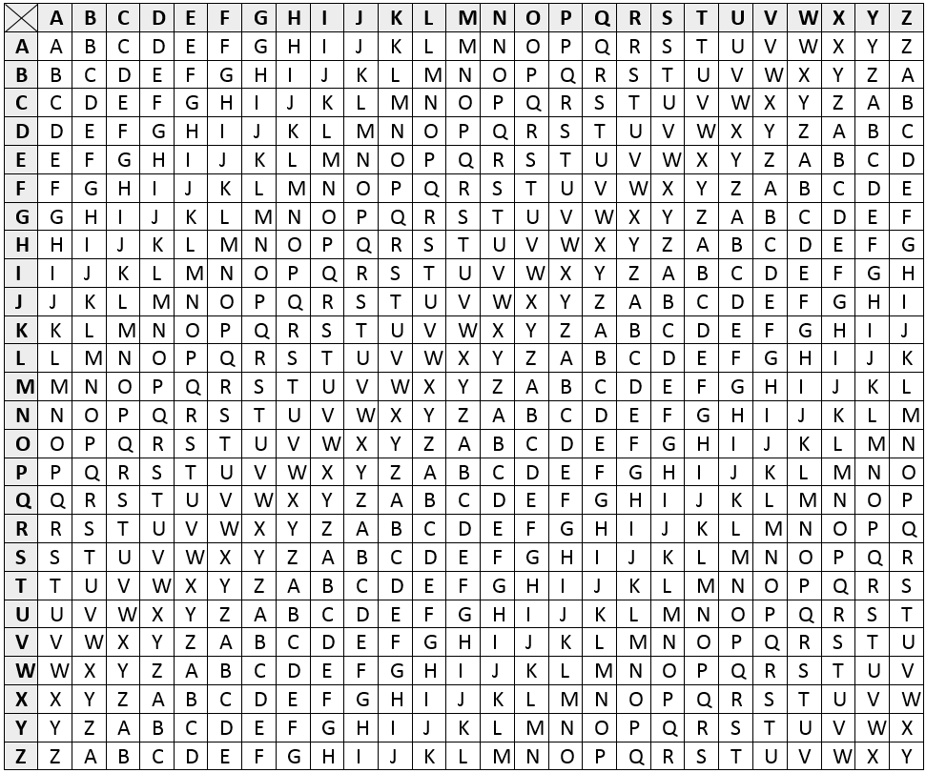
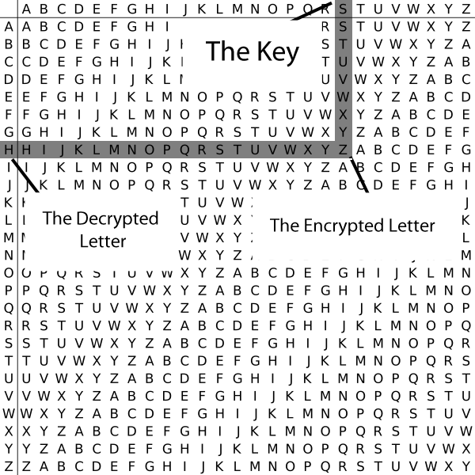
Notes:
http://pages.mtu.edu/~shene/NSF-4/Tutorial/VIG/Vig-Base.html
KEY: FUGLFU
TXT: HEHEHE
CT: MYNPMY
DEC
KEY: FUGLFU
TXT: MYNPMY
DECTXT: HEHEHE

Slide 39
MODERN CYPHERS
Secret-key cryptography usually works using various more or less creative combinations of the aforementioned principles.
For example, DES uses 56-bit secret keys and a combination of substitution and transposition.
DES was broken in 1998. Don't use it!
Its modern successor, AES, is also a combined substitution/transposition cypher, combined with a matrix multiplication scheme (and much bigger keys).

Slide 40
MODERN CYPHERS
With public-key cryptography, the central challenge is the fact that the two keys are inversely related. Knowing one means that you can figure out the other.
...in theory. Public-key crypto schemes are designed so that the only known algorithms for actually doing so run in exponential time (I think your Data Structures teacher also told you about that).

Slide 41
MODERN CYPHERS
A good example of a public-key scheme is RSA (after Rivest, Shamir and Adleman).
Practical implementation of public key crypt
Encryption:
  C = m^e mod n, where e,n are public key components
Decryption:
  m = c^d mod n, where d,n are private key components

Slide 42
MODERN CYPHERS
Obviously, an attacker who wants to know d (from the private key) can figure it out, given all the other numbers (which are publicly available)! However...
This equates to finding the prime factors in very large numbers. Only exponential-time algorithms are known to exist for doing that.
A 300-bit RSA key can be cracked in a few hours.
A 4096-bit RSA key will take trillions of years.

Slide 43
Cracking the encryption
Is a simple substitution function secure?
How can we attack it?
Brute force(Exhaustive keysearch)
  Is it even possible?
    Analyse the keyspace
    KeySpaceFactorial (v=K!) possible values
Frequency Analysis
    Counting letters
    What do we need for this?
    Works because it maps directly to cyphertext symbols
Social engineering
Implementation attacks (bugs/errors)
Side channel attacks
    Hardware
Notes:
http://www.math.cornell.edu/~mec/2003-2004/cryptography/subs/frequencies.html

Slide 44
Cryptographic hashing

Slide 45
INTERLUDE: CRYPTOGRAPHIC HASHING
In some situations, we might not even need the information we have to keep secret – we just need to ensure that the user knows it.
Example: Passwords.
Passwords typically reside in some file on a computer, or in some record on a database.
What happens if that file gets stolen?

Slide 46
INTERLUDE: CRYPTOGRAPHIC HASHING
We could encrypt the passwords. But since we don't actually need the passwords, we can in fact do one better: We can simply not store them at all.
The basis of this trick is a hash function.
Whereas the hash functions used in hash tables are usually optimized for performance, a cryptographic hash is almost exactly the opposite.

Slide 47
INTERLUDE: CRYPTOGRAPHIC HASHING
Simplified example: If my password A hashes to H(A), then why would the computer have to keep A anywhere at all? It could just keep H(A), recompute H(A) and when I enter my password.
Problem?
  Collisions
    Why is this a problem?
  Solution?
Notes:
Collisions – solved with hashes?

Slide 48
INTERLUDE: CRYPTOGRAPHIC HASHING
Examples: MD5, SHA-1, SHA-2, SHA-256
Iterated password hashes: PBKDF2, Argon2
Password hashes are frequently incredibly slow compared to other hashes. But this is good – it means that a password thief has to spend lots of time trying to crack the passwords.
The biggest weakness to password security, unfortunately, remains: People tend to choose incredibly stupid passwords.
Notes:
With a $150 graphics card, you can perform 680 million SHA-1 hash computations per second.
If you use only one round of hashing, all 6-character passwords can be tested in a little over 15 minutes (that's assuming all 94 printable ASCII characters are used).
Each additional character multiplies the time by 94, so 7 characters requires one day, 8 characters requires 103 days on this setup.
Remember, this scenario is a 14-year-old using his GPU, not an organized criminal with real money
Now consider the effect of performing multiple iterations. If 1,000 iterations of hashing are performed, the 6-character password space takes almost 12 days instead of 15 minutes.
A 7-character space takes 3 years.
If 20,000 iterations are used, those numbers go up to 8 months and 60 years, respectively.
At this point, even short passwords cannot be exhaustively searched; the attacker has to fall back to a dictionary of "most likely" passwords.

Slide 49
Characteristics
Deterministic
One-way
Collision probability low
Fixed range
Uniformity
Notes:
Deterministic – message x always translates to message y
One-way – it should be mathematically infeasible to reverse the function
Collisions should very rarely occur
The output of the hash function is fixed in length
Output must be uniformely distributed with roughly the same probability

Slide 50
INTERLUDE: CRYPTOGRAPHIC HASHING
Cracking passwords is done in different ways, depending on whether it is a targeted attack (on a single user's password), or a mass attack (on an entire stolen password file).
For targeted attacks, the most common source of success is knowledge of the user's personal life (because of passwords with references to that).
For mass attacks, the most common source of success is … using a dictionary.
Notes:
Dictionary can also be a rainbow table
Calculate a hash and google it:
MD5 CALC: http://md5-hash-online.waraxe.us/
http://www.xorbin.com/tools/sha256-hash-calculator
NOTICE THE IMPORTANCE OF A PRECALCULATED SALT!

Slide 51
EXERCISES
Implement code that can hash an input string, save it in memory.
  Afterwards, create a method where you can check if a newly input string hashes to the same value as is saved in memory.
  Implement a simple user login system that stores hashed (and salted) password values.
Implement code that cracks a Caesar-style substitution cypher, brute force style.
ADVANCED: Implement code that cracks the Vigénere cypher using frequency analysis.
Notes:
https://stackoverflow.com/questions/4181198/how-to-hash-a-password/10402129#10402129
Password-Based Key Derivation Function 2

