Slide 1
Application Development Basics

Slide 2
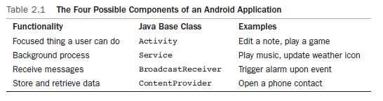
Application Building Blocks
Activity
As of version 3.0 the Fragment class has been included. This helps us to create UI that can work on both tablets and phones. You should consider whether Fragments are needed from the start as it takes time to convert
IntentReceiver
Service
ContentProvider

Slide 3
Activities
Typically correspond to one UI screen
But, they can:
Be faceless
Be in a floating window
Return a value

Slide 4
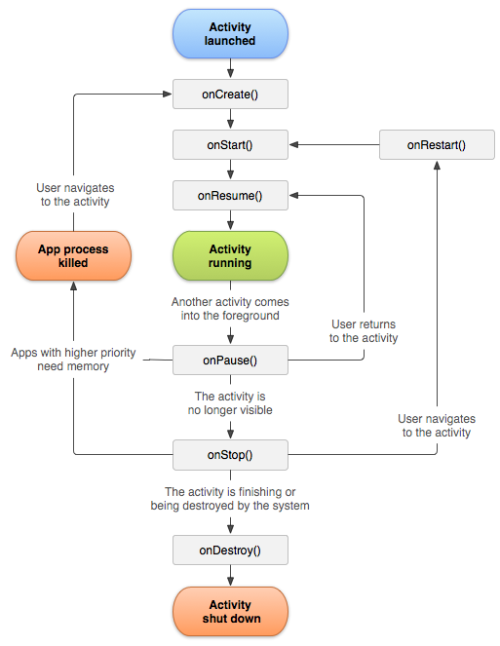
Activity Lifecycle https://developer.android.com/guide/components/activities/activity-lifecycle

Slide 5
See the activities
public class ActivityLifecycle extends Activity {
@Override
public void onCreate(Bundle savedInstanceState) {
super.onCreate(savedInstanceState);
setContentView(R.layout.main);
Toast.makeText(this, "onCreate", Toast.LENGTH_SHORT).show();
}
@Override
protected void onStart() {
super.onStart();
Toast.makeText(this, "onStart", Toast.LENGTH_SHORT).show();
}
@Override
protected void onResume() {
super.onResume();
Toast.makeText(this, "onResume", Toast.LENGTH_SHORT).show();
}
@Override
protected void onRestart() {
super.onRestart();
Toast.makeText(this, "onRestart", Toast.LENGTH_SHORT).show();
}
@Override
protected void onPause() {
Toast.makeText(this, "onPause", Toast.LENGTH_SHORT).show();
super.onPause();
} …..

Slide 6
Exercise
Make the application shown on the previous slide.
Try to get it through all the states.
What will happen when somebody calls the phone? When you background the app and so on? What happens when you tilt the phone?

Slide 7
Application Building Blocks
Activity
As of version 3.0 the Fragment class has been included. This helps us to create UI that can work on both tablets and phones. You should consider whether Fragments are needed from the start as it takes time to convert
IntentReceiver
Service
ContentProvider

Slide 8
IntentReceivers
Components that respond to broadcast ‘Intents’
Way to respond to external notification or alarms
Apps can invent and broadcast their own Intent
Can be seen as a message from one app to another or within an app

Slide 9
Intents
Think of Intents as a verb and object; a description of what you want done
E.g. VIEW, CALL, PLAY etc..
System matches Intent with Activity that can best provide the service
Activities and IntentReceivers describe what Intents they can service
Notes:
Intents is IPC (inter process communication) and uses Message Passing

Slide 10









Intents
Home
Picasa
Photo Gallery
Contacts
“Pick photo”
GMail
Client component makes a request for a specific action
System picks best component for that action
Chat
New components can use existing functionality
Blogger
Blogger

Slide 11
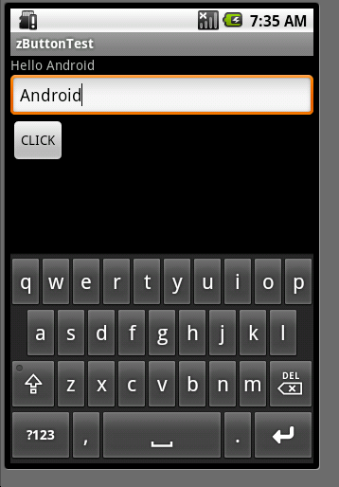
A simple example Hello You

Slide 12
UI is declarative
<?xml version="1.0" encoding="utf-8"?>
<LinearLayout xmlns:android="http://schemas.android.com/apk/res/android"
android:orientation="vertical"
android:layout_width="fill_parent"
android:layout_height="fill_parent"
>
<EditText
android:id="@+id/editText"
android:layout_width="fill_parent"
android:layout_height="wrap_content"
android:singleLine="true" />
<Button
android:id="@+id/submit"
android:layout_width="wrap_content"
android:layout_height="wrap_content"
android:text="Search" />
<TextView
android:id="@+id/display"
android:layout_width="fill_parent"
android:layout_height="fill_parent"
android:text="@string/hello"
android:textSize="18dp“ />
</LinearLayout>

Slide 13
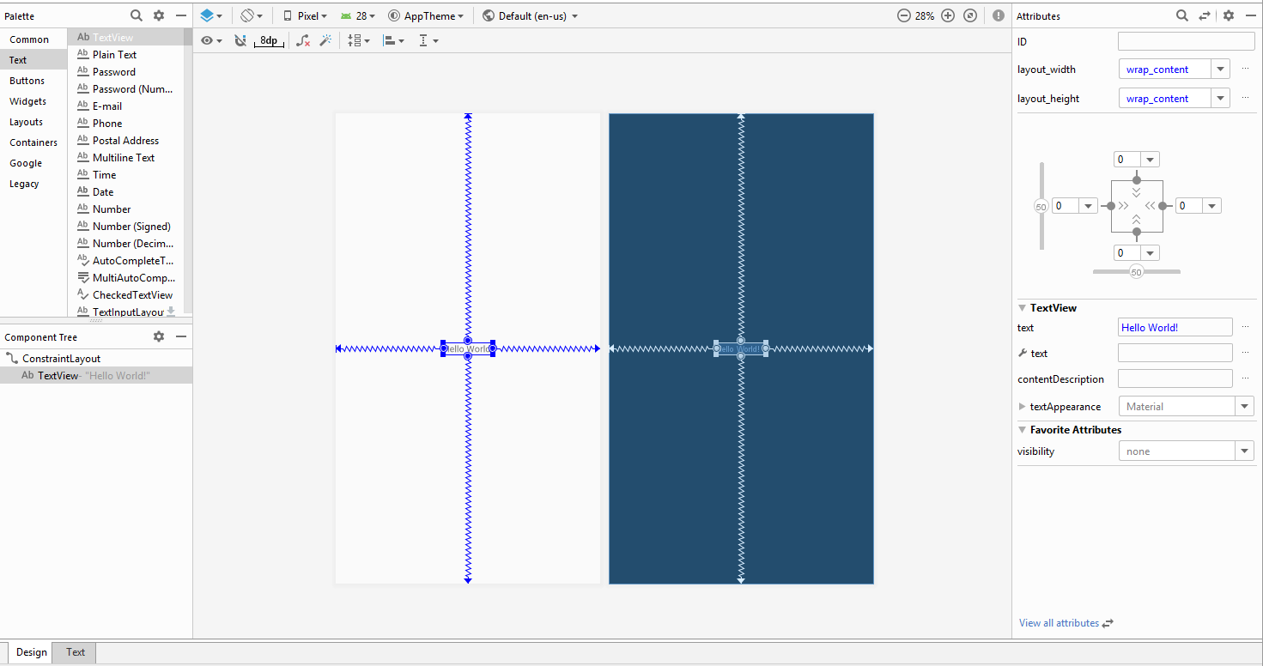
Visual Layout Editor in Android Studio

Slide 14
The Java code:
import android.app.Activity;
import android.os.Bundle;
import android.view.View;
import android.widget.Button;
import android.widget.EditText;
import android.widget.TextView;
public class ButtonTest extends Activity {
@Override
public void onCreate(Bundle savedInstanceState) {
super.onCreate(savedInstanceState);
setContentView(R.layout.main);
Button b=(Button) findViewById(R.id.submit);
b.setOnClickListener(new View.OnClickListener() {
@Override
public void onClick(View v) {
EditText et=(EditText)findViewById(R.id.editText);
TextView tv=(TextView)findViewById(R.id.display);
tv.setText("Hello "+et.getText());
}
});
}
}
To update R.java: Save the layout.

Slide 15
Exercise
Lets try a little advanced version of the example. Do the tutorial on https://developer.android.com/training/basics/firstapp/
Notice how intents are used.
There is a problem with the code shown for the button, can you find it? Hint it has something to do with reflection.
Could you have solved the problem in another way with what you have learned up to now?

Slide 16
Application Building Blocks
Activity
As of version 3.0 the Fragment class has been included. This helps us to create UI that can work on both tablets and phones. You should consider whether Fragments are needed from the start as it takes time to convert
IntentReceiver
Service
ContentProvider

Slide 17
Services
Faceless components that run in the background
E.g. music player, network download etc…

Slide 18
Application Building Blocks
Activity
As of version 3.0 the Fragment class has been included. This helps us to create UI that can work on both tablets and phones. You should consider whether Fragments are needed from the start as it takes time to convert
IntentReceiver
Service
ContentProvider

Slide 19
ContentProviders
Enables sharing of data across applications
E.g. address book, photo gallery
Provides uniform APIs for:
querying
delete, update and insert.
Content is represented by URI and MIME type

