Slide 2
Android – Getting started
Introduction to the platform
Installation and introduction to development environment

Slide 3
Android
Open platform for
Primary mobile phones
And tablets
But also other uses, e.g. car computers, control panels, cameras etc.
Complete stack: OS, Middleware and applications.
A kind of Linux – act as a HAL (Hardware Abstraction Layer)
Develop in Java (with restrictions)
Open source (Apache license)
Currently the mostly used smartphone OS with Samsung as the largest manufacturer

Slide 4
Android: Background history
In July 2005, Google acquired Android, Inc., a small company that developed software for mobile phones
In the following months, the former “Android, Inc.” team started working on a Linux-based OS for mobile devices
By the end of 2006, media and press was filled with news about Google entering the mobile market.
Today two major versions of Android are on handsets
Version with Google Play (and other Google ecosystem)
Open source version without the Google ecosystem (very popular in Asia)

Slide 5
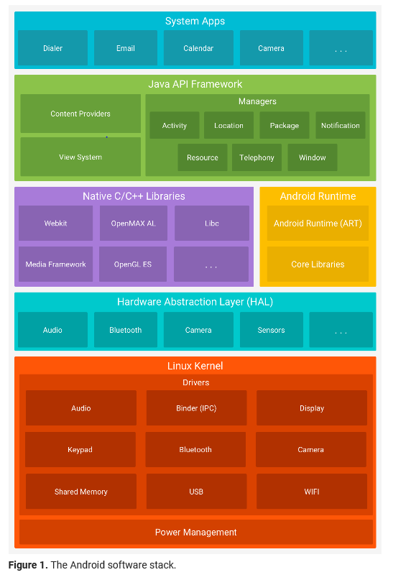
Graphical presentation

Slide 6
Installation of IDE
Lets start by queuing up installation requests
Go to the android developer page and select the get android studio (you should have done this already)
This leads you to a page where you can download the newest IDE for your system

Slide 7
Installation ctd
After the IDE is installed go to the folder you selected at run the studio64.exe file
This fires up the IDE with the latest SDK
I would recommend installing more SDKs:
The version that fits with your phone
Android 8 meaning build tool 27.0.3, Android 26, Google API, Intel x86 Atom_64 emulators for both android and google api in order to have a base for React-Native.
And a common version for your group (when you are getting into a group. This can be added later)
And finally:
Google USB driver (it might work for you)
Google Play Services

Slide 8
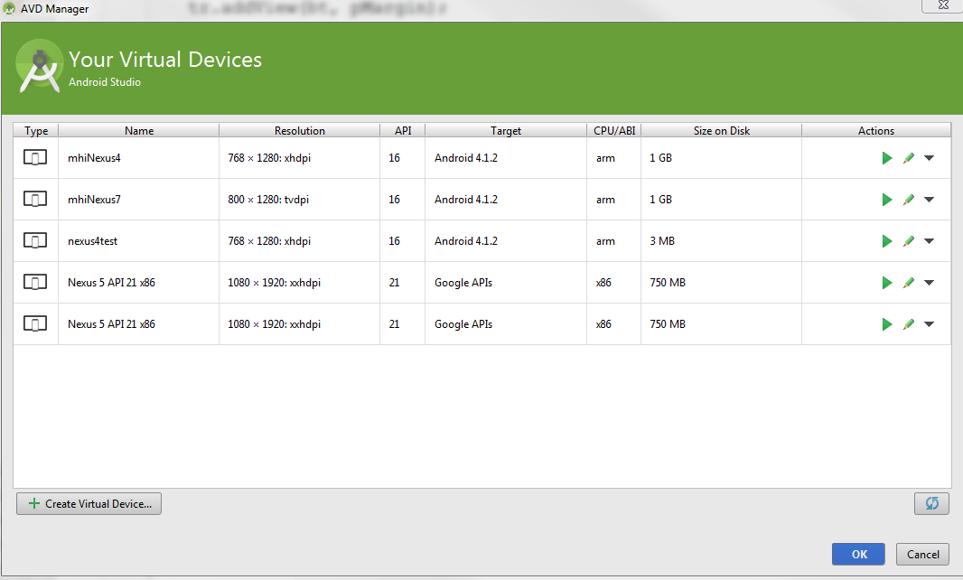
Emulator setup
Choose Tools->Android->AVD Manager from Android Studio
Press to configure a new device

Slide 9
Configuring the emulator
Just follow the instructions in the wizard
Select version of android to develop against and a display which fits with the intended target
It should work out of the box
Newer versions of the emulator requires installation of Hyper-V. Android Studio will guide you, but you need to know how to get into the BIOS of your computer

Slide 10
Configuring the phone
Enter settings->about phone, scroll to the bottom
Tap several times on Build Number to get the phone in developer mode.
Now a couple of settings needs to be changed, see next slide
Note that setting the phone in developer mode is depending on the version of Android on Your phone and also the manufacturer of the phone

Slide 11
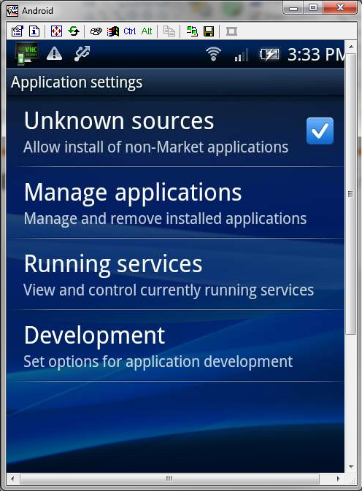
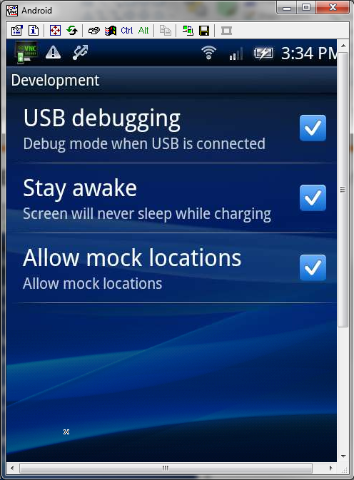
Run the application on a real phone
Enable development and debuging on the phone
Note that these settings have changed depending on Android version

Slide 12
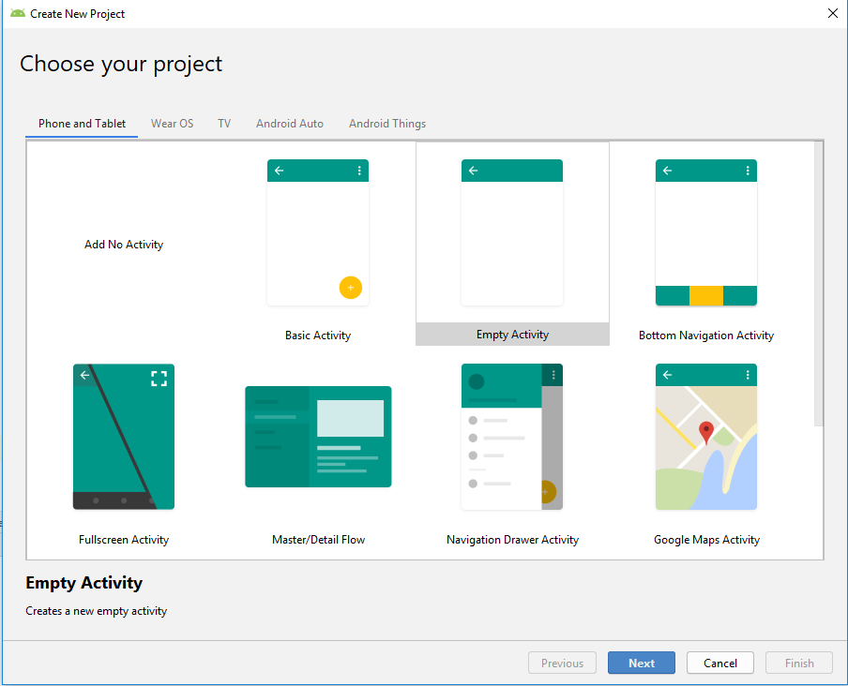
Lets create a HelloWorld project
File->new project, select empty Activity

Slide 13
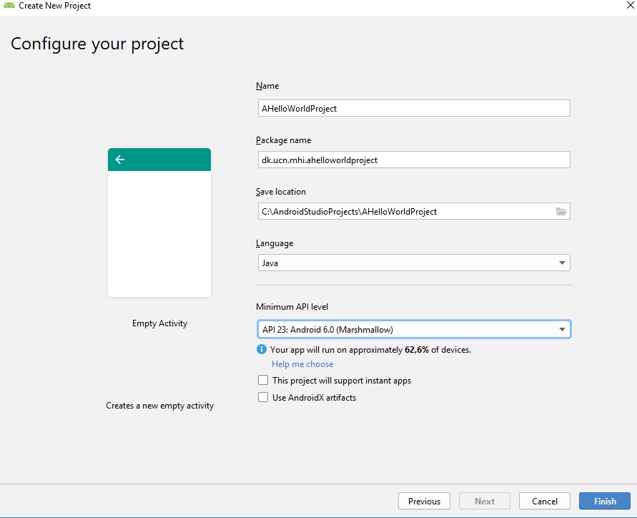
Do the final configuration

Slide 14
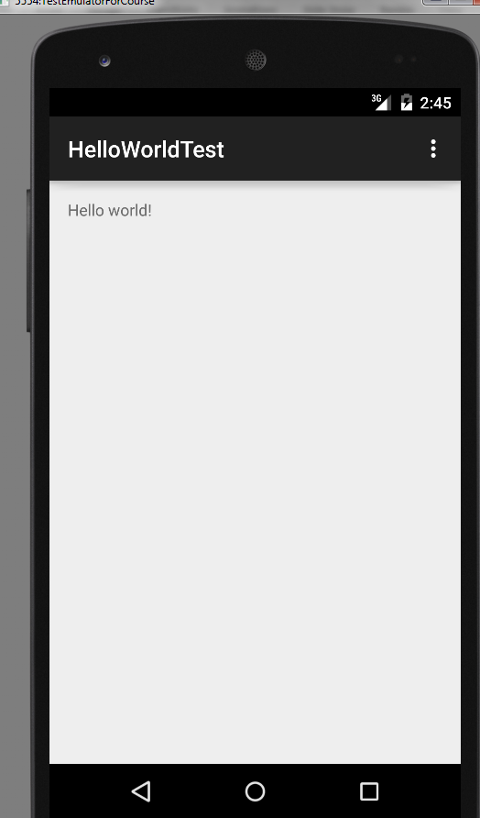
Run the application on a emulator
Just run the application
First time you will be asked which emulator you want to use. You can change it later if you want
Note it takes a lot of time to deploy on the emulator
So start it first and dont kill it when you develop
Or even better, use your phone

Slide 15
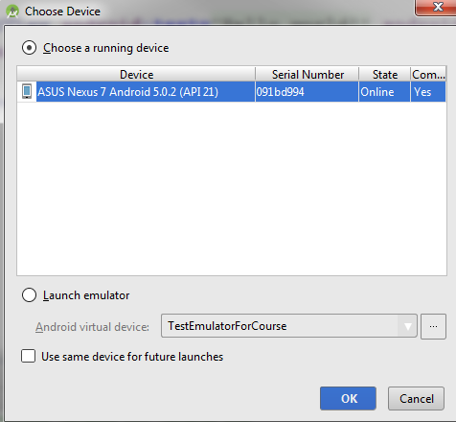
Run the application on a real phone
Plug the phone into the usb. (note ensure that the settings from earlier are set)
And run the application again.
Then, by default, it will run on the phone
If your phone doesn’t show up. You will need to install USB drivers

Slide 16
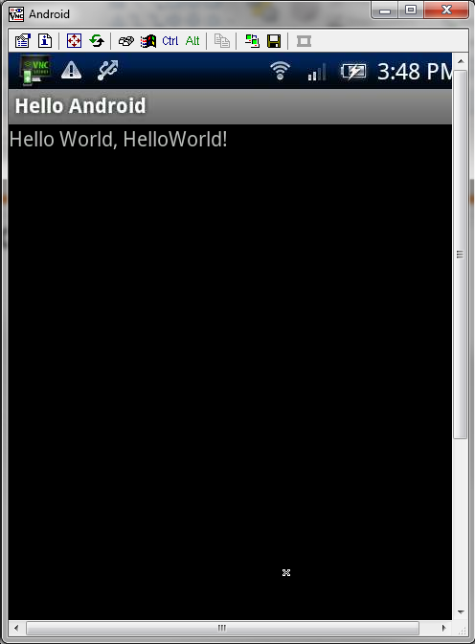
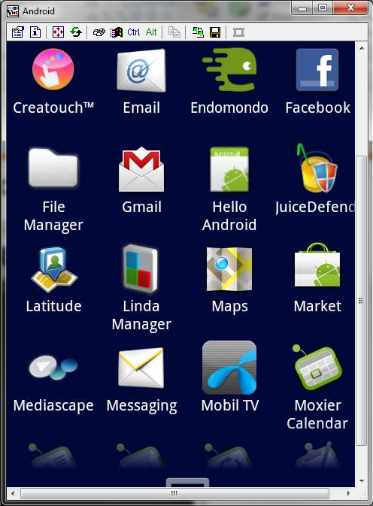
… and here it is on a X10

Slide 17
Exercise
Setup the development environment
Make Hello World
Create a simple UI and try to get familiar with the environment especially the UI designer

Slide 18
Monitoring and Debugging on Android
There are several services we can use
A profiler view->Tool Windows->Android Profiler
For UI analysis we have tools->Android->Layout Inspector
As well as your standard debugger
Remember you have to select debug instead of run in order to launch the debug perspective

Slide 19
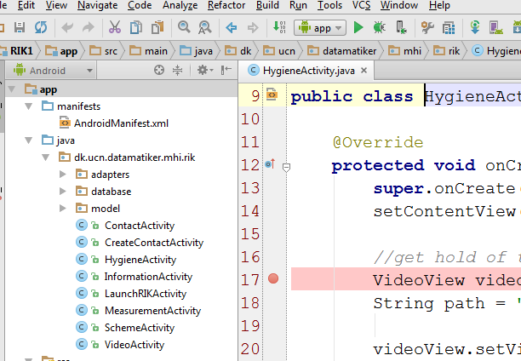
One way of starting the debugger
Press this icon for debug

Slide 20
Another way to find errors
As we know one of the more powerful tools to error finding is a good log system.
Android comes with one (android.util.Log)
We have the possibility to set several levels of information from here written from most critical to least critical.
ERROR, WARN, INFO, DEBUG, VERBOSE
Verbose must not be used in live apps. Debug will automatically be excluded by the system on live and the other three are kept.
When the system crashes it will also send out log information on logcat. That can help you in getting the first clue to what went wrong

Slide 21
How to use the logger
Add the LogCat window (view) to your Android Studio IDE if not present already.
Include the library
And write your log statements in the code
import android.util.Log;
Log.d(“TestActivity”, “This is a debug statement”);

Slide 22
Exercise
Try to run the applications you created in the previous exercise in debug mode.
Put in some breakpoints and debug the application
Add some Log statements to your code and get them shown in the logcat view

