Slide 1
Resources and Manifest

Slide 2
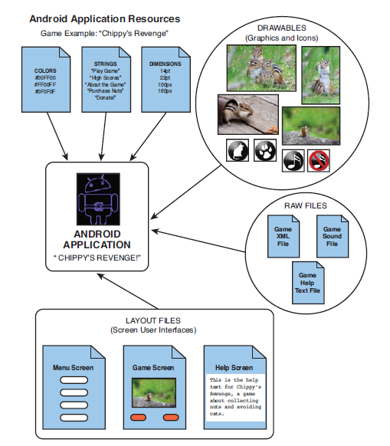
Android apps can use a variety of resources

Slide 3
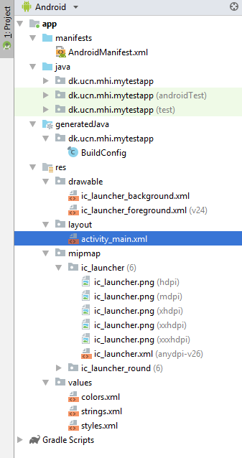
Project Structure User-generated files
java/ contains the Java packages the developer writes or imports for the application. Each package can have multiple .java files representing different classes.
res/layout/ contains the XML files that specify the layout of each screen.
res/values/ contains the XML files used as references by other files.
res/drawable are the directories that contain pictures the application uses.
res/mipmap contains launcher icons in different screen sizes (mdpi, hdpi, xhdpi, xxhdpi, xxxhdpi)
AndroidManifest.xml specifies the project to the Android OS.
Gradle Scripts contains the build instructions

Slide 4
Project Structure Autogenerated files
When you build your project for the first time Android Studio will generate R.java using Android Asset Packaging Tool (aapt). This is used to link resources to java.
Buildconfig.java is also created. It is used for building the project
package dk.ucn.mhi.helloworld;
public final class R {
public static final class attr {
}
public static final class drawable {
public static final int ic_launcher=0x7f020000;
}
public static final class id {
public static final int menu_settings=0x7f070000;
}
public static final class layout {
public static final int activity_hello_world_main=0x7f030000;
}
…
} //Each resource has a unique integer value

Slide 5
Why resources
Code is cleaner and easier to read, leading to fewer bugs.
Resources are organized by type and guaranteed to be unique.
Resources are conveniently located for handset customization.
Localization and internationalization are straightforward. It still takes a lot of time though
But it might be troublesome to load every resource incl. strings from an xml file

Slide 6
More information on resources
See the Android documentation
But it is really straight forward and just requires some experience and practice

Slide 7
Manifest
Manifest is something Android inherits from J2ME
The Android manifest file is to determine application settings
Such as
the application name and version
which permissions the application requires to run
what application components it is comprised of.
In Android Studio some of the information is placed in the Gradle Scripts

Slide 8
The Manifest File
<?xml version="1.0" encoding="utf-8"?> <manifest xmlns:android="http://schemas.android.com/apk/res/android" package="dk.ucn.mhi.helloworldyetagain"> <application android:allowBackup="true" android:icon="@mipmap/ic_launcher" android:label="@string/app_name" android:roundIcon="@mipmap/ic_launcher_round" android:supportsRtl="true" android:theme="@style/AppTheme"> <activity android:name=".HelloWorldActivity"> <intent-filter> <action android:name="android.intent.action.MAIN" /> <category android:name="android.intent.category.LAUNCHER"/> </intent-filter> </activity> </application> </manifest>

Slide 9
The Build.gradle File (for the module)
apply plugin: 'com.android.application' android { compileSdkVersion 28 defaultConfig { applicationId "dk.ucn.mhi.mytestapp" minSdkVersion 23 targetSdkVersion 28 versionCode 1 versionName "1.0" testInstrumentationRunner "android.support.test.runner.AndroidJUnitRunner" } buildTypes { release { minifyEnabled false proguardFiles getDefaultProguardFile('proguard-android-optimize.txt'), 'proguard-rules.pro' } } } dependencies { implementation fileTree(dir: 'libs', include: ['*.jar']) implementation 'com.android.support:appcompat-v7:28.0.0' implementation 'com.android.support.constraint:constraint-layout:1.1.3' testImplementation 'junit:junit:4.12' androidTestImplementation 'com.android.support.test:runner:1.0.2' androidTestImplementation 'com.android.support.test.espresso:espresso-core:3.0.2' }

Slide 10
Which activity starts the application?
An Activity class can be designated as the primary entry point by configuring an intent filter using the tag <intent-filter> with the MAIN action type and the LAUNCHER category.
<activity android:name=".HelloWorldActivity"> <intent-filter> <action android:name="android.intent.action.MAIN" /> <category android:name="android.intent.category.LAUNCHER"/> </intent-filter> </activity>

Slide 11
Configuring Other Intent Filters
The Android operating system uses Intent filters to resolve implicit intents.
That is Intents that do not specify the Activity or Component they want launched.
Intent filters can be applied to Activities, Services, and BroadcastReceivers.
The filter declares that this component is open to receiving any Intent sent to the Android operating system that matches its criteria.
The following filter tells that the activity can be used for showing content with the schema geoname://
<intent-filter>
<action android:name="android.intent.action.VIEW" />
<category android:name="android.intent.category.BROWSABLE" />
<category android:name="android.intent.category.DEFAULT" />
<data android:scheme="geoname"/>
</intent-filter>

Slide 12
Permissions
In Android, applications have limited capability to adversely affect operations outside their process space.
Instead Android applications run within their own virtual machine, with their own Linux user account (and related permissions).
Android applications have no permissions by default <6.0.
Any permissions for shared resources or privileged access must be explicitly registered within the Android manifest file.
These permissions are granted when the application is installed <6.0.
Examples of shared resources are the Contacts database (data), or the built-in camera (hardware)
Drawback of this concept is that most users will just accept any permission without reading them.

Slide 13
Define permissions Get access to the camera
The following XML excerpt for the preceding Android manifest file defines a permission using the <uses-permission> tag to gain access to for example the built-in camera:
This example is for Android before version 6.0.
When users install the application, they are informed what permissions the application requires to run and must approve these permissions.
Request only the permissions your application really requires. E.g. users don't feel safe about a causal game that asks for permission to start phone calls.
A complete list of the permissions can be found in the android.Manifest.permission class.
The application can grant permissions to other applications This is also done in the manifest file
<uses-permission android:name="android.permission.CAMERA" />

Slide 14
Permissions ctd
Therefore a new permission model has been introduced with version 6.0 of Android.
Permissions are split up into two groups dangerous and normal. All normal are automatically granted.
The dangerous are split into groups, granting permission to one in the groups automatically grants to all in that group. Permission is at runtime. You cannot assume that the groups stays constant and must not assume that since there is permission to one category in the group then there is to another as well
You will have to check every time as the user might change his/hers mind at any time

Slide 15
Permissions ctd
Android now requires you to target version 23 (Android 6.x, Marshmallow) when you are developing an application
The implication of this is that you have to use the new permission model

Slide 16
Checking for permission
If you are using functionality requiring permission then you need to encapsulate your code with something like
if (ContextCompat.checkSelfPermission(getApplicationContext(),
Manifest.permission.ACCESS_FINE_LOCATION)!=
PackageManager.PERMISSION_GRANTED) { if (ActivityCompat.shouldShowRequestPermissionRationale(this,
Manifest.permission.ACCESS_FINE_LOCATION)) { //Show explanation to user why permission is needed //remember to listen for answers and when there ask for
//permission } else { //just asking for permission ActivityCompat.requestPermissions(this, new String[]
{Manifest.permission.ACCESS_FINE_LOCATION},
MY_CALLBACK_VALUE); } }

Slide 17
Asking for permission callback
Finally there is an answer from the user if we are allowed to use the functionality
public void onRequestPermissionsResult(int requestCode,
String[] permissions, int[] grantResults) { switch (requestCode) { case MY_CALLBACK_VALUE: if (grantResults.length > 0 &&
grantResults[0] == PackageManager.PERMISSION_GRANTED) { //we got our permission and can start working } else { //we did not get permission and must handle that issue } break; default: //some common error handling here break; } }

