Slide 1
Final Defense on:
Student attendance System
using QR code
Presented by:
Dishan Shrestha
Pawan Thapa
Rajkumar bishwakarma

Slide 2
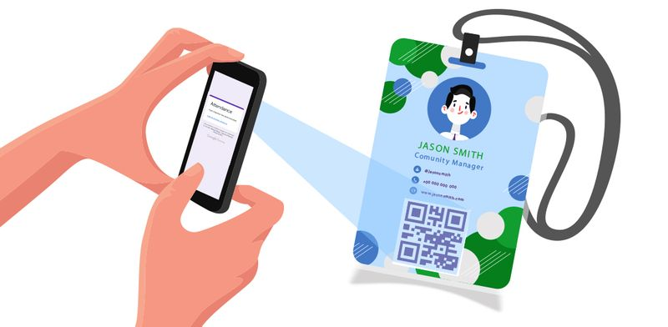
Introduction
QR Code Attendance System is purposely designed to be used by the educational institution. The attendance system will only require the students to scan the QR codes to record their attendance at the end of their lecture.
What we achieve?
Saves time.
Efficient.
Provides better security.
Reports are easily generated.

Slide 3

Problem Statement
Manual system is time consuming.
Risk of misplacing the paperwork.
False attendance.
Possibility of error during manual attendance.

Slide 4

Project Objective
To timely monitor attendance of student.
To ease up the recording of attendance just by scanning the QR code.
To develop a system that will manage attendance records easy and convenient.
To provide accurate list and records of student attendance.

Slide 5
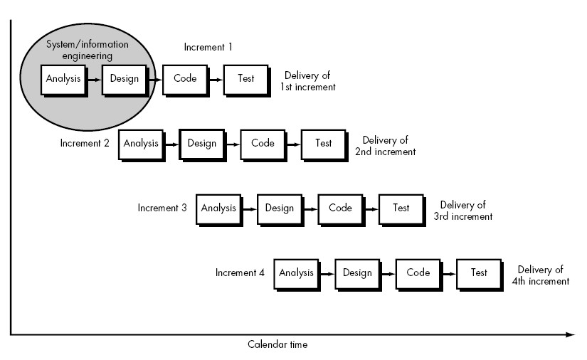
Methodology
Incremental model was used for Software Development Lifecycle (SDLC).
Incremental model uses the following
phases:
1. Requirement Analysis
2. Design
3. Coding
4. Testing

Slide 6
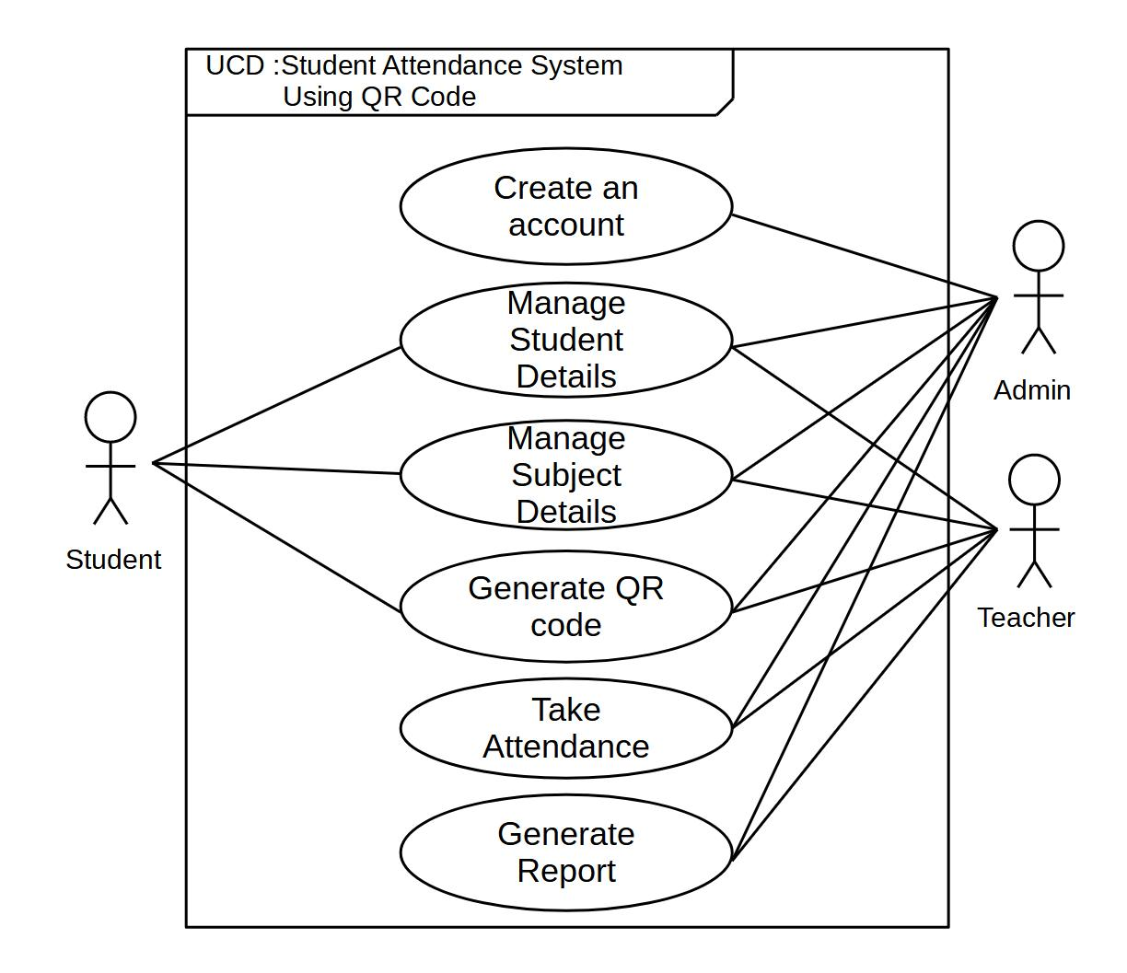
Use Case Diagram

Slide 7

Tools and Techniques
Front End: Flutter
Design: Draw.io, Libreoffice
Backend: Firebase
Manage Source Code: Github

Slide 8
Conclusion
The implementation of the QR Code-based attendance system will ease up student attendance recording and monitoring.
The system will eliminate the errors and problems encountered in the manual attendance system.
By implementing the system, the recording of attendance will be efficient, timely, convenient, and accurate.
The developed system will meet the needs and requirements of the intended users and respondents.

Slide 9
THANK YOU!

