Slide 1
Thingus perfectus
A.k.a. no name yet

Slide 2
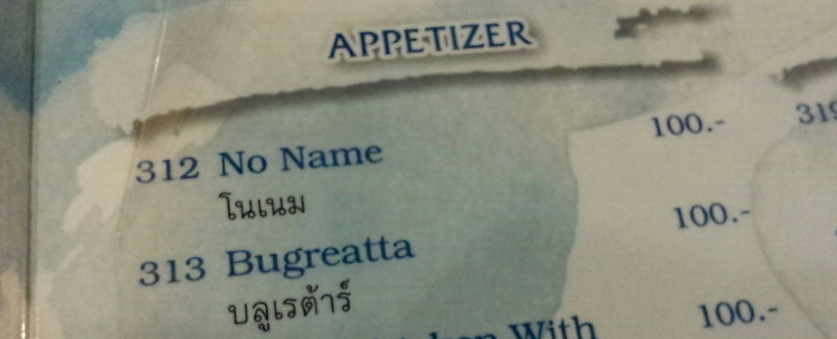
Menu from Freedom Bar – Koh Lanta

Slide 3
Problem
A lot of fact-less political discussion. (Trump, Brexit, ++)
Lack of knowledge of ballpark national and local budget sizes
Pointless comparisons of tax levels in different countries due to differences in tax systems, not tax levels.
Big numbers thrown around in the media. Too big to make sense and be relatable to most people.

Slide 4
Background
Norway has 8 political parties. 4 of which have majority in the government right now and the 2 parties on the right almost have majority on their own.
There is currently a budget debate on whether we should care about the climate and stuff like that.
Nobody knows the actual numbers of anything but everybody has an opinion based on some Facebook-article-title-reading-research.

Slide 5
Solution??
Break national budget numbers down into individual contribution levels
Show comparison of total tax levels between countries (compared to Norway)
Show changes in department budgets from year to year and between political parties.
Maybe: Game of balancing different budget items and see which political party you are closest too (might be good for engagement, social media sharing etc)

Slide 6
Demo & status

Slide 7
Questions
How best to visualize and create engagement?
Which data to visualize?
Name??
Other features?
Internationalization?
Monetization?
Partnerships? Journalists? Public electees?

Slide 8
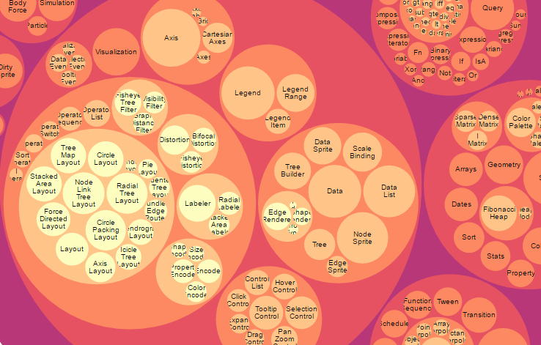
Pretty things - Circle chart

Slide 9
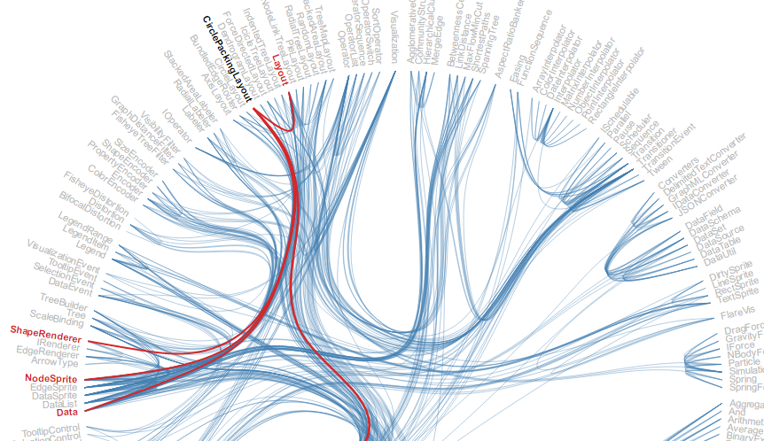
Pretty things - Hierarchical Edge Bundling

Slide 10
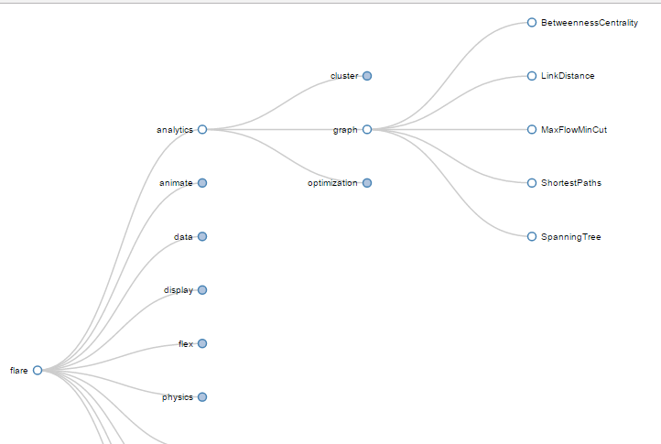
Pretty things - Trees

Slide 11
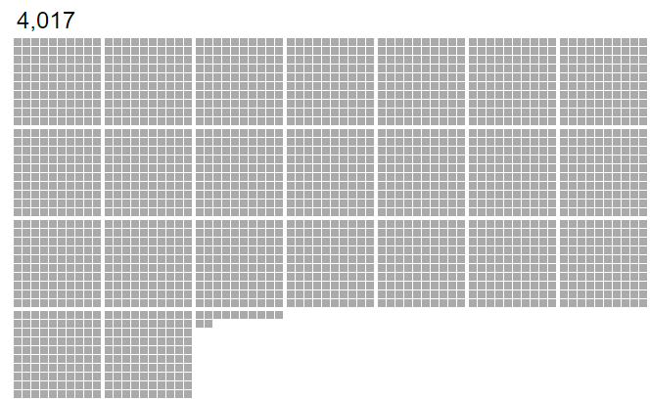
Pretty things – Square grid

Slide 12
Motivation
Introduce myself to frontend development, d3js (v4), javascript
Optionally: Fix borken democrazy

