Slide 1
Analyzed CP comments assoc. with NPS score
Accessed raw data from Oracle database table “net_promoter_score”
3,486 records w/comments, April 1, 2015 through October 31, 2016
Overall NPS = 37
Divided comments into two datasets based on user score
Positive score: 9-10
Negative score: 0-6
Top keywords in comments overall (most frequent keywords in each dataset)
Clustered words from each dataset and inferred categories (unsupervised learning)
First “rough” model provided insights, more can do

Slide 2
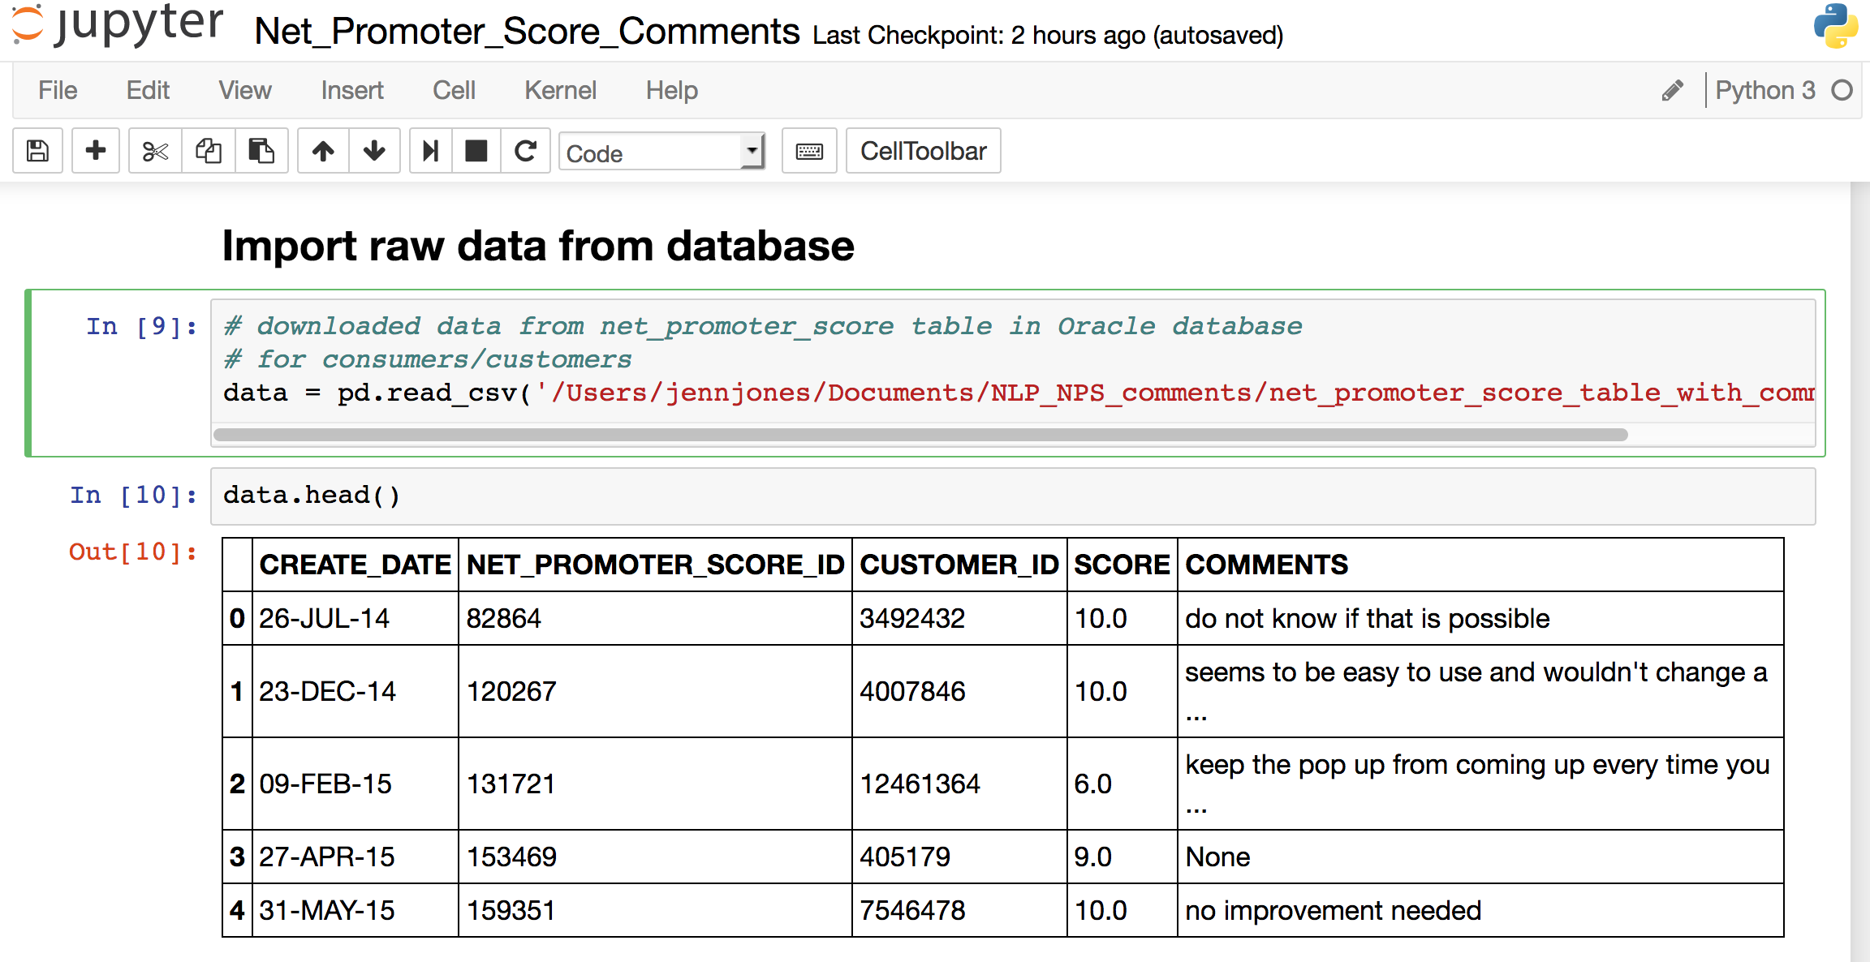
This is what the data looks like

Slide 3
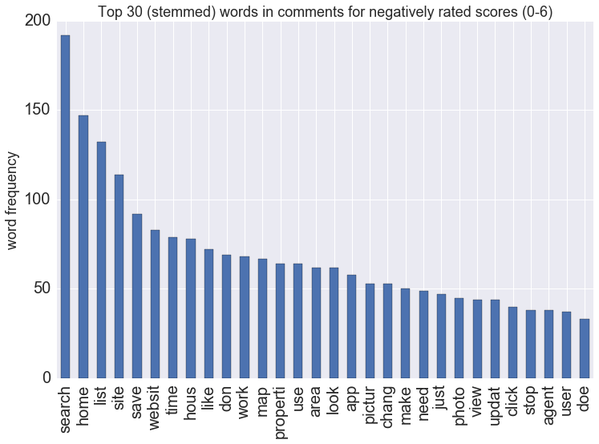
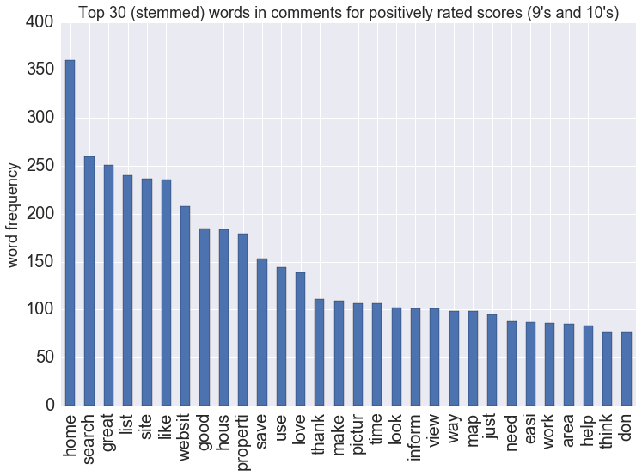
Top keywords in comments
negative scores
positive scores

Slide 4
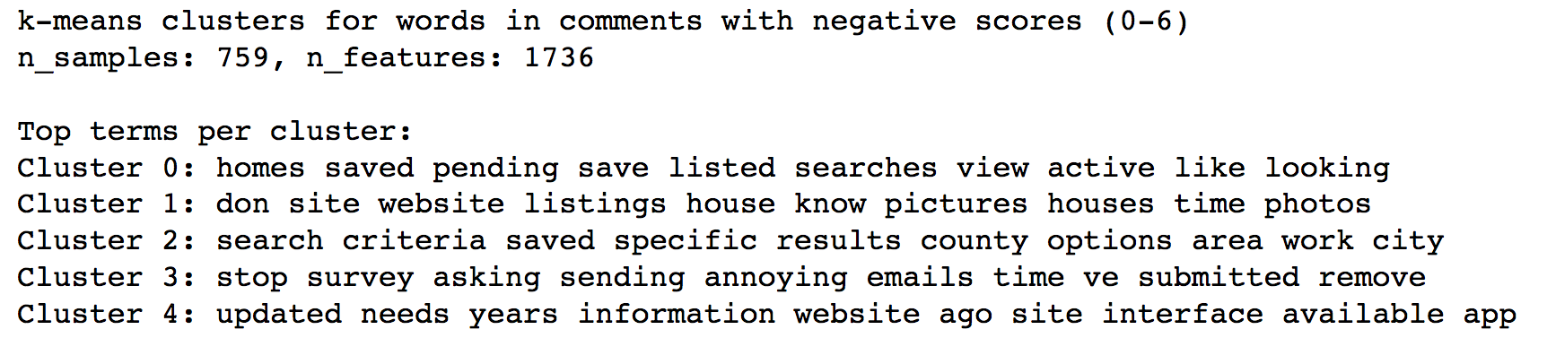
For negative scores, comments appear to be organized into:
Site functionality: homes, save, search, listed, view, active, looking
Photos! and listings: listings, house, pictures, photos, time
Location & search: search, criteria, save, specific, results, county, options, area, work, city
“Things that are irritating:” stop, survey, asking, sending, annoying, emails, time, remove
Improvements needed or lagging: updated, needs, years, information, ago, interface, available
from k-means model, 5 clusters:

Slide 5
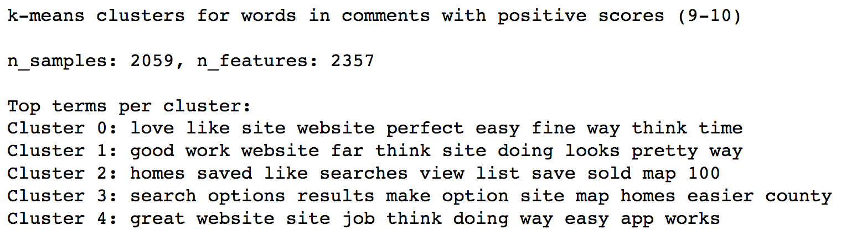
For positive scores, comments appear to be organized into:
Ease of use of site/website: easy, time, love, like
Look/aesthetic of website: good, work, pretty, look
Content and functionality: homes, save, search, list, view, sold, map
Not sure yet - location?, or desired improvements?: search, options, results, make, map, home, easier, county
Overall/general positive? (similar to 1st one?): great, job, think, doing, easy, work
from k-means model, 5 clusters:

