Slide 1
DevOps online Kharkiv 2022Q1Q2
Automated web application on AWS
Student: Evgeniy Kharin

Slide 2
Objective: learn how to automate the build process and deployment of the project and try to implement this knowledge ion the example of a small web application
What I used in the project:
AWS EC2
Git
GitHub
Jenkins
Docker
Python

Slide 3


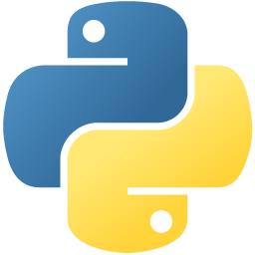



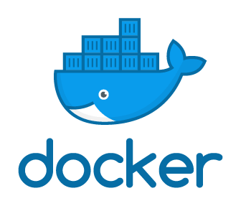


Our Infrastructure
Production Server
Deploy
Commit, Push
Webhook
Wait commit
EC2
172.31.89.16
Public IP: 52.55.250.114 (Elastic IP)

Slide 4
Project steps
Setting up Git on local machine and connecting it to GitHub Repository.
Creating Dockerfile for our application.
Setting up Jenkins and configuring Jenkins plugins on AWS instance.
Connecting Jenkins and GitHub via Webhook.
Configuring the Build actions in Jenkins.

Slide 5
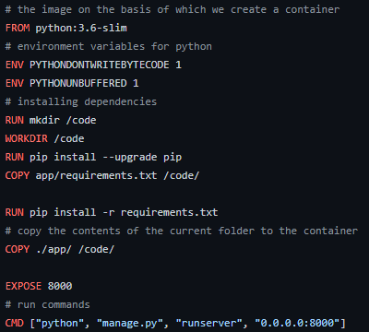
Dockerfile for our application

Slide 6
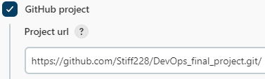
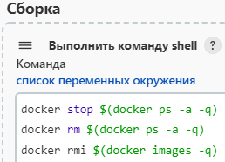
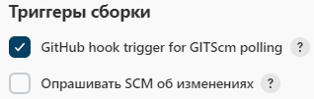

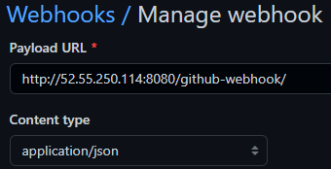

Configuring the Build actions in Jenkins
1
4
2
5
6
3
Webhook for automatically start a build by commit

Slide 7
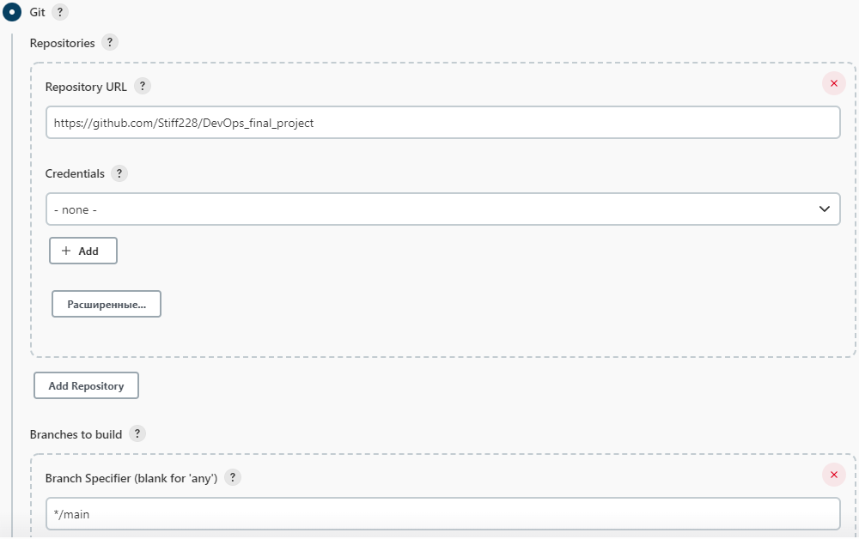
Configuring the Build Pipeline

Slide 8
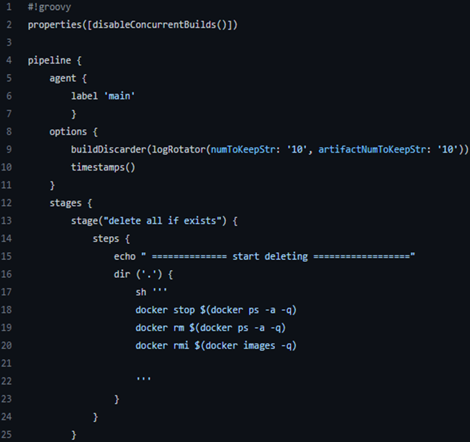
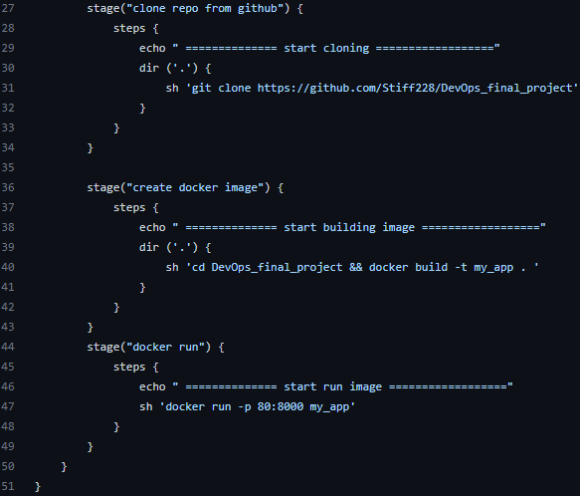
Jenkins Pipeline

Slide 9
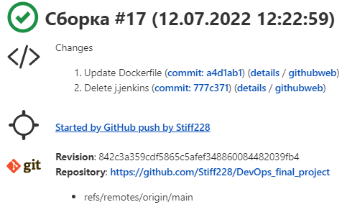
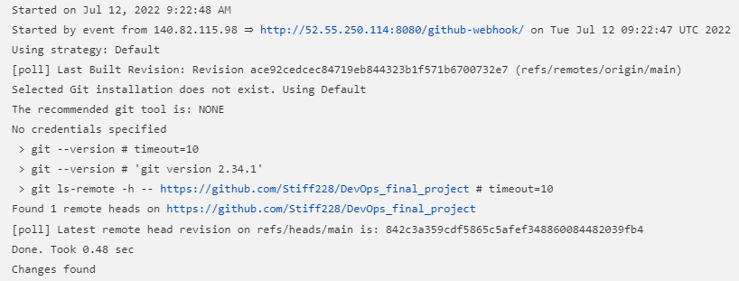
Jenkins completed the build
Log

Slide 10
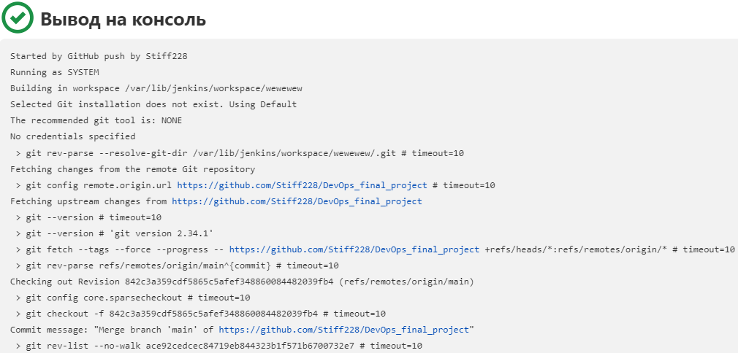
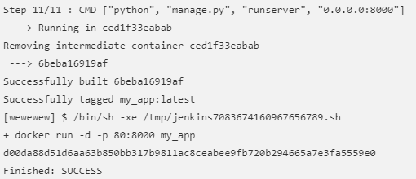
…

Slide 11
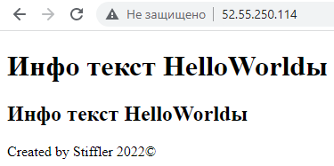
And finally…)

Slide 12
What needs to be improved
Perform jenkins jobs on a slaves in Docker
Use a database
Install DB and Jenkins on different servers
Configure SSL *
Thank you for your attention and time spent!

