Slide 1
Faces and Personality: Facial Expressions as an Indicator of Personality Attribution

Slide 2
Personality Computing
The study and use of technologies which are used to understand, predict, and analyse human Personality.
What is 'Personality', and how would we measure it?

Slide 3
Personality Computing
Personality is a psychological construct which aims at capturing stable individual characteristics about an individual, explaining and predicting observable behavioural differences.
Measured in 'Traits': dimensions which allow us to form quantitative models of human behaviour .

Slide 4
Big Five Personality Traits
Openness
Conscientiousness
Extroversion
Agreeableness
Neuroticism

Slide 5
Measurement
The standard is the “Likert Scale”
  Traits are measured by questions which correspond to a particular trait of the “Big Five”, which are answered on a scale between “Strongly Disagree” to “Strongly Agree”.

Slide 6
APP: Automatic Personality Perception
“The task of inferring the personality observers attribute to a given individual from proximal cues.
Plenty of research done on body language, 'paralanguage' (pauses and gaps in speech, etc.), social media usage, etc.
And now facial expressions!

Slide 7
Our Data
Average Rankings of each personality trait attributed to 829 different individuals based on an image provided
OpenFace analyses of these images, giving us information such as which “Action Units” are active, and how intensely.

Slide 8
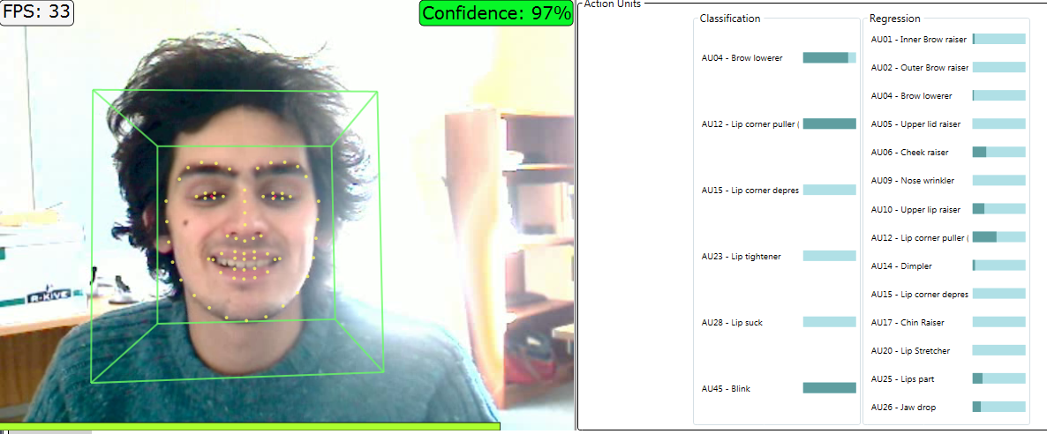
Action Units

Slide 9
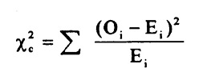
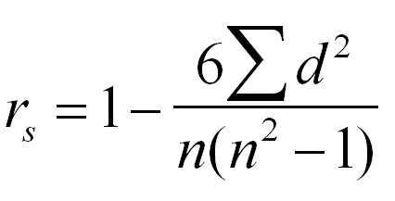
Our Methods
Chi-Squared Tests for categorical data
Spearman's Rank Tests for continuous data

Slide 10
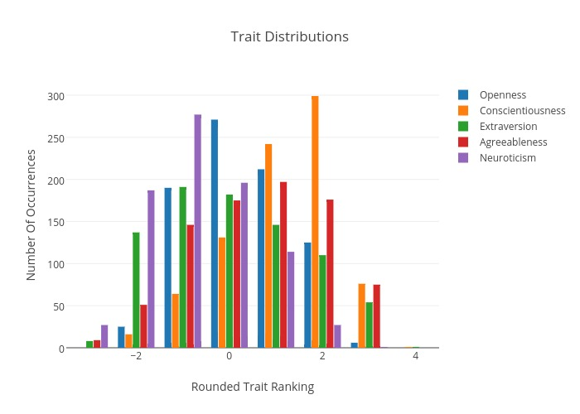

Slide 11
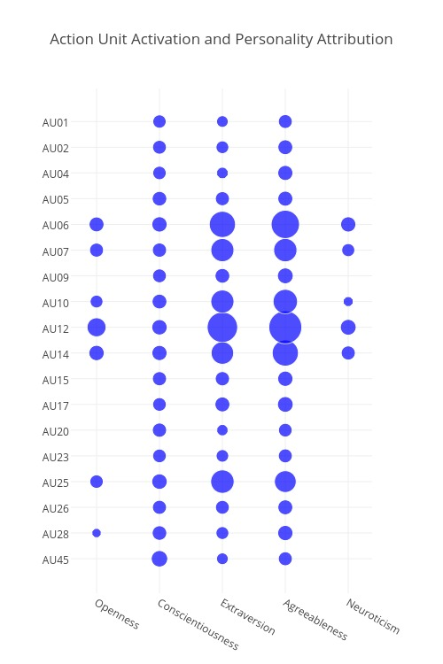

Slide 12
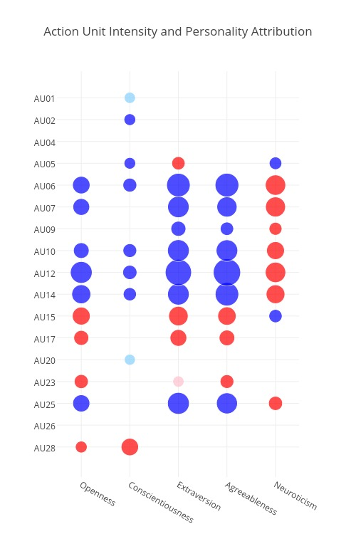

Slide 13
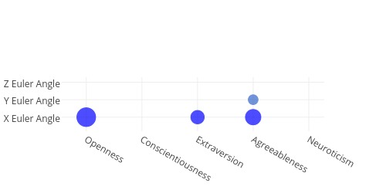
Head Pose

Slide 14
So What?
Well, with statistically significant results, we have good reason to attempt to get some insight from building and testing a Classifier.
If we can get a machine to reliably predict personality traits, we'd then be much closer to getting machines to choose their interactions with people in a similar fashion as other humans.

Slide 15
Classifiers
Implemented two classifiers, which attempted to, given an array of Action Unit Intensities, predict if it belonged to an image which was attributed “At or above” or “Below” the median of each personality trait:
  Naive Bayesian
  K-Nearest-Neighbours

Slide 16
Bayes
For Openness, Conscientiousness, and Extraversion, results were not much better than chance.
For the other two traits, predictions were higher, up to 70% for Neuroticism.
Not looked into further; results were not particularly interesting and only used as a baseline

Slide 17
K-Nearest-Neighbours
Effectively looks for 'K' most similar images, based on treating the different parts of the array fed in as measurements to form a Euclidean Distance.
Results, despite no optimisation, were very promising.

Slide 18
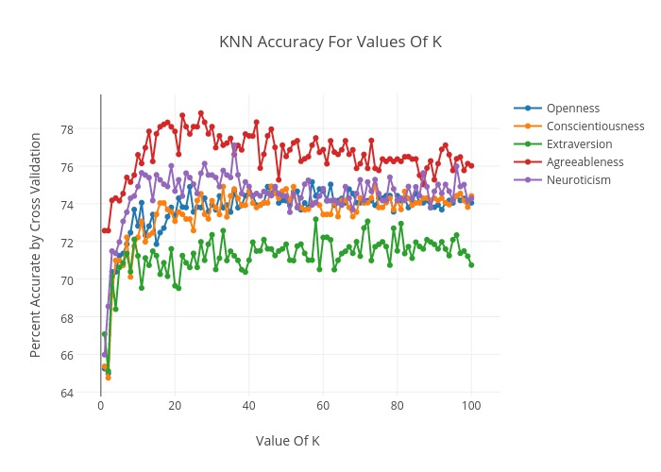

Slide 19
Again, So What?
With these results, it looks very promising that facial feature analysis can provide a good base upon which machines can predict attributed traits.
As discussed in the beginning, these attributions have a strong influence on guiding interactions between people, so this represents a big step towards making socially intelligent machines.

Slide 20
Future Research
Presumably the results can be made even better by finding ways to optimise classification. Could be stricter classification, finding features which are irrelevant, combining particular features, etc.
Investigate more deeply the particular changes in behaviour that should be expected given personality attributions.

Slide 21
Conclusions
Personality is a strong indicator of behaviour and has the potential to form a base for the ways social machines interact with us.
Attributions of personality have a very regular relationship with facial expressions, enough so that given the latter, a machine can accurately predict the personality traits we would judge someone to have
Facial expressions can serve as a big next step towards creating better socially intelligent machines.

Slide 22
That's it!
Thank you for your attention !

