Slide 1

A ROBUST FETAL ECG DETECTION METHOD FOR ABDOMINAL RECORDINGS
IMPLEMENTED BY VALERIA STIGHEZZA,
INSPIRED BY Suzanna M. M. Martens, Chiara Rabotti, Massimo Mischi and Rob J. SluijterY

Slide 2

INTRODUCTION

Slide 3
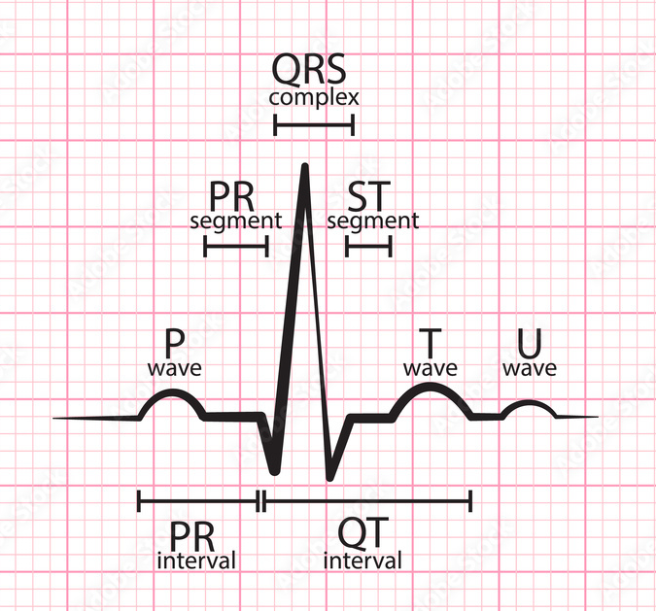
Why is fecg important? HOW IS IT DONE?
Morphological and temporal parameters of the ECG of the foetus during gestation can provide information about the fetal well-being, e.g. level of fetal oxygenation
FECG can be obtained by placing electrodes on the mother’s abdomen
FECG detection = detection of a small amplitude fetal signal overwhelmed by a large number of interference signals and noise

Slide 4
METHODOLOGY

Slide 5

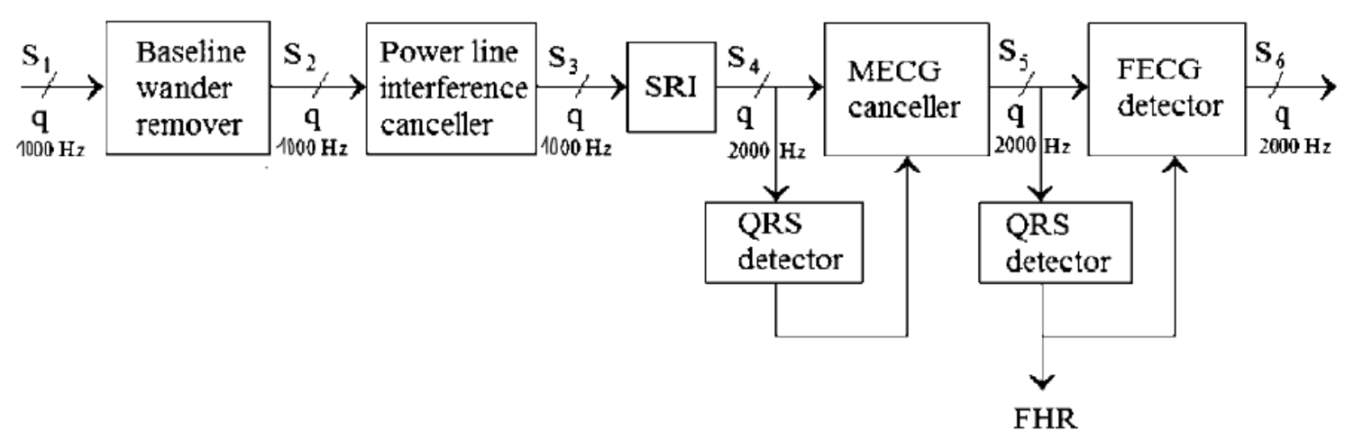
APPROACH: SEQUENTIAL ANALYSIS (SA)
Estimating and removing the interference signals step-by-step, using a priori information about the interference signals and the signal of interest

Slide 6
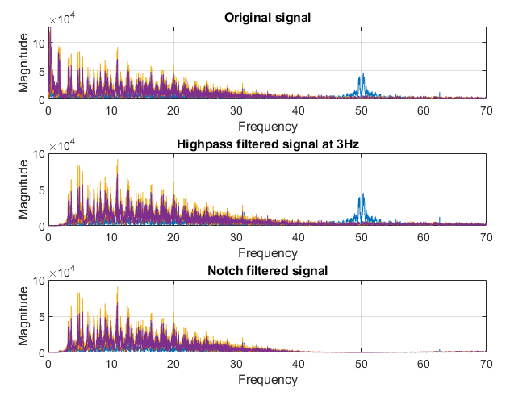
FILTERING
LINEAR INTERPOLATION
  To replace NaN values
BASELINE WANDER REMOVER
Highpass filter at 3 Hz
POWER – LINE INTERFERENCE CANCELLER
  Notch filter at 50 Hz

Slide 7

MQRS DETECTOR
MULTI- CHANNEL QRS ENHANCEMENT METHOD → using PCA
UPSAMPLING up to 2000 Hz
PAN TOMPKINS QRS DETECTOR
  Additional filtering
    band pass 5 – 15 Hz $→$ noise cancellation
    derivative filter $→$ emphasizing R peaks
    moving average (150 ms window) $→$ get smooother signal
  R-peaks detector
    adaptive thresholds and decision rules

Slide 8
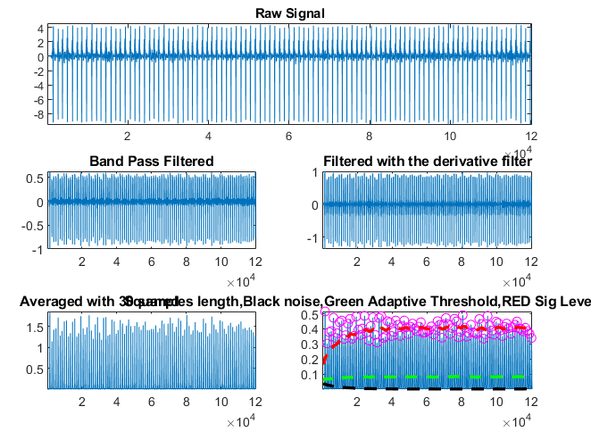
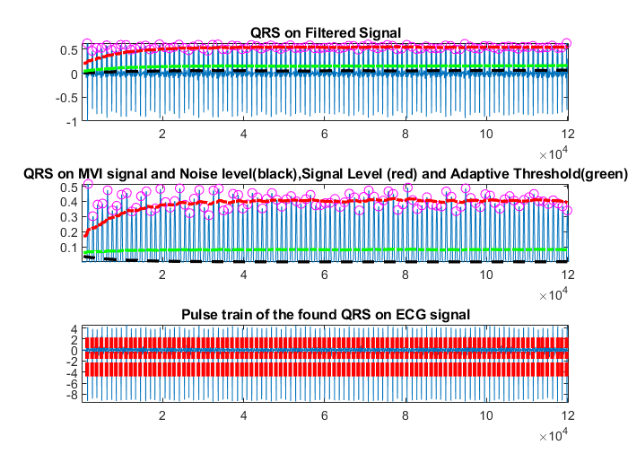
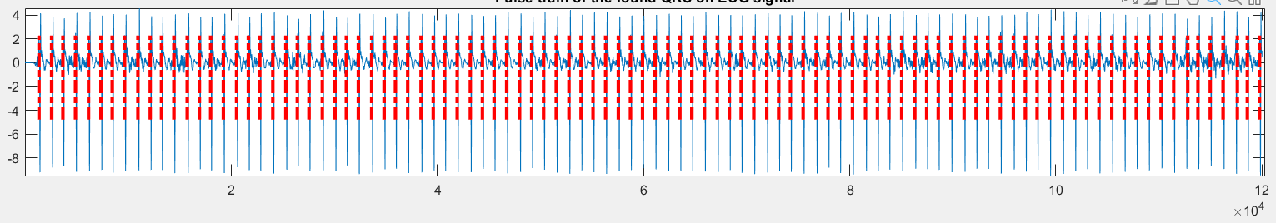

Slide 9
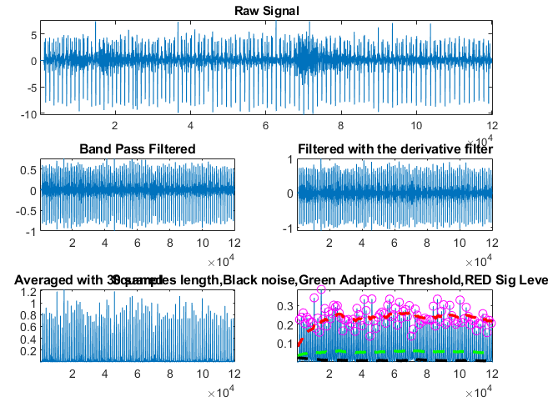
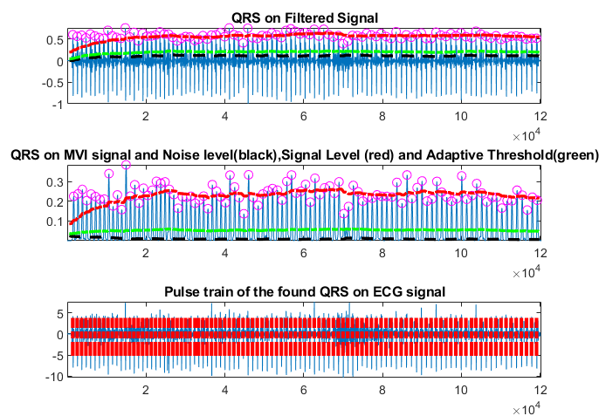
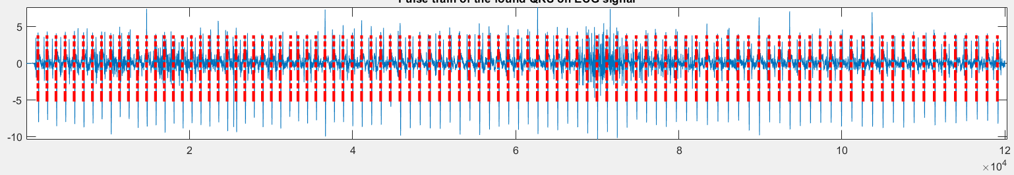

Slide 10
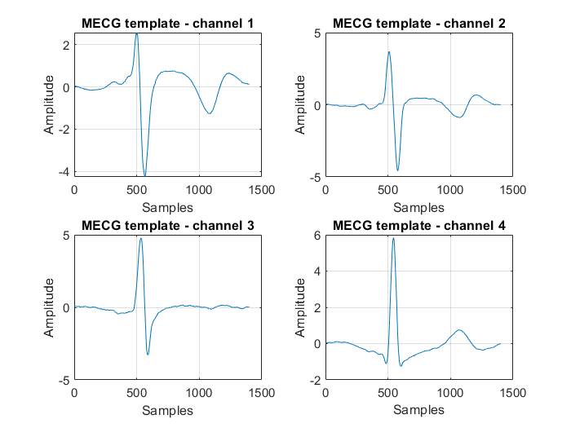
MQRS TEMPLATE
Extract the found QRS complexes from each channel
  P wave - 0.20 s
  QRS complex - 0.10 s
  T wave - 0.40 s,
Average the extracted QRS complexes to obtain the average MQRS template for each channel

Slide 11
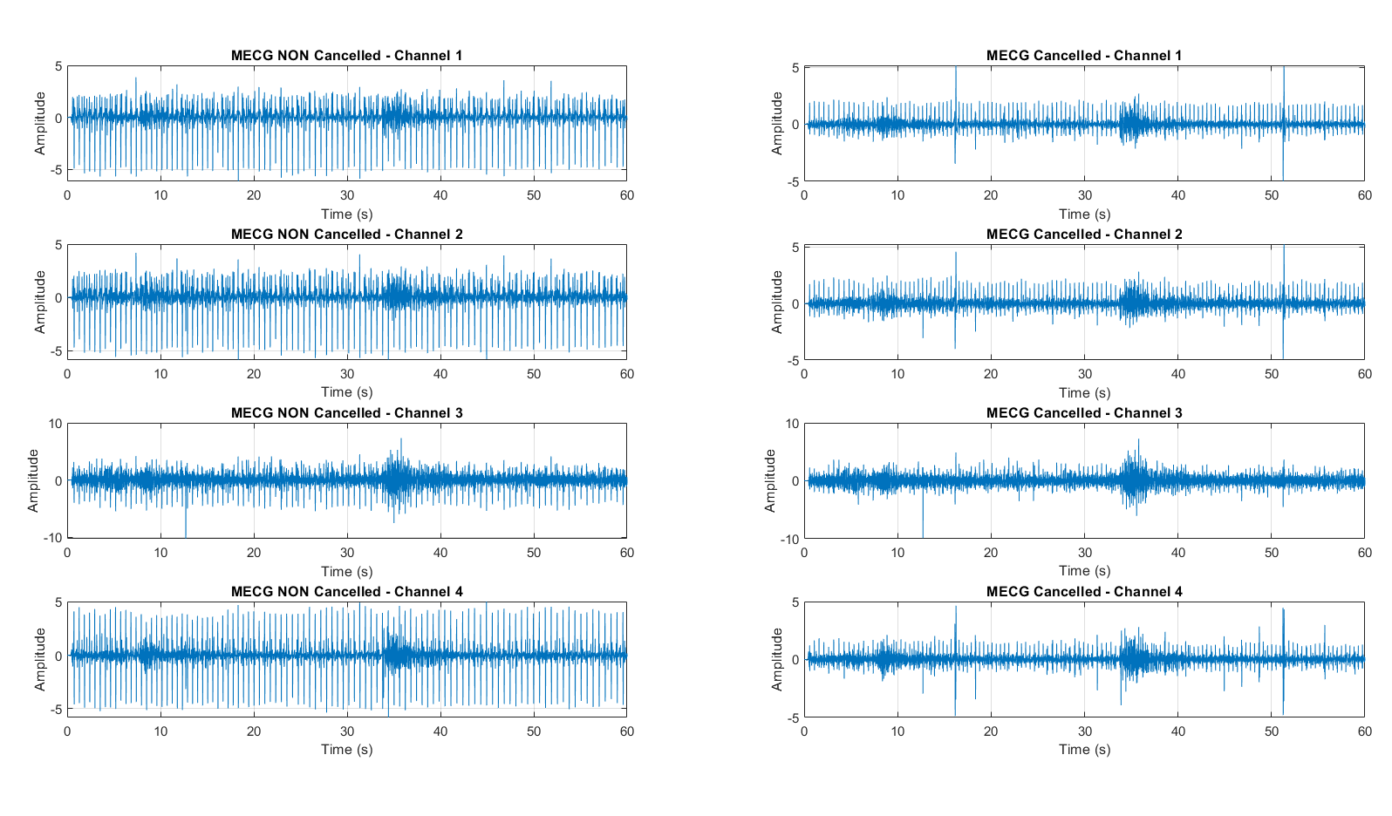
MECG CANCELLER
For each channel, subtract the average template in the MECG by shifting and subtracting the template at each position detected by the QRS detector

Slide 12
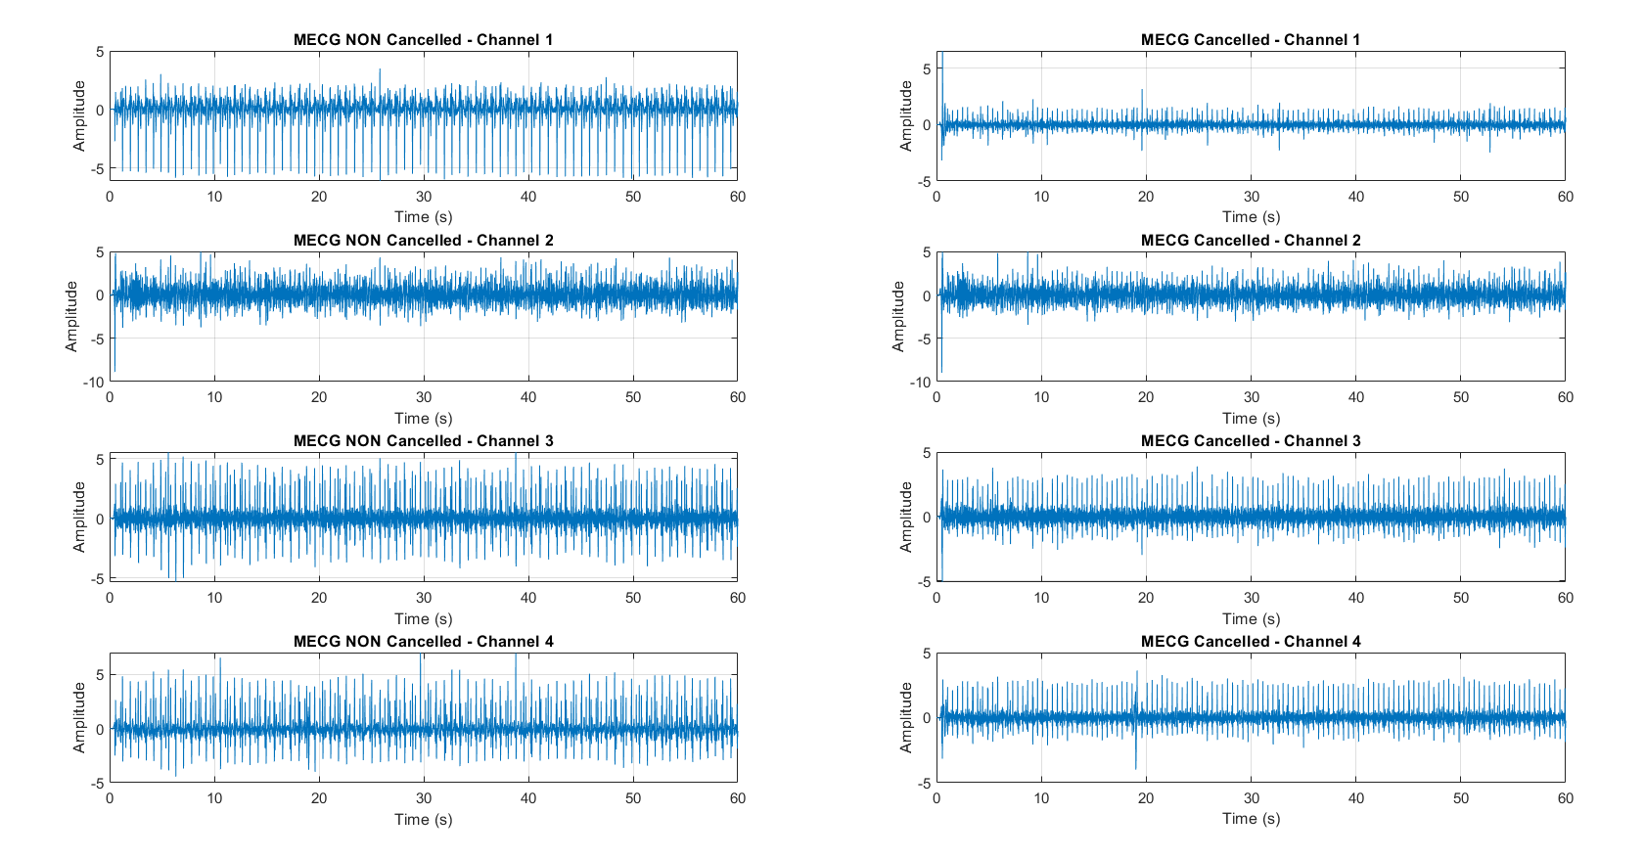

Slide 13
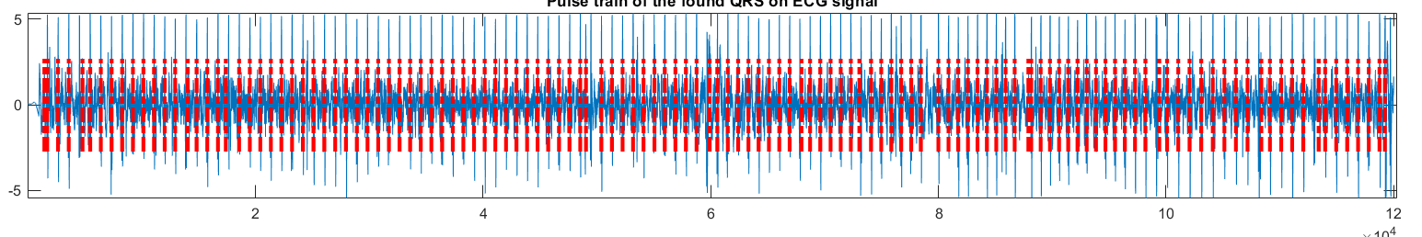
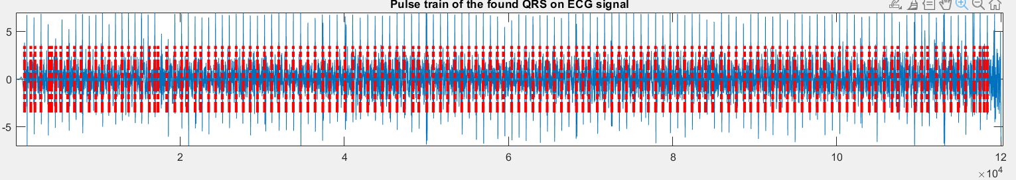
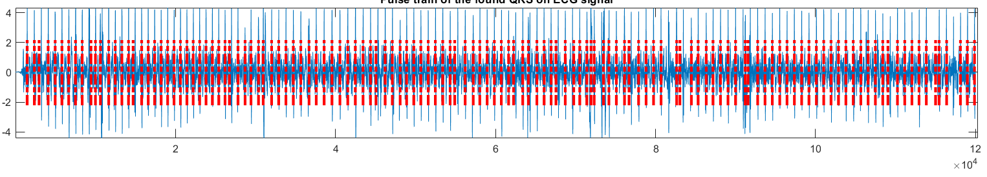
FQRS DETECTOR and fhr estimation - success
Sig. no. 4
Found MHR = 79 bpm
Found FHR = 130 bpm
Target FHR = 129 bpm
Sig. no. 12
Found MHR = 86 bpm
Found FHR = 138 bpm
Target FHR = 138 bpm
Sig. no. 15
Found MHR = 85 bpm
Found FHR = 133 bpm
Target FHR = 134 bpm

Slide 14
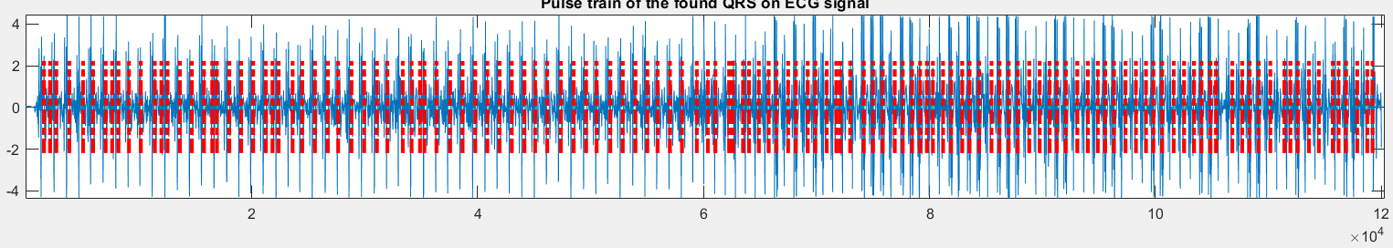
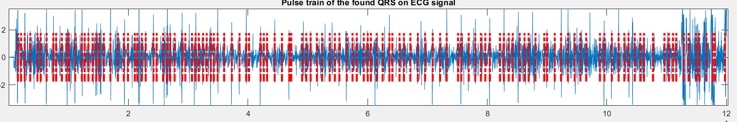
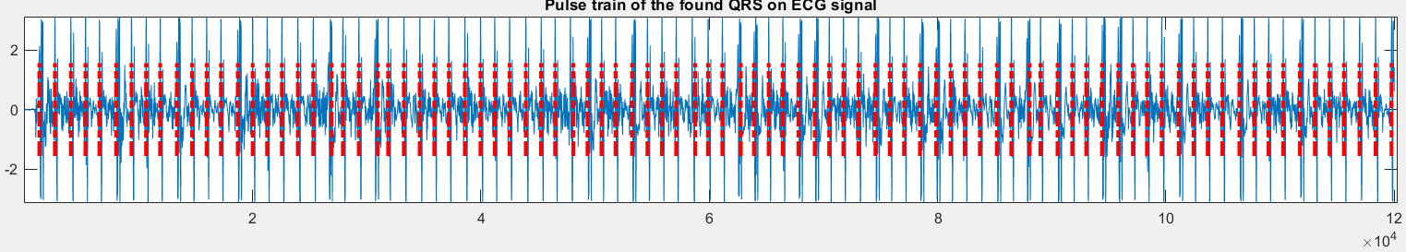
FQRS DETECTOR and fhr estimation - FAILURE
Sig. no. 2
Found MHR = 124 bpm
Found FHR = 132 bpm
Target FHR = 160 bpm
Sig. no. 6
Found MHR = 100 bpm
Found FHR = 127 bpm
Target FHR = 160 bpm
Sig. no. 21
Found MHR = 90 bpm
Found FHR = 90 bpm
Target FHR = 145 bpm

Slide 15
RESULTS AND CONCLUSIONS

Slide 16
OVERALL RESULTS
No. of samples in the dataset : 25 signals
No. of correctly estimated FHRs*: 18
No. of wrongly estimated FHRs*: 7
*the error tolerance to consider the prediction correct is 10 bpm

Slide 17
CONCLUSIONS
Being a sequential analysis, a wrongly executed step generates a chain reaction leading to the wrong estimate of the FHR
  MHR is the main example: if the MQRS detector calculates incorrectly, it can lead to the deletion of parts of the FECG that should be kept and the retention of parts that should be discarded
There are particular cases of examples in the dataset containing artifacts or particular noisy areas. In such instances, dedicated preprocessing is necessary, including clipping and adjustment of parameters (e.g., signal threshold in the QRS detector).

Slide 18

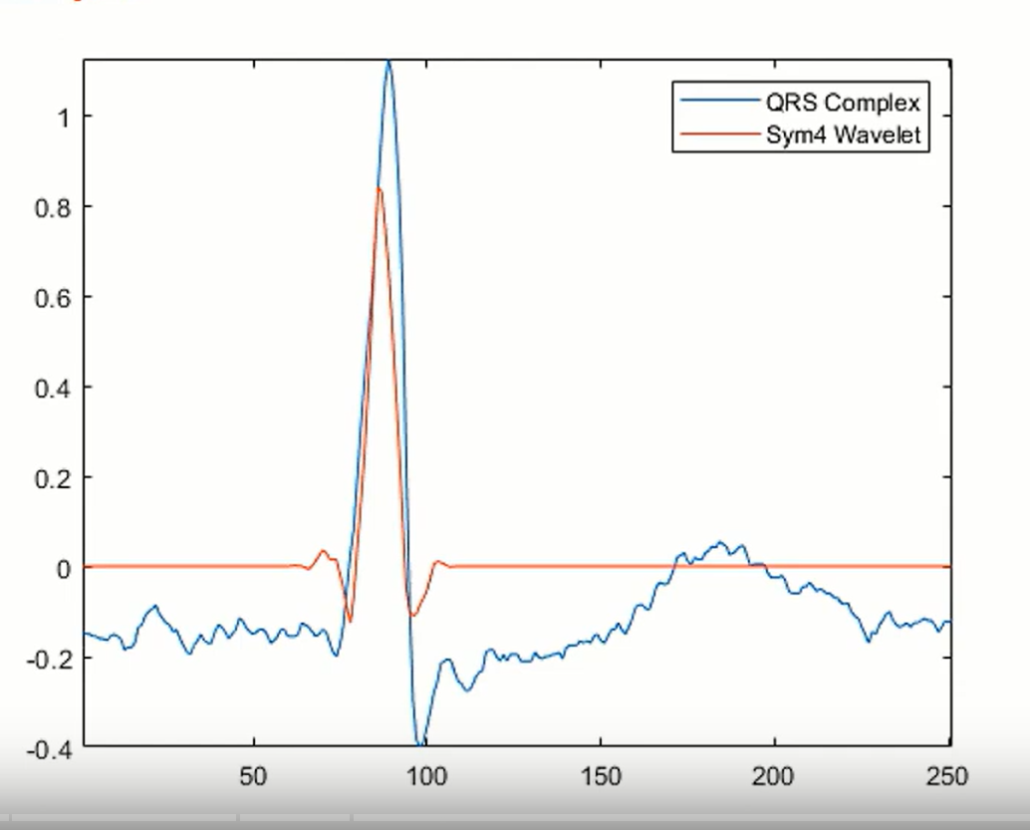
ANOther implemented step but not used
WAVELET
as band pass filter
QRS detection using wavelet is excellent in cases of clean ECG (e.g. electrodes on the chest), but when the ECG is noisy (e.g. FECG), the wavelet can emphasize artifacts and noise in addition to the ECG itself
The sym4 wavelet resembles the QRS complex
Automazione

Slide 19
THANK YoU FOR Your ATTENTION!

