Slide 1
Price forecasting of financial instruments
Brainjar sync 21/05/2021

Slide 2
Subject internship
01
One problem of data
02
Too many variables
Lots of volatility
TABLE OF CONTENTS
04
03
Backtesting
05
Retrospective
06
The problem I’m trying to solve
Proprietary data or universally available?
Changing my output
Designing a model for all markets
Baseline performance versus algorithm performance
An ongoing process

Slide 3
01
Subject internship
The problem I’m trying to solve

Slide 4
The 90-90-90 rule
90% of traders lose 90% of their capital in 90 days.

Slide 5
02
One problem of data
Proprietary data or universally available?

Slide 6
Which one is better?
Proprietary data
Exchange data
+ Technical relationships
+ Fundamental relationships
- Scalability
+ Technical relationships
- Fundamental relationships
+ Scalability

Slide 7
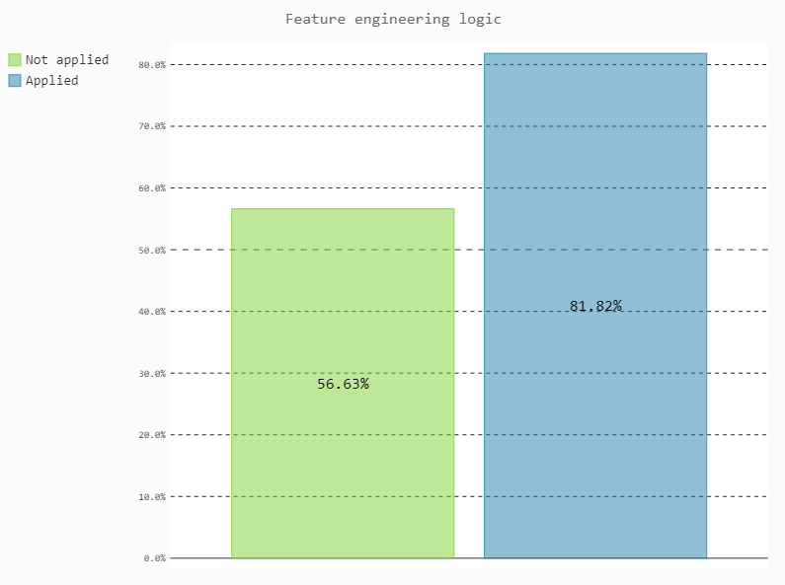
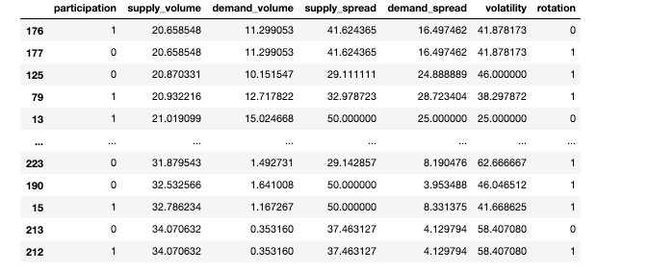
Proprietary data

Slide 8
Classification report
 | Precision | Recall | F1-score | Support
0 | 0.62 | 0.71 | 0.66 | 69
1 | 0.68 | 0.59 | 0.63 | 73
Accuracy |  |  | 0.65 | 142

Slide 9
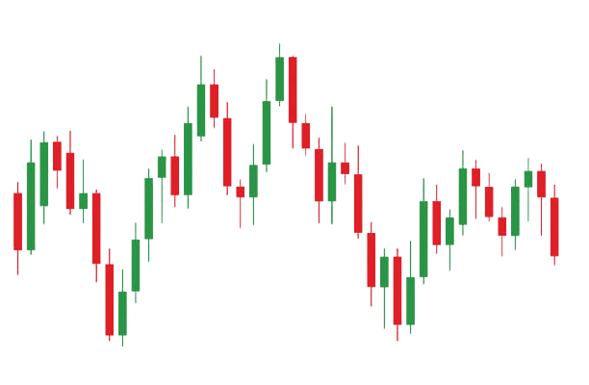
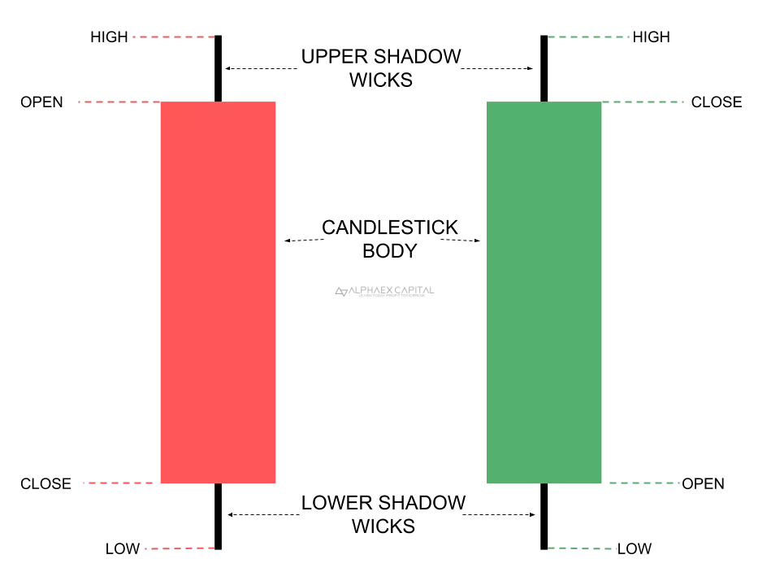
Exchange data

Slide 10
03
Lots of volatility
Designing a model for all markets

Slide 11
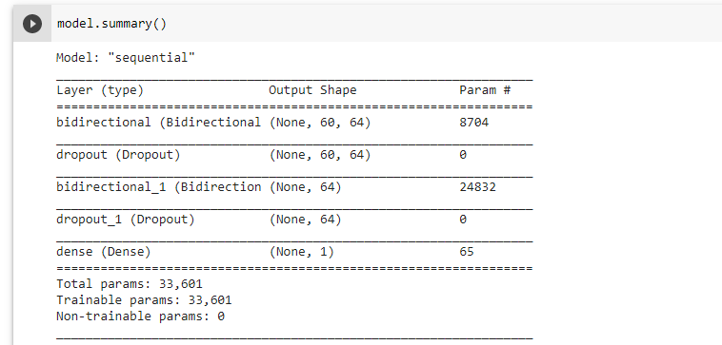
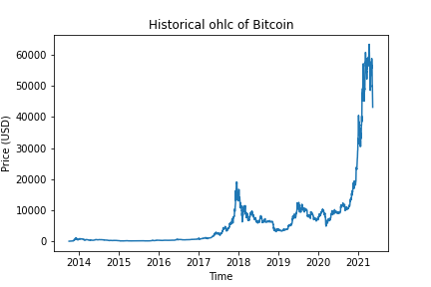
Long short term memory (lstm)

Slide 12
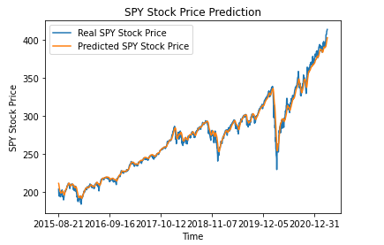
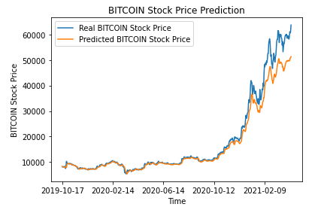
Predicting the closing price of tomorrow’s session

Slide 13
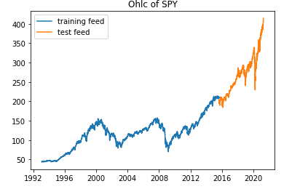
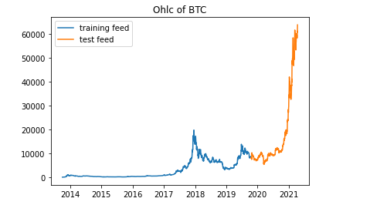
Split (80/20)

Slide 14
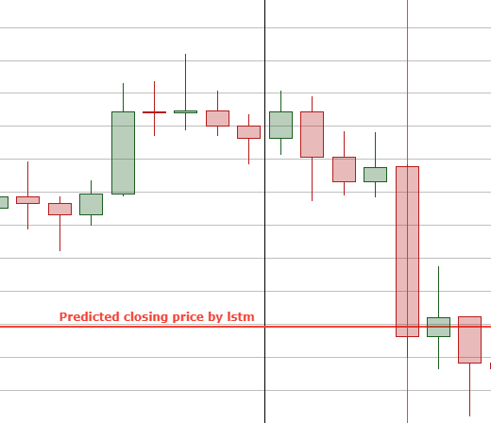

Slide 15
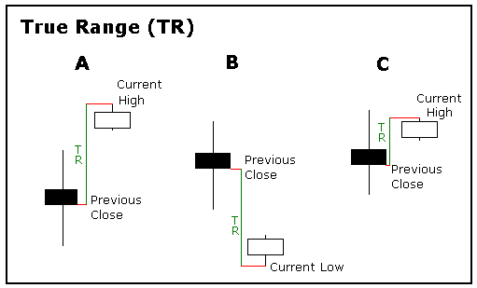
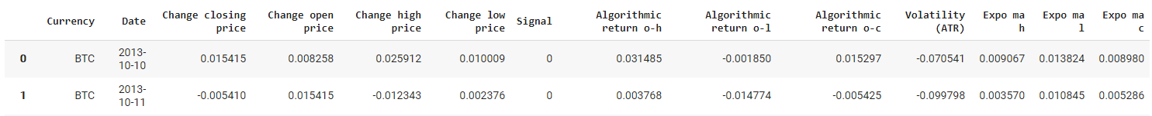
Volatility as a feature
Ohlc (high - high)
Ohlc (open – close)
Measurements
Feature-related
Session-related
Average true range
Exponential ma

Slide 16
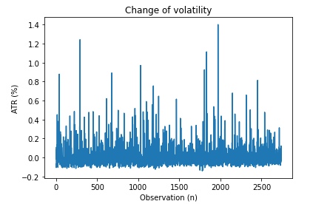
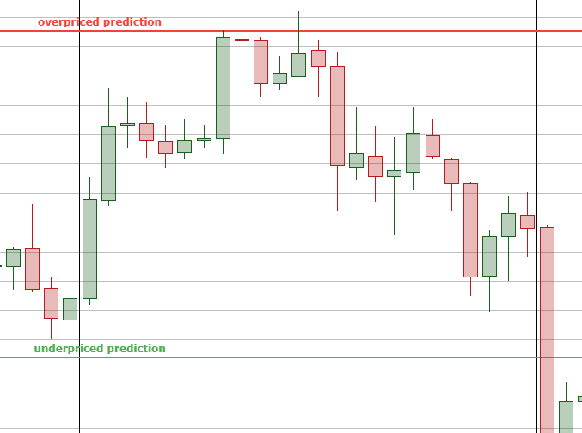
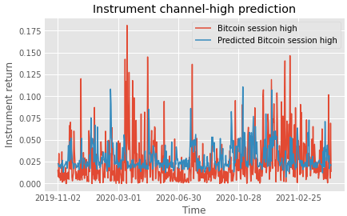
Predicting the boundaries of tomorrow’s session

Slide 17
04
Too many variables
Returning to categorical variables

Slide 18
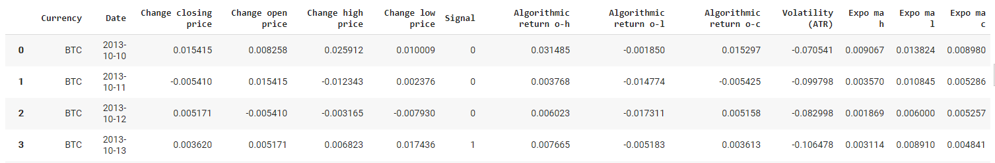
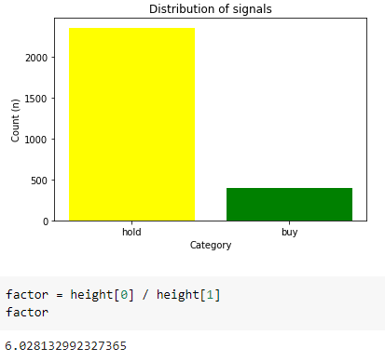
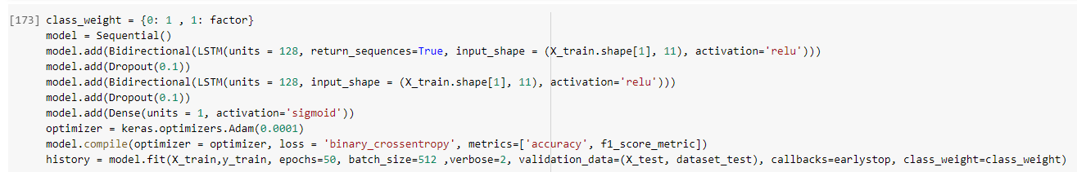
Signal implementation

Slide 19
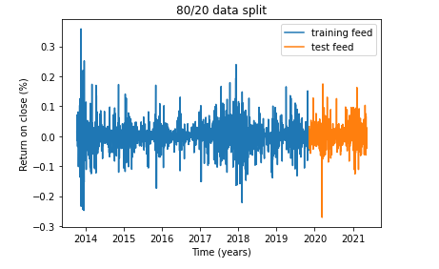
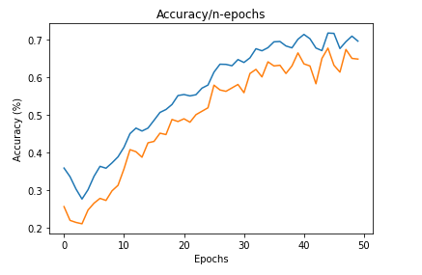
Outcome

Slide 20
Classification report
 | Precision | Recall | F1-score | Support
0 | 0.94 | 0.63 | 0.76 | 475
1 | 0.24 | 0.74 | 0.36 | 73
Accuracy |  |  | 0.65 | 548

Slide 21
05
Backtesting
Baseline performance versus algorithm performance

Slide 22
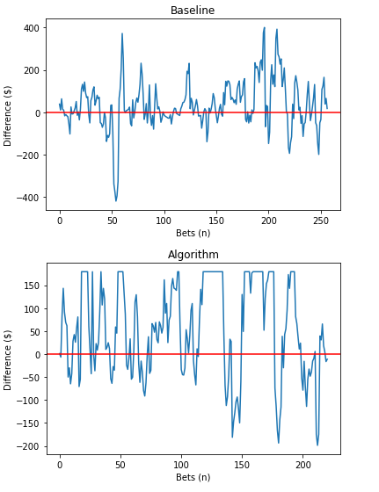
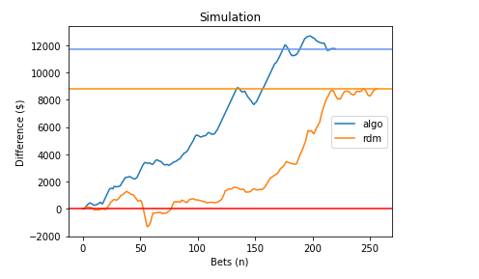
Profitability

Slide 23
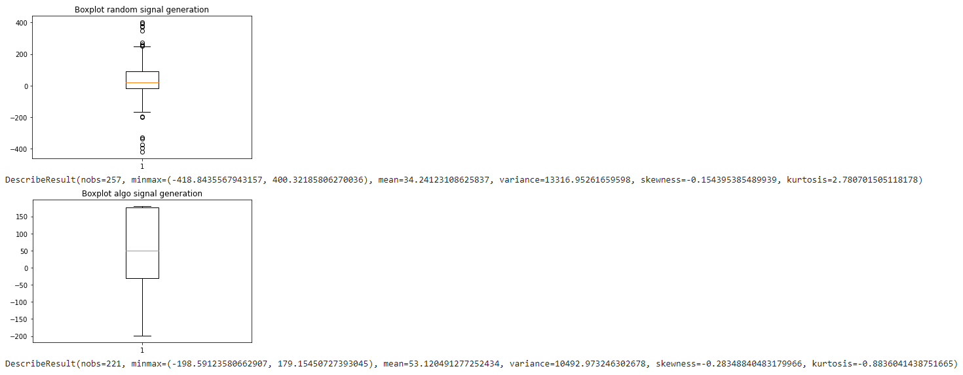
Statistics

Slide 24
06
Retrospective
Process overview

Slide 25
Signal generation
01
Backtest
02
Manual
Next steps
03
More fine tuning
Deployment on other financial markets
How should you make predictions?

Slide 26
THANKS
Does anyone have any questions?

