Slide 1


Slide 2
Goal
Identify citizen needs in each of the
cities’ districts
By offering people a fantastic gaming experience!

Slide 3
How?

Slide 4
Step 1: Subscribe
Provide your gender, nationality, …
Your district is determined by geolocation
You get a number of random resources
(a resource is anything that makes life better in the city)

Slide 5
Step 2: Rank your needs
By dragging and dropping resource icons

Slide 6
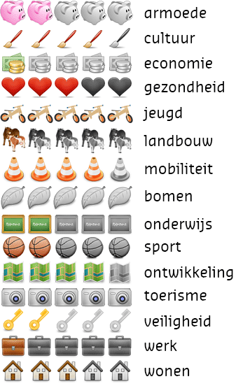
Step 3: Needs ≠ resources

Slide 7


Step 4: Trade or Steal!
Each turn you can either:
STEAL ONE RESOURCE (any resource from any other district) or
TRADE MULTIPLE ITEMS (trade your own excess resources with others)

Slide 8
We have a winner! …
Whenever a district fulfills all its needs

Slide 9
… or a loser
When a district loses all resources of a specific type

Slide 10
Benefits
The city council is continuously informed about the district needs per citizens’ profile (age, gender, nationality, …)
Citizens can express their needs in a playful way

Slide 11
Datasets Used
Bestuursakkoord
Etnisch culturele minderheden per wijk
Bevolkingssamenstelling
Datasets Produced
Citizen needs per district and profile

