Slide 1
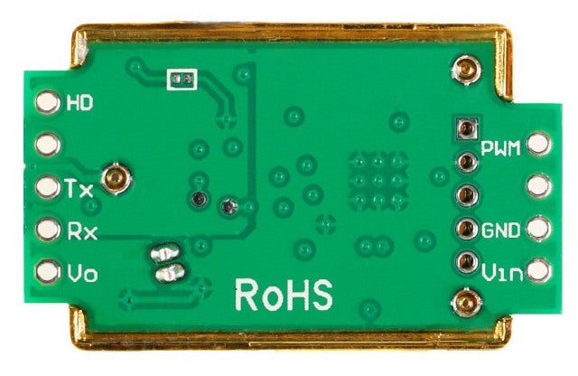
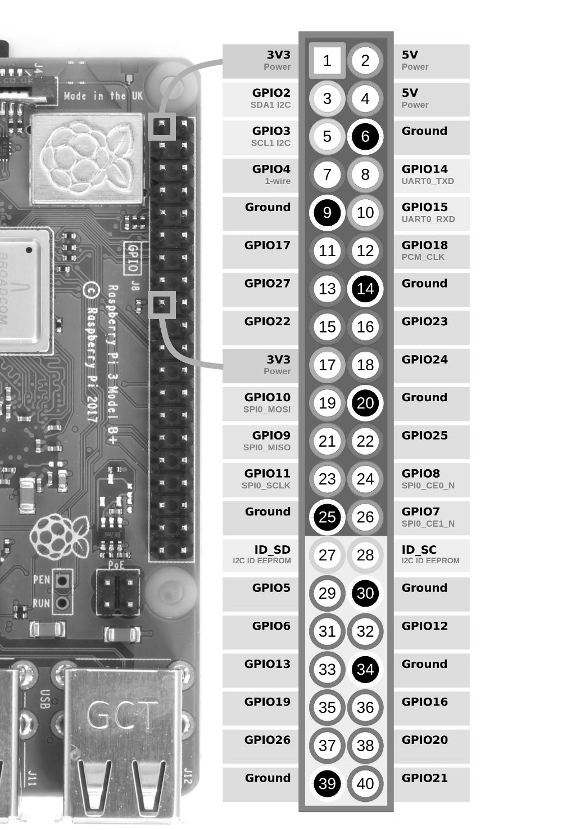
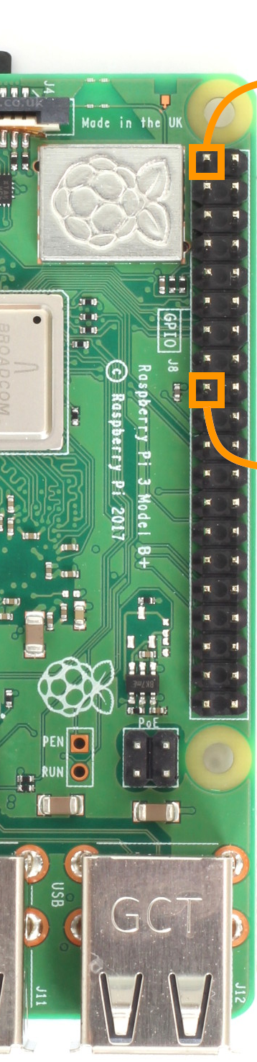
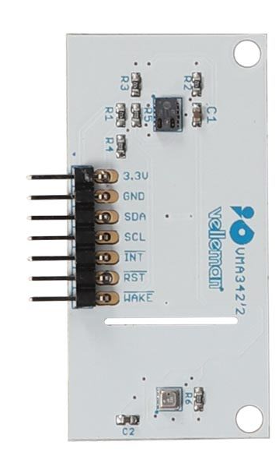
Raspberry Pi
MH-Z19
VMA342

Slide 2
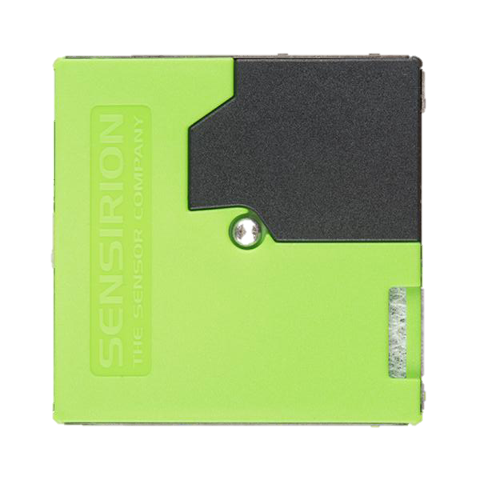
Raspberry Pi
MH-Z19
SPS30
5 - GND
4 - SEL
3 - SCL
2 - SDA
1 - VDD
VMA342

