Slide 1
M9 sensor iteratie 2
04-06-2024

Slide 2
Adjustments – by priority
Variable input voltage or amplification factor
Add a high pass filter on the microphone output blocking sound below 5 kHz to prevent clipping from noise
Adapt the TOF code so it uses the same input design software as the block wave. This will allow us to measure through tomato stems. Currently the power is insufficient to punch through a stem.

Slide 3
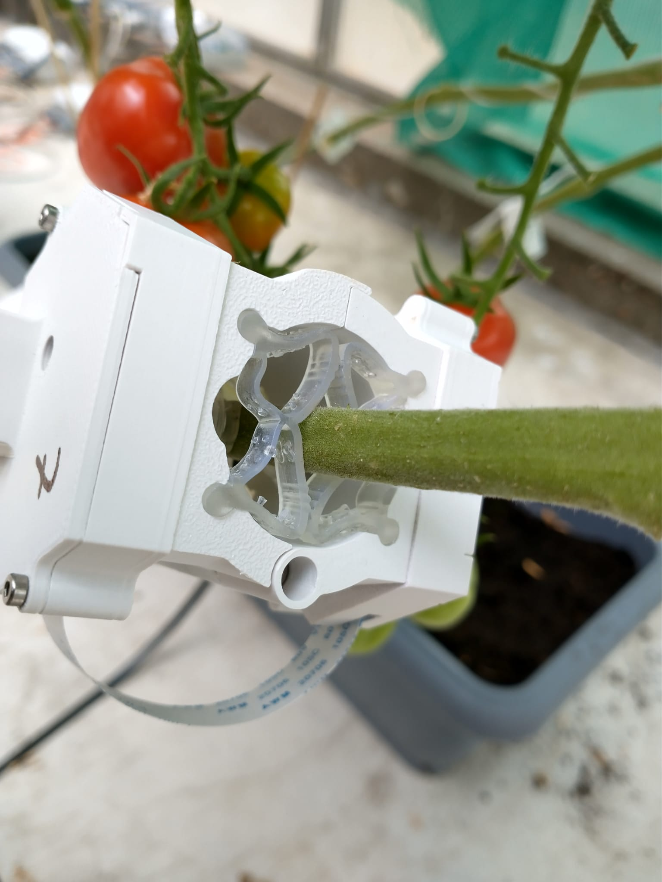
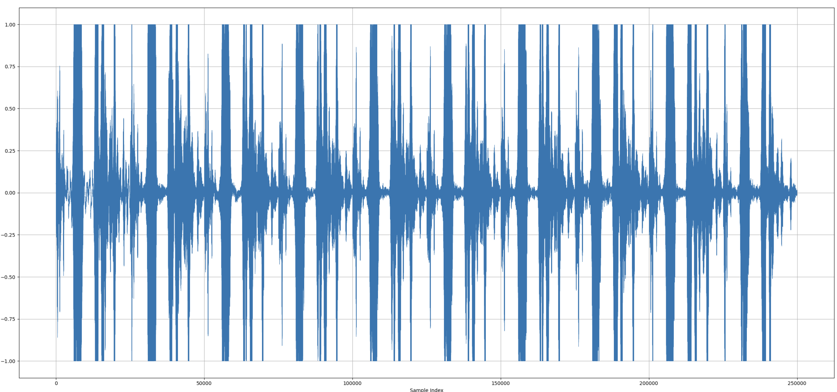
Input/amplification adjustment: clipping
For smaller stems the signal clips and the signal is useless
We need a way of scaling the output voltage to at least three settings to prevent clipping

Slide 4
Two ways of solving this, which is fastest?
Varying the microphone amplification
Varying the input voltage
Might be more flexible and easy to integrate if we can do it with a digital potentiometer
Not sure if this is even possible
Amplification factors from 10 to 100 times might suffice
Might need to sacrifice the sine sweep
Three/four settings: (0.5 V), 1 V, 5 V and 10 V

Slide 5
High pass filter
Here I used a 4th order Butterworth filter, can also be lower order with a higher cut-off frequency.
(Ex. 2nd order at 10 kHz)
Without It in loud environments we might get clipping from noise.
Especially below 5 kHz we seem to have large effects so a cut-off at 5 kHz should be fine.

Slide 6
High pass filter
Here I used a 4th order Butterworth filter, can also be lower order with a higher cut-off frequency.
(Ex. 2nd order at 10 kHz)
Without It in loud environments we might get clipping from noise.
Especially below 5 kHz we seem to have large effects so a cut-off at 5 kHz should be fine.

Slide 7
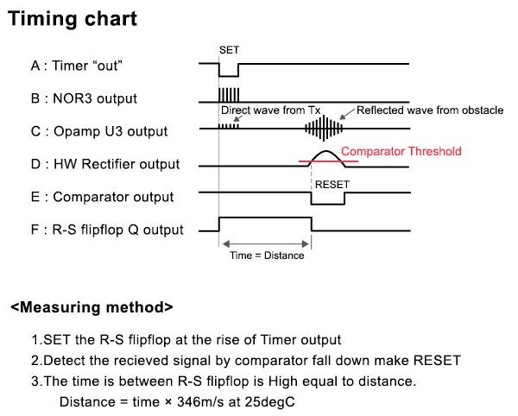
TOF logic
Send 5 block wave repetitions at 40 kHz (resonance of the speaker)
Then wait for the comparator to be crossed.
How do we set the comparator threshold?

