Slide 1
Short-term forecasting of individual household electrical consumption
Thesis defence Stijn Staring

Slide 2
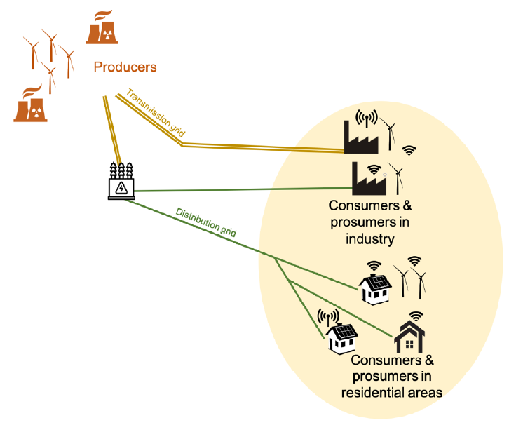
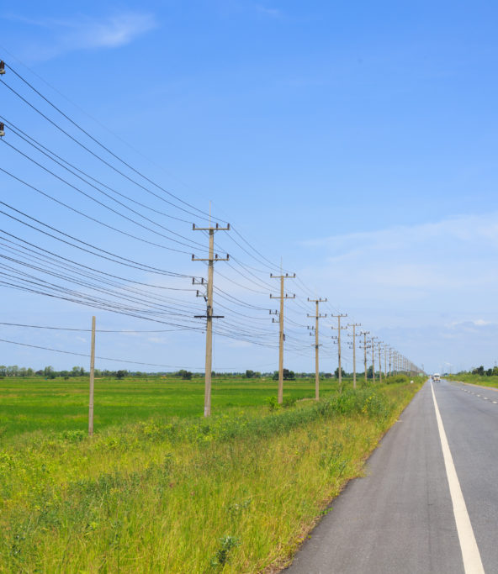
Distribution lines
Distribution grid

Slide 3
Time line
First semester
Second semester
Exploratory data analysis
Literature review
Getting familiar with software
Baseline models
LSTM models
Writing thesis
Parameter search
Testing

Slide 4
Agenda
Research question
Methodology
Literature review
Results
Conclusion

Slide 5
Agenda
Research question
Methodology
Literature review
Results
Conclusion

Slide 6
LSTM model
Introduction

Slide 7
Take away message

Slide 8
Thank you for your attention. Questions?

