Slide 1
Don't Hallucinate My Clusters
What if your AI study assistant
only knew your course?
RAG Test Maker
Chatbot
A retrieval-augmented generation system that generates grounded explanations and practice quizzes strictly from Unsupervised Learning course materials: slides, notes, R code, and datasets.
Unsupervised Learning
Study Assistant
📄 Course-grounded
🔍 Smart retrieval
🧪 Auto quiz gen
Christian Breton · Stiles Clements
Keerti Rawat · Carolina Rios
RAG Test Maker Chatbot // Unsupervised Learning

Slide 2
01 CONTEXT
⚠ Hallucination risk
The Problem with Generic AI
for Course Study
Generic AI fabricates course-specific details — referencing topics, examples, or notation the professor never used.
Large language models like GPT-4 and Gemini are remarkable generalists. But when students study a specific course, generic answers create a dangerous illusion of learning — the model answers confidently about topics it was never taught in class.
📂 Context blindness
Models cannot access lecture slides, R scripts, or spreadsheet data unless explicitly provided. They guess.
~80%
🎯 The fix: RAG
of student queries to generic AI return answers not traceable to their actual course materials*
Retrieval-Augmented Generation forces the model to reason from real course documents — every answer is traceable.
*Estimated based on off-topic outputs in testing with vague queries
The Problem
2 / 7

Slide 3
02 PIPELINE
End-to-End RAG System
How the system indexes course files (once) and answers student questions (every query)
Course Files
Parse & Chunk
Embed + Tag
Vector Search
Re-ranking
GPT-4o-mini
Chat UI
PDF, PPTX, R, XLSX
Extract text
HuggingFace embeddings
Cosine similarity
Cross-encoder scores
Generates answer
Grounded answer
from Google Drive
split into passages
362 chunks total
Vector
Database
top-10 candidates
top-10 → best 4
top 4 chunks + citations
on the website
+ metadata labels
384-dimensional vector
All indexed chunks
with embeddings
& metadata tags
ChromaDB
① INDEXING PHASE — runs once when the system is deployed
Vector DB
② QUERY FLOW — every time a student asks a question on the website
System Architecture

Slide 4
03 RETRIEVAL
Smart Retrieval: Beyond Keyword Search
Two complementary signals: semantic meaning AND document metadata combined to surface the most relevant course chunks.
🔍 Semantic Similarity
🏷 Metadata-Aware Retrieval
Query embedding compared via cosine similarity to all indexed chunks:
Each chunk carries structured metadata, enabling lecture-level context inference:
lecture_03_kmeans.pdf
92%
source_file
lecture_03_kmeans.pdf
R_demo_clustering.R
85%
doc_type
lecture_slides
pca_notes.pdf
78%
topic
Unsupervised Learning
content_type
R_code / slides / notes
regression_intro.pdf
41%
marketing_data.xlsx
29%
💡 If a student asks about "Lecture 3", metadata retrieval surfaces all Lecture 3 chunks — even if no topic keyword was mentioned.
Smart Retrieval
4 / 7

Slide 5
04 RERANKING
Cross-Encoder Reranking
Vector search retrieves broadly. Reranking chooses precisely.
STAGE 1 — Vector Search → Top 10
STAGE 2 — Reranked → Top 4 to LLM
lecture_03_kmeans
92%
Why reranking? Embedding models measure semantic similarity — but cosine distance is symmetric and context-free. The cross-encoder evaluates the query and chunk together, asking: does this chunk actually answer the question?
pca_notes
87%
R_demo_cluster
83%
lecture_07_pca
79%
▶
1
lecture_03_kmeans.pdf
97%
notes_week3
74%
Cross-
Encoder
regression_intro
65%
2
R_demo_cluster.R
93%
week2_overview
58%
marketing_data
49%
3
lecture_07_pca.pdf
88%
r_basics
43%
4
pca_notes.pdf
81%
syllabus
37%
Remaining 6 chunks discarded — not sent to GPT-4o-mini
Cross-Encoder Reranking
5 / 7

Slide 6
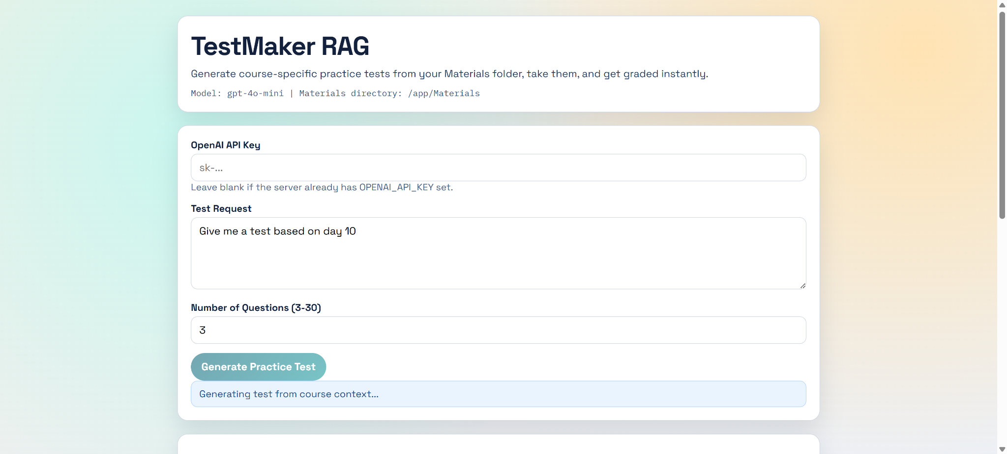
Local -> Website
03 UI
Render Frontend
1
Built dynamic frontend in HTML/CSS/JavaScript
2
Containerized app with Docker, Configured Gunicorn
Providing a UI
3
Added health checks,
Configured environment variables
for the Chatbot
4
Connected persistent storage for vector data
Live Demo
▶
RAG Test Maker Chatbot // Unsupervised Learning

Slide 7
04 RESULTS
Does It Work?
🔎 Test Query: "mixed conceptual questions"
✗ Without Reranking
✓ With Reranking + Metadata
Q1: What is Simpson's Paradox and why does it matter in data analysis?
Q1: Explain k-means and how to choose k using the elbow method.
Q2: In a marketing campaign, explain conversion rates using regression.
Q2: How does PCA reduce dimensionality? Show in R.
→
Q3: Write R code to model email click-through probability.
Q3: Implement hierarchical clustering on the course dataset.
⚠ Sources: none cited
✓ Sources: lecture_03.pdf, R_demo.R, pca_notes.pdf
⚠ Topics: NOT in course syllabus
✓ All topics from Unsupervised Learning syllabus
Results
6 / 7

Slide 8
05 CONCLUSION
What We Built.
What It Proves.
What's
Next?
🔗 RAG grounds the model
Expand to more courses
Every answer is anchored in actual lecture data — not the internet.
Allowing code question generation
🎯 Metadata enables lecture-level search
Ask about "Lecture 3" and get all Lecture 3 content, even unprompted.
Include real course quiz questions as a framework for new questions
🔢 Reranking improves precision
Cross-encoder cuts 10 candidates to 4 — quality over quantity.
🌐 Deployed end-to-end
Full chatbot pipeline accessible via web interface using Docker + Render.
Breton · Clements · Rawat · Rios // RAG Test Maker Chatbot

