Slide 1
Being agile with modern Java

Slide 2
Being agile?

Slide 3
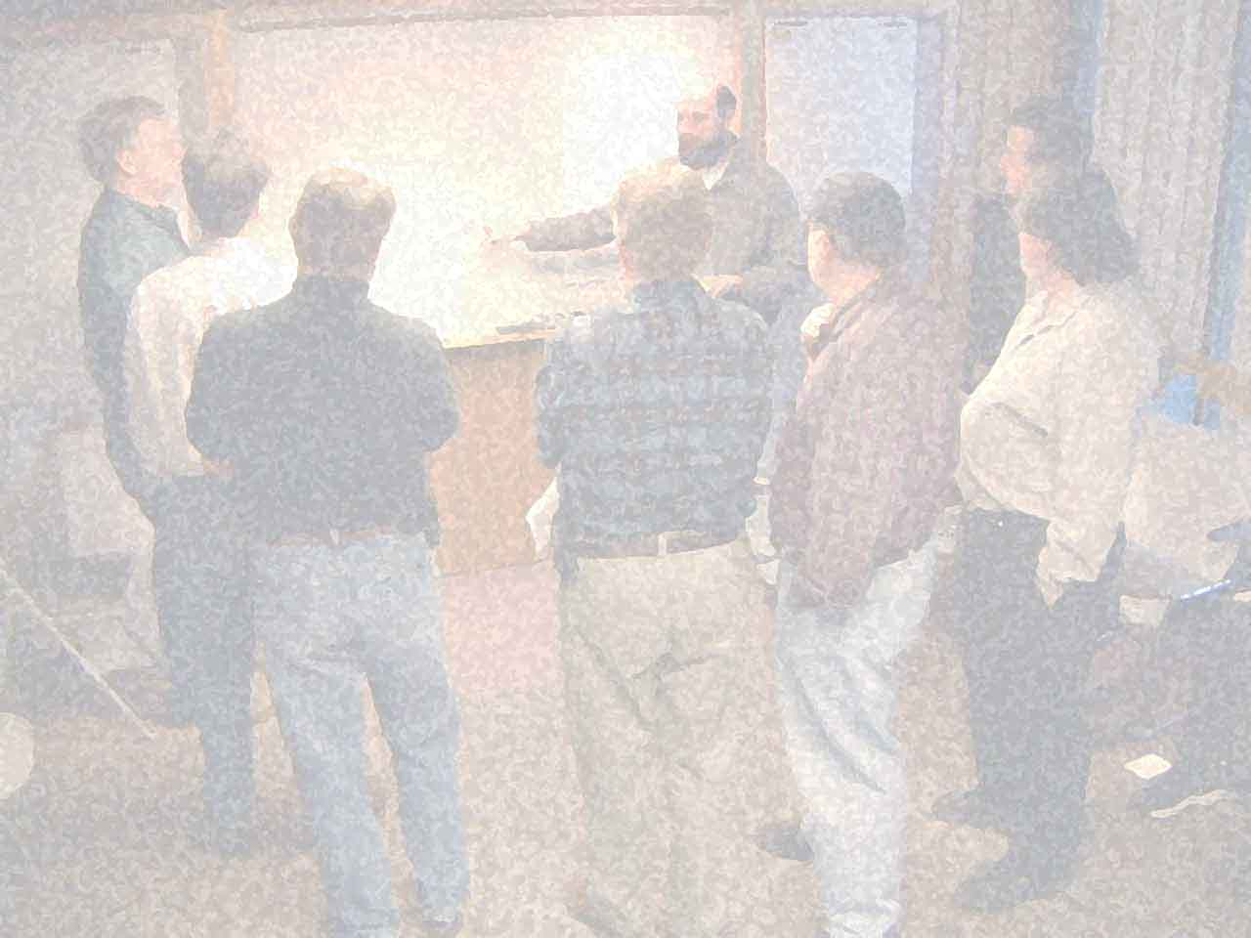

Slide 4
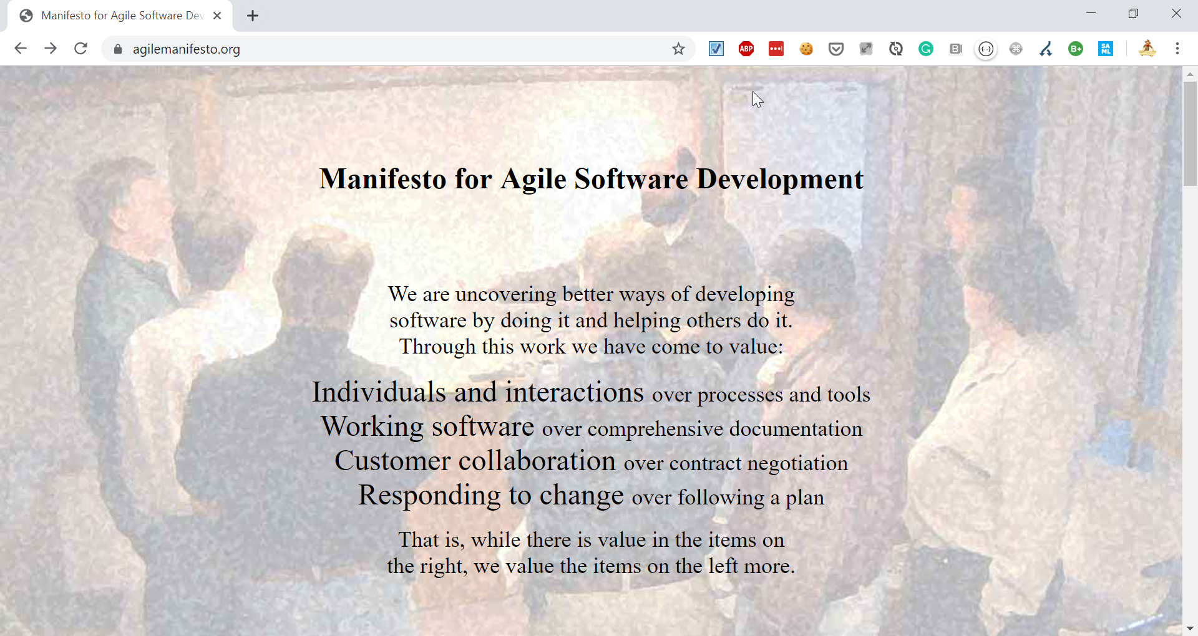

Slide 5



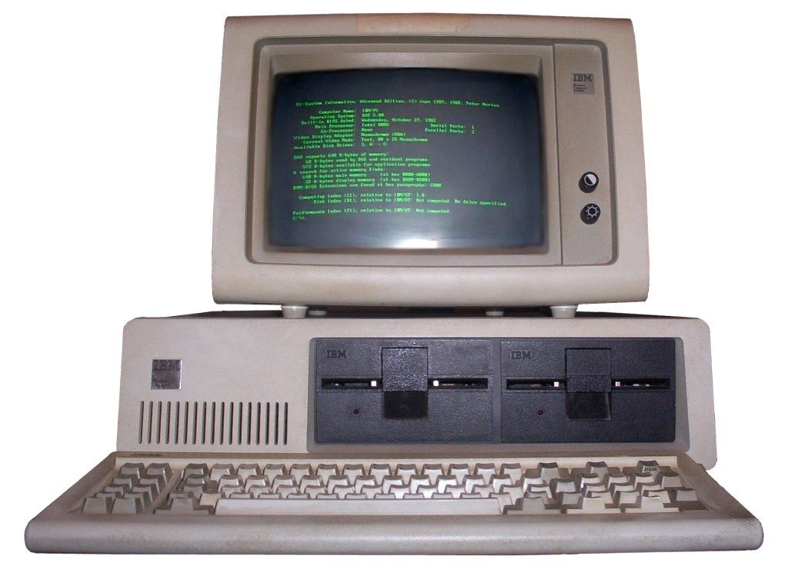
(at that time…)
PROBLEMS

