Slide 1


HTML & CSS: FUNDAMENTALS OF DEVELOPMENT
Instructor: Beck Johnson

Slide 2

TABLES

Slide 3

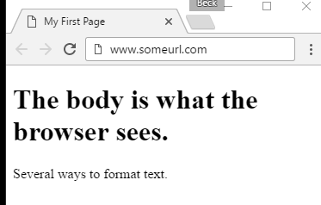
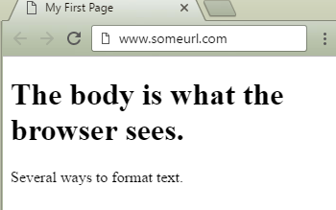

A basi
Basic table
<table>
<thead>
<tr>
<th>Header 1</th>
<th>Header 2</th>
</tr>
</thead>
<tbody>
<tr>
<td>Data 1a</td>
<td>Data 2a</td>
</tr>
<tr>
<td>Data 1b</td>
<td>Data 2b</td>
</tr>
</tbody>
</table>

Slide 4
TABLE ELEMENTS
Table elements
<table> wraps the whole table
<thead> wraps the table header
<tbody> wraps the main data
<tr> wraps a table row
<th> wraps a table header cell
<td> wraps a regular table data cell

Slide 5
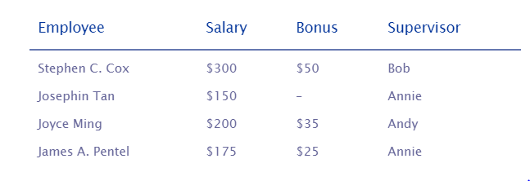
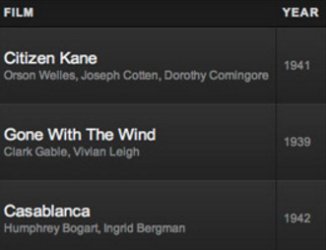
Styling Tables
Styling Tables
Tables can be styled using the CSS properties we’ve already discussed.

Slide 6
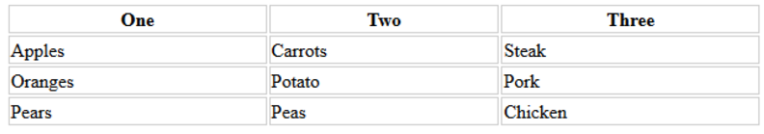
Styling Tables
Styling Tables
If you try to add borders to table cells you may notice something odd:
td, th { border: 1px solid #cccccc; }
This is because adjacent table cells each have their own distinct borders that do not merge together
You can get rid of this behavior by setting this CSS style:
table { border-collapse: collapse; }

Slide 7

Styling Tables
Styling Tables
You can create zebra-striped tables by using the pseudo-selector :nth-child
tr:nth-child(odd) td { background-color: #ccc; }
That applies a light grey background to only table data contained in odd rows.

Slide 8


Ye old nth-childe
Select the 5th element :
li:nth-child(5) { color: green; }
Select every 4th element starting at 1:
li:nth-child(4n+1) { color: green; }
See more: https://css-tricks.com/useful-nth-child-recipies/

Slide 9

PRACTICE TIME!

Slide 10
ASSIGNMENT
Make a table
Using the table you already built (or create a new one):
Style the table header and table body differently.
Apply some CSS to make your table look nice:
Box model properties (padding, margin, border)
Font properties (size, color, font-family)
Container properties like background-color

