Slide 1


HTML & CSS: FUNDAMENTALS OF DEVELOPMENT
Instructor: Beck Johnson
Week 3

Slide 2

SESSION OVERVIEW
Review Intro to CSS
The CSS box model
Block vs inline elements
Content Management Systems
Coding from a design “comp”

Slide 3

REVIEW!

Slide 4
{ } REVIEW: EXAMPLE CSS RULE
p { color: blue; }
selector is p (all <p> tags in the HTML)
property is color
value is blue (many color names are supported, or use the hex code #0000ff)

Slide 5
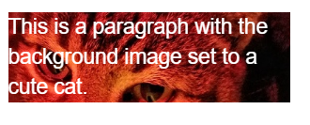
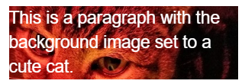
BACKGROUND IMAGES
{ } REVIEW: background images
Can set background of an element as an image (instead of a color) with the property background-image
The value is url("path"), where path is the relative or absolute path to where the image lives, like this:
p {
background-image: url("images/kitten.jpg");
color: white;
}

Slide 6
BACKGROUND IMAGES
{ } REVIEW: background images
background-position: allows you to move a background image around within its container
background-attachment: images usually scroll with the main view, but setting to fixed means the image stays in place when the user scrolls the page
background-repeat: defines if (and how) the background image will repeat
background-size: specifies how much of the container that the image covers

Slide 7


BACKGROUND IMAGES
{ } REVIEW: background images
You can set background-image to linear-gradient, which is a gradient that the browser draws for you:
section { background: linear-gradient(black, white); }
By default linear-gradient draws from top to bottom, but you can set the gradient to draw at an angle instead by starting with to
section {
background: linear-gradient(to right, red, #f06d06, yellow, green);
}

Slide 8
Height and width
{ } REVIEW: height and width
height and width can be set on (most) elements to change how much room they take up on the page.
We’ll discuss later why elements like <a> and <em> don’t change when you set their height or width
The value of this property must be a positive number.
Units are either px or em
Or you can specify a percentage
header { height: 6em; }

Slide 9
REVIEW: Linking to external stylesheet
<link href="css/styles.css" rel="stylesheet">
Tells the browser to find and load the styles.css file from the css directory
The rel attribute stands for "relation" - in this case, this link's relationship to the document is "stylesheet"
This tag goes inside the <head> element
Should be on every page that needs the styles

Slide 10
REVIEW: The “CASCADING” Part
The 3 rules for determining how styles get applied:
Styles are applied from far to near
Styles are applied from top to bottom
Children elements are more specific than parents

Slide 11




{} Styles “Location”
REVIEW: near to far
Styles that are “closer” to the elements they style take precedence
Browser default
External styles
(in a .css file)
Internal styles
(in the <head>)
Inline styles
(directly on an element)
Closer to element

Slide 12
REVIEW: Top to bottom
If the same property is styled multiple times for the same selector, the last one sticks.
p { color: #2f4251; }
p { color: #daa645; } /* this wins */

Slide 13
REVIEW: children are specific
If one style is more specific than another, it takes precedence
p { color: #daa645; } /* all paragraphs */
a { color: #e7c0c8; } /* links in general */
p a { color: #c4fe46; } /* links in paragraphs */

Slide 14
QUESTIONS?

Slide 15
THE CSS BOX MODEL

Slide 16
CSS BOX MODEL
Content: stuff in the box
Padding: bubble wrap and packing peanuts
Border: sides of the box
Margin: space between multiple boxes

Slide 17
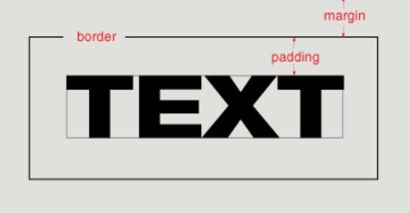
CSS BOX MODEL

Slide 18
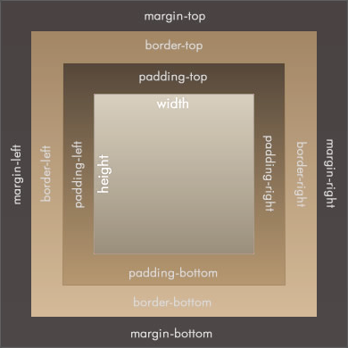
CSS BOX MODEL
Content
Padding
Border
Margin

Slide 19
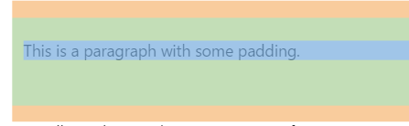
Padding
Padding creates space inside an element.
Padding affects how far content is from the border.
p {
padding-top: 20px; padding-right: 5px; padding-bottom: 40px; padding-left: 10px;
}
Shorter way:
p {
padding: 20px 5px 40px 10px;
}

Slide 20
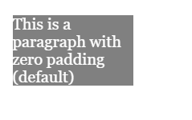
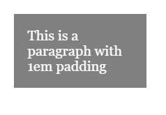
Padding
Padding is useful for moving content away from the edges of its container.

Slide 21
Padding
If top/bottom and left/right padding match…
p {
padding-top: 20px;
padding-right: 10px;
padding-bottom: 20px;
padding-left: 10px;
}
Combine them!
p { padding: 20px 10px; }

Slide 22
Padding
If all padding matches…
p {
padding-top: 20px;
padding-right: 20px;
padding-bottom: 20px;
padding-left: 20px;
}
Combine EVEN MORE!
p { padding: 20px; }

Slide 23
Padding
Padding can be applied only to the top, only to the bottom, and so on – or any combination of those:
p {
padding-left: 40px;
}
p {
padding-top: 20px;
padding-right: 10px;
}

Slide 24
MARGIN
Margin creates space outside an element.
Same abbreviation style and rules as padding
p {
margin-top: 20px;
margin-right: 5px;
margin-bottom: 40px;
margin-left: 10px;
}
Is the same as
p { margin: 20px 5px 40px 10px; }

Slide 25
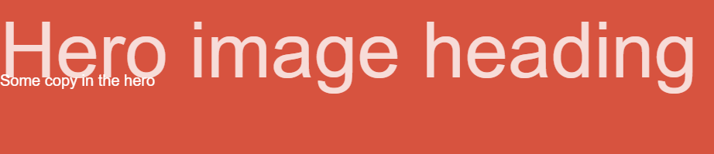
MARGIN
You can give margin a negative value to shift elements in the opposite direction.
p {
margin-top: -20px;
}
This may result in overlapping text!

Slide 26
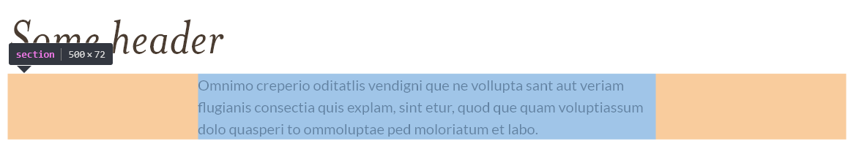
MARGIN auto
To automatically center elements, you can use the property auto, which evenly applies a margin on both sides
When using auto, a width must be applied to the element, so that the browser knows how much margin to automatically apply
section {
margin: 0 auto;
width: 500px;
}

Slide 27
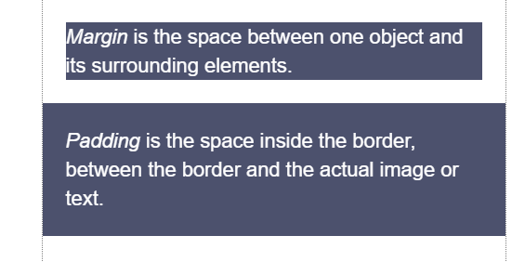
MARGIN vs. padding
Use margin to separate the element from the things that are around it.
Use padding to move the element away from the edges of the block.

Slide 28
BORDER STYLES
Between margin and padding, you can set a border
Values are separated with spaces, in this order:
Width (usually in pixels, but can be em)
Border style (solid, dotted, dashed, etc)
Color
p {
border: 2px dotted #ff0000;
}

Slide 29
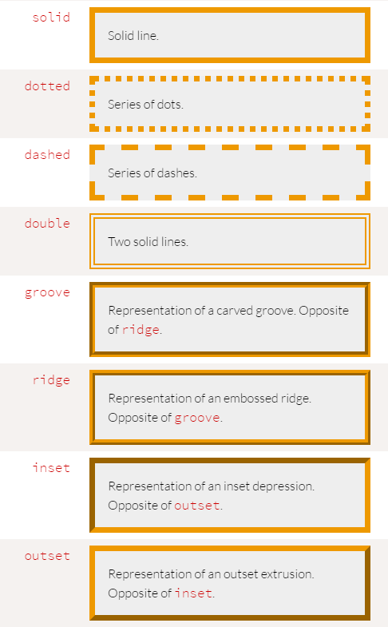
BORDER STYLES
Border styles:

Slide 30

BORDER STYLES
You can set a border on only one side of an element:
h1 { border-bottom: 3px solid black; }

Slide 31

BORDER STYLES
A common use of border is to visually separate list items in a navigation menu.
ul {
list-style : none;
}
li {
padding: 1em;
background-color: #283c51;
border-top: 1px solid #395673;
color: #adadad;
}
<ul>
<li>About us</li>
<li>Products</li>
<li>Services</li>
<li>Contact Us</li>
</ul>

Slide 32
List style
Note that we set
ul {
list-style: none;
}
to remove the bullets that appear
by default on an unordered list

Slide 33
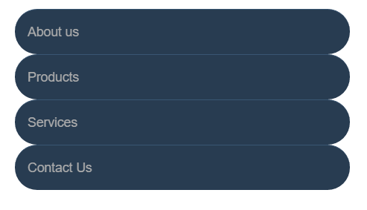
BORDER radius
To make an element appear curved, use the property border-radius
The value is a number (in px or em) or percentage
You can use border-radius even if you don’t explicitly set a border
li {
/* same styles... */
border-radius: 2em;
}

Slide 34

BORDER radius
border-radius can be used to create a circle.
Set border-radius to 50%
Set height and width to the same value
li {
border-radius: 50%;
background-color: black;
color: white;
text-align: center;
height: 3em;
width: 3em;
line-height: 3em;
margin: 5px;
}

Slide 35

BORDER radius
This technique can be used on images to crop them into a circle
Note: if the image itself doesn’t have a square ratio, it will look distorted
<img src="kitten.jpg" />
img {
border-radius: 50%;
height: 200px;
width: 200px;
}

Slide 36

PRACTICE TIME!

Slide 37
ASSIGNMENT
Add a list of links in your navigation menu
Make the navigation menu pretty by using padding, margin, border, background color, and other tricks we’ve learned.
ONLY style lists that are in the nav menu – not any lists that may appear on the rest of the page
Give your design some “breathing room” with padding and/or margin.

Slide 38
<>
Block vs. Inline Elements

Slide 39
<> Block ELEMENTS
<> Block ELEMENTS
Block elements
Expand naturally to fill their parent container
Takes up a “full line”
Can have margin and/or padding
Can have height and/or width
By default, will be placed below previous elements in the markup

Slide 40
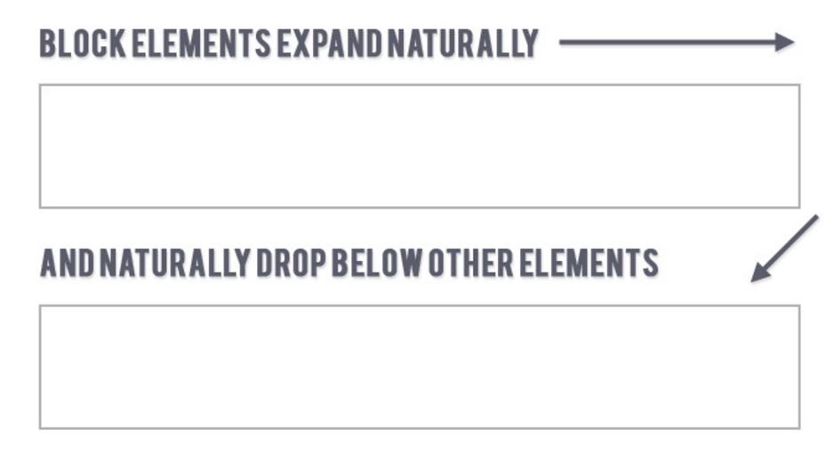
<> Block ELEMENTS
<> Block ELEMENTS

Slide 41
<> Block ELEMENTS
Examples of block elements:
Headings <h1>…<h6>
Paragraphs <p>
Lists <ul>, <ol>

Slide 42
<> INLINE ELEMENTS
inline elements
Flow along with text content
Only take up as much space as necessary
Ignore width and height properties
Margin and padding only pushes other elements away horizontally, not vertically
Top and bottom margin/padding is ignored

Slide 43
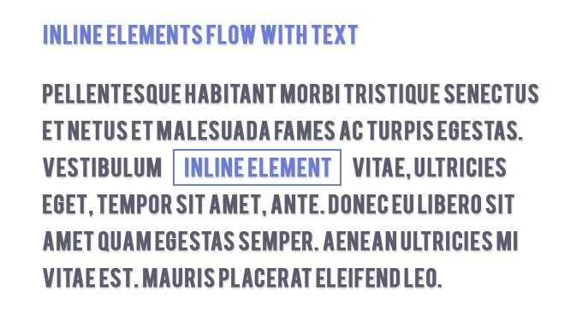
<> INLINE ELEMENTS

Slide 44
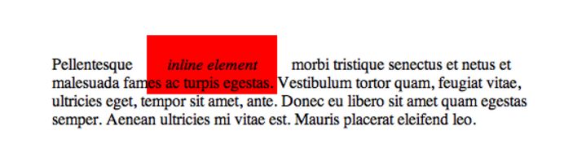
<> Block & INLINE ELEMENTS
Examples of inline elements:
Links <a>
Font emphasis <em>
Font bold <strong>

Slide 45
<> Inline block
inline-block element
Is a hybrid of inline and block
Takes up width and height like block-level elements
Flows with content
Can have margin and padding
Examples of inline-block elements:
Image <img />

Slide 46
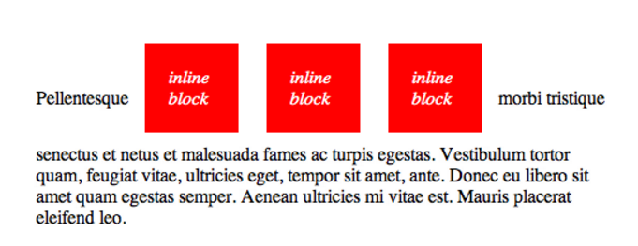
<> Inline block

Slide 47

<> Display
You can change whether or not any element is block, inline, or inline-block by using the CSS display property.
This means we can do some neat things!
li {
display: inline-block;
}

Slide 48
PRACTICE TIME!

Slide 49
ASSIGNMENT
Update your navigation to a horizontal menu using CSS.
Give the li elements a display property of either inline or inline-block. Which looks better? Why do you think that is?
Update your styles so that they look nice in the new orientation
Create an <a> link that looks like a button.
Style the button differently on hover and click

Slide 50
<html>
(MORE) HTML ELEMENTS

Slide 51
<SPAN> elements
<span></span>
A <span> is a generic inline element
No default style
Used to style inline content

Slide 52
<div> elements
<div></div>
A <div> is a generic block element
No default style
Heavily used as a wrapper for other elements, to create complex layouts

Slide 53
Why use div or span?
Both div and span really need something extra to be useful, since they have no presentation style by default.
Used mostly to create layout
Have no semantic meaning
You don’t need to “reset” them before making them fit your design (like ul or p)

Slide 54

CONTENT MANAGEMENT
SYSTEMS (cms)

Slide 55


CONTENT, DESIGN, & CODE
Content
most important part of any website
Design
critical to the best user experience
Code
brings content and design to life

Slide 56

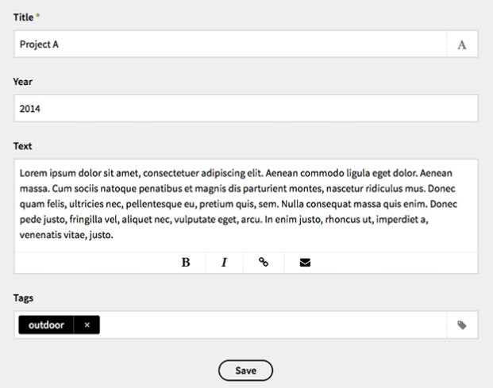
CMS
Most modern websites use a Content Management System to store content
A CMS is a 3rd party system that holds images and text.
That content is dynamically injected into a markup template.

Slide 57
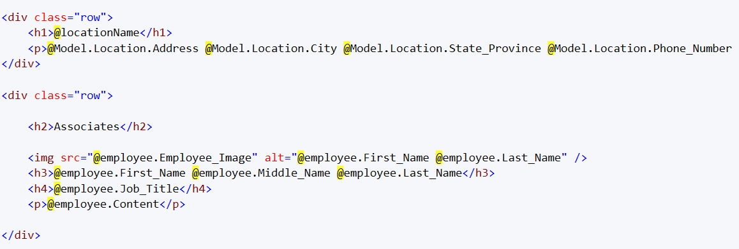
CMS
A developer builds markup as normal, but uses placeholders instead of actual content:

Slide 58
CMS pros
Non-developers can easily edit text and change images, and even create new pages
Allows translation services to load different languages without changing the design or code of the website
Since images are loaded from a third party, this distributes the load across multiple servers, which usually speeds pageload

Slide 59
CMS cons
Most CMS are expensive and challenging to set up, and require ongoing training and administration
Because you can no longer know how much content is going on a page, you have to design for more flexibility
Most European languages are more than 2x longer than English (especially German!)

Slide 60

CMS for translations

Slide 61
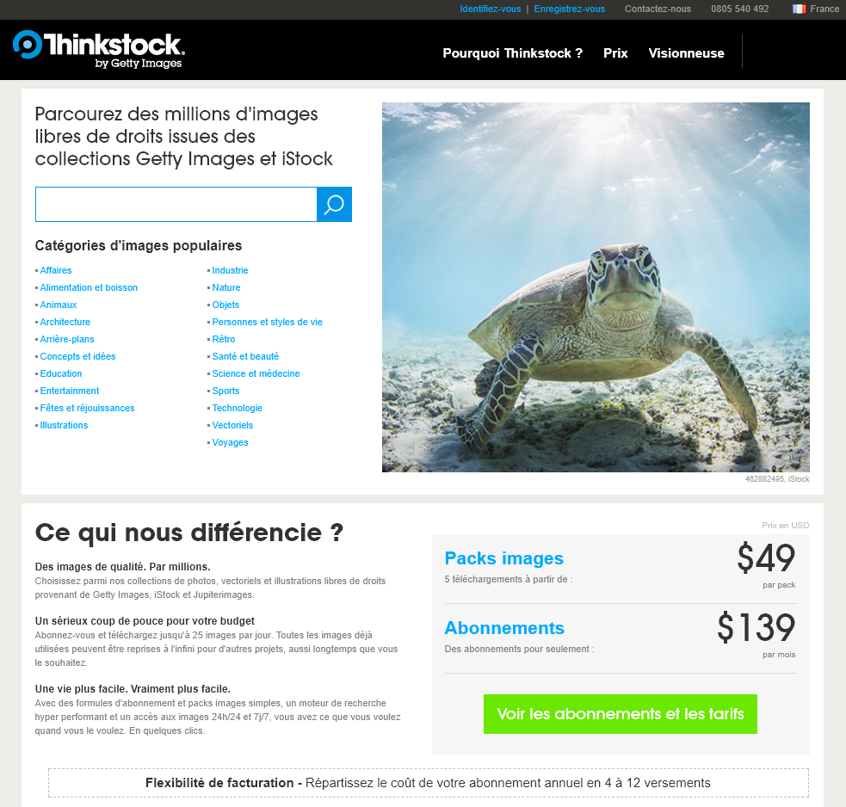
CMS for translations

Slide 62




Popular cms
There are hundreds of Content Management Systems, all using different ways to store, edit, and access data

Slide 63
Putting it together:
Working from a
design comp

Slide 64
comps
A standard way for designers to tell developers what they need to code is via a design “comp” (comprehensive layout)
A comp is a picture of the website the way it should look
Can be delivered as a Photoshop psd file, or an annotated png or pdf file

Slide 65
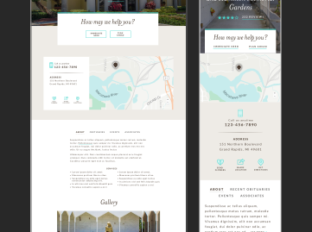
comps
Different states should be shown (for example, what happens when you open a dropdown menu?)
Different screen resolutions should be shown (mobile, tablet, desktop)
The developer inspects the text, colors, and font types in Photoshop to determine what to code

Slide 66
Style guide
Alternatively, designers can provide developers with a style guide instead of a comp
Used in conjunction with wireframes, which show what content belongs on a page and how that content should be laid out
A style guide shows an example of common elements on the site and the color palette to use

Slide 67
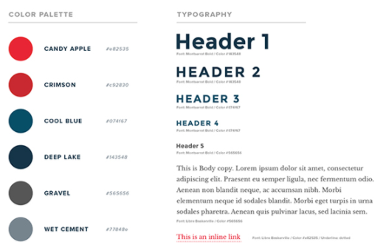
Style guide

Slide 68
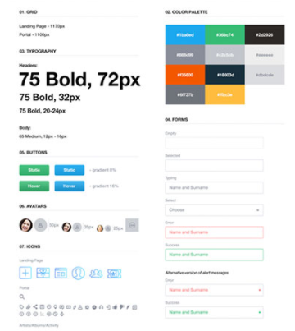
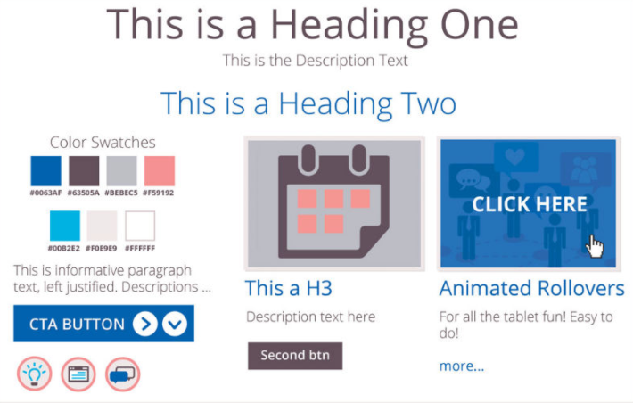
Style guide

Slide 69
PRACTICE TIME!

Slide 70
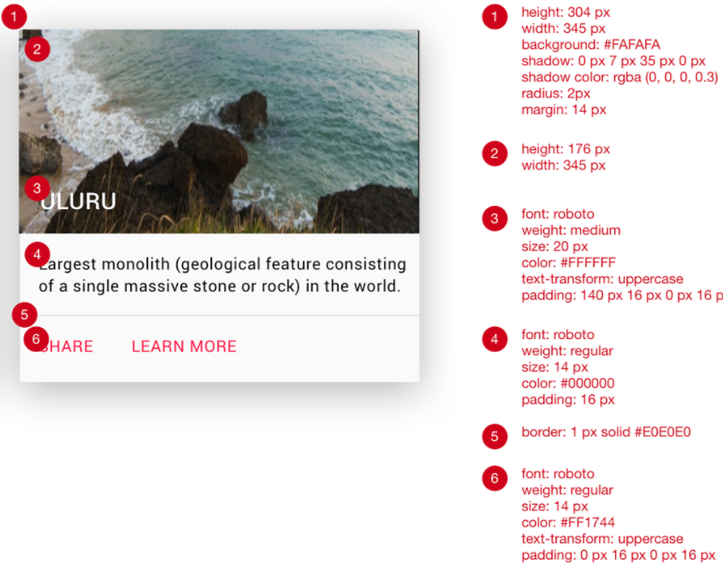
{ } match the comp
Using all the techniques you’ve learned, try to match this comp:

Slide 71
{ } match the comp: Tips
Use a <section> for the entire tile, and specify a width using CSS
Use a <header> to hold the title, and apply a background image to that element
Use this URL to generate a random nature photo:
https://placeimg.com/344/204/nature
Use a <nav> for the row that contains links, and specify a border-top using CSS
To get the drop-shadow effect, apply this CSS to the section:
box-shadow: 0 7px 35px 0 rgba(0, 0, 0, 0.3);

Slide 72

“HOMEWORK”
Practice!
Optional: read chapter 8 of HTML and CSS: Design and Build Websites
Try playing with this interactive demo of the CSS box model

