Slide 1
The Internet and User Experience
Notes:
What I’m here to tell you about
A brief history of the Internet
Some of my personal experiences as a front end developer in the industry around Seattle
Time for discussion or questions after

Slide 2
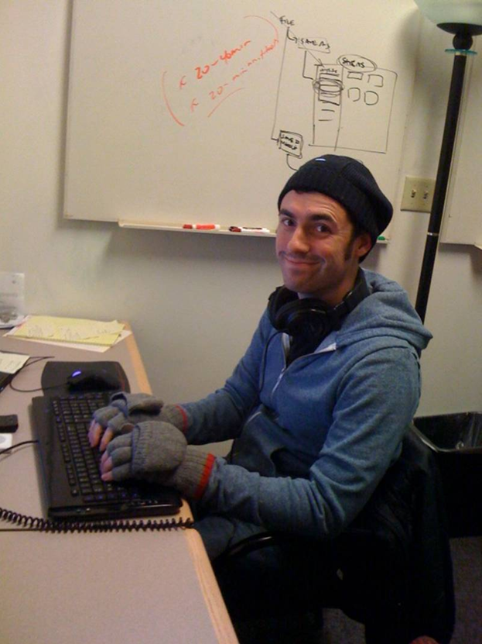
Aaron Bronow
Software Architect / Digital Nomad
@aaronbronow
Building web pages since 1997
10+ Years as a Software Developer
Travelling full time and working remotely
Notes:
Here’s a picture of me doing my glamorous job
Who I’m working for.
A lot has changed in the industry but my hands still get cold
It was very cold working in that utility room at Microsoft
But I grew up in Montana so I didn’t mind and this was my version of “making it” as a success
I started when I was in junior high building an e-commerce site for a greeting card startup
Prototypes
Portfolio
Full time travel
--- How it all began, before I left the woods in Montana

Slide 3
What’s a front-end developer?
Notes:
How I interact with design.
In the begining (how data drove everything):
Now (how design takes more of a role:
I’m passionate about accessibility and globalization.
--- how did this all start?

Slide 4
The ARPANET

Slide 5
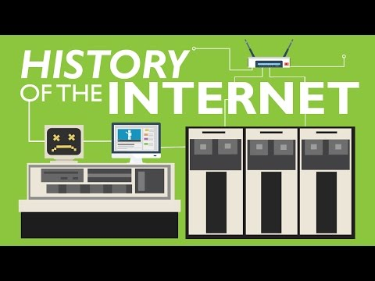

Slide 6
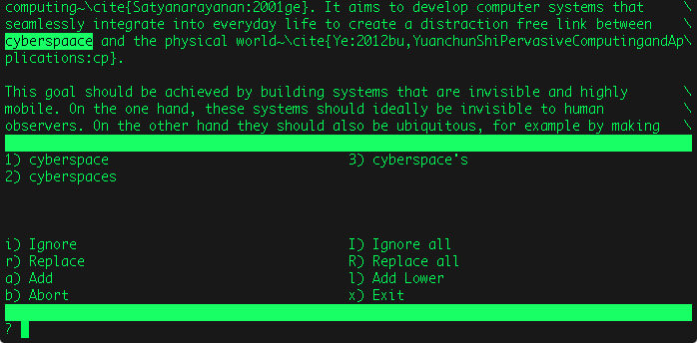
Spellcheck
Notes:
I want to give an idea what people were looking at in those days
in the 80s this is what it looked like to spellcheck a document. this kind of design came out of IBM and had to fit into a fixed number of columns and rows of characters. that’s why the monospace font and the precise layout.
An example of user experience:
The goal is to find misspelled words, in the context of a block of text, with options.
About 2 paragraphs, word is highlighted, you can see tags that start with ~\cite -- before HTML users were doing document editing and sharing with files and folders.
The menu shows options for correction and general methods the user can choose.
User’s goal
Context
Navigation
--- Next step: the web of documents

Slide 7
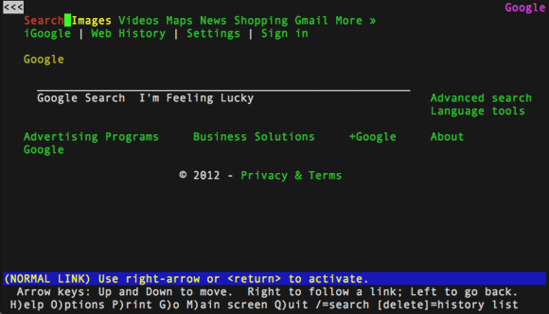
LYNX Browser
Notes:
Here’s a text based browser. Still in the 80’s.
This is the Google homepage. -- A quick note about how I’ve used lynx in the real world: it’s a free way to see how a screen reader sees your site. I used this technique working on corporate sites like target.com. User experience is drastically different for the sightless.
The cursor is that green square. The back button is present. The highlighted link is red. The layout is probably determined by a table. The standard menu and instructions are at the bottom.
Just text
Accessibility testing
Keyboard dependence
--- Make it look better

Slide 8
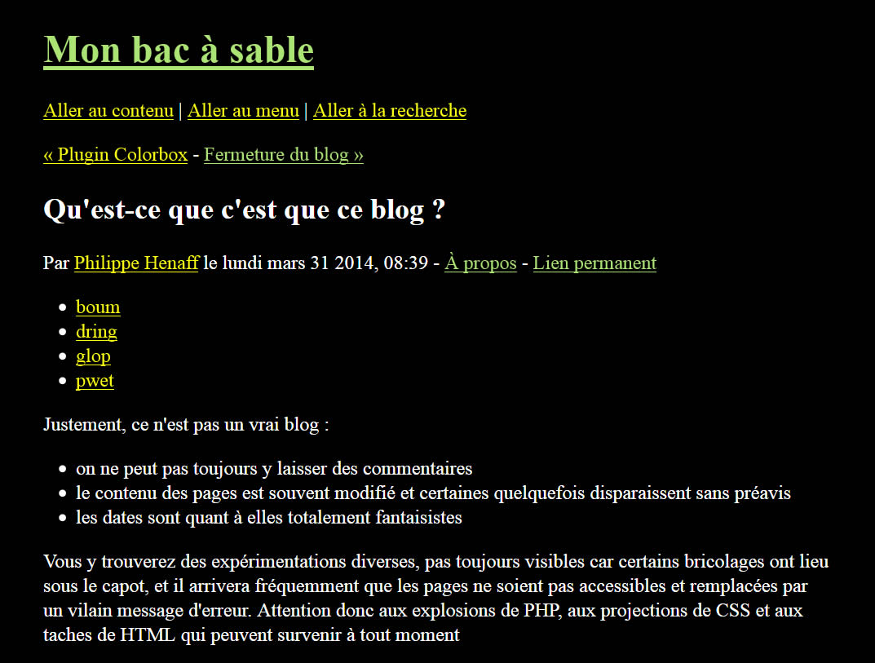
Notes:
Here’s lynx from a newer version showing how fonts, size, special characters for different language sets, text decoration like underline, and bullet points work.

Slide 9
Where do we go from here?
HTML
CSS
JavaScript
Cloud Hosting
To the cloud!
Notes:
Why go to the cloud? - cost efficiency
What’s the cloud? - first let’s talk about what’s IN the cloud
Still a web of documents
--- What people are using on laptops, tablets, phones, XBox, even desktop software has HTML embedded in it.

Slide 10
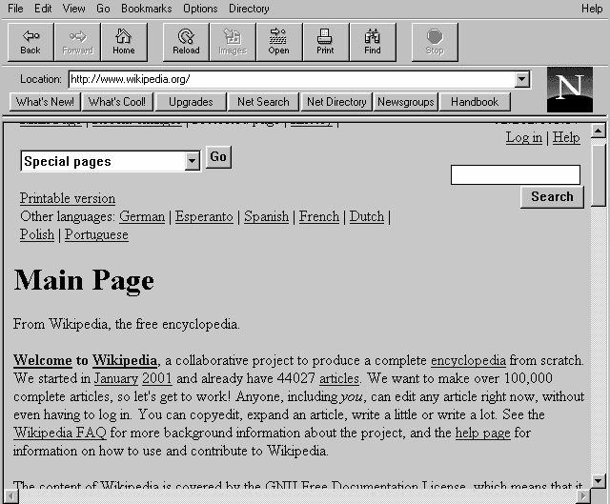
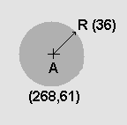
HTML
Version 1 released in 1993
Version 2 released in 1995
Tables
Image maps
Version 5 released in 2014
<!DOCTYPE html> <html> <head> <title>This is a title</title> </head> <body> <p>Hello world!</p> </body> </html>
Notes:
Netscape Navigator’s WYSIWYG page builder (Dreamweaver)
Tables for layout
Image maps
--- Altering design elements done in-line up until CSS
story about the greeting cards sale sign in the window.

Slide 11
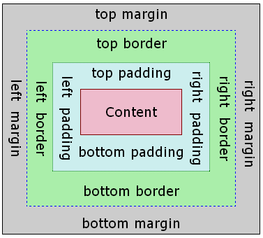
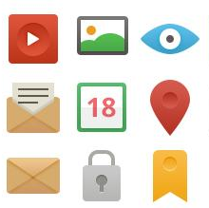
CSS
Version 1 released in 1996
Font and color
Alignment
Margin
Version 3 released in 2011
Media queries
body {
background-color: black;
}
p {
color: orange;
}
a:hover {
text-decoration: none;
}
Notes:
Made development easier by separating markup from style design
Fonts, colors, alignment, margins
Media queries for different devices (or print)
--- Introduced new problems like the box model

Slide 12
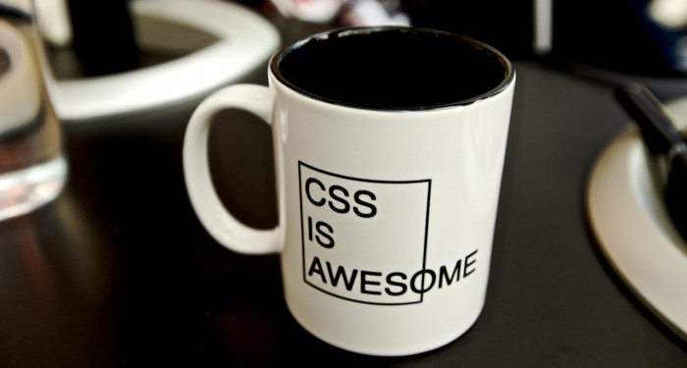
Notes:
The box model stumps a lot of people who are new to CSS.
It’s a little better now, especially with libraries like jquery and bootstrap. We use standard CSS templates called resets to make all the browsers act the same and build up from there. Kind of like primer paint - makes everything white - so the “color” of the underlying browser doesn’t affect your project.
The C in CSS is for cascading
Dropping into a project after 10 years of CSS is a nightmare
Cross-browser issues

Slide 13
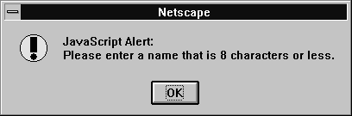
JavaScript
Version 1 released in 1995
Functions
Objects
Inheritance
Version 6 released in 2015
var new_h1 = document.createTextNode('Hello World!');
new_h1.id = 'header';
document.body.appendChild(new_h1);
function changeHeaderColor(color) {
var h1 = document.getElementById('header');
h1.style.color = color; }
Notes:
JS made the web interactive
Functions, objects, inheritance - concepts from software development
CSS selector syntax
--- With great power comes great responsibility. It enabled us to do some terrible things too

Slide 14
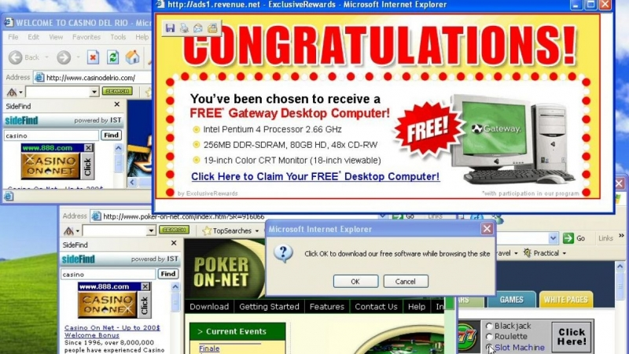
Notes:
Popup ads and alert boxes
Popup ads work. PayPerClick and PayPerImpression advertising is how google made their money.
Popups are still there but done with JS - much harder to avoid
--- Cookies, user tracking, and privacy are beyond the scope of this talk. Back to the good stuff.

Slide 15
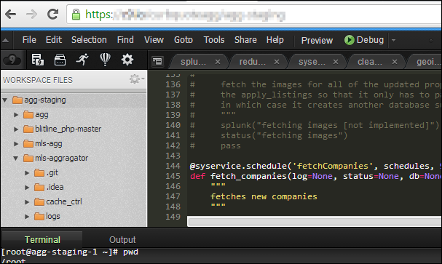
Web Development in a browser
Notes:
A web based IDE that really works
I made this presentation in Google Slides on a chromebook
Note the colorscheme and monospace font - reminds me of the old days
--- It’s still just a web page with a lot of CSS and Javascript. back to the cloud

Slide 16
The Cloud
Notes:
remember What’s the cloud? - Like an apartment building instead of a single family home with the occasional renter
instead of one site per server (self managed)
expanding rapidly

Slide 17
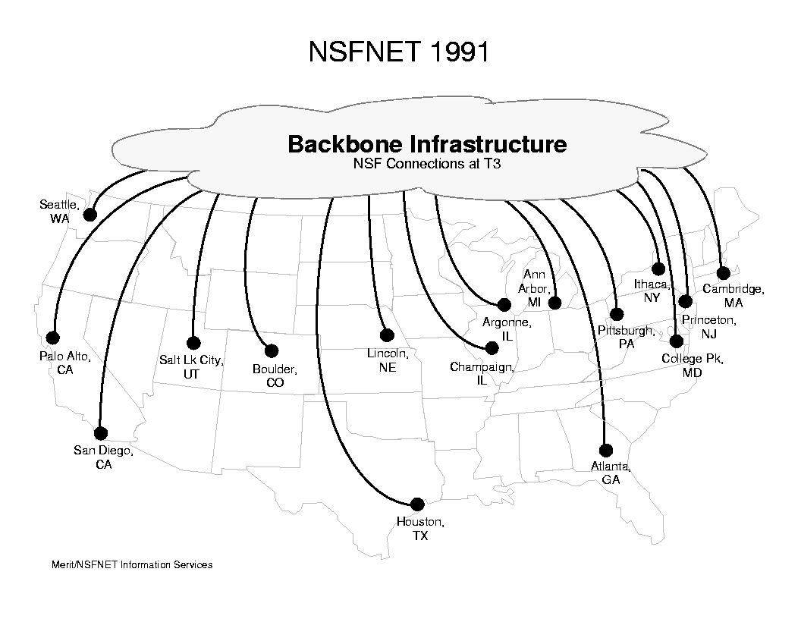
Notes:
This is what the backbone looked like in the 90s. I couldn't find a graphic to illustrate how it looks today.

Slide 18

Around 40% of the world population has an internet connection today.
In 1995, it was less than 1%.
Notes:
The company I work for now is a nonprofit looking at working conditions in developing nations. One way we collect data is phone surveys. That data ends up in a system I'm responsible for that does a bunch of calculations and helps analysts make infographics and reports. The number of people coming online every year just keeps growing and soon some of us will be working for the next generation of startups and worldwide teams.

Slide 19
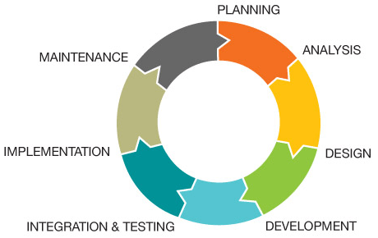
Software Development Lifecycle
Notes:
Some examples of interactions I’ve had in the SDL with the whole lifecycle and in design. Working with teams overseas.
Creeping into the design lab at POP.
Working from wireframes in Visio.
Paper prototyping.
getting with the developer early and often to ask about new page components or technical problems with the concept.
how to make my life easier as a developer. some of my favorite design teams.

Slide 20
Problems we faced in web development
90’s
Tables
Clear pixel
Page load
“Above the fold”
Notes:
--- this all boils down to one question I think all of you are already asking when you work on projects

Slide 21
Problems we faced in web development
90’s
00’s
10’s
Tables
Clear pixel
Page load
“Above the fold”
Static layout
Browser compatibility
Mobile-first design
Tables
Notes:
--- this all boils down to one question I think all of you are already asking when you work on projects

Slide 22
Problems we faced in web development
90’s
00’s
10’s
Now
Tables
Clear pixel
Page load
“Above the fold”
Static layout
Browser compatibility
Mobile-first design
Tables
Globalization
Premature optimization
User-centered design
Semantic markup
Notes:
--- this all boils down to one question I think all of you are already asking when you work on projects

Slide 23


How does the user experience this?
Notes:
I still ask myself this question whether I'm designing a database schema or API or new feature layout.

Slide 24
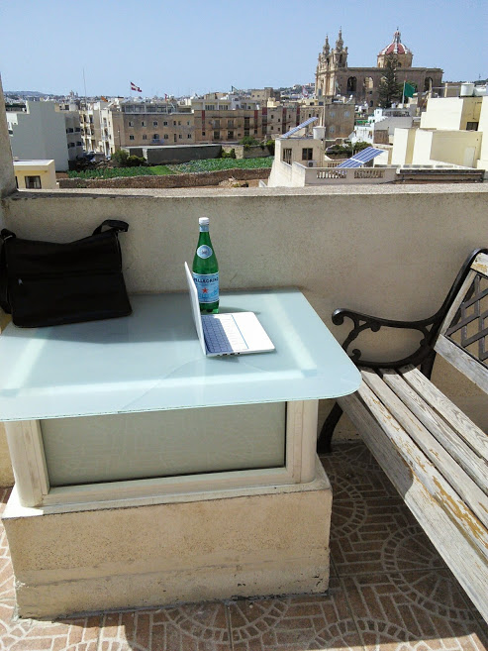
Thanks!
@aaronbronow
Notes:
Thanks
Follow me on twitter if you like. I post about my travels and events in the industry.
Here’s a rooftop in Malta, in the southern Mediterranean where I spent a day at work

