Slide 1


HTML & CSS: FUNDAMENTALS OF DEVELOPMENT
Instructor: Aaron Bronow Week 1

Slide 2

Introductions
Who are you?
What do you do/study/etc?
What is your experience with web development?
Do you have related skills like Photoshop, Wireframing, E-mail Marketing, etc?
What are you hoping to get out of this class?

Slide 3

CLASS SCHEDULE
Five sessions over a five-week period
Thursdays from Jan 11 to Feb 8, from 6:30-9:30 p.m.
10 minute break somewhere in the middle
No grades, no tests
Questions and feedback highly encouraged!

Slide 4

course OVERVIEW
Basic rules of HTML and CSS
Using CSS to style web pages
Website structure, navigation, and file organization
Hosting, FTP, Github
Overview of Javascript and jQuery
The role of the developer

Slide 5

today
Overview of a website
Code editors (and revision control)
Basic HTML
How to FTP (put your website online)
What does a developer DO anyway?

Slide 6
ODDS & ENDS
aaronbronow.github.io/svc-class-jan-2018
Slides, sample files, “homework", and interesting links will be posted here

Slide 7

Overview OF A WEBSITE

Slide 8



CONTENT, DESIGN, & CODE
Content
Most important part of any website
Design
Critical to the best user experience
Code
Brings content and design to life

Slide 9

CONTENT
What am I presenting?
TEXT
Articles
Links
Lists
MEDIA
Images
Videos
Audio

Slide 10
DESIGN
What is the experience?
USER EXPERIENCE
GRAPHIC DESIGN
Layout
Navigation
User flows
Ease of use
Colors
Fonts
Backgrounds
Icons

Slide 11
CODE
How does the computer understand?
HTML structures and organizes content
CSS stylizes the content and creates layout
Javascript adds interactivity

Slide 12

CODE EDITING TOOLS

Slide 13






CODE EDITORS
VS Code
Brackets
Atom
Sublime Text
Coda

Slide 14
PRACTICE, STUDY, PRACTICE
CODE EDITORS
HTML is just text
You can right-click and select "View Source" on any webpage to see how the developer made it

Slide 15

WEB BROWSERS
HTML and CSS require testing in all major modern browsers and devices
You can experiment directly in the browser before making permanent changes

Slide 16

DEVELOPER TOOLS
Chrome
Right-click > Inspect
OR hit the F12 key
Safari
Open Preferences > Advanced > Show Develop menu
Right-click > Inspect Element
Internet Explorer
F12 key

Slide 17
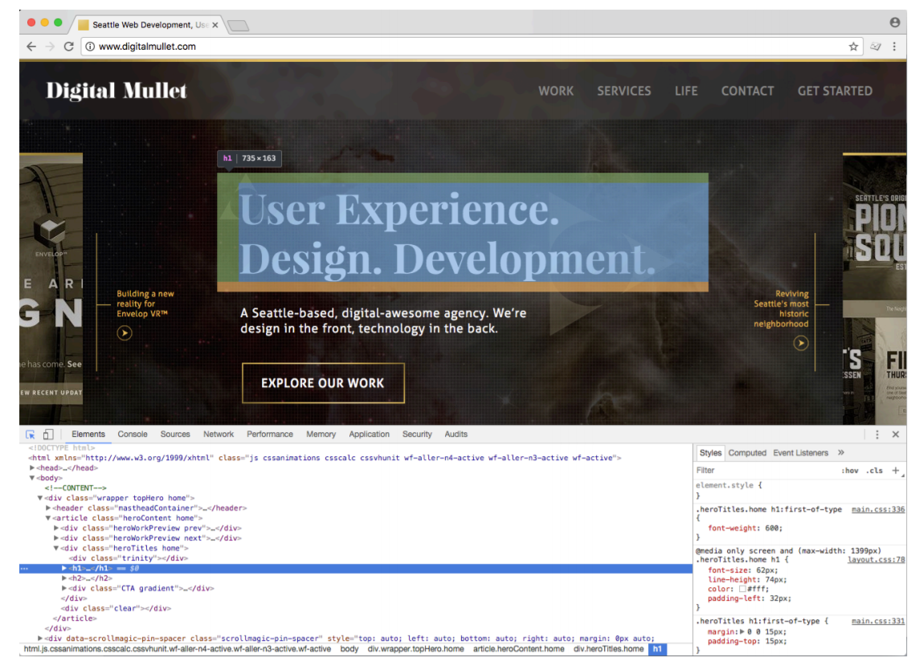
DEVELOPER TOOLS

Slide 18
Let’s try it

Slide 19
<html>
HTML DOCUMENTS

Slide 20

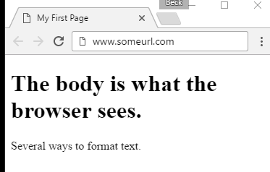
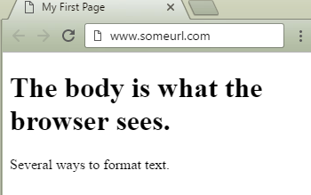
HTML DOCUMENT
<!doctype html>
<html>
<head>
<meta charset="UTF-8">
<title>My First Page</title>
</head>
<body>
<h1>The body is what the browser sees.</h1>
<p>Several ways to format text.</p>
</body>
</html>

Slide 21
HTML Elements
HTML elements are contained in <> brackets
Most HTML elements have an opening tag and a closing tag
<tag>Content goes in here</tag>
Some types of elements are “self-closing”
<tag />

Slide 22


HTML Elements
20

Slide 23
HTML RULES
Tags are written in lowercase
<a> not <A>
Tags must be closed
<p>Text in here.</p>
<div>Content in here.</div>
<br/> Self-closing line break

Slide 24
DOCTYPE
<!doctype html>
The very first thing in any HTML document
Tells the browser what version of HTML the document is written in (this one is HTML5)

Slide 25
DOCTYPE
These other doctypes are not commonly in use anymore:
<!doctype html PUBLIC "=//W3C//DTD XHTML 1.0 Strict//EN" "http://www.w3.org/TR/xhtml1/DTD/xhtml-strict.dtd">
<!doctype html PUBLIC "=//W3C//DTD HTML 4.01 Transitional//EN" "http://www.w3.org/TR/xhtml1/DTD/transitional.dtd">

Slide 26
HTML DECLARATIOn
<html>
The top line after <doctype>
declaration.
Tells the browser “This is where everything starts!”
<html><!-- everything else --></html>

Slide 27
<!--HTML COMMENTS-->
<!-- Comments are great -->
Are not visible to the user in their browser
Great for leaving notes for yourself or other developers
Can be seen in “view source”

Slide 28
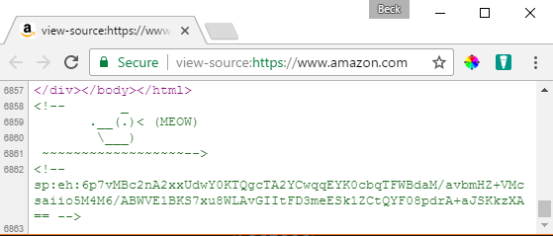
<!--HTML COMMENTS-->
Sometimes they don’t really have a point…

Slide 29
HEAD ELEMENT
<head></head>
Required for a valid HTML document
Holds information about the document that is (mostly) not visible to the user
Can contain CSS and Javascript
<head>
<!-- metadata and resources -->
</head>

Slide 30
META TAGS
<meta charset="UTF-8"/>
Used to specify "meta" information to the browser like page description, author, search engine keywords, and character encoding
UTF-8 represents Unicode, a system to handle text consistently in a variety of languages.
<head>
<meta name="author" content="Your Name" />
<meta name="description" content="A thrilling page"/>
</head>

Slide 31
TITLE TAG
<title>My First Page</title>
Displays in the browser tab
Required inside <head>

Slide 32
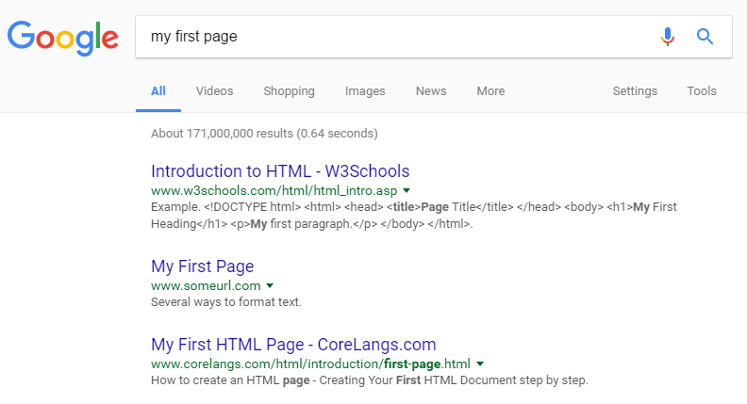
TITLE TAG
<title>My First Page</title>
Name of the page when page is bookmarked
The title for the page in search results on Google (or Bing)

Slide 33
BODY ELEMENT
<body></body>
The part of the HTML document that’s visible to the user
Contains all content of the document, such as tags, links, images, tables, etc.
<body>
<!-- all my sweet content -->
</body>

Slide 34
MAJOR BODY ELEMENTS
Headings for dividing up your page and content
Paragraphs of text
Bulleted, ordered, unordered lists
Images
Links to other pages, websites, or resources.

Slide 35
HEADINGS
<h1>My Page Header</h1>
Headings range from most important to least important
<h1> to <h6>
Search engines use <h1> to determine important information about the page

Slide 36
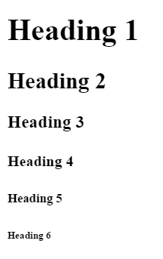
HEADINGS
<h1>Heading 1</h1>
<h2>Heading 2</h2>
<h3>Heading 3</h3>
<h4>Heading 4</h4>
<h5>Heading 5</h5>
<h6>Heading 6</h6>

Slide 37
PARAGRAPHS
<p>Hi! I’m a paragraph!</p>
Browsers automatically add space around
<p> elements (although this can be changed with CSS)

Slide 38
layout
<header> wraps header content
<footer> wraps footer content
<nav> indicates that everything inside is related to navigation
<section> is used to define content sections

Slide 39
formatting
<em> indicates emphasis
By default, this displays as <em>italic</em>
<strong> indicates importance
By default, this displays as <strong>bold</strong>

Slide 40
List Elements
<ul>
<li>Puppies</li>
<li>Kittens</li>
</ul>
Unordered lists <ul> appear in the browser by default with bullets
Puppies
Kittens

Slide 41
List Elements
<ol>
<li>Puppies</li>
<li>Kittens</li>
</ol>
Ordered lists <ol> appear in the browser by default with numbers
Puppies
Kittens

Slide 42
List Elements
<ul>
<li>Puppies</li>
<li>Kittens</li>
</ul>
Both unordered and ordered lists can only contain list items <li> directly

Slide 43
IMAGES
<img src="kitten.jpg" alt="Cute kitten" />
Images do not have a closing tag
Images have two required attributes:
src is where the file lives (local or external)
alt is a description of the image (used for screen readers, search engines, etc)

Slide 44

IMAGES
<img src="kitten.jpg" alt="Cute kitten"
height="200" title="Ollie" />
height and width resize images and ensure the page
doesn't jump
title is shown as a tooltip in some browsers when you hover your mouse over the image

Slide 45
Links with the anchor tag
<a href="http://google.com">Google</a>
The <a> element defines an "anchor" or link
Anything inside <a> is clickable – can be text, an image, or any other valid HTML

Slide 46
Some <A>ttributes
<a href="http://google.com" title="Search" target="_blank">Google</a>
href is the URL where the link should send the user
title appears as a tooltip when you mouse over the link. It is read by screen readers
target="_blank" opens link in a new tab

Slide 47
Url-scuse me?
URL stands for “Uniform Resource Locator”
Uniform
because it is a global standard
Resource Locator
because that’s what an URL does – it locates a resource that lives on the internet

Slide 48
Relative file Paths
Relative paths are URLs that go to a resource in relation to the page you’re on
Resources “local” to you should all be relative paths (your images, HTML documents, fonts, CSS, and JS files)
<a href="other-page.html">Link to another page on my website</a>
<img src="image.gif" /> (image is in same folder)
<img src="../images/image.gif" /> (image is in parent folder)

Slide 49
absolute FILE PATHS
Absolute paths are URLs that start with http
<a href="http://google.com">Ubiquitous search engine</a>
These documents are not hosted by you, so if someone renames or deletes the file, your link will be broken

Slide 50
PRACTICE TIME!

Slide 51
Assignment
Create a website that about something that interests you
At least two pages that are linked to each other
Include a link to an outside website. Bonus: have the link open in a new tab
Use three heading tags and at least one paragraph
Use at least one list
Show at least two images – one local and one remote
Add one HTML comment
Validate your website

Slide 52
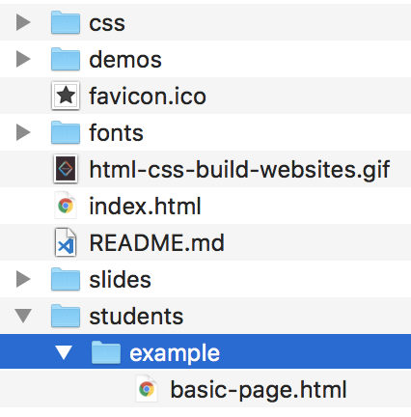
Relative and Absolute File Paths
Assuming the project folder is in the root of the drive: “/” on Mac and Linux; “C:\” on Windows…
Relative | Absolute
../../css | /svc-class-jan-2018/css
../../demos | /svc-class-jan-2018/demos
../../favicon.ico | /svc-class-jan-2018/favicon.ico
../../fonts | /svc-class-jan-2018/fonts
../../html-css-build-website.gif | /svc-class-jan-2018/html-css-build-webs…
../../index.html | /svc-class-jan-2018/index.html
../../README.md | /svc-class-jan-2018/README.md
../../slides | /svc-class-jan-2018/slides
../ | /svc-class-jan-2018/students
./ | /svc-class-jan-2018/students/example
./basic-page.html | /svc-class-jan-2018/students/example/ba…

Slide 53
DOMAINS & WEB HOSTING

Slide 54
PRACTICE, STUDY, PRACTICE
Domains & hosting
What is a domain name?
The Domain Name System, or DNS, is like a phone book for the internet
It’s essentially a list that maps the location of files on a server (identified by a series of unique numbers called an IP Address) to a friendly name, like Wikipedia.org

Slide 55
PRACTICE, STUDY, PRACTICE
Domains & hosting
How do I buy a domain name?
Companies called registrars manage the reservation of domain names
GoDaddy is one of the largest registrars, but many smaller companies also provide this service
ICANN is the agency responsible for regulating and accrediting registrars

Slide 56
PRACTICE, STUDY, PRACTICE
Domains & hosting
I bought a domain name…
now what?
Registering a domain name maps that name to a location where the files will be hosted, but does NOT necessarily provide server space for your files
GoDaddy will both register and host your website, as will many other companies
You can buy a domain name from one company and host your files at another (or, host from a computer you own!)

Slide 57

PRACTICE, STUDY, PRACTICE
Domains & hosting
A common way to upload your website is using FTP (File Transfer Protocol).
You don’t have to understand it, just find an FTP client you like and copy your files using the program.
Filezilla
Cyberduck

Slide 58
The role of the developer

Slide 59
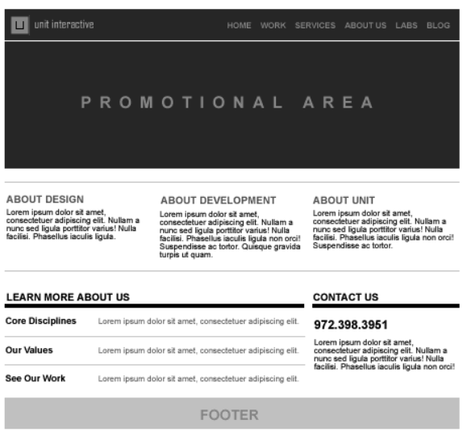
Lifecycle of a website
Step 1
User Interface Designers (UX) create wireframes based on research and conversations with the client
Wireframes show layout and content

Slide 60
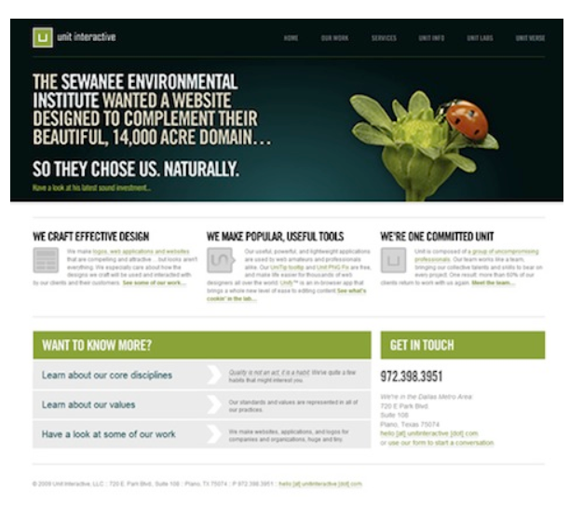
Lifecycle of a website
Step 2
Visual Designers turn wireframes into comprehensive layouts, or “comps”

Slide 61
Lifecycle of a website
Step 3
Developers turn comps into HTML and style with CSS
Add interactivity with Javascript

Slide 62
The role of the dev
What do I do besides code?
Problem solve
Innovate with new technologies and frameworks
Bring designs to life with animation and motion
Optimizing for fast loading

Slide 63

“HOMEWORK”
Practice!
Next time you see a cool website, inspect how they did it
If you have questions during the week, feel free to email me at aaron@bronow.net
Optional: read chapters 6-7 of HTML and CSS: Design and Build Websites

