Slide 1


HTML & CSS: FUNDAMENTALS OF DEVELOPMENT
Instructor: Beck Johnson
Week 4

Slide 2

SESSION OVERVIEW
Review CSS box model and inline/block
Classes and IDs
Layout – floats and positioning
Using web fonts
Supplemental technologies: Javascript, jQuery

Slide 3

REVIEW!

Slide 4
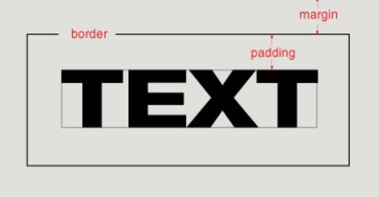
{ } css box model
Content: stuff in the box
Padding: bubble wrap and packing peanuts
Border: sides of the box
Margin: space between multiple boxes

Slide 5
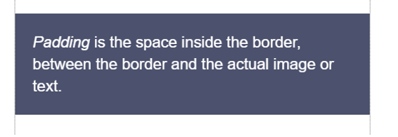
{ } padding
Padding creates space inside an element
Padding affects how far content is from the border

Slide 6
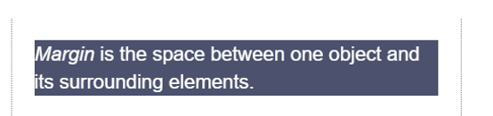
{ } margin
Margin creates space outside an element.
Margin affects how far elements are from each other

Slide 7
{ } border
Between margin and padding, you can set a border
Width (usually in pixels)
Border style (solid, dotted, dashed, etc)
Color
p
border: 2px dotted #ff0000;
}

Slide 8

{ } border-radius
To make an element appear curved, use the property border-radius
The value is a number (in px or em) or percentage
You can use border-radius even if you don’t explicitly set a border
li {
border-radius: 50%;
height: 3em;
width: 3em;
}

Slide 9
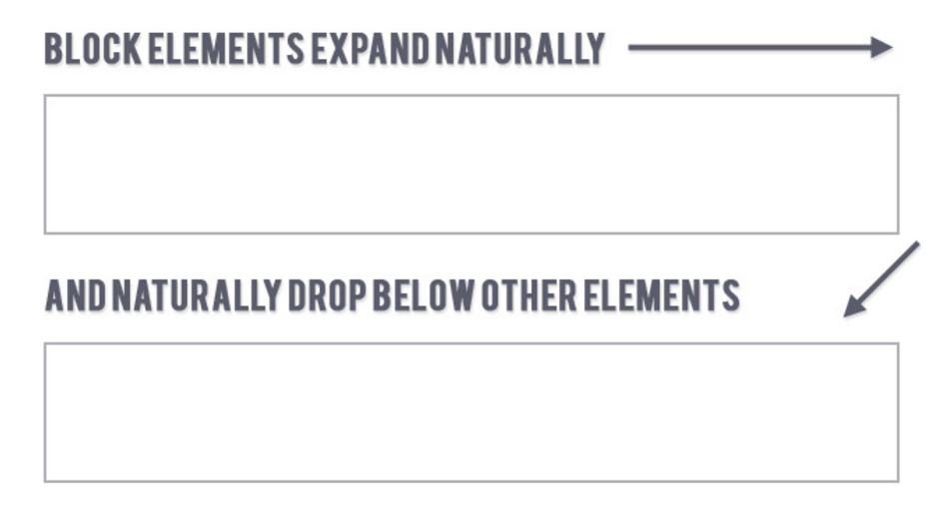
{ } block elements
Block elements
Expand naturally to fill their parent container
Can have margin and/or padding

Slide 10
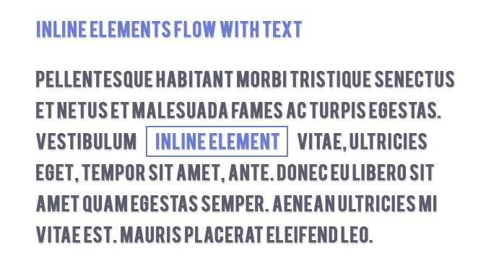
{ } inline elements
inline elements
Flow along with text content
Ignores height, width, top margin, and bottom margin
Honors left and right margins (and any padding)

Slide 11
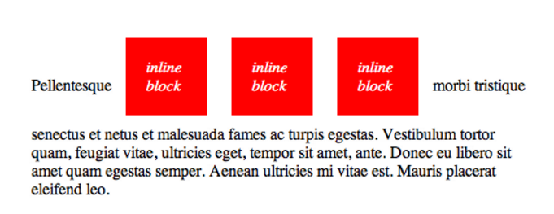
{ } inline-block elements
Inline-block elements
A hybrid of block and inline
Flow along with text content
Has height, width, margin, and padding

Slide 12
QUESTIONS?

Slide 13

ID & Class selectors

Slide 14
CLASSES AND IDs
CSS lets us target all paragraphs like this:
p {
font-size: 20px;
}
But what if we want to style only some paragraphs?

Slide 15
CLASSES AND IDs
You can add class and id attributes to any HTML element to identify it for styling.
You decide the class and id values – be descriptive!
<p class="important">Big text</p>
<p class="anyLettersOrNumb3rsOr_Or-">Still totally valid</p>

Slide 16
CLASSES AND IDs
Adding a class or id does nothing to an element by default.
Classes and ids don’t have any styling information by themselves
They require you to add CSS selectors if you want styling to be applied

Slide 17
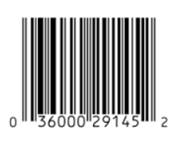

CLASSES AND IDs
Multiple elements can have the same class
A class is like a barcode – all of the same products have the same barcode
Only one element per page can use the same id
An id is like a serial number – it uniquely identifies one specific instance of a product

Slide 18
Class selectors in css
In CSS, target a class with a period
Will style all types of elements that have that class:
.kittens { color: gray; }
<p class="kittens">This will be gray.</p>
<div class="kittens">This will be gray too.</div>

Slide 19
Class selectors in css
Child selectors work with classes:
.card p { padding: 16px; }
“Any paragraph that is inside an element with a class of card gets 16px of padding.”
<div class="card">
<h2>This will not get padding</h2>
<p>But this will</p>
</div>

Slide 20
ID Attributes
An id can only be used once per page
Elements cannot have multiple id attributes
<div id="mainContent">
<!-- This better be the only main -->
</div>

Slide 21
ID selectors in css
In CSS, target an id with a hash:
<div id="kittenContainer"></div>
#kittenContainer {
color: gray;
}

Slide 22
IDs for anchoring
If you put a hash followed by the element’s id in the URL, the browser will jump to that location on the same page:
<a href="#kittenContainer">Proceed directly to kittens</a>

Slide 23
ID Attributes
Q: What horrible thing will happen if you use an id twice on the same page?
A: Well…actually nothing.
But your page won’t validate
Jump links will go to whatever id appears first
And any Javascript that needs to locate that specific element will fail

Slide 24
how to choose - class or id?
If you think it’s likely or possible that you’ll want to apply the same style to multiple things, definitely use class
If your element is guaranteed to be the only one on the page, you can use id – or you can still use class
If your element needs to be linked to directly, use id

Slide 25
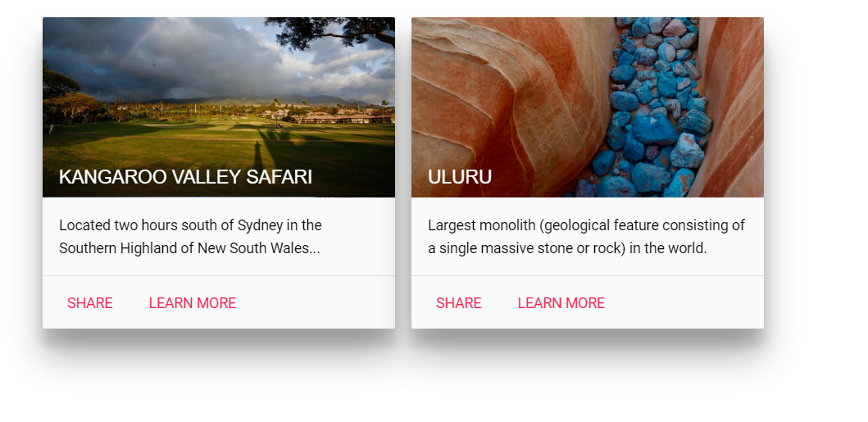
class components
The most common use of classes is to define reusable components.

Slide 26
class components
A component is an outline defined in HTML that will have the same markup every time it’s used, but with different content inside it.
<div class="card">
<div class="image">
<h2></h2>
</div>
<p></p>
<div class="action-bar">
<a></a>
<a></a>
</div>
</div>

Slide 27
Children in class
.card {
display: inline-block;
width: 344px;
height: 304px;
}
.card p {
padding: 16px;
margin: 0;
line-height: 1.6;
}
.card .action-bar {
border-top: 1px solid #E0E0E0;
height: 52px;
}
See a live demo with all the styles

Slide 28
PRACTICE TIME!

Slide 29
ASSIGNMENT
Give an element on your page a descriptive class
Apply a special style using a CSS class selector
Style a child element of this element
Create another class and apply it to two different types of elements
Bonus points: apply to an element that already has a class. What happens if the styles conflict? How would you make sure the result is what you want?
Assign an id to an element on your page
Apply a unique style using an id selector
Create a link in your nav that jumps to that element

Slide 30

WEB LAYOUTS

Slide 31
WEB lAYOUTS
With CSS, we can use a variety of properties to arrange elements on the screen by adjusting the flow of the page.
Basically, you can put elements anywhere…which can be both a good and a bad thing!

Slide 32
3 web layout properties
display: dictates how elements behave within the box model
float: moves elements around within the page flow
position: takes elements entirely out of the page flow

Slide 33
Display property
The display property tells the browser what type of box model to use:
inline
inline-block
block
This changes how padding, margin, height and width affect an element.
You also can set display: none to hide an element entirely.

Slide 34
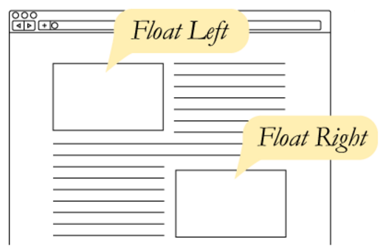
CSS Floats
Up to now, elements have displayed sequentially, in the order that you placed them in your HTML.
The float property takes an element out of the normal flow and “floats” it to the left or right side of its container.
This allows other content
to flow around it
img { float: left; }

Slide 35
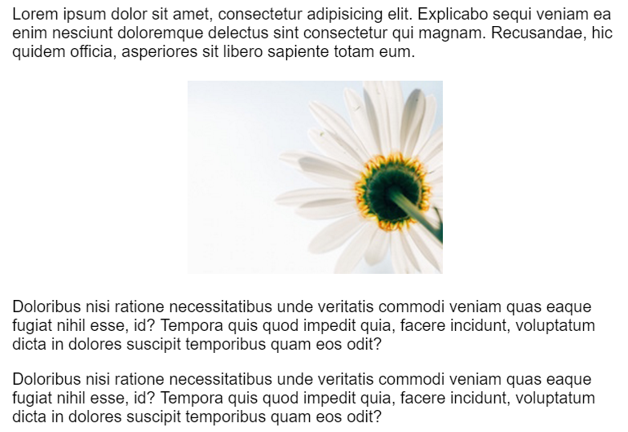
CSS Floats
The three values for float are:
left
right
none
By default, elements are float: none

Slide 36
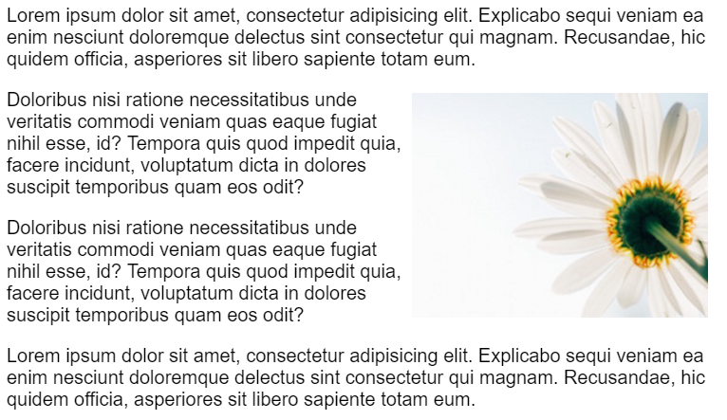
CSS Floats
img { float: right; }

Slide 37
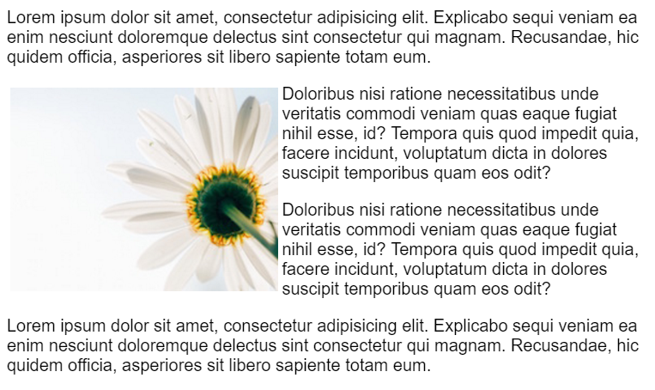
CSS Floats
img { float: left; }

Slide 38
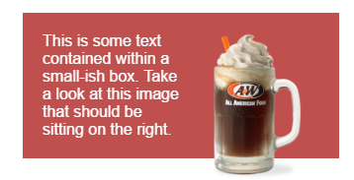
Flows before rows
Where you place your floated element in your HTML can cause different results.
Live demo here.
<div id="container">
<img src="rootbeer-float.png" style="float:right" />
<p>This is some text contained…</p>
</div>

Slide 39
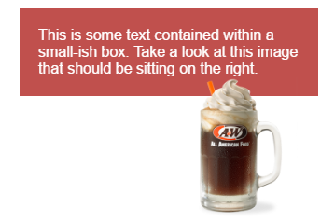
Flows before rows
What happens if we move the image below the paragraph?
<div id="container">
<p>This is some text contained…</p>
<img src="rootbeer-float.png" style="float:right" />
</div>
A general rule is float first.
Place floated elements before
any non-floated elements the
float interacts with

Slide 40
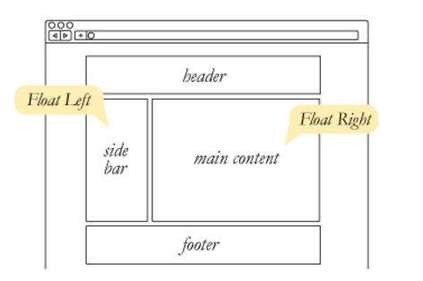
CSS Floats
float can be used to float text around images, but it also can be used to create entire page layouts.

Slide 41

CSS Floats
CSS Floats
For example, this layout was built using float. How do you think it was done?

Slide 42

CSS Floats
CSS Floats
.avatar { float: left; }
.bio { float: right; }
Let’s try that…

Slide 43

CSS Floats
CSS Floats
The container thinks it has no content!
It collapsed to the size of its padding (you can see the top and bottom border)
The floated content is spilling out

Slide 44
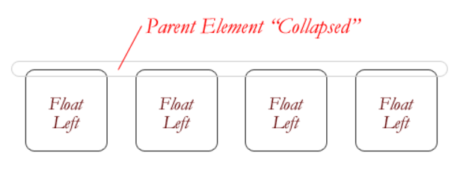
CSS Floats
CSS Floats
If you float an element, it is no longer in the normal document flow.
If all elements in a container are floated, that means that the container is effectively “empty.”

Slide 45
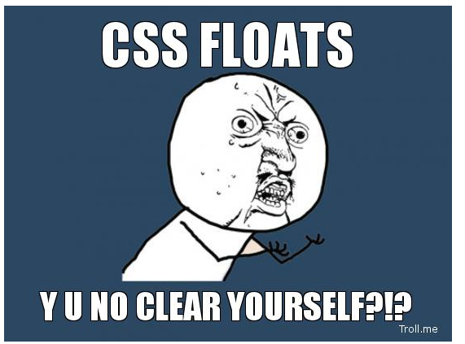
How to fix floats?

Slide 46
How to fix floats?
There are 2 ways to fix this:
Apply the CSS rule clear: both to an element after the floated content
Apply a CSS rule using the property overflow to the container

Slide 47
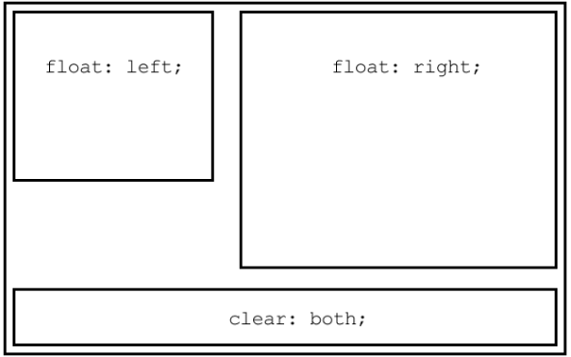
The CLEAR PROPERTY
The clear property is the sister property to float
It doesn’t do much until there are floated elements on the page
An element with clear applied to it will force itself below the floated element
Everything after that will be back in the normal flow
This “stretches” out the container and keeps it from collapsing

Slide 48
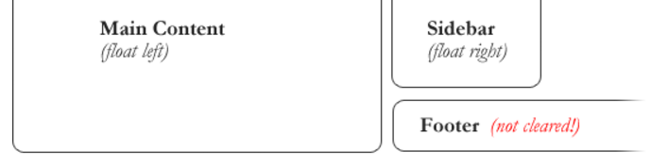
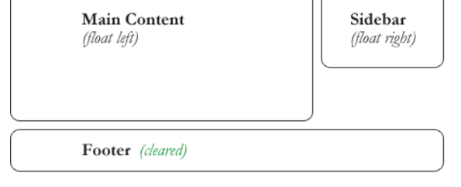
The CLEAR PROPERTY
The CLEAR PROPERTY
clear has similar values to float:
clear: none – the element does not move down to clear past floating elements (this is the default value)
clear: both – the element is moved down to clear both right- and left-floated elements

Slide 49
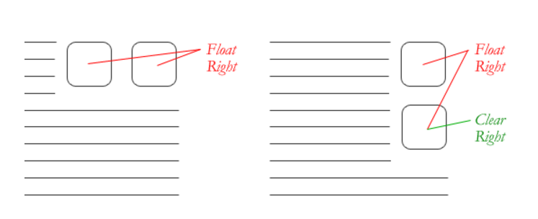
The CLEAR PROPERTY
The CLEAR PROPERTY
Sometimes, you want to let some content after a clear continue floating, but not other content:
clear: left – only clear left-floated elements
clear: right – only clear right-floated elements

Slide 50
The CLEAR PROPERTY
The CLEAR PROPERTY
So to solve our problem, you could add this empty div after the bio container:
<div style="clear: both"></div>
(We could apply the class to any type of element, but the benefit of using a div is that it has no style of its own.)

Slide 51
The overflow PROPERTY
The other way to force a container to expand around floated content is to apply a CSS rule with overflow to the container that the floated content is inside.
Any valid value for overflow will cause floated content to stretch out the container
Too complicated to explain, but it basically forces the container to re-assess the content inside it

Slide 52
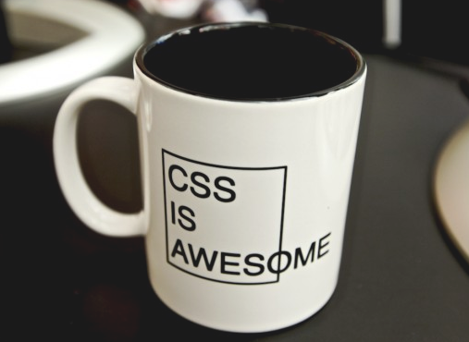
The overflow PROPERTY
The overflow PROPERTY
overflow is a CSS property that governs how content looks when it breaks out of its container.
By default, elements have
overflow: visible,
which means all content
is fully visible
Even if that means
overflowing its container!

Slide 53
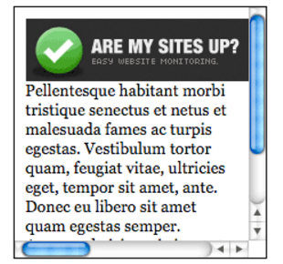
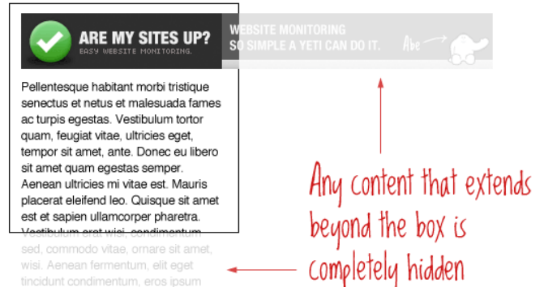
The overflow PROPERTY
The overflow PROPERTY
overflow: scroll makes scrollbars appear both horizontally and vertically…even if they don’t need to be there.
None of the content that would
overflow appears outside the box
overflow: hidden cuts off any content that “sticks out” of
its box
No way to scroll, so content is
no longer accessible

Slide 54
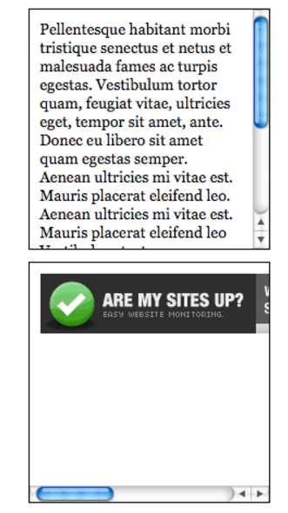
The overflow PROPERTY
The overflow PROPERTY
overflow: auto only adds scrollbars when the content requires it (which may mean no scrollbars are added at all)

Slide 55
The overflow PROPERTY
The overflow PROPERTY
So to solve our problem, you could add this CSS rule to the floated div:
.bio { overflow: visible; }

Slide 56
PRACTICE TIME!

Slide 57
ASSIGNMENT
Create a container that has an image floated to the side of some text.
Give the container a background color, gradient, or borders (to make sure floated content is really clearing properly)
Try both techniques to force the container to expand around floated content
Apply box model properties like padding and margin so that your content looks nice

Slide 58
Web fonts

Slide 59
Web fonts
Remember that font-family looks for a font installed on the user’s local machine.
body { font-family: Tahoma, sans-serif; }
If the Tahoma font isn’t found, the browser will default to a generic sans-serif font instead.
What if you want to use an interesting font that most people aren’t likely to have installed?

Slide 60
Web fonts
The absolutely easiest way to get custom fonts is to link to a CDN font stylesheet in the head of your page:
<link href="https://fonts.googleapis.com/css?family=Roboto" rel="stylesheet">
CDN means “Content Delivery Network”
A fancy way of saying a big, reliable company hosts the file for you
Google hosts 100s of free fonts

Slide 61
Web fonts
<link href="https://fonts.googleapis.com/css?family=Roboto" rel="stylesheet">
Once you include a font stylesheet from a CDN, you can refer to the font in a font-family rule, just like you would a web-safe font:
p { font-family: Roboto, sans-serif; }

Slide 62
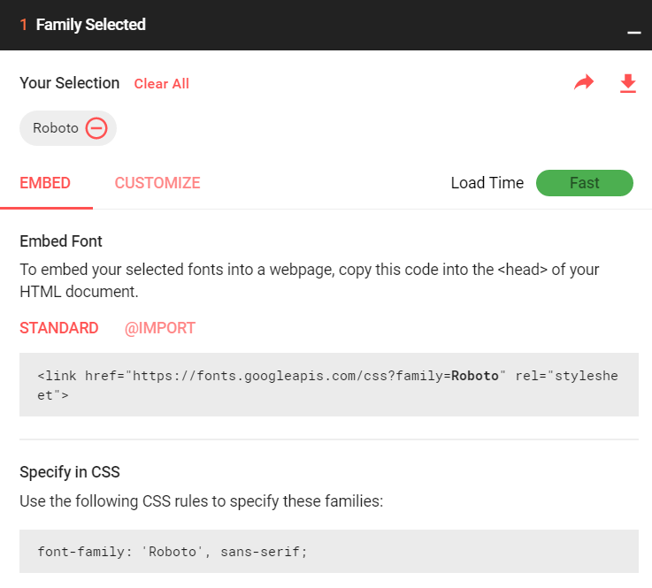
Web fonts
When you choose a font Google will tell you what name to use.

Slide 63
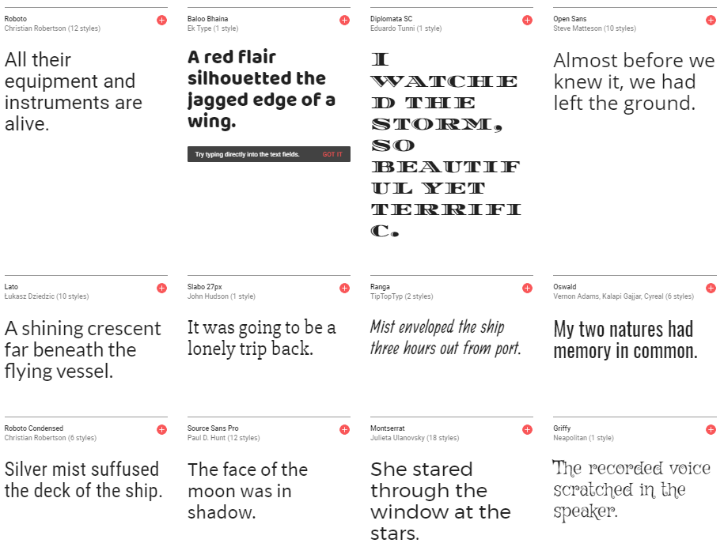
Web fonts
https://fonts.google.com/

Slide 64
Web fonts
cons:
Relies on a 3rd party to provide assets
If the request times out, the font won’t download (so always provide fallbacks!)
pros:
Extremely easy to get working
Possibility that user already has the font in their web cache due to visiting other sites that use the same font

Slide 65
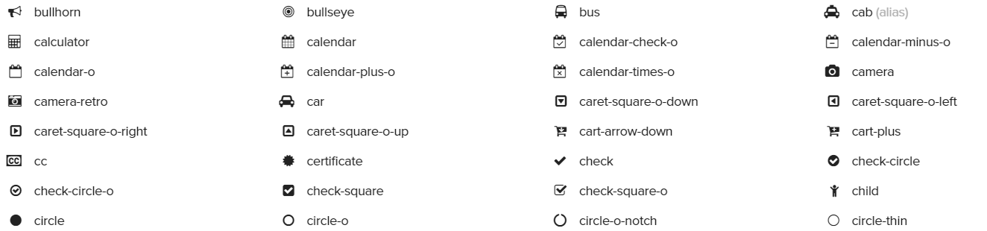
icon fonts
Font Awesome is a free icon font that is used in many real-world projects.
An icon font means letters have been replaced with vector images
So to color or re-size icons on your site, just use the CSS font properties we already learned.

Slide 66

icon fonts
To quickly start using Font Awesome, add this stylesheet to the head of your page:
<link href="https://maxcdn.bootstrapcdn.com/font-awesome/4.7.0/css/font-awesome.min.css" rel="stylesheet">
Click an icon from the Font Awesome website, and copy the markup they provide, like:
<i class="fa fa-heart"></i>

Slide 67



Font AWesome
You can put a Font Awesome class on any element:
<span class="fa fa-paw"></span>
<i class="fa fa-cog"></i>
<h1 class="fa fa-thumbs-down"></h1>

Slide 68
Web fonts
The other way to ensure people see the correct font is to download the font onto their computer when they load your page.
You do this by first downloading a font into a folder on your website
There are free fonts available for download at websites like Font Squirrel or Font Spring
After you have a copy of the font you can share it just like any other media file on your website

Slide 69
Web fonts
Some considerations with hosting fonts:
Have to consider licensing fees – many fonts cost money
Some fonts prohibit commercial use, or limit the number of pageviews

Slide 70
@Font-face
If you download a font that you want to use on your site, add @font-face before any other styles:
@font-face { font-family: MyWebFont; src: url('webfont.eot');
url('webfont.eot?#iefix') format('embedded-opentype'),
url('webfont.woff') format('woff'),
url('webfont.ttf') format('truetype'),
url('webfont.svg#svgFontName') format('svg'); }
(The good news is, font sites will provide this chunk of CSS for you to copy into your stylesheet!)

Slide 71
@Font-face
@font-face { font-family: MyWebFont; src: url('webfont.eot');
url('webfont.eot?#iefix') format('embedded-opentype'),
url('webfont.woff') format('woff'),
url('webfont.ttf') format('truetype'),
url('webfont.svg#svgFontName') format('svg'); }
Different browsers support different font filetypes
Modern browsers use woff
IE needs eot
Mobile devices need ttf or svg

Slide 72
PRACTICE TIME!

Slide 73
ASSIGNMENT
Find a free font from Google fonts and use it on your site by including the font stylesheet.
Apply the font to some (or all) elements on the page
Include the Font Awesome stylesheet:
<link href="https://maxcdn.bootstrapcdn.com/font-awesome/4.7.0/css/font-awesome.min.css" rel="stylesheet">
Display at least two different icons
Make them different sizes and/or colors
Bonus points: what other CSS can you apply to the icons?

Slide 74

javascript

Slide 75

What is javascript?
JavaScript is a programming language that runs in your web browser
Can manipulate any element on the page
Can listen to user interaction, such as button clicks or scrolling the browser window

Slide 76
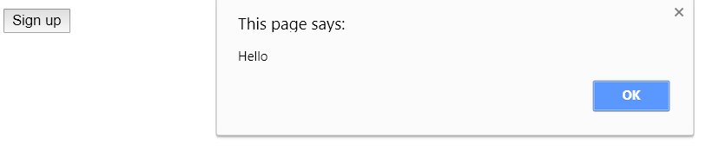
Javascript example
<button id="signup">Sign up</button>
<script>
var signupButton = document.getElementById("signup");
signupButton.addEventListener("click", function(){
alert("Hello");
});
</script>
See a live demo

Slide 77
What is jquery?
jQuery is a popular Javascript library that makes it easy to locate and manipulate elements
Uses CSS syntax for finding DOM elements
Handles browser inconsistencies so that you don’t have to
Simplifies many common tasks

Slide 78
Using jquery
To be able to use jQuery, you have to include a link to the javascript file that contains it
Like web fonts, the easiest way to get started is to link to a CDN:
<script src="https://code.jquery.com/jquery-1.12.4.js"></script>

Slide 79
Jquery example
<button id="signup">Sign up</button>
<script>
var signupButton = $("#signup");
signupButton.on("click", function(){
alert("Hello");
});
</script>

Slide 80
Better Jquery example
<a class="menu-toggle">Top level menu</a>
<ul class="menu">
<li>Menu item</li>
<li>Menu item</li>
<li>Menu item</li>
</ul>
<script>
$(".menu-toggle").on("click", function(){
$(this).next(".menu").slideToggle();
});
</script>
See a live demo

Slide 81
Jquery provides easy animations
jQuery makes showing or hiding elements very easy, and provides a bunch of animation options as well
Show/hide
Fade in / fade out
Slide down / slide up
Each of these options can be given a duration (how long the animation lasts) and a speed (called “easing”, which can vary over time)
See some jQuery animation examples

Slide 82

“HOMEWORK”
Practice!
Optional: read chapters 15 and 17 of HTML and CSS: Design and Build Websites

