Slide 1


HTML & CSS: FUNDAMENTALS OF DEVELOPMENT
Instructor: Beck Johnson
Week 5

Slide 2

SESSION OVERVIEW
Review Week Four
CSS positioning
Responsive design
“The Grid”
Redlines and how UX/Design communicate with dev
Evaluations

Slide 3

REVIEW!

Slide 4
{} classes and ids
You can add class and id to any HTML element to identify it for styling.
You decide the class and id values – be descriptive!
<p class="important">Big text</p>
<p class="anyLettersOrNumbersOr_Or-">Still totally valid</p>

Slide 5
{} classes
Multiple elements can have the same class
In CSS, target a class with a period
.kittens { color: gray; }
<p class="kittens">This will be gray.</p>

Slide 6
{} ids
Only one element per page can use the same id
In CSS, target an id with a hash:
#kittenContainer { color: gray; }
<div id="kittenContainer">This will be gray.</div>

Slide 7
{} how to choose between them
If you think it’s likely or possible that you’ll want to apply the same style to multiple things, definitely use class
If your element is guaranteed to be the only one on the page, you can use id – or you can still use class
If your element needs to be linked to directly, use id

Slide 8
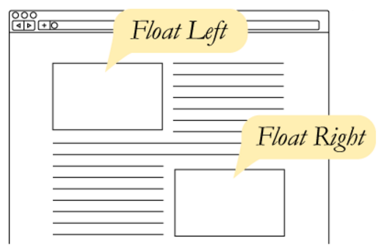
CSS Floats
The float property takes an element out of the normal flow and “floats” it to the left or right side of its container.
This allows other content
to flow around it
img { float: left; }

Slide 9
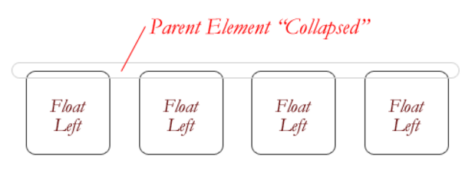
CSS Floats
The three values for float are:
left
right
none
If everything in a container is floated, then the container thinks it’s empty.

Slide 10
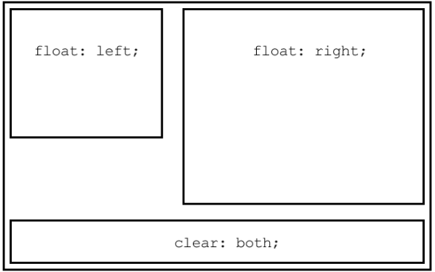
The CLEAR PROPERTY
The clear property is the sister property to float
It doesn’t do much until there are floated elements on the page
An element with clear applied to it will force itself below the floated element
Everything after that will be back in the normal flow
This “stretches” out the container and keeps it from collapsing

Slide 11
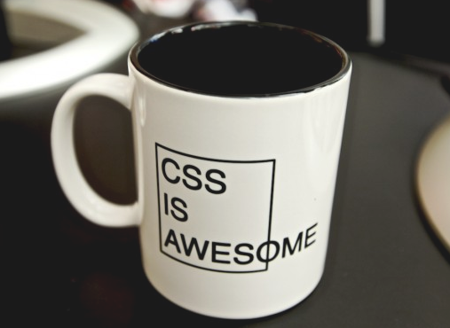
The overflow PROPERTY
overflow is a CSS property that governs how content looks when it breaks out of its container.
By default, elements have
overflow: visible,
which means all content
is fully visible.
overflow: auto
adds scrollbars when
the content is bigger than
its container.

Slide 12
QUESTIONS?

Slide 13

CSS POSITIONING

Slide 14
3 web layout properties
display: dictates how elements behave within the box model
float: moves elements around within the page flow
position: takes elements entirely out of the page flow

Slide 15
CSS POSITIONing
The position property specifies how an element is positioned on the page. Possible values are:
static
fixed
absolute
relative
The default position is static, which just means that the element obeys whatever its box model rules tell it to do.

Slide 16
CSS POSITIONing
There are 4 directional properties that affect positioning:
left
right
top
bottom
The value is a number (positive or negative) followed by a unit.
They define how far an element is offset that direction.

Slide 17
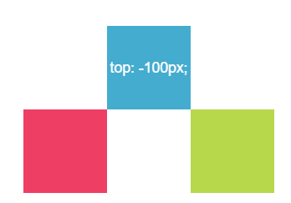
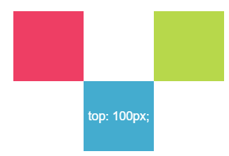
CSS POSITIONing
top defines how far an element is offset from its original top edge.
Positive top values push an element down
Negative top values push an element up

Slide 18
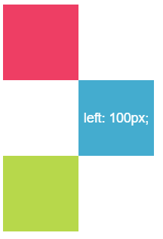
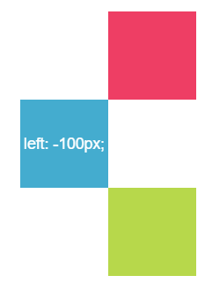
CSS POSITIONing
Similarly, left defines how far it’s offset from its original left edge.
Positive left values push an element right
Negative left values push an element left

Slide 19
POSITION: FIXED
position: fixed makes content “stick” to the browser window, regardless of where the user scrolls.
Commonly used to make headers, navigation menus, or sidebars that follow the page as it scrolls.
nav {
position: fixed;
left: 0;
top: 0;
}
Hard to describe, see a live demo

Slide 20
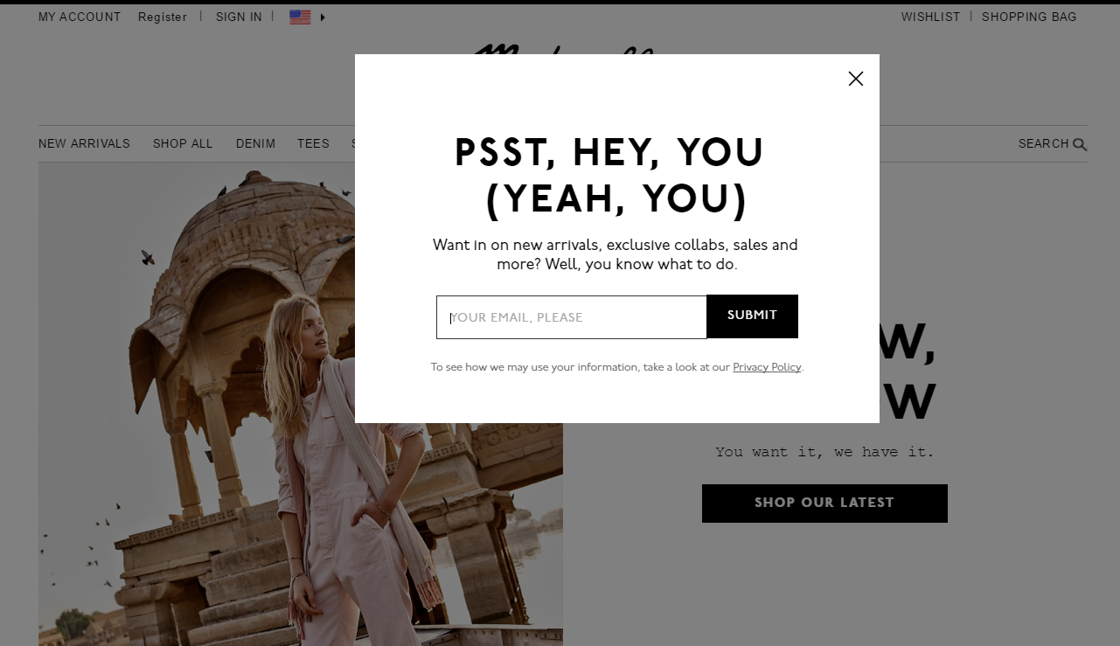
Fixed
This popup background uses position: fixed to grey-out the entire page, even if the user scrolls.

Slide 21
absolute
position: absolute is a powerful tool that allows you to place any page element exactly where you want it, down to the pixel.
When an element has position: absolute, it is entirely removed from the normal flow of the page.
That means its padding, margins, and borders no longer affect the elements around it

Slide 22
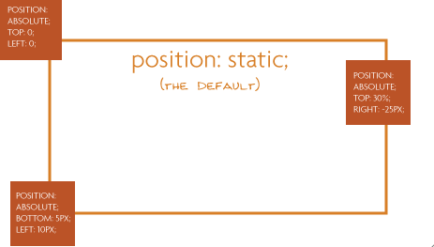
absolute
An element with position: absolute is absolutely positioned:
To its closest parent with positioning
Or (if it has no parents with positioning other than static), to the body of the page

Slide 23
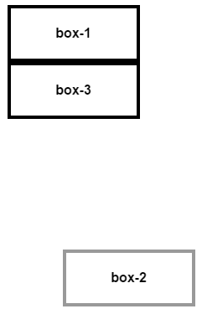
absolute
box-2 has the following style, which moves it to the bottom right of the page:
box-3 moves up to occupy the space
vacated by box-2
#box-2 {
position: absolute;
right: 10px;
bottom: 10px;
}

Slide 24

Absolute power
position: absolute is commonly used when creating page modals that pop up over other content

Slide 25
relative
position: relative allows you to move an element using directional attributes (top, bottom, etc).
If you set position: relative but no directional attributes, the element won’t change at all
If you set top: 10px; then it will be shifted 10 pixels down from where it would normally be

Slide 26
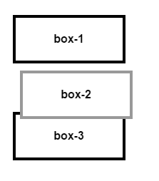
relative
box-2 has the following style, which moves it down and right:
The other boxes behave like box-2 was in its original position (unlike using negative margins).
#box-2 {
position: relative;
left: 10px;
top: 10px;
}

Slide 27
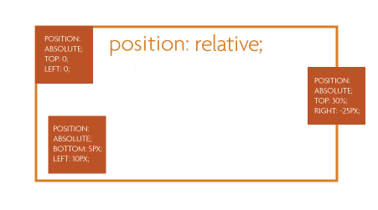
relative
More commonly, position: relative is used to position other absolutely-positioned elements inside the container

Slide 28

PRACTICE TIME!

Slide 29
ASSIGNMENT
Create a new page using this page as a template:
https://alistapart.com/d/css-positioning-101/example_a.html
Give at least one of the boxes relative positioning and apply left, top, etc.
Give at least one of the boxes absolute positioning.
Try putting a section around the boxes and give that relative positioning – what happens as you resize the browser?

Slide 30

Javascript/jquery
Javascript is a scripting language that developers use to manipulate the Document Object Model.
jQuery is a Javascript library for easily creating animations and interactions with very little code
Find elements on the page using CSS syntax

Slide 31
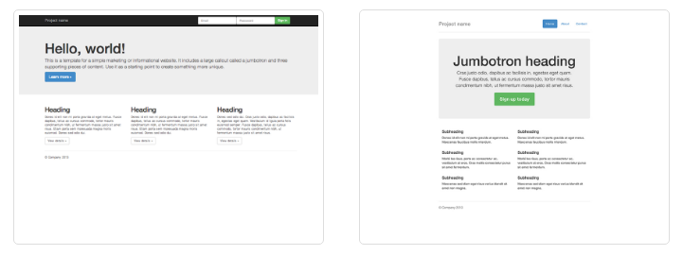
bootstrap
Bootstrap is a CSS library you can import into a project to quickly provide some base styles for your project.
http://getbootstrap.com/getting-started/

Slide 32
bootstrap
The main thing Bootstrap provides is a grid framework
http://getbootstrap.com/getting-started/

Slide 33
Thats ALL FOLKS!
Please provide feedback for this class!
http://svcseattle.com/evaluation

