Slide 1

INDIAN INSTITUTE OF INFORMATION TECHNOLOGY RANCHI
EARLY DIAGNOSIS AND COGNITIVE OUTCOME
PREDICTION OF POST-VIRAL
NEUROLOGICAL SYNDROMES
Brain MRI analysis and a proposed prediction framework
Researchers
Abhinav Kr Srivastava, 2023UG1070
Aishwary Dixit, 2023UG1049
Faculty Advisor
Dr. Dhiran Kumar Mahto

Slide 2
INTRODUCTION AND MOTIVATION
Post-viral neurological symptoms can persist after acute infection and affect memory, attention, and mental speed.
Clinical need
Why brain MRI?
Self-reported “brain fog” does not consistently match measured cognitive impairment.
Structural and diffusion measures may reveal subtle tissue changes missed by routine review.
Two tasks: identify current impairment; forecast cognition at a later follow-up from an earlier scan.
Evidence centers on SARS-CoV-2; other viral syndromes require separate validation.
2

Slide 3
LITERATURE SURVEY
Study | Main evidence | Prediction limit
Douaud et al., 2022 785 participants | Repeat MRI linked infection with brain change and greater average cognitive decline. | No individual forecast of later cognition.
Hosp et al., 2024 89 symptomatic patients | Diffusion microstructure related to cognition, smell, and fatigue. | Single center; concurrent assessment.
Seo et al., 2025 269 infected participants | Cognitive impairment associated with regional MRI and biomarker differences. | Cross-sectional analysis.
Rau et al., 2025 127 infected participants | Diffusion features classified current post-COVID condition (AUROC 0.95). | Small test group; different outcome target.
The reported AUROC measures discrimination in that study’s test split, not prediction of future cognition.
3

Slide 4
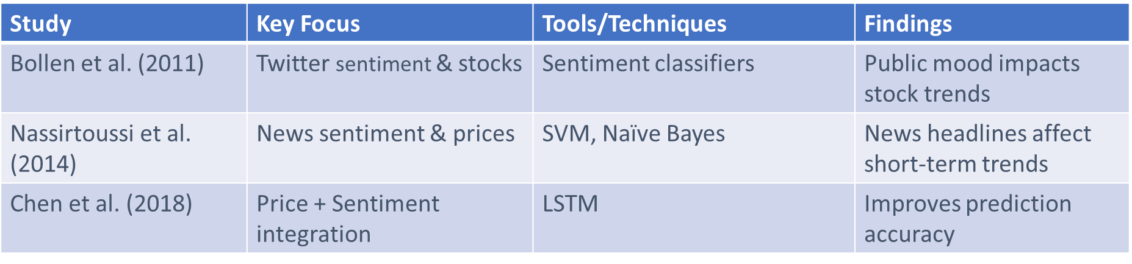
RECENT PROGRESS
2024
Contrast MRI detected blood–brain barrier differences in a small brain-fog cohort.
2025
Structural MRI, diffusion measures, and blood markers distinguished cognitive subgroups.
2026
Functional connectivity and longitudinal clinical modeling expanded the evidence base.
Key implication: better biological detail has yet to establish a reliable MRI forecast of later cognition.
4

Slide 5
RESEARCH GAP AND PROBLEM STATEMENT
Can MRI obtained early after infection improve prediction of cognition months later?
Temporal evidence
Generalizability
Outcome definition
MRI and cognition are often measured at roughly the same visit.
Small, single-center cohorts give uncertain performance elsewhere.
Post-COVID condition, brain fog, and objective cognitive deficit are different targets.
Transfer to other viral illnesses must be tested directly.
5

Slide 6
OBJECTIVES OF THE PROPOSED WORK
Identify concurrent cognitive impairment from a small, prespecified MRI feature set.
01
Measure improvement over an available demographic and clinical baseline.
02
Report sensitivity, specificity, AUROC, and uncertainty across repeated splits.
03
Extend to later cognitive outcome prediction when paired follow-up data become available.
04
6

Slide 7
HIGH-LEVEL TECHNICAL MODEL
INPUTS
PREPARE
MODEL
OUTPUT
MRI cortical thickness and diffusion features; age band, sex, time since infection
→
Handle missing values; scale and select features inside training folds
→
Regularized logistic regression; linear SVM benchmark
→
Pilot: probability of concurrent low MoCA (<26)
Future extension: use earlier MRI to predict a later cognitive score after longitudinal data and independent validation are available.
7

Slide 8
SOURCE OF THE TRAINING DATASET
Source | Available data | Proposed use
Open Dryad dataset | MoCA, cortical measures, whole-brain diffusion features | Train and evaluate concurrent screening pilot
Study cohorts by request | Participant-level MRI and clinical data, subject to approval | Potential external validation
UK Biobank | Repeat imaging and linked health measures, subject to access | Candidate longitudinal analysis after field review
The open file provides extracted MRI features, not raw scans. The reported symptomatic cohort has 89 participants; usable sample depends on missing values.
8

Slide 9
TRAINING ITERATIONS AND EVALUATION
5 folds × 10 repeats
Within each split
50 held-out evaluations
3-fold tuning of regularization
Preprocessing
Report
Scale and select MRI features only within each training fold to avoid data leakage.
AUROC, sensitivity, specificity, confidence intervals, and variation across repeats.
Repeated internal evaluation tests stability; an independent cohort is still needed.
9

Slide 10
CONCLUSION
MRI detects group-level brain differences associated with post-COVID cognitive symptoms.
A compact, interpretable model can test whether MRI improves current cognitive screening.
Prediction of later cognition needs earlier MRI, later testing, and independent validation.
10

Slide 11
REFERENCES
1.
Dayoung Seo et al. — Distinct brain alterations and neurodegenerative processes in cognitive impairment associated with post-acute sequelae of COVID-19
5.
Colin Greene et al. — Blood–brain barrier disruption and sustained systemic inflammation in individuals with long COVID-associated cognitive impairment
2.
Alexander Rau et al. — Cerebral microstructural alterations as an imaging biomarker for Post-COVID-condition
6.
Stina Hedström et al. — Brain connectivity and its relation to cognitive function in patients with post-COVID 19 condition after mild infection
3.
Gwenaëlle Douaud et al. — SARS-CoV-2 is associated with changes in brain structure in UK Biobank
7.
Julia Walders et al. — Longitudinal modeling of Post-COVID-19 condition over three years: A machine learning approach using clinical, neuropsychological, and fluid markers
4.
Jonas A. Hosp et al. — Cerebral microstructural alterations in Post-COVID-condition are related to cognitive impairment, olfactory dysfunction and fatigue
8.
Jonas A. Hosp et al. — Cerebral microstructural alterations in Post-COVID-condition are related to cognitive impairment, olfactory dysfunction, and fatigue [Dataset]
11

Slide 12
PROGRESS AND NEXT STEPS
Completed
Literature synthesis; research gap and objectives; dataset source; model and evaluation design.
Next
Check data completeness, train the screening pilot, and report repeated-validation performance.
Later
Obtain paired follow-up data and test future cognition prediction in an independent cohort.
GitHub URL: [Add repository URL]
12

