Slide 1
MyEducator
An innovation by Stinë Demolli and Vesë Vrellaku

Slide 2
Our Vision…
Our educational system is overcrowded by unnecessary material which is usually hard to understand, and sometimes even hard to find. We are offering a platform to help students and teachers close this gap between learning and teaching.

Slide 3
What does MyEducator offer?
01
Accessibility
Available app at anytime anywhere!
02
Thorough Planning
Creating detailed syllabuses for teachers.
03
Detailed Explanation
Comprehensive explanation on any subject
04
Various Tests
Testing or strengthening the students knowledge

Slide 4
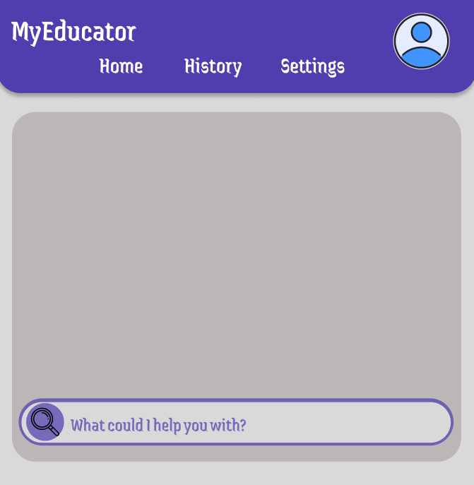

Slide 5
Thank you!
Do you have any questions?

