Slide 1
Peer to Peer Lending: Optimal Decisions for Investors and Lending Companies
Jacob Stinnett
May 3, 2016

Slide 2
Background
Various companies created to crowdfund personal loans (Lending Club, Prosper, etc).
How to best identify good/bad loans?
How do different sites compare?
What information matters? What is the “best” site?
Can we improve on company’s internal score?
How do investment strategies compare?

Slide 3
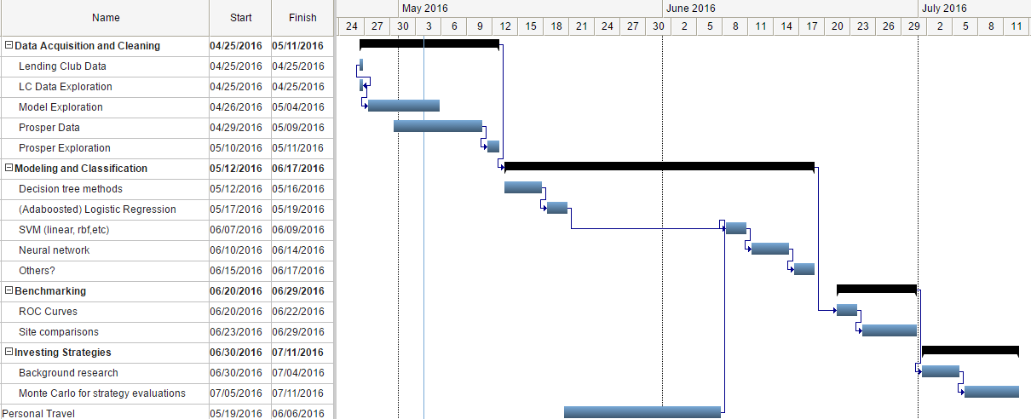
Research Plan

Slide 4
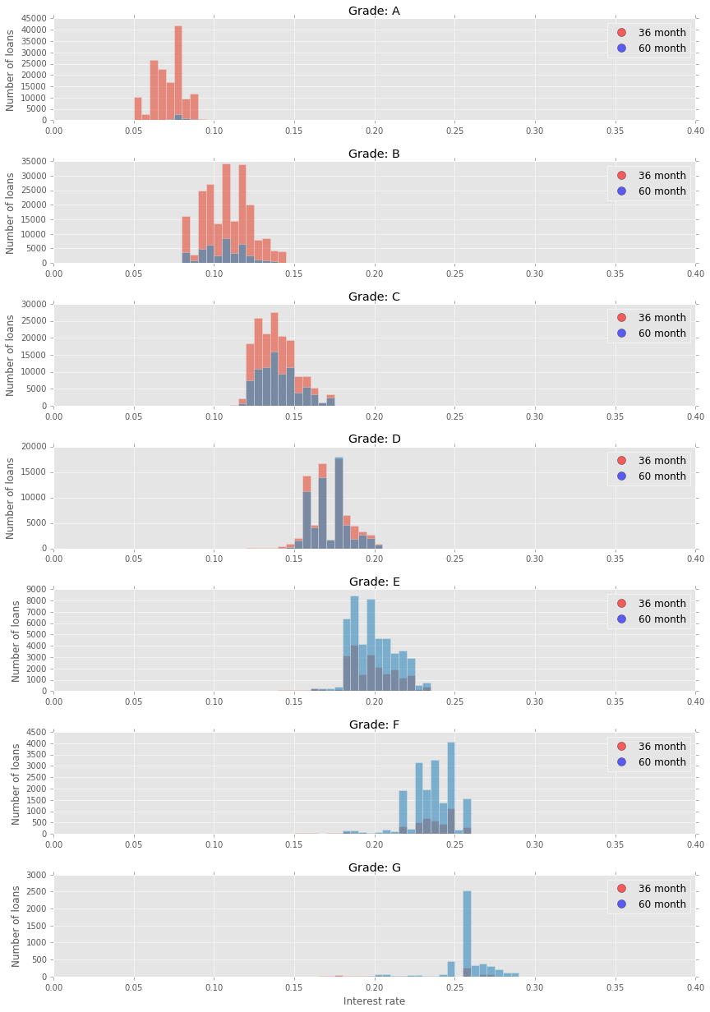
Previous Work
Lending Club (LC) data acquisition/prep
Exploratory analysis
Early tests of various classifiers (limited dimensions)

Slide 5
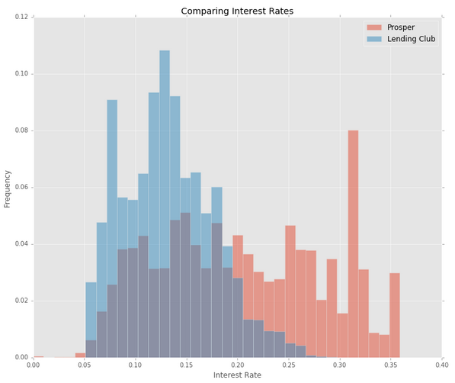
Progress
Obtained Prosper data
Database merging problem: loan histories and loan applications don’t have matching identifiers
Less records than LC (~100k vs 800k) but much more application data
 | Lending Club | Prosper
Records | 800k | 100k
Useful columns | 100 | 500
Max Interest | 29% | 36% *
Bad loan rate | 6.10% | 13.80%

Slide 6
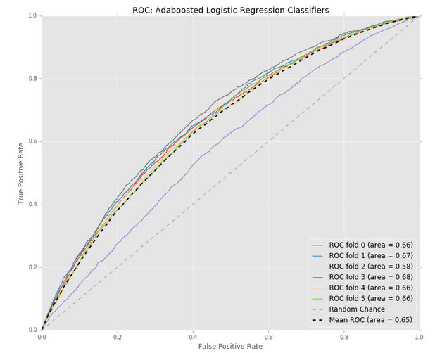
Preliminary Classification Results: LC
Lending Club data, 32 features
However, ROC curve may not be the best metric for performance evaluation!

