Slide 1
State Machines & Regular Expressions

Slide 2
Introduction

Slide 3
Outline
Motivation
Terminology
Finite Automata & Regular Languages
RegEx
Finite State Transducers
Modelling State Machines in Python
RegEx in Python
More Theory

Slide 4
Motivation
Sometimes limiting your power is good!
Many problems lend themselves to being modelled as state machines
TCP/IP
CPUs
Regexes, regexes, regexes!
CS theory baby steps

Slide 5
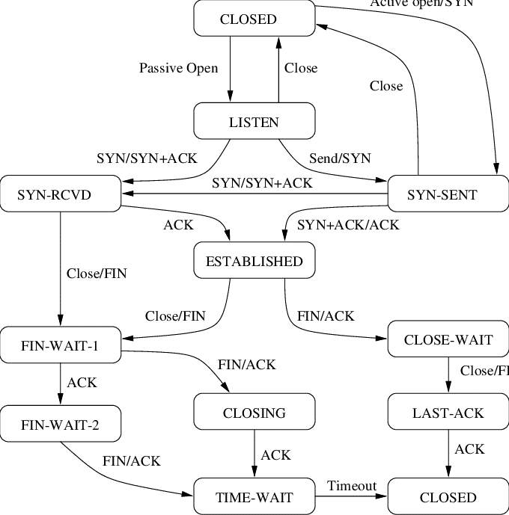
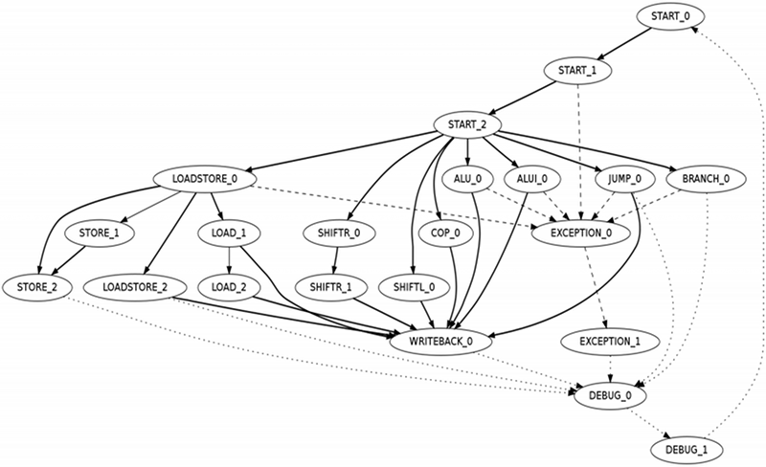
CPU
TCP/IP

Slide 6

Terminology: Sets & Sequences
Sets: Collections of objects; order does not matter and repetition is meaningless
$\left\{1,2,3\right\}$
$\{\left\{a,b,c\right\}, \{x,y,z\}\}$
$\left\{1,2,3\right\}=\left\{1,3,2\right\}=\{1,2,2,3\}$
Sequences: Collections of objects; order matters and repetition is meaningful
$\left(1,2,3\right)$
$\left(1,2,3\right)≠\left(1,3,2\right)≠(1,2,2,3)$

Slide 7

Terminology: Functions
Associate each object in a set (domain) to at most one object in another set (range)
Two objects in the domain may be associated to the same object in the range
An object in the domain may be associated to only one object in the range
Not all objects in the range may be associate-to by an object in the domain
$f :A →B$, is the notation for a function from (the set) $A$ to (the set) $B$

Slide 8

Terminology: Strings & Languages
String: Any sequence of characters drawn from a set of symbols (conventionally $Σ$)
Language: A non-empty set of strings
For $Σ=\{a,b,c,d\}$
$abcd$, $acccdba$, $a$, are all strings
$ε$ is the empty string
$L_{1}=\left\{abcd, abbccdd\right\}, L_{2}=\left\{a, b, bb, c, cc, ccc\right\}$, and $L_{3}=\{ε\}$ are examples of languages

Slide 9
Finite Automata & Regular Languages

Slide 10
Finite Automata

Slide 11
Example: Even Number

Slide 12
Regular Languages

Slide 13
RegEx

Slide 14
What is a RegEx

Slide 15
RegEx Blitz

Slide 16
Finite State Transducers

Slide 17
Finite State Transducers

Slide 18
Example: Video Game NPC

Slide 19
Exercise: Video Game NPC – Add Bribery Mechanism

Slide 20
Applications

Slide 21
Modelling State Machines in Python

Slide 22
RegEx in Python

Slide 23
More Theory

Slide 24
Non-Deterministic FSA

Slide 25
Equivalence of DFAs and NDFAs

Slide 26
Closure of Regular Languages under the Regular Operations

Slide 27
Markov Chains

Slide 28
Non-Regular Languages

Slide 29
Exercises

