Slide 1
State Machines & Regular Expressions

Slide 2
Introduction
What is a computer? What does it mean to compute?
How do we talk about computation in a grounded manner
i.e., unambiguous and rigorously defined
What is a model of a computer? What are the different models of computation
Why would we choose one model of computation over another?

Slide 3
Outline
Motivation
Terminology
Finite Automata
Regular Languages
RegEx
Finite State Transducers
Modelling State Machines in Python
RegEx in Python
More Theory

Slide 4
Motivation
Sometimes limiting your power is good!
Many problems lend themselves to being modelled as state machines
TCP/IP
CPUs
Regexes, regexes, regexes!
CS theory baby steps

Slide 5
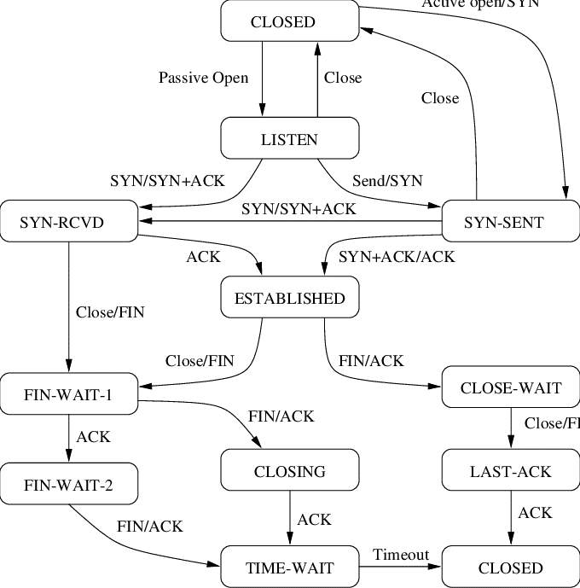
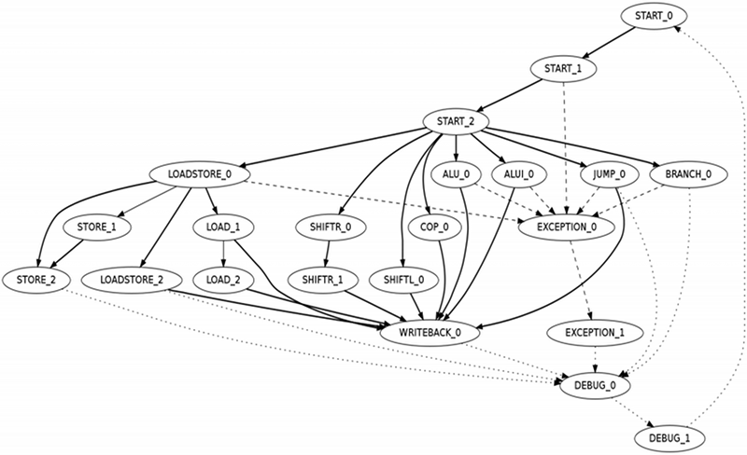
CPU
TCP/IP

Slide 6

Terminology: Sets & Sequences
Sets: Collections of objects; order does not matter and repetition is meaningless
$\left\{1,2,3\right\}$
$\{\left\{a,b,c\right\}, \{x,y,z\}\}$
$\left\{1,2,3\right\}=\left\{1,3,2\right\}=\{1,2,2,3\}$
Sequences: Collections of objects; order matters and repetition is meaningful
$\left(1,2,3\right)$
$\left(1,2,3\right)≠\left(1,3,2\right)≠(1,2,2,3)$

Slide 7

Terminology: Functions
Associate each object in a set (domain) to at most one object in another set (range)
Two objects in the domain may be associated to the same object in the range
An object in the domain may be associated to only one object in the range
Not all objects in the range may be associate-to by an object in the domain
$f :A →B$, is the notation for a function from (the set) $A$ to (the set) $B$

Slide 8

Terminology: Strings & Languages
String: Any sequence of characters drawn from a set of symbols, or alphabet, conventionally denoted $Σ$
Language: A non-empty set of strings
For $Σ=\{a,b,c,d\}$
$abcd$, $acccdba$, $a$, are all strings
$ε$ is the empty string (Note $Ø≠\{ε\}$)
$L_{1}=\left\{abcd, abbccdd\right\}, L_{2}=\left\{a, b, bb, c, cc, ccc\right\}$, and $L_{3}=\{ε\}$ are examples of languages

Slide 9
Finite Automata & Regular Languages

Slide 10
Finite Automata
A limited form of computation
Models computation that takes constant memory
States
Initial state
Final state(s)
Alphabet
Transitions
What does it mean for a finite automaton to compute?

Slide 11
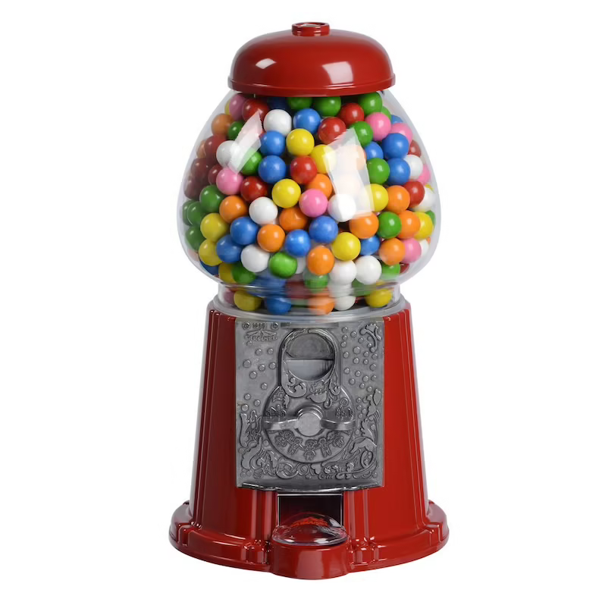
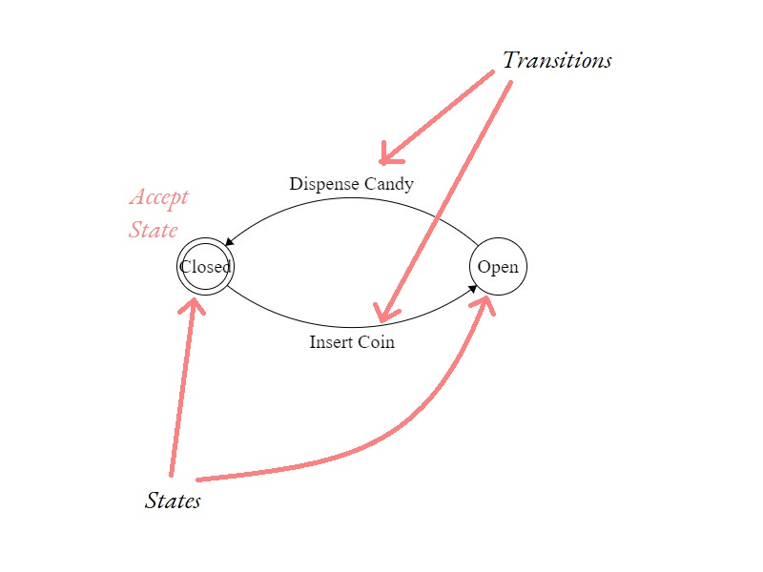
Intuitive Definition

Slide 12

Formal Definition
$M$=$(Σ, Q, q_{0}, F, δ)$, a finite state automaton
$Σ$ – Alphabet / set of symbols
$Q$ – (non-empty , finite) set of states
$q_{0}$ - start state
$F$ – set of accepting states
$δ :Σ ×Q →Q$ – transition function
Computation is defined in terms of strings that a machine accepts. $M$ accepts a string $w_{1}w_{2}…w_{n}$if a sequence of states $r_{0}r_{1}…r_{n}$exists in $Q$ such that
$r_{0}=q_{0}$
$δ\left(r_{i},w_{i+1}\right)=r_{i+1}$ for $i=1,2,…n−1$ and
$r_{n}∈F$
$M$ is said to accept a language $L$ if it accepts all strings in $L$

Slide 13
What makes an FSA finite
What can a finite automata do?
Where am I? (current state)
What just happened? (input)
Specifically, it cannot —
Choose inconsistently
Decide "at runtime" where to transition
"Remember" previous input
Know if/when the end of the input is coming

Slide 14
Example: Even Number
A state machine that recognizes when a binary string represents an even number

Slide 15
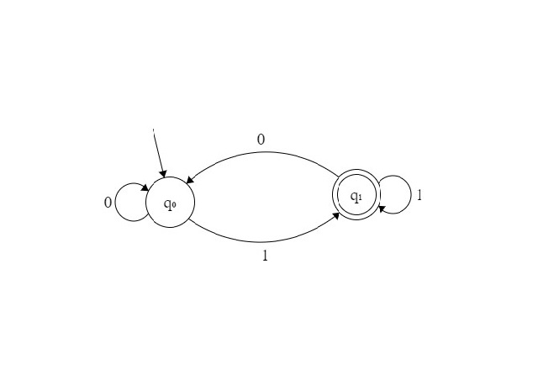
Example: Even Number
A state machine that recognizes when a binary string represents an even number

Slide 16
Remember
There must be start state
Each state must have an arrow going out of it for each symbol in the alphabet
There may or may not be an accept state (although, not having one is not very useful)
Each state can have at most one outgoing arrow for each symbol in the alphabet

Slide 17

Exercise: Even Binary
Design a state machine that checks if a binary number has an even number of ones. $Σ$ $=$ $\{0,1\}$
Hint: You do not need the machine to count how many ones there are in the string, just whether or not it has an even number of ones

Slide 18
Regular Languages
Languages recognized by a finite automaton
What does it mean for a language to be recognized by an automaton
Equivalent to finite automata
One-to-one correspondence
What makes a regular language regular?
Exactly what makes a finite automaton finite

Slide 19
Regular Expressions
An algebra for regular languages
The regular operations –
Union
Kleene Star
Concatenation
Construct bigger regular languages from smaller regular languages

Slide 20

Regular Expression
$R$ is a regular expression if $R$ is ($R_{1}$ and $R_{2}$ are other regular expressions)
$a$ for some $a ∈Σ$
$ε$
$Ø$
$(R_{1}∪R_{2})$
$(R_{1}∘R_{2})$
$(R_{1}∗)$

Slide 21
RegEx

Slide 22
What is a RegEx
One of the most useful things FSAs do is recognize patterns in strings
This is almost a literal programming equivalent of language recognition
RegEx evolved out of regular expressions, but have diverged significantly since
Most common implementations can recognize more than just regular languages

Slide 23
RegEx Blitz
Strings (.)
Character Classes ([], ^)
Repetition (?, *, +, {n}, {n,},{,m},{n,m})
Pre-defined character classes (\d, \D, \s, \S, \w, \W)
The Regular Operations (concatenation, alternation)
Anchors (^,$)

Slide 24
Finite State Transducers

Slide 25
Finite State Transducers
Finite automata with a notion of "output"
What does it mean for a transducer to compute?
Transducers establish relations between sets of strings (languages)
Formal definition
Applications
Mostly computational linguistic
Compilers - lexing

Slide 26

Formal Definition
$M$=$(Σ, Γ, Q, q_{0}, δ)$, a finite state transducer
$Σ$ – Alphabet
$Γ$ – Output alphabet
$Q$ – (non-empty, finite) set of states
$q_{0}$ - start state
$δ :Σ ×Q →Q ×Γ$ – transition function
Computation is repeated application of $δ$ to a sequence of symbols, from a starting state, to generate an output string

Slide 27
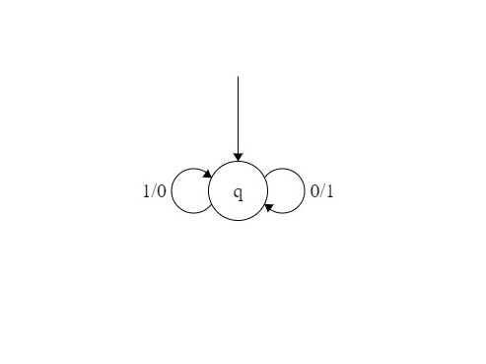
What does this do?

Slide 28

Example: Video Game NPC
A finite state transducer that models a video game NPC for a turn based game. The scenario - the player is an adventurer and the NPC is a castle guard.
$Σ=\left\{TALK, ATTACK\right\}$
$Γ=\{TALK, ATTACK\}$

Slide 29

Exercise: Video Game NPC – Add Bribery Mechanism
Add a bribery mechanism to the guard –
When bribed, the guard should --
Stop attacking, if currently attacking
Open gate, if the player has never attacked the guard
Talk, if the player has ever attacked the guard
$Σ=\{TALK, BRIBE, ATTACK\}$
$Γ=\{TALK, OPEN GATE, ATTACK\}$

Slide 30
Applications

Slide 31
Modelling State Machines in Python
Five iterations, each demonstrating a general software design principle
1 is the basic implementation
2 gives us encapsulation
3 gives us more structure
4 gives us reusability
5 gives us "type safety" and error handling

Slide 32
Exercise: Video Game NPC
Using what we learned, implement a finite state transducer that models the video game NPC (either version).

Slide 33
RegEx in Python
Python’s standard library has the module re which provides RegEx functionality
Basic workflow
import re
compile
match/search/findall/finditer
Match Objects
group/start/end/span

Slide 34
More Theory

Slide 35
Non-Deterministic FSA
Jump to many states “at once” while consuming a single symbol
Makes many state machines simpler to design (but more complex to implement)
Equivalent to (i.e., no more powerful than a deterministic FSA)

Slide 36
Closure of Regular Languages under the Regular Operations
Non-Deterministic FSAs lead to elegant proofs of the closure of regular languages under the regular operations

Slide 37
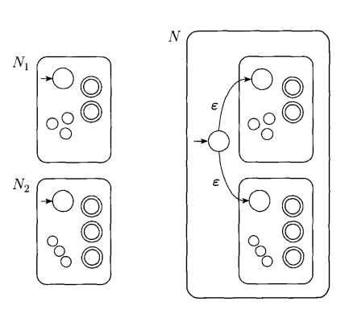

$$N=N_{1}∪N_{2}$$

Slide 38
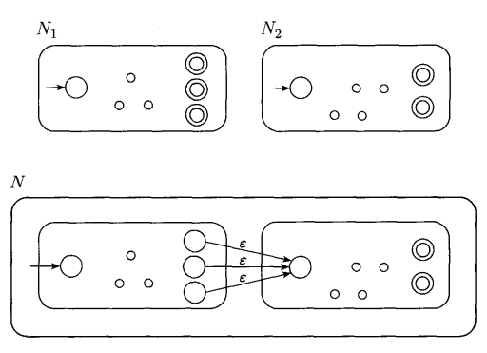

$$N=N_{1}∘N_{2}$$

Slide 39
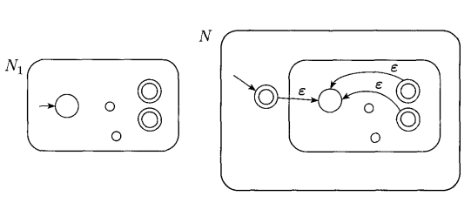

$$N=N_{1}∗$$

Slide 40
Markov Chains
Weighted FSA
Transitions are tagged with probabilities
Primitive text generation
Google’s PageRank

Slide 41
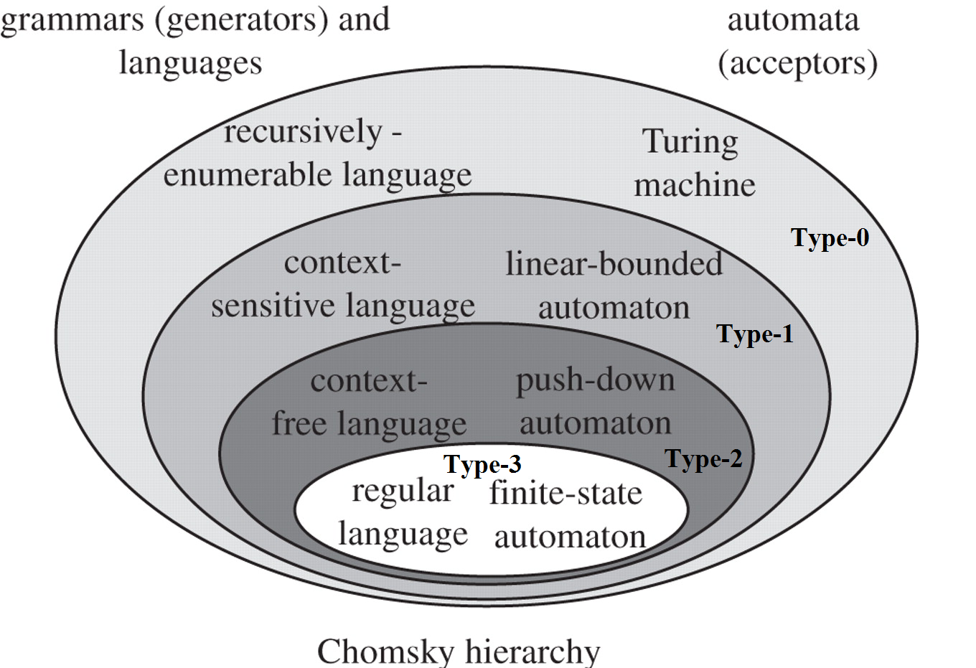
Non-Regular Languages
Some languages cannot be recognized by FSA (non-deterministic or otherwise)

Slide 42
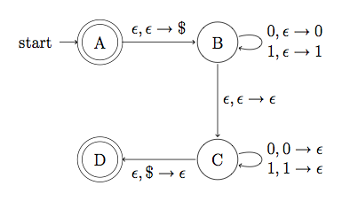
Other Models of Computation
Pushdown Automata (Recognizes context-free languages)

Slide 43
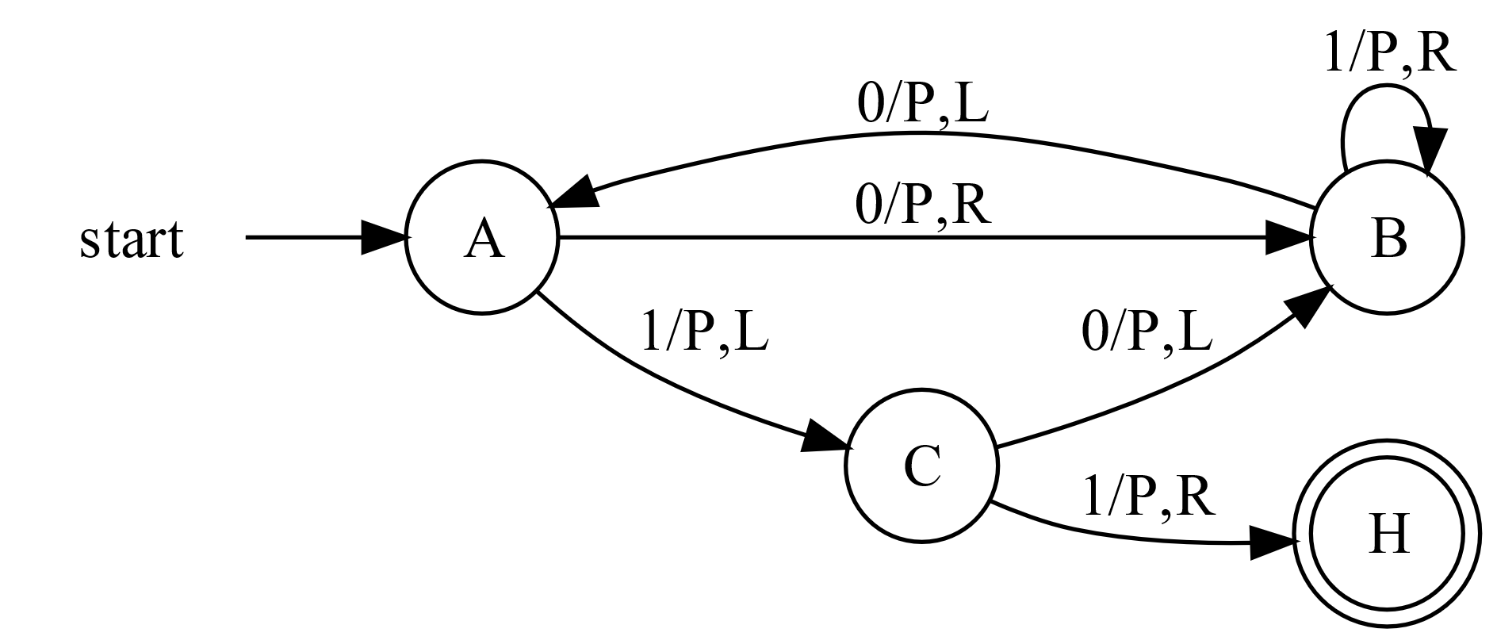
Other Models of Computation
Turing Machine (Recognizes recursively enumerable languages)

Slide 44
web.stanford.edu/class/archive/cs/cs103/cs103.1142/button-fsm/
raganwald.com/2018/02/23/forde.html
"Introduction to the Theory of Computation“, Part 1, Chapter 1, Sipser.
regexr.com
docs.python.org/3/library/re.html
www.regular-expressions.info/
https://cstheory.stackexchange.com/a/14818
inst.eecs.berkeley.edu//~cs150/fa05/CLD_Supplement/chapter11/chapter11.doc3.html

