Slide 1

AI Based E-commerce Platform (StitchSmart)
SUPERVISOR: SIR TANVEER AHMED
DEPARTMENT OF COMPUTER SCIENCE | UNIVERSITY OF CENTRAL PUNJAB (UCP)
Group Member Name | Registration No
MOIZ AHMED | S3F22UBSCS008
BISSMA IJAZ | S3F22UBSCS025
ALI HAIDER | S3F22UBSCS091
FYP Internal Evaluation Presentation
Academic Session Spring 2026
1
17 JULY 2026

Slide 2



Introduction
Problem Domain
Typical clothing websites lack custom design tools, product comparison, automated return management, and 24/7 customer assistance..
Most online clothing stores today are very basic. Customers cannot compare clothes, face difficult return processes, cannot design clothes, and rarely get instant customer support.
StitchSmart solves all these problems by creating an all-in-one AI-Assisted E-Commerce Store.
Academic & Industry Relevance
Solves real-world shopping problems by combining modern AI features with local Pakistani retail needs
Project Scope
A complete web store built with PHP & MySQL combined with Python.
Department of Computer Science | FYP |
2

Slide 3
Problem Statement
Most online clothing stores today still rely on simple, outdated websites that do not meet the smart needs of modern shoppers.
Without features like side-by-side Product Comparison, a clear Return & Refund System, custom Design Studio, or a 24/7 AI Chatbot.
Customers cannot easily compare fabric quality, pricing, colors, and sizing of two clothes side-by-side on typical websites.
Store Admins waste hours manually writing product descriptions and struggle to track low stock.
Returning clothes is a confusing, manual process without automated tracking.
Department of Computer Science | FYP |
3

Slide 4
Objectives
To build a complete and secure e-commerce website using PHP & MySQL connected with Python & Google AI for smart online features.
Main Objective | What Our System Does
1. Web Store | Builds a fast online clothing store
2. Design Studio | Provides an interactive design tool
3. Smart Chatbot | Integrates an AI-powered chatbot that answers customer questions
4. Admin Automation | Uses AI to automatically generate product descriptions and sends emails
5. Bug-Free Testing | Performs testing to ensure website is fast
To save time by using AI to automatically write product descriptions, track low stock, and answer customer questions 24/7.
To test website with real users and verify that everything runs fast without any errors.
Department of Computer Science | FYP |
4

Slide 5
Existing Systems
Gaps & References
Shopify: Dependent on costly third-party without AI chatbot.
WooCommerce: No live product customization.
Printful: Overwhelming B2B drop-shipping interface.
CustomInk: Lacking localized payments and AI automation.
Lack of Interactive Customization Tools: Online stores display static product images (Ahmed & Tariq, 2022).
Absence of Real-Time RAG AI Assistants: E-commerce chatbots are predefined (Khan & Raza, 2023).
Heavy Manual Workload for Administrators: Existing platforms require administrators to manually create product descriptions (Fatima et al., 2021).
Lack of an Integrated AI-Powered Local E-Commerce Platform: Current solutions do not combine interactive apparel customization and intelligent customer support (Hussain & Ali, 2023).
5

Slide 6
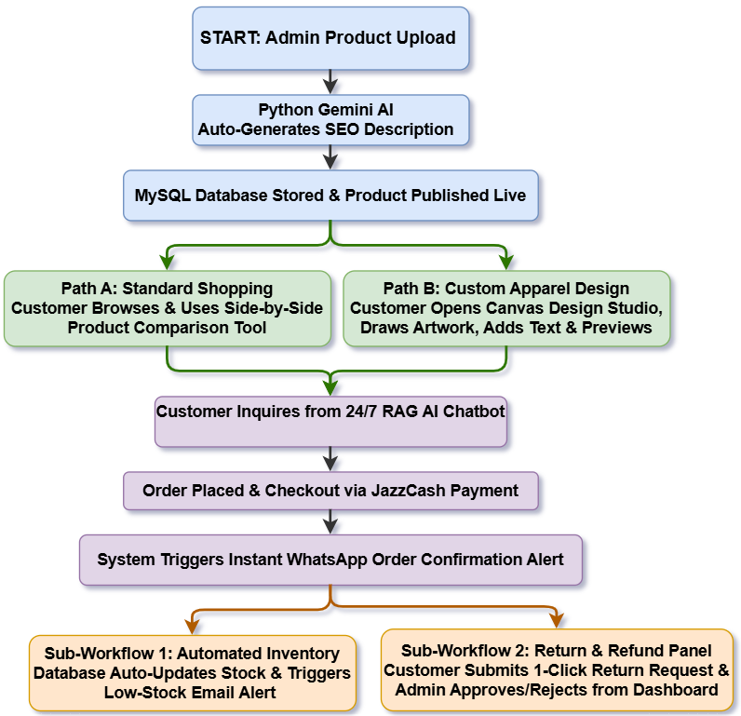
Proposed Solution
Proposed System: StitchSmart is an online store where customers can design clothes, and owners can manage orders.
Key Features:
Interactive Design Studio
24/7 AI Chatbot
Automatic product description generator
JazzCash payments
Automated low-stock email alerts
Innovation: This solution incorporate customization, comparison, product descriptions, automated low-stock alerts, return portal
Department of Computer Science | FYP |
6

Slide 7
Methodology
Development Methodology: A step-by-step approach was followed to design, build, and test website in small stages.
In this project, we built StitchSmart step-by-step using reliable web technologies. We first created customer shopping pages, then added admin management tools, and tested every feature carefully to make sure website runs without any errors.
Technologies & Tools:
Frontend Languages: HTML5,CSS3 and JavaScript.
Frontend Framework: Bootstrap
Backend Logic: PHP
Database Management: MySQL
Third-Party Integrations: PHPMailer and JazzCash Sandbox
AI/ML Frameworks: Google Gemini AI, LangChain, Sentence Transformers, FAISS
Department of Computer Science | FYP |
7

Slide 8
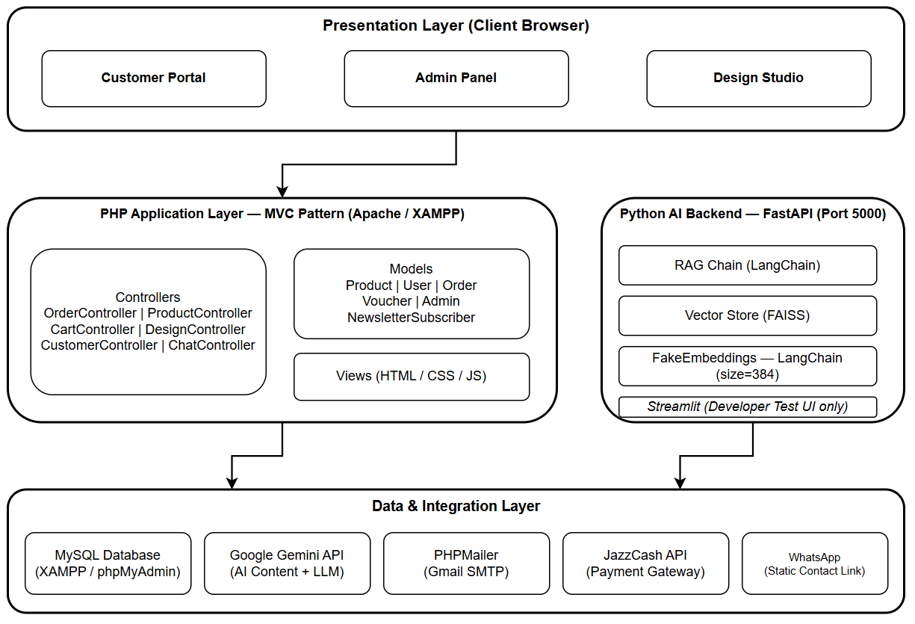
System Design – I
Architecture Diagram
Department of Computer Science | FYP |
8

Slide 9
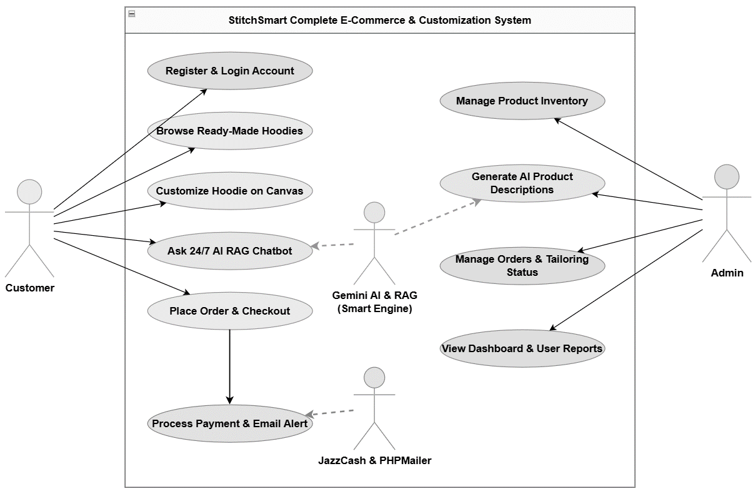
System Design – I
Use Case Diagram
Department of Computer Science | FYP |
9

Slide 10
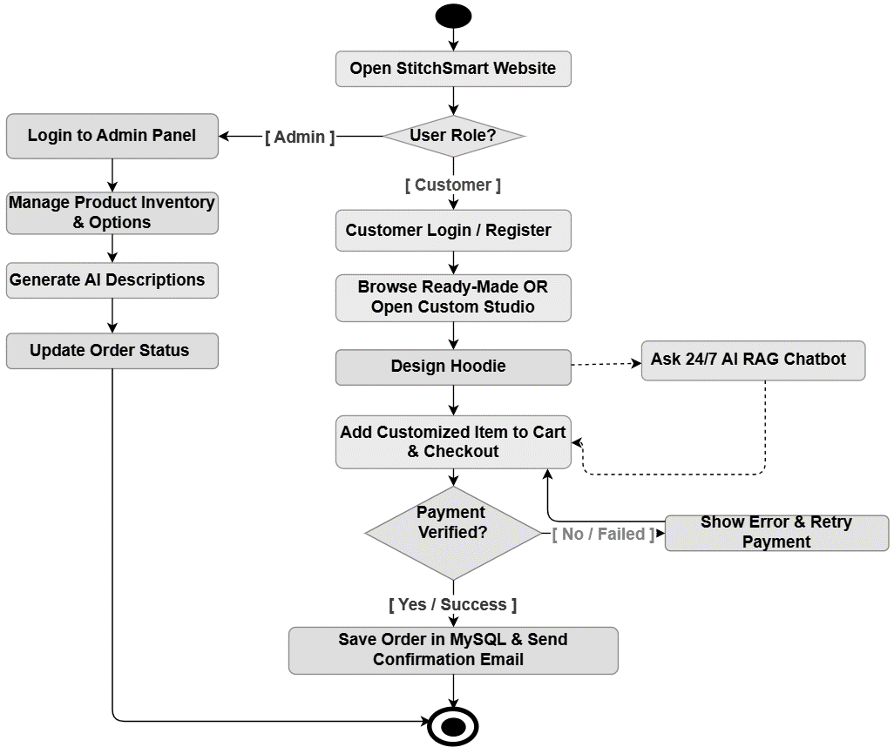
System Design – II
Activity Diagram
Department of Computer Science | FYP |
10

Slide 11
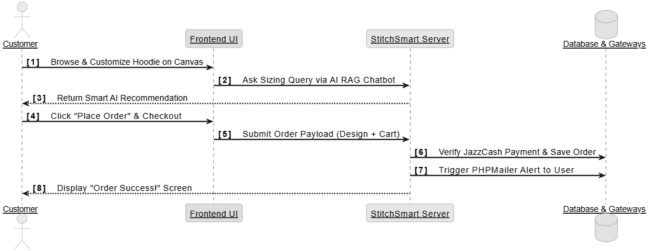
System Design – II
Sequence Diagram
Department of Computer Science | FYP |
11

Slide 12
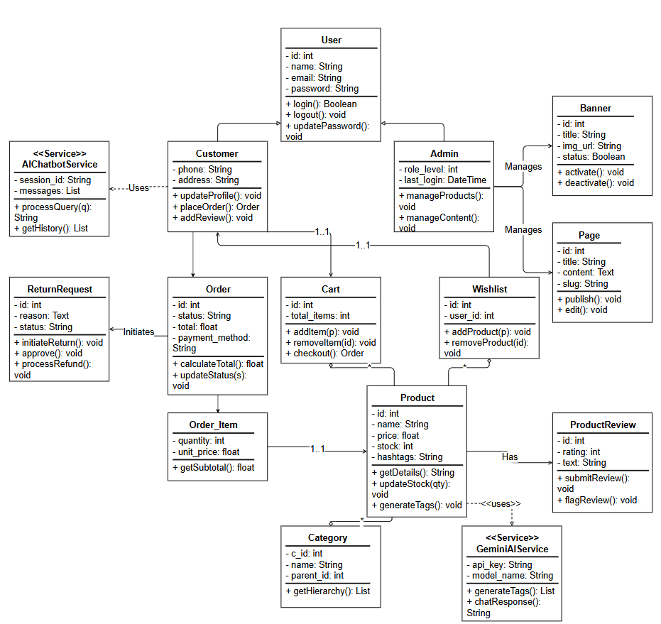
System Design – III
Class Diagram
Department of Computer Science | FYP |
12

Slide 13
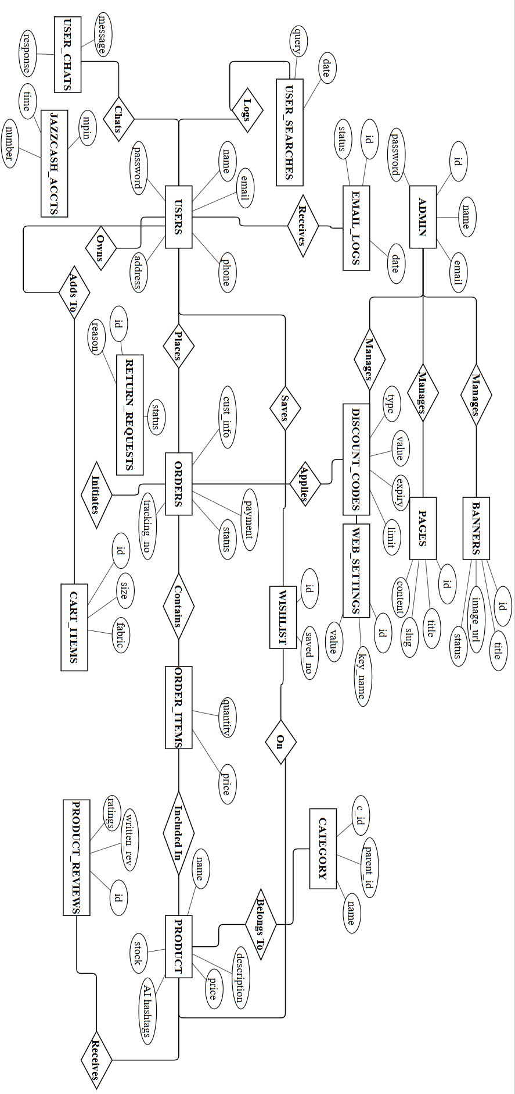
System Design – III
ER Diagram
Department of Computer Science | FYP |
13

Slide 14
Implementation Progress – I
Completed Modules
User Registration Module
Database Schema Design & Setup
Core Backend API Development
Admin Dashboard UI implemented successfully.
This slide presents final development status of our e-commerce system. We are proud to report that 100% of planned development work has been successfully completed.
Current Development Status
Project modules have fully developed. Unit testing for Chatbot workflows have been successfully completed.
Milestones Achieved
System architecture approved, Live Customization UI developed and AI RAG Chatbot deployed successfully.
Department of Computer Science | FYP |
14

Slide 15
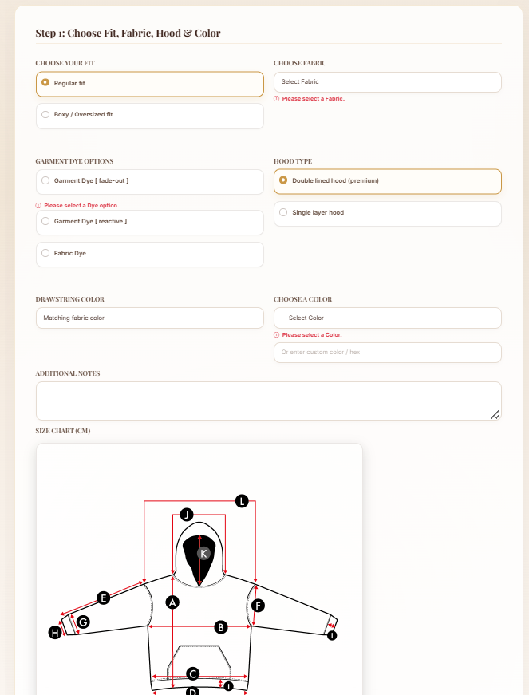
Implementation Progress – II
The following screenshots illustrate core modules developed, including our Interactive Custom Hoodie Design Canvas, intelligent 24/7 AI RAG Chatbot, and the Admin Inventory Control Dashboard.
Figure 1: Interactive Custom Hoodie Design Canvas illustrating live product customization, color selection, and real-time visual rendering.
12
Department of Computer Science | FYP | 15

Slide 16
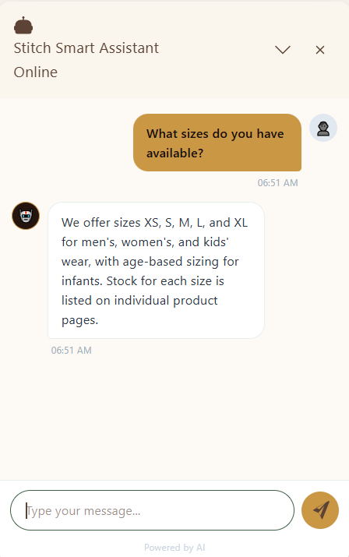
Implementation Progress – II
The following screenshots illustrate core modules developed, including our Interactive Custom Hoodie Design Canvas, intelligent 24/7 AI RAG Chatbot, and the Admin Inventory Control Dashboard.
Figure 2: 24/7 AI RAG Chatbot assisting users with instant sizing recommendations and tailoring queries.
12
Department of Computer Science | FYP | 16

Slide 17
Testing
Types of Testing: Unit testing was performed on individual core modules. Functional testing validated specific system features against project requirements.
This section outlines testing strategies used to verify performance of StitchSmart. Rigorous multi-level testing was performed to ensure that the custom e-commerce workflows and automated email alerts operate seamlessly for all users.
Sample Test Cases: User authentication tested with credentials. API payload tested for limits. End-to-end checkout data flow tested from cart to admin database .
Test Findings & Stability: All test cases for AI Chatbot passed successfully. Minor data-sync bugs identified during PHP-MySQL integration testing were resolved.
Department of Computer Science | FYP |
17

Slide 18
Challenges Faced
Solutions Applied
AI Chatbot Accuracy: Chatbot initially gave irrelevant and out-of-context responses to user.
Canvas Performance: Real-time hoodie customization with color, text, and logo updates caused slow rendering on low-end devices.
Database Complexity: Designing a relational database that efficiently links users, orders, and product inventory was complex.
Email Delivery Issues: Automated order confirmation emails were not being sent reliably.
AI Chatbot Accuracy: Implemented RAG with a custom store knowledge base to restrict and improve chatbot responses.
Canvas Performance: Optimized HTML5 Canvas API for smooth preview.
Database Schema Design: Created a normalized MySQL schema with proper foreign key relationships to manage all data tables.
Email Delivery Issues: Configured PHPMailer with SMTP credentials for reliable email automation.
14
Department of Computer Science | FYP | 18

Slide 19
Future Work
Remaining Tasks: Integrate a live payment gateway to replace current dummy checkout, expand Chatbot knowledge for broader query coverage
This section outlines planned next steps and future enhancements for StitchSmart. The following goals will guide platform's growth beyond the Final Year Project scope.
Development Roadmap: Short-term goals include replacing dummy payment with a JazzCash gateway. Mid-term goals focus on building mobile app for Android.
Long-Term Goals: Scale into a multi-vendor marketplace for designers, introduce personalize style recommendations, and explore opportunities in Pakistan.
Department of Computer Science | FYP |
19

Slide 20
Conclusion
StitchSmart delivers a complete e-commerce experience from AI-assisted browsing to secure order placement and real-time admin management
StitchSmart successfully addressed gap in Pakistan's custom clothing market by delivering a fully functional e-commerce platform with AI-powered assistance, interactive product customization, and seamless order management.
StitchSmart is fully tested, and successfully deployed. Implementation stands at a completed state across all core modules.
StitchSmart has potential for real-world impact in Pakistan's fashion e-commerce market. Future enhancements can further extend value for customers.
Department of Computer Science | FYP | 20

Slide 21
Thank You
WE WELCOME YOUR QUESTIONS AND FEEDBACK.
17
Department of Computer Science | FYP | 21

