Slide 1
Temperature and Inverter Monitoring
University of Trento Embedded Software for the Internet of Things
Ettore Saggiorato
Stiven Sharra
Prof. KASIM SINAN YILDIRIM

Slide 2
1. Problem Statement:
Make a non IoT device an IoT device
Automate room temperature management

Slide 3
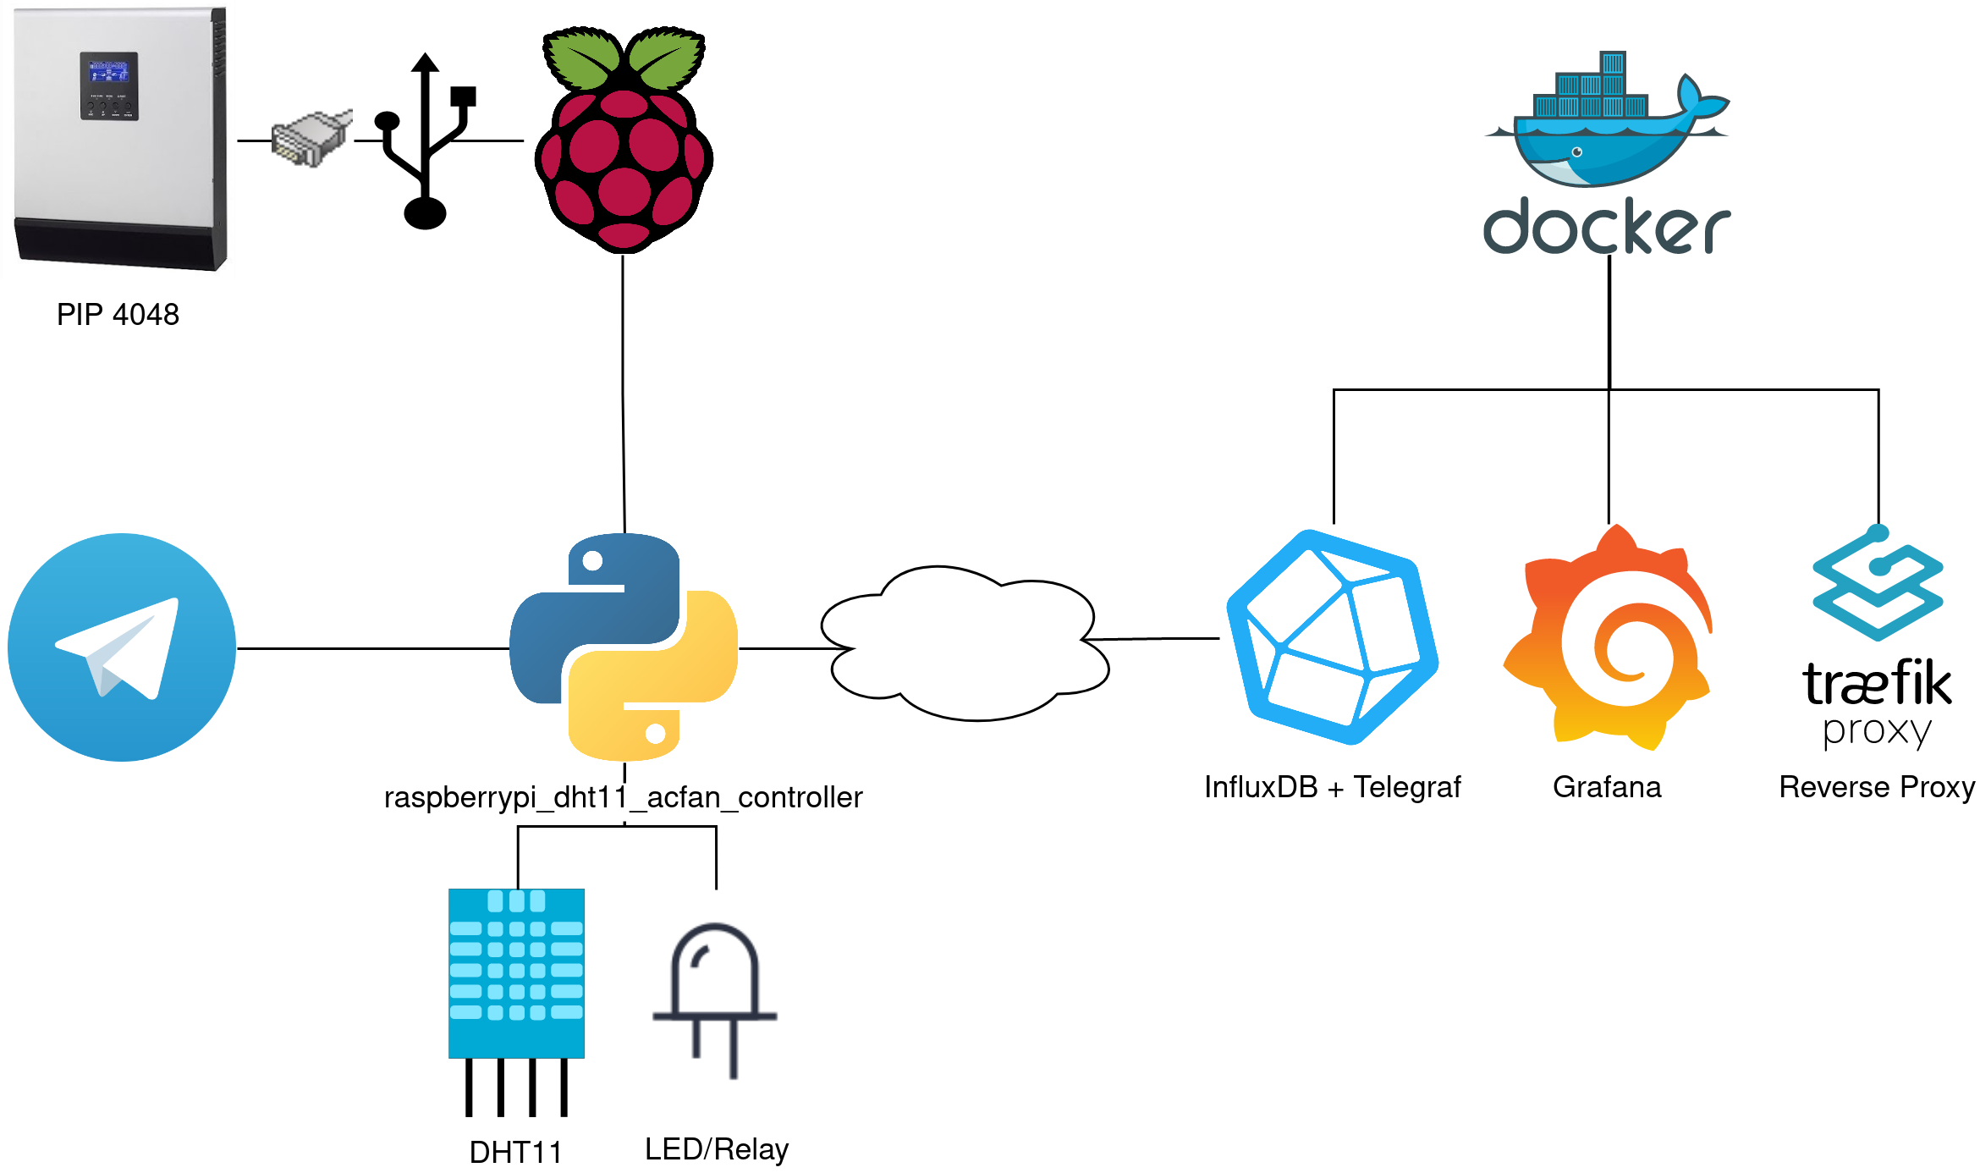
2. Basic Working Scheme
¡ Show some pictures (at least one) of your system.

Slide 4
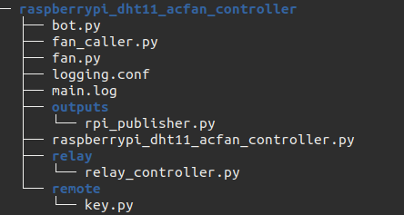
3. Software Architecture
When SIGTERM/KILL is received from the program:
Telegram’s thread kills itself, sends SIGUSR1 to fan_caller
fan_caller’s thread cleans GPiO and exit
Threads communicate with a queue of fan status

Slide 5
4. Problems and Testing
Problems
Testing
DHT11’s library discontinued
RJ45-USB com cable
Issues solved asking on forums
Software was tested on the field and with virtual variables
For safety a led was used instead of a relay

Slide 6
5. Conclusions and Future Work
Make more responsive RaspberryPi-DHT11’s package
Add a Buzzer that rings when Active Power (AC) overshoots a threshold
Add sensors in other rooms to monitor temperature and humidity

