Slide 1


Digital and Cognitive Transformation

Slide 2







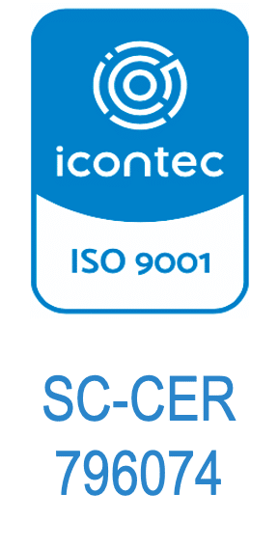






We make things easier with technology.
SVC/DEV
2023
5 Countries
200 Clients
1000 Projects
200 Employees
2022
2021
2020
2019
+Software Factory
+Data Unit
+Exports USA
2018
Mobile
2017
2011
2012
2014
2015
2016
2013
SC–CER763134
SI–CER763135
+Consulting
+Dedicated Teams

Slide 3














Our Partners

Slide 4










Our Formula
Idea
Solution
Solution Design Lab
UX Innovation
Process Fitness
Analysis & Design
Agile Transformation
Build Lab
Coding
Low Code
Integration
Mobile
Testing
DevOps
Go Live Lab
Cloud
Admin Apps
ITO Cybersecurity
Data Lab
Big Data
BI
AI
ML
Automation Lab
RPA
BPM

Slide 5


Delivery Models
Dedicated Teams
(IT Talent)
Project Based
(Deliverables by Sprint)
0
Level of Madurity
5

Slide 6


Methodology
+
Sprint Planning
Modeling
Coding
Kick Off
Product Planning
Deploy
End
Test
Sprint Review
Sprint Retrospective
Monitoring and Control
Change Request
Peer Review
Integrated Management System

Slide 7






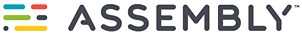















































































Technologies
Solution Design Lab
Go Live Lab
Build Lab
Data Lab
Automation Lab

Slide 8








































Our Customers
TI

Slide 9















































Our Customers
Service, Commerce, Communications, and Health

Slide 10















































Our Customers
Government, Financial, Automative, Transportation, and Others

Slide 11
Thank you for your time.
www.softgic.co

