Slide 1

Helm The package manager for Kubernetes
17. November 2021
Stefan Kürzeder

Slide 2
Agenda
Overview
What is Helm?
Why Helm?
A Helm Chart
Hands-on Demo
Create an Helm Chart
Deploy an Helm Chart
Interesting Links
https://helm.sh
https://github.com/StiviiK/helm-handson

Slide 3
What is Helm?
”Helm is the best way to find, share, and use software built for Kubernetes” – helm.sh
Kubernetes Applications can become very quickly complex with all the resources you need to manage and deploy – such as ConfigMaps, Services, Deployments, …
Helm Charts help you define, install, and even the most complex Kubernetes application
Integrates perfectly into a DevOps and even into a GitOps workflow
Community insights
First commit October 19, 2015
500+ contributers
6K+ code commits
20,6k stars on GitHub

Slide 4
Why Helm?
All resources and their manifests are stored in a single place, in a so called Helm Chart
Manifests are templated for simple configuration and customization
Configuration will be done with so called “values” files
There can be per each environment a single “values” file
Charts will be deployed with a single and easy command
Provides useful fetures as automated tests, pre/after/… deployment tasks, rollback, and many more
Helm ships as a single small CLI for all common operating systems (Windows, MacOS, Linux)
Since Helm v3: Clientside only – no controller / operator are required within the Kubernetes Cluster

Slide 5
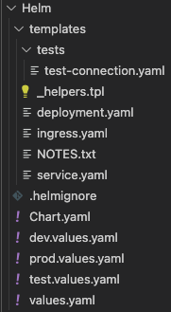
A Helm Chart
/templates
Contains all K8s resource manifests
E.g., Deployment, Service, Ingress, Jobs, …
Can be templated using the Helm Templating Engine
/templates/tests
Contains manifests for automated tasks after deployment has successfully finished
/Chart.yaml
Contains the name, version and general description of the Chart
/*.values.yaml
One or more files, will be used to customize and configure the Chart and also provide default values

Slide 6
Demo Time!
Source Code on GitHub!

