Slide 1
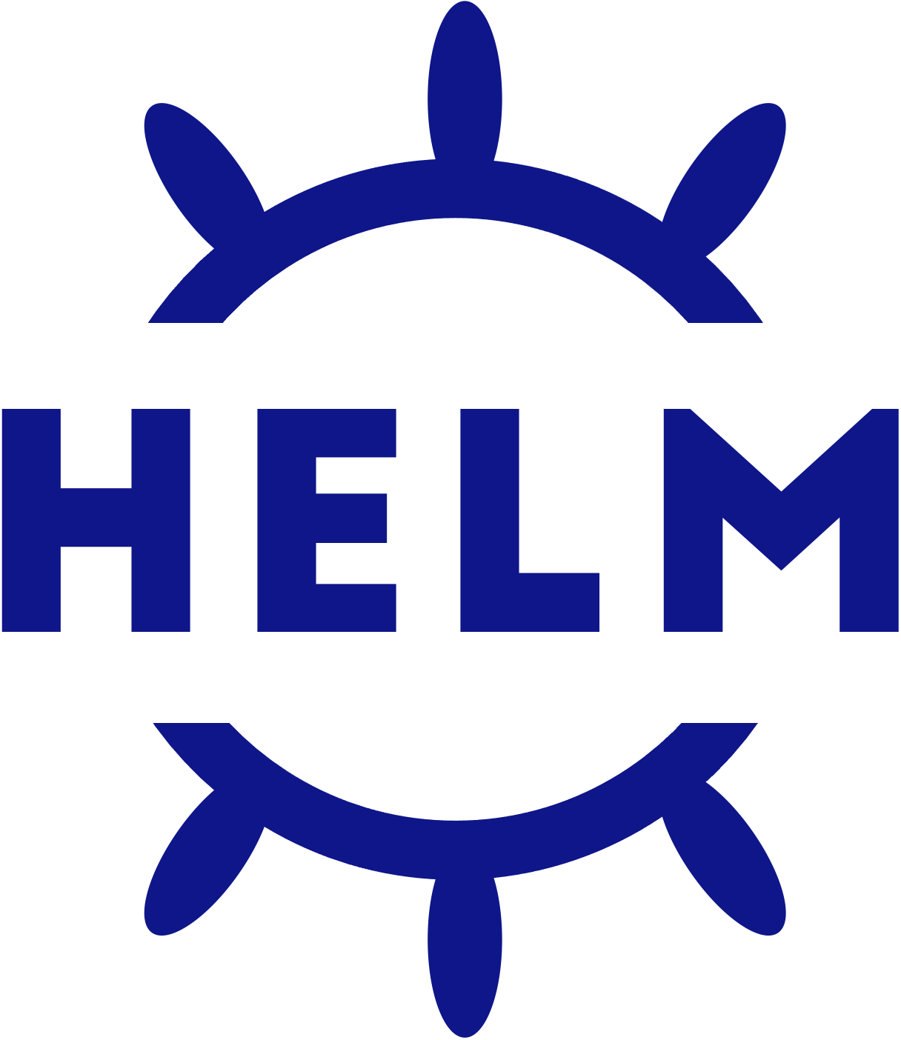
Helm The package manager for Kubernetes
18. November 2021
Stefan Kürzeder

Slide 2
Agenda
Overview
What is Helm?
Why Helm?
A Helm Chart
What is a Chart Registry?
Hands-on Demo
Create an Helm Chart
Deploy an Helm Chart
Interesting Links
https://helm.sh
https://github.com/StiviiK/helm-handson

Slide 3
What is Helm?
”Helm is the best way to find, share, and use software built for Kubernetes” – helm.sh
Kubernetes Applications can become very quickly complex with all the resources you need to manage and deploy – such as ConfigMaps, Presistent Volumes, Services, Deployments, …
CLI Tool for managing and deploying complex Kubernetes Applications
Helm Charts help you define, install, and even the most complex Kubernetes application
Integrates perfectly into a DevOps and even into a GitOps workflow
Community insights
First commit October 19, 2015
500+ contributers
6K+ code commits
20,6k stars on GitHub
CNCF graduated June 8, 2020

Slide 4
Why Helm?
All resources and their manifests are stored in a single place, in a so called Helm Chart
Manifests are templated for simple configuration and customization
Configuration will be done with so called “values” files
There can be per environment a “values” file, for easy seperation of environment specific settings
Charts can be deployed and upgraded with a single and easy command
Provides useful fetures as automated tests, pre/after/… deployment hooks, rollback, and many more
Helm ships as a single small CLI for all common operating systems (Windows, MacOS, Linux)
Since Helm v3: Clientside only – no controller / operator are required within the Kubernetes Cluster

Slide 5
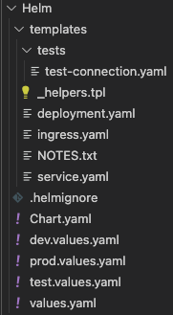
A Helm Chart
/templates
Contains all K8s resource manifests
E.g., Deployment, Service, Ingress, Jobs, …
Can be templated using the Helm Templating Engine
/templates/tests
Contains manifests for automated tasks after deployment has successfully finished
/Chart.yaml
Contains the name, version and general description of the Chart
/*.values.yaml
One or more files, will be used to customize and configure the Chart and also provide default values
Notes:
Templates:
- Enthält alle Kubernetes Resource manifests wie Deployment, Service, Ingress
- Manifeste können per Templating Enginge parametisiert werden
- Tests dort kann man z.B. einen Pod deployen der schaut ob die Anwendung erreichbar ist oder eine Datenbank initalisiert ist
Chart:
- Enthält Namen, Version und eine Beschreibung des Charts
- Simple Metadata
Values:
- Kann eine oder mehrere Dateien seinen welche allgemeine Settings beschreiben, wie z.b. Image Registry o.ä.
- Kann aber auch in mehrere Dateien aufgeteilt werden, per Environment eine
- dev.values.yaml, prod.values.yaml

Slide 6
What is a Chart Registry?
Public accessible registry where your Charts can be stored for easy distribution
Provides a tool for easy versioning of Helm Charts
Since Helm v3, OCI conform Registries (formerly Docker Registry) can also be used to store Helm Charts
Popular Helm Charts and their Registries
cert-manager, used for TLS certificate management from various issuing sources – https://charts.jetstack.io/
ingress-nginx, nginx reverse proxy used as ingress controller – https://kubernetes.github.io/ingress-nginx
Browse well-known and popular Helm Charts
https://artifacthub.io/
Notes:
OCI Open Container Initiative:
- Gegründet von Docker
- Vereinigung aus vielen großen Unternehmen wie Microsoft, Intel, Docker und vielen mehr
- Ziel ist industrie standards in und mit Umgang von open source container technologien

Slide 7
Demo Time!
Source Code on GitHub!
Notes:
Demo:
- Simpler Go Webserver
- Wird deployed in einem K8s Cluster mit einem nginx ingress und cert-manager für lets encrypt zertifakte
- Helm Chart erstellen -> Komponenten erklären
- Bestehenden Helm Chart herzeigen und Anwendung damit deployen
- Eventuell rollback?
Wenn Lust besteht, eventuell in Artifakt Hub schauen.

