Slide 1
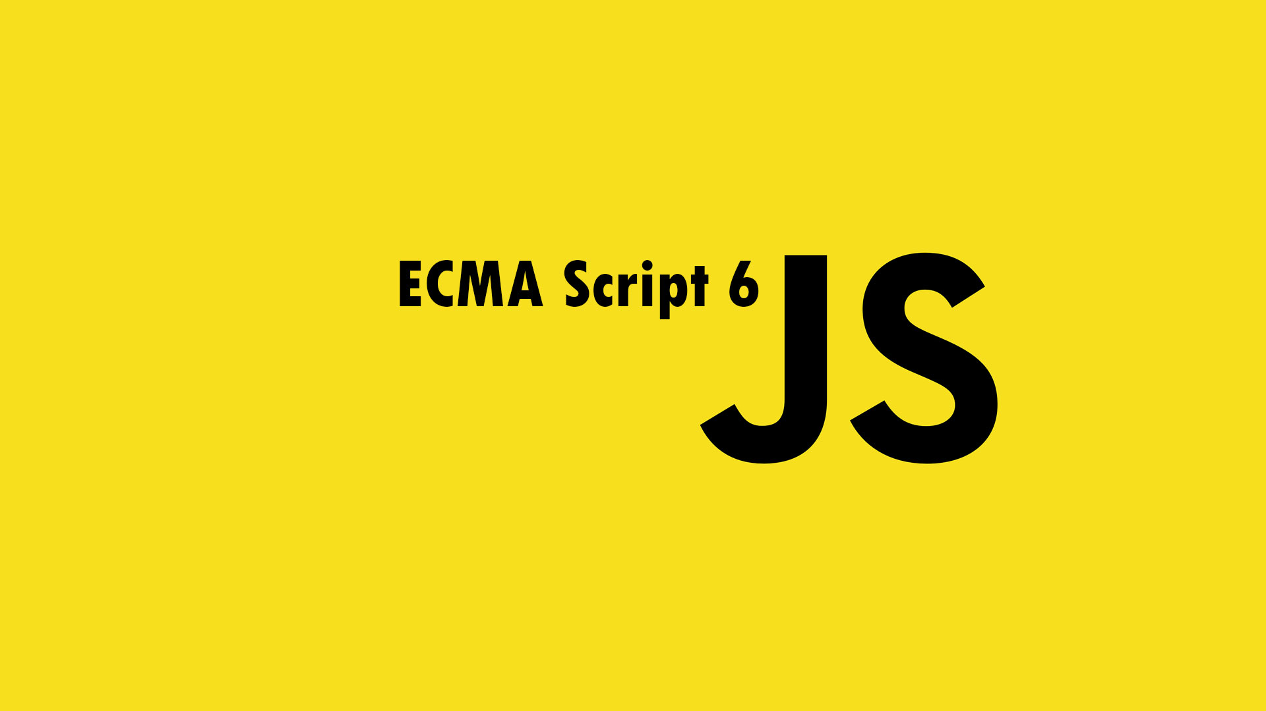

Slide 2
About the Program
Published on June 17, 2015
Formally "ECMA Script 2015"
6 years! from ES5

Slide 3
Why ES6 ?
Modern syntax fixing pitfalls
Better support for large applications
No (or few) breaking changes

Slide 4
Browser Support…
Modern browsers and io.js (node.js) support half of ES6 features.
Safari 9 (WebKit) will support many ES6 features soon.
Except for IE11…
Check http://www.caniuse.com

Slide 5
Libraries to bridge the support now…
BabelJs : https://babeljs.io/
Traceur: https://github.com/google/traceur-compiler

Slide 6
What’s new in ES6 ?
Block Scope (let/const) Default Params Rest Params Arrow Function Spread Operator Destructuring Iterator Generator | Set and Map Promise Proxy Template Strings Classes Modules Extended Object Generics

