Slide 1
DAT500 - PREPRESENTATION
Audun and Emil

Slide 2
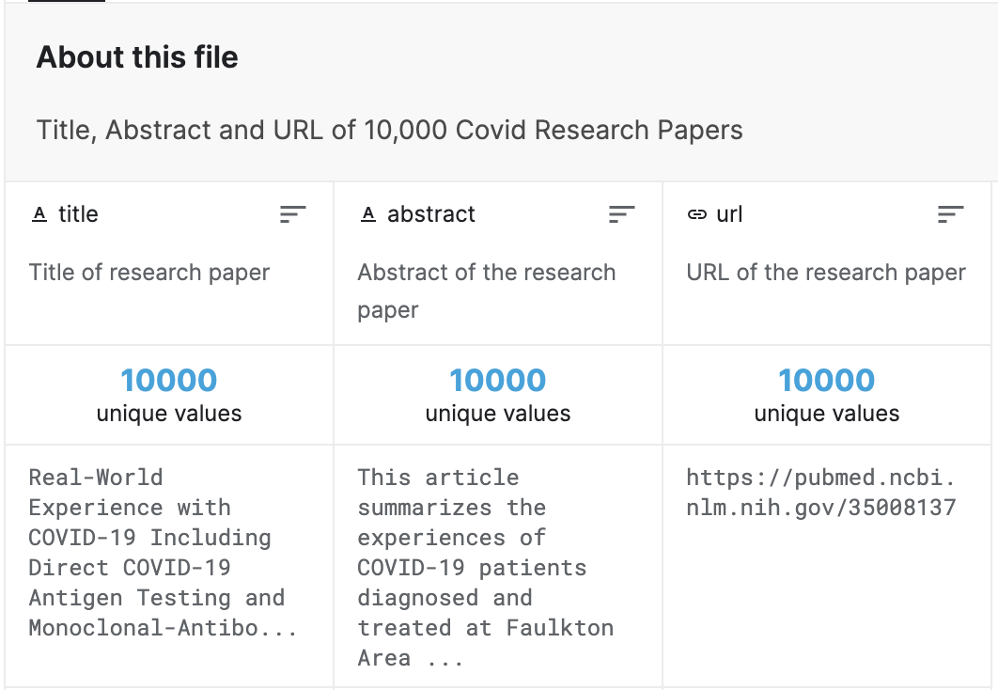
Dataset
Abstracts of 10,000 Covid
Research Papers
Collected from PubMed
https://www.kaggle.com
/anandhuh/covid-abstracts

Slide 3
USE CASE
Many research papers
Find out if they are similar
Motivation:
  Could some papers be grouped?
  Unnecessary papers?
  Can we use this to look for plagarism?

Slide 4
Related work
Same dataset
  Compare readability
  Generate text using Markov Chains
  https://www.kaggle.com/roshanr11/interesting-eda-covid-abstracts-dataset
Similar dataset and analysis
  Googles BERT
    Analyse Covid related twitter posts; negative/neutral/positive
  https://www.kaggle.com/ludovicocuoghi/twitter-sentiment-analysis-with-bert-roberta/

Slide 5
Algorithms
Locality-sensitive hashing
Encoding
  One-Hot Encoding
  MinHash
Jaccard similarity
MRJob for preprocessing

