Slide 1
Layout
Nombre del equipo, challenge, integrantes
Introducción BH (objetivo y su estrategia)
No. De clientes (15) y plantas alrededor del mundo (45), número de turbinas (8) (Breve explicación ciclo Brayton?)
PRODUCTO FINAL
Solución (tipo de dashboard/reporte) datasets usados?
Valor que tiene para la empresa
Cliente
Plataforma de entrega
¿Algún Partner?
Métricas
Gestion del cambio
Presentar visualizaciones
Emisiones por cliente/planta, (kg/s), eficiencia por turbina (%), potencia promedio (kW), consumo de combustible (kg/s), turbinas con mas y menos emisiones (benchmarking, comparación de operaciones, KPIs)
Uso y beneficio del reporte/dashboard para la empresa (analysis de tendencias, reportes HSE, monitoreo KPIs, benchmarking con otras plantas/clientes…)

Slide 2
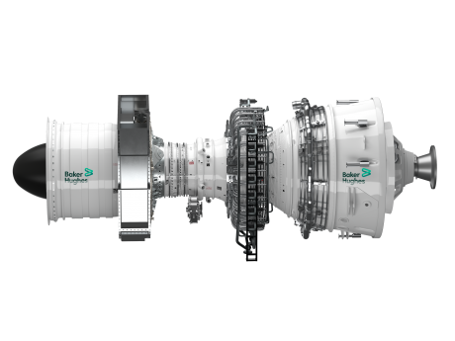

VISUALIZATION CHALLENGE
Team 4 - COde2Zero
Marco Rocha Uribe
Pamela Rocío Ibarra Tapia
Pedro Domínguez Balderas
Sofía Eurivinci Díaz Gutiérrez
Prepared for

Slide 3

15 clients
45 plants
8 types of engines
As an energy technology company, Baker Hughes' strategy is to help industry advance on the route to net zero and a sustainable energy future by identifying, controlling, and minimizing emissions from operations.

Slide 4
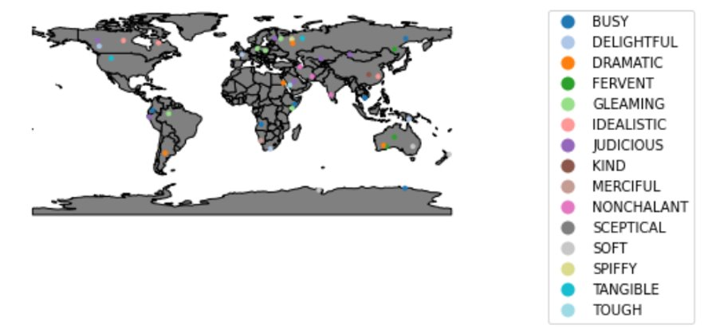
Location of plants around the world

Slide 5
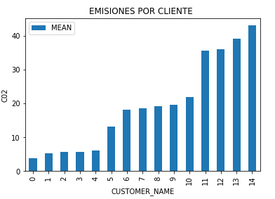
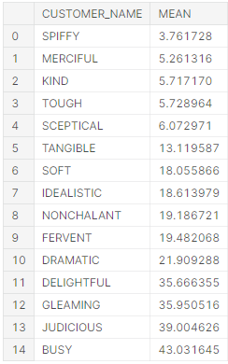
Solution – A visual report
Average of CO2 emissions per customer

Slide 6
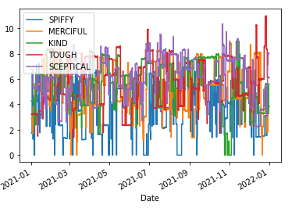
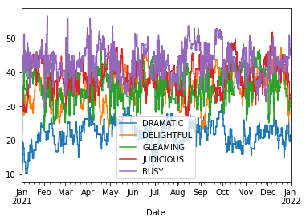
Customers with higher and lower amount of emissions
Minor 5 emitters
Largest 5 emitters

Slide 7
Business opportunity
Change Management
Communicate information about emissions from gas turbines
Solution
Communication and development strategies
Internal client oriented model
Value
Success metrics
Emissions based on scenarios (power, fuel flow, etc...)
CO2 emissions, thermal efficiency
Customers
Datasets
Internal clients (HSE, Operations, Maintenance)
Engine, site, and, measurements data
Partners
Decision makers
Clients/plants
Delivery platform

Slide 8
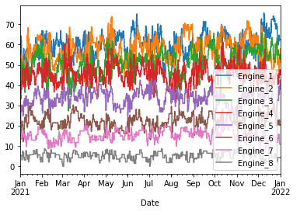
CO2 emissions (kg/s) per type of engine

Slide 9
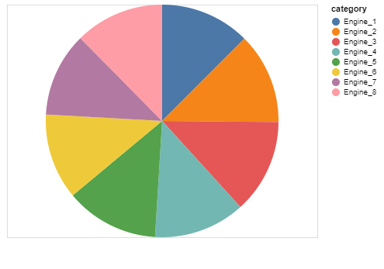
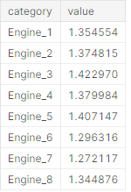
Average CO2 emissions (kg/s) per type of engine

Slide 10
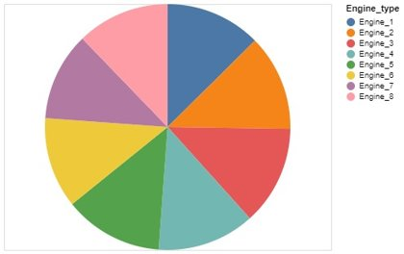
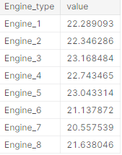
Thermal Efficiency (%)

Slide 11
Value proposition
Measure and track emissions for cleaner gas turbine operations
Plan net-zero targets
Calculate an opportunity score of current performance vs. benchmark in other clients' facilities
Provide insights to users for better decision making

