Slide 1

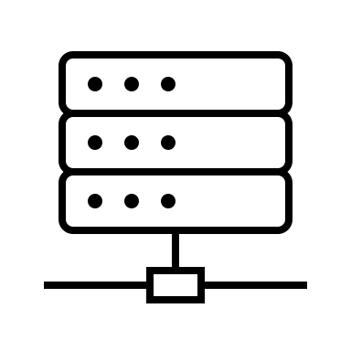














Mongo DB
Communication Manager
Data Analytics
Data Logging Server
Data Sharing Server
Data Analytics Platform
Timing Server
Static Server
Visual Reporting Server
Visual Reporting
WebRTC Client

Slide 2













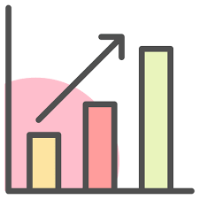
Communication Manager
Static Server
Shared State
Timing Server
Data Logging Server
Learning Record Store
User monitoring
Data Analytics Platform
Data pre-processing
Model fine-tuning
Prediction and Clustering
Visual Reporting Server
Web viz interface
Automatic report generation

