Slide 1
















Mongo DB
Communication Manager
Data Analytics
Data Logging Server
Data Sharing Server
Data Analytics Platform
Timing Server
Static Server
Visual Reporting Server
Visual Reporting
WebRTC Client

Slide 2













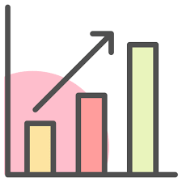
Communication Manager
Static Server
Shared State
Timing Server
Data Logging Server
Learning Record Store
User monitoring
Data Analytics Platform
Data pre-processing
Model fine-tuning
Prediction and Clustering
Visual Reporting Server
Web viz interface
Automatic report generation

Slide 3
Multi-user Interactions
Data Storage
Interoperability
AI-based analytics
Visual Reports

Slide 4

Multi-user Interactions
Data Storage
Interoperability
Easy to Develop
AI-based analytics
Visual Reports

Slide 5
Multi-user Interactions
R1
Data Storage
DS1: Interoperability
Easy to Develop
R10
AI-based analytics
Visual Reports

Slide 6

DO2: Multi-user Interactions
R1
R4
R2
R3
R8
R7
R6
DO3: Data Storage
DO1: Interoperability
DO6: Easy to Develop
DO4: AI-based Analytics
DO5: Visual Reports
R5
R9
R10
R11

