Slide 1
Webpage Categorizer
Ben Plotke
Renato Stoco

Slide 2
Webpage Categorizer:
Task: Classifying how much a webpage is interesting
Problems:
Dataset containing the Train data has only Unigrams
Need Actual “informal” text data from the webpages.
Webpage Category may be composed by two different Categories.

Slide 3
Webpage Categorizer:
Proposed Solution using Naïve Bayes/SVM
Use an existing labelled category dataset.
Extract and store the text information from the categorized Webpages
Apply Level of interest on each category
Use categorization task on the recently generated Training data.

Slide 4
Webpage Categorizer:
Datasets and Tasks
20 Newsgroup Dataset using Bag of Words Feature
Both Train Data and Test Data
Webpages Text Data using Unigrams and Bigrams
Beautifulsoup library for html parsing
Using NLTK toolkit for language detection, and Sci-kit for Naïve Bayes/SVM

Slide 5
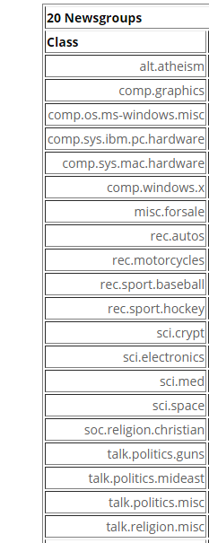
Webpage Categorizer
All Categories
One random Sample from the
20 newsgroup labelled dataset
comp.os.ms windows.misc :
windows crashing article apr oracle oracle ebosco oracle eric bosco writes ebosco oracle eric bosco subject windows crashing […]

Slide 6
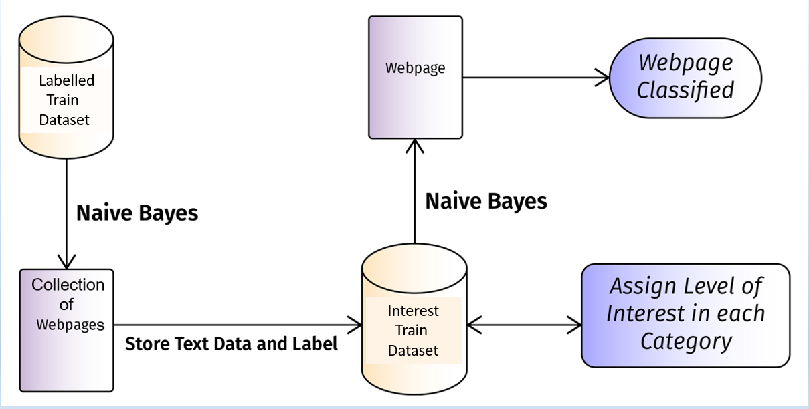
Project Diagram

Slide 7



Webpage Categorizer: Results Using our own Naïve Bayes from scratch

Slide 8
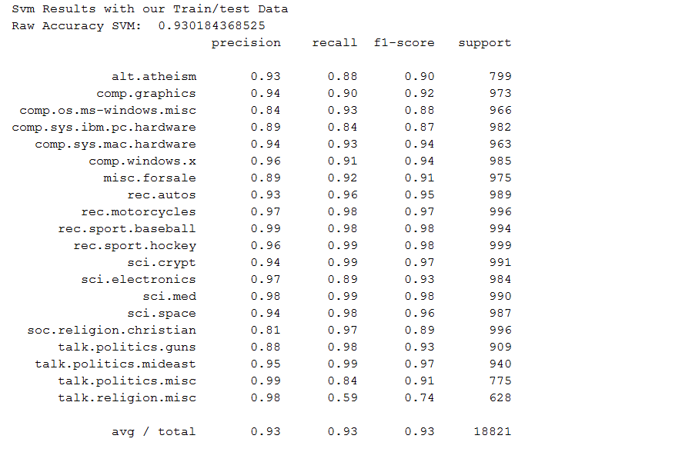
Webpage Categorizer: Results Using sci-kit Support Vector Machines

Slide 9
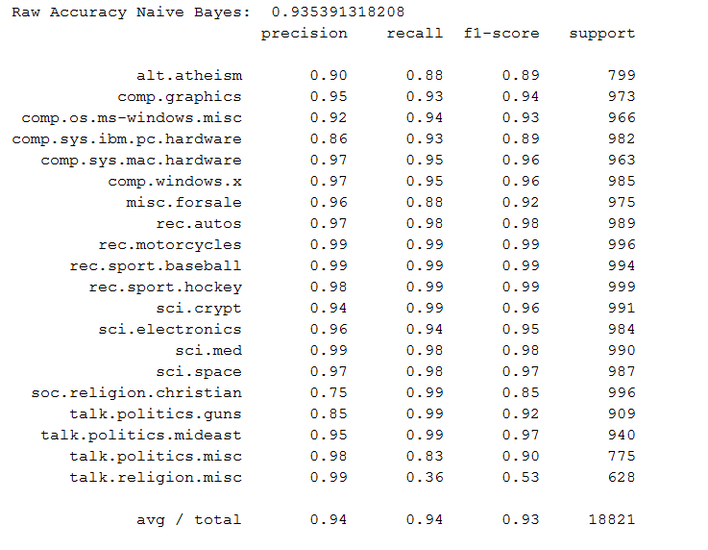
Webpage Categorizer: Results Using sci-kit Naïve Bayes

Slide 10
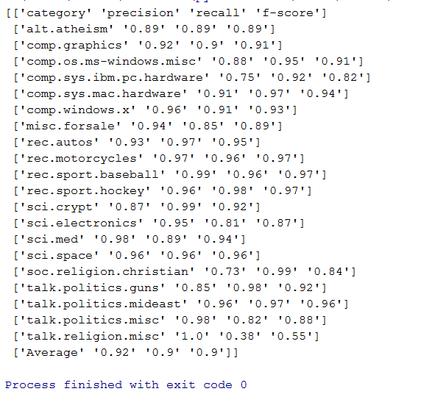
Webpage Categorizer: Results 10 fold cross validation using sci-kit Naïve Bayes

Slide 11
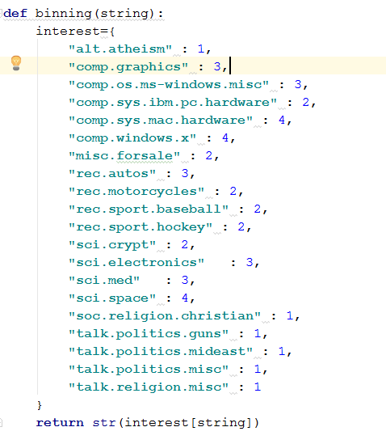
Final Results Scale: 1:Not Interested, 2:Maybe Interested, 3:Interested, 4:Very Interested

Slide 12
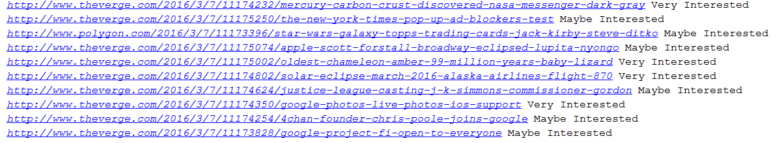
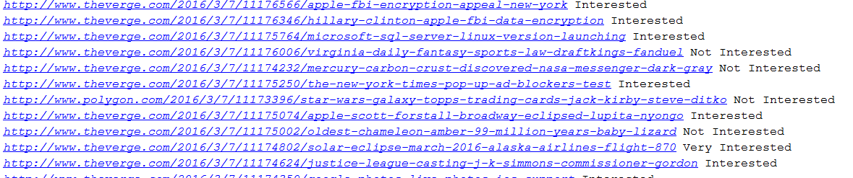
Final Results Scale: Not Interested, Maybe Interested, Interested, Very Interested
Using All Data
Comp.sys.Mac and Sci.cryptograph Removed

Slide 13
Future work & Conclusion
Results are not good enough, either too high or too low
Try to add more Good Features
Maybe try another Category Dataset

