Slide 1
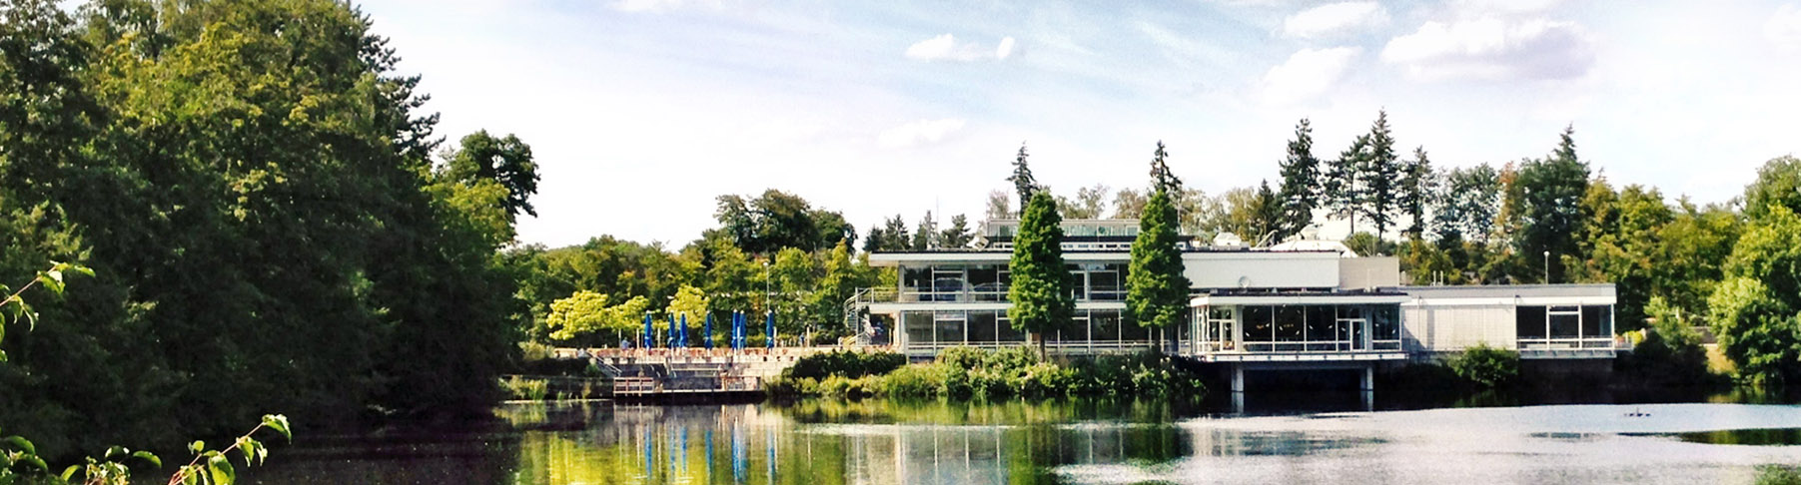
Structural causal models and diffusion models
Workings of causaldiffae
13.08.2025 I lado turmanidze
Notes:
Hello, I am Lado Turmanidze, an intern from Kutaisi International University, and for the past 6 weeks I’ve been working on structural causal models, diffusion models, and their combination - Causal Diffusion Autoencoders.

Slide 2
Structural Causal Models and Diffusion Models
Unlikely Alliance
Why Combine Structural Causal Models and Diffusion Models?
Interpretability: Integrating structural causal models (SCMs) with diffusion models aligns generative factors with meaningful, causal variables, making model behavior more transparent and controllable. This is vital in domains like physics, where understanding the effect of each variable is crucial.
Interventions with Limited Data: SCMs enable explicit interventions, allowing users to generate and analyze counterfactual scenarios. In fields with scarce data, such as experimental sciences, this means researchers can simulate the impact of changes or rare events, improving robustness and insight even when real-world data is limited.
Notes:
Combining the two makes sense, as integrating structural causal models (SCMs) with diffusion models aligns generative factors with causal variables, making them more interpretable and controllable, which can be crucial in some domains. SCMs enable explicit interventions, allowing users to generate and analyze counterfactual scenarios, and this is a huge advantage in fields with scarce data.

Slide 3
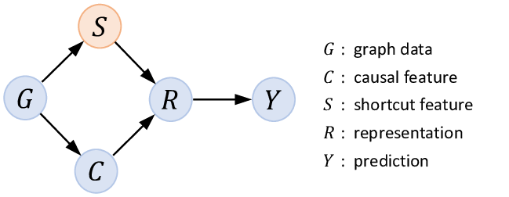
Structural Causal Models
SCMs for short
Traditional machine learning models often identify correlations between variables, but they do not inherently provide insights into whether one variable causes change in another.
By representing the variables involved within a directed acyclic graph (DAG), one can identify potential confounders and assess the direct effects of the medication on recovery.
That is exactly what SCMs do.
SCMs enable the analysis of counterfactual scenarios, which can answer questions of the form "What would have happened if...?".
Yongduo Sui et al. Deconfounded Training for Graph Neural Networks. December 2021.
Notes:
Traditional machine learning models often identify correlations between variables, but they do not inherently provide insights into whether one variable causes changes in another. By representing the variables involved within a directed acyclic graph (DAG), one can identify potential confounders and assess the direct effects of medication on recovery. That is exactly what SCMs do. SCMs enable the analysis of counterfactual scenarios, which can answer questions of the form "What would have happened if...?".

Slide 4
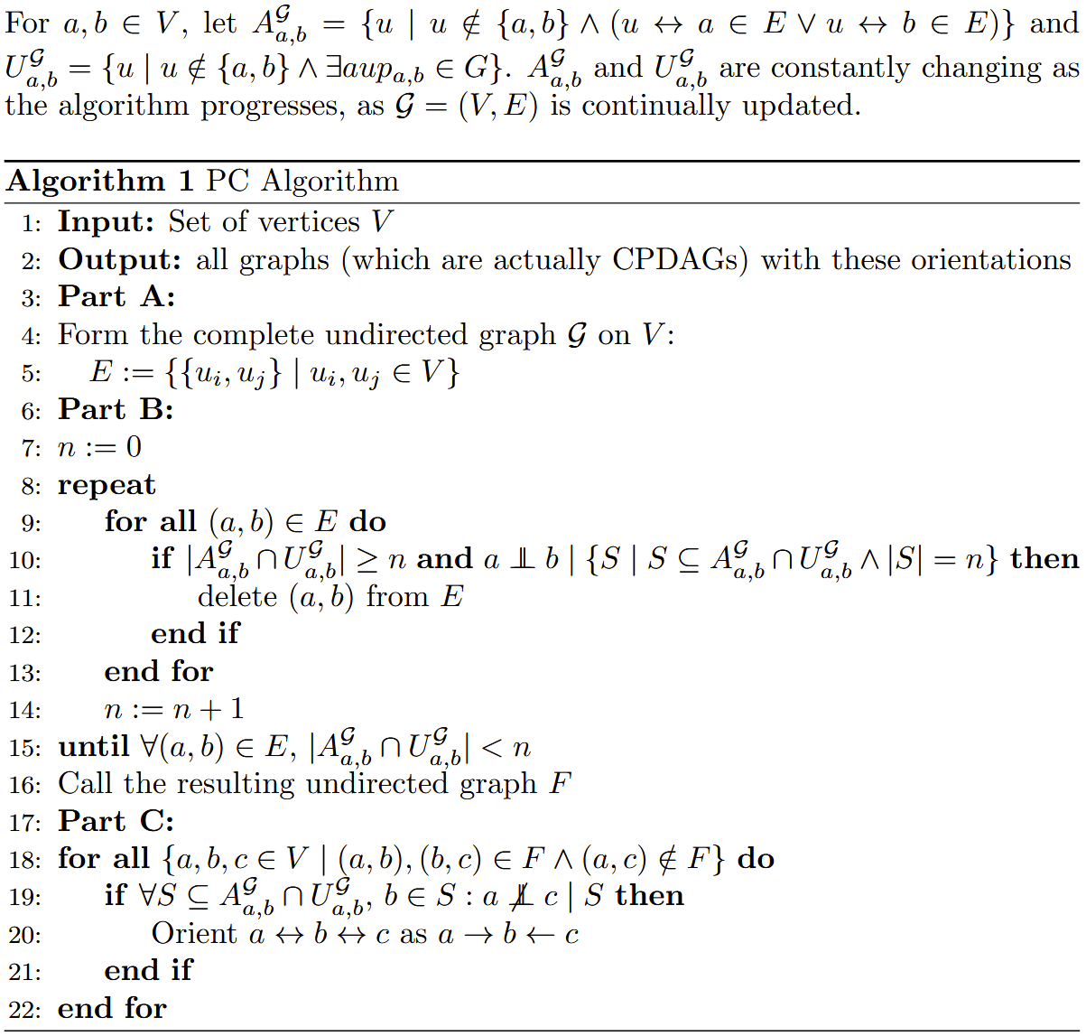
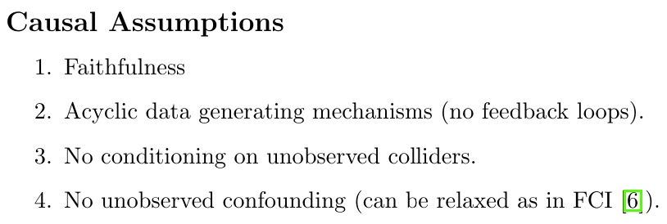
Structural causal models
Buildup to SCMs
Notes:
There are certain assumptions that we must make to reason about SCMs. These assumptions are faithfulness (which basically ensures that the graph structure captures all and only the conditional independencies present in the distribution), no feedback loops, no conditioning on unobserved colliders, and no unobserved confounding, though the latter can be relaxed in some algorithms like FCI. The pseudocode you see is for the classic PC algorithm, which I had to formalize, as the original paper barely used math and described the whole algorithm in natural language.

Slide 5
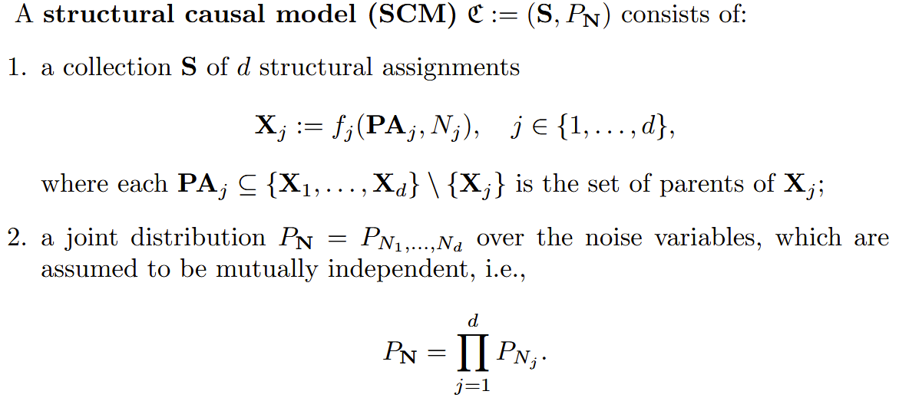
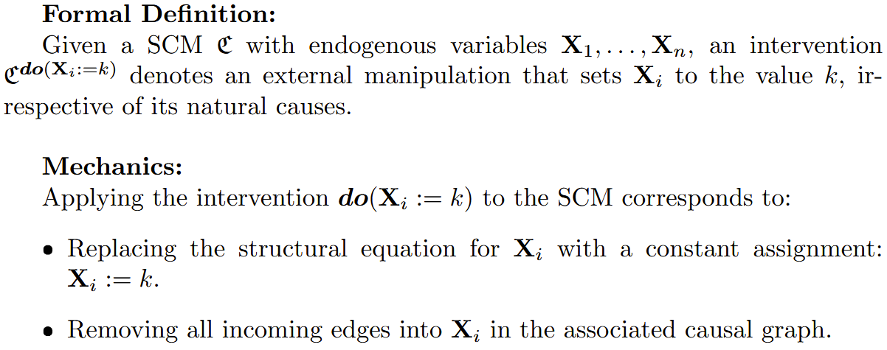
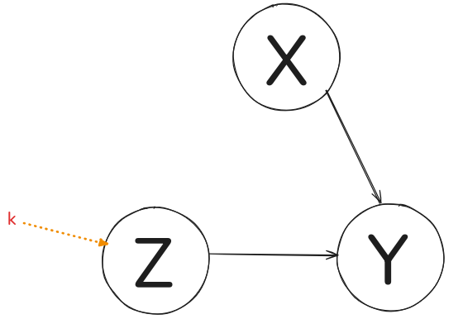
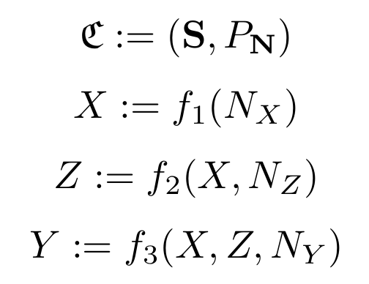
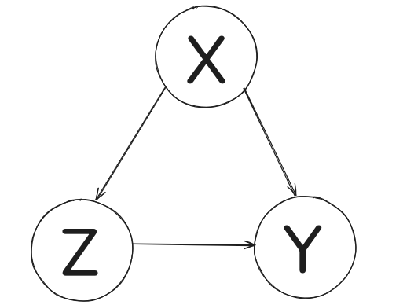

Structural causal models
Formal definition of SCMs and interventions
Notes:
SCMs consist of some d number of structural assignments, where each node is assigned a function that depends on the set of parents of this node - which can be an empty set—and a noise variable. We intervene on nodes using do-calculus, allowing us to overwrite the value of the node. Here is an example of a structural causal model, where X only depends on its noise, Z depends on X (its parent) and its noise, and Y depends on X, Z, and its noise. We can intervene with do(Z := k) to completely change the value of Z. We can also see how this affects Y, but not X.

Slide 6
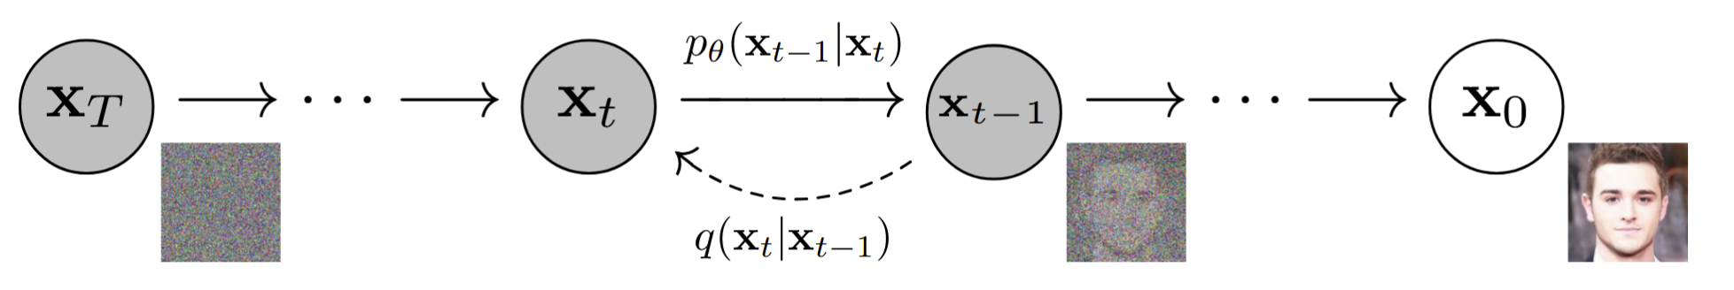
Diffusion
Powering most of today's image generation
Construct a chain of transformations instead of the single-step process used in the Variational Autoencoder (VAE). Analogous to the encoder and decoder architecture of VAEs, diffusion models involve forward and reverse processes(q and p, respectively).
Instead of relying on a single encoder to map data to a latent space and a single decoder to reconstruct the data, diffusion models use a sequence of T+1 steps, where each step incrementally adds or removes noise.
At each step, the transition distribution depends only on the immediate previous state, allowing the overall generation process to be decomposed into many simpler sub-tasks.
Ho et al. Denoising Diffusion Probabilistic Models, 2020.
Notes:
Now, the second main concept is diffusion, which is an improvement over variational autoencoders. Here, instead of a single-step process, we construct a chain of transformations. We replace the encoder-decoder with forward and backward processes repeatedly. At each step, the transition distribution depends only on the immediately previous state, allowing the overall generation process to be decomposed into many simpler sub-tasks.

Slide 7
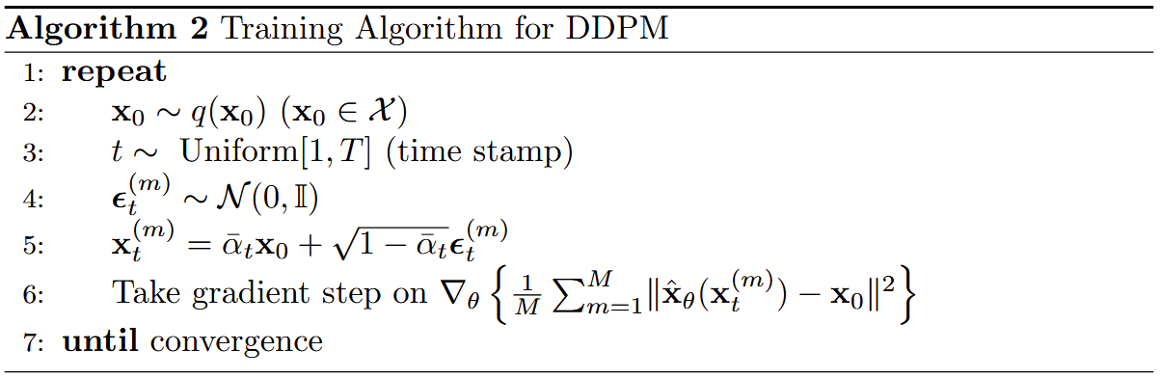
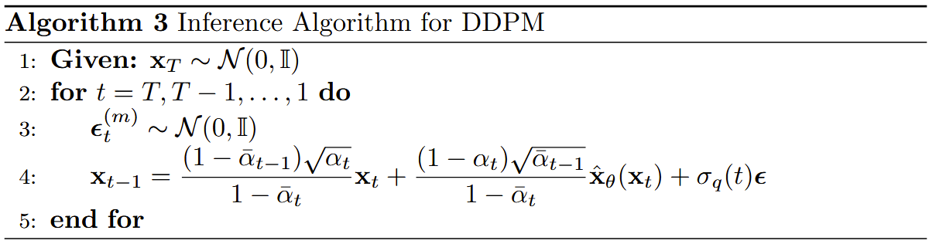
DENOISING DIFFUSION PROBABILISTIC MODELS
DDPMs for short
Notes:
These are the pseudocodes for training and inference of Denoising Diffusion Probabilistic Models (DDPMs).

Slide 8
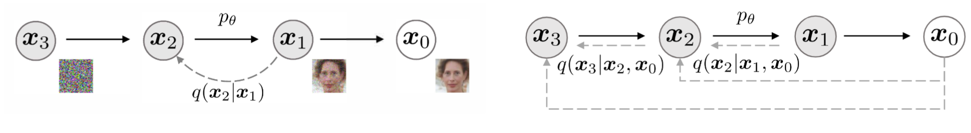
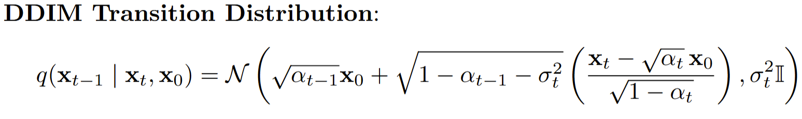

Denoising Diffusion Implicit models
An improvement over DDPM
A key drawback of DDPMs is their reliance on many iterations to generate high-fidelity samples.
As noted by Song et al. Denoising diffusion implicit models (International Conference on Learning Representations (ICLR), 2023), a DDPM would take more than 1,000 hours to generate 50K 256 x256 images on a standard GPU.
This inefficiency arises because the reverse diffusion process requires iterative denoising.
If the process intrinsically needs many steps to converge, generation will inherently be slow. Therefore, to accelerate computation, it is necessary to reduce the number of iterations.
Song et al. Denoising diffusion implicit models, International Conference on Learning Representations (ICLR), 2023.
Notes:
A key drawback of DDPMs is their reliance on many iterations to generate high-fidelity samples. For example, a DDPM would take more than 1000 hours to generate 50K 256x256 images on a standard GPU. This inefficiency arises because the reverse diffusion process requires iterative denoising. If the process intrinsically needs many steps to converge, generation will inherently be slow. Therefore, to accelerate computation, it is necessary to reduce the number of iterations.

Slide 9
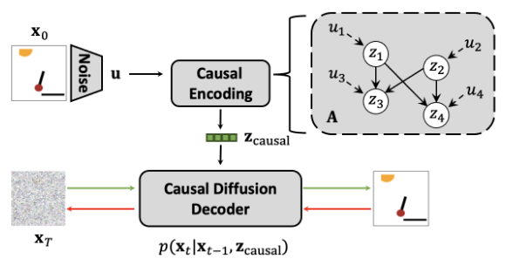
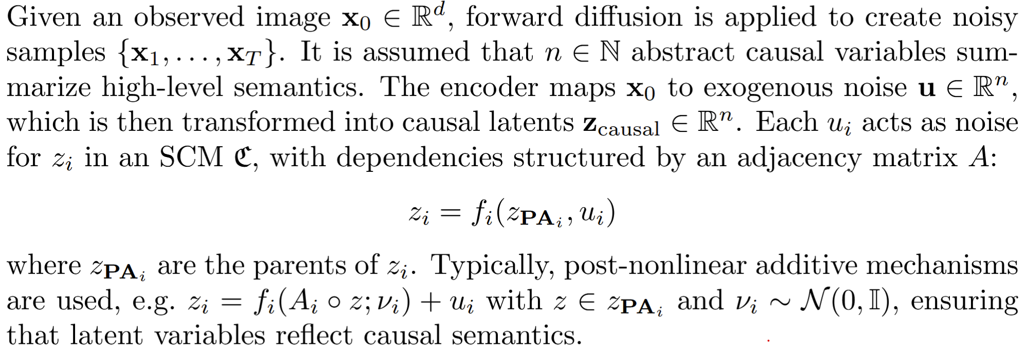
Causal Diffusion Autoencoders
Komanduri et al. Causal Diffusion Autoencoders: Toward Representation-Enabled Counterfactual Generation via Diffusion Probabilistic Models.
The authors aim to model causal relations among semantic latent variables in order to learn causal representations and enable counterfactual generation in DPMs. To this end, the authors propose CausalDiffAE, a framework for causal representation learning and controllable counterfactual generation in DPMs.
The main idea is to learn a causal representation using a stochastic encoder, and to model the relationships among latent variables by parameterizing causal mechanisms with neural networks.
Decoding and stochastic variation modeling are achieved using a conditional DDIM. This approach yields a compact, causally-relevant latent representation for reverse diffusion image synthesis.
By explicitly modeling causal relations in the latent space, counterfactual samples can be generated via interventions on the learned causal variables.
Komanduri et al. Causal Diffusion Autoencoders: Toward Representation-Enabled Counterfactual Generation via Diffusion Probabilistic Models. 2024
Notes:
Last year, a paper was published about Causal Diffusion Autoencoders - CausalDiffAE for short. The authors aim to model causal relations among semantic latent variables in order to learn causal representations and enable counterfactual generation in DPMs. The main idea is to learn a causal representation using a stochastic encoder and to model the relationships among latent variables by parameterizing causal mechanisms with neural networks. Decoding and stochastic variation modeling are achieved using a conditional DDIM. This approach yields a compact, causally relevant latent representation for reverse diffusion image synthesis. By explicitly modeling causal relations in the latent space, counterfactual samples can be generated via interventions on the learned causal variables

Slide 10
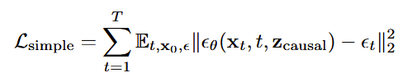
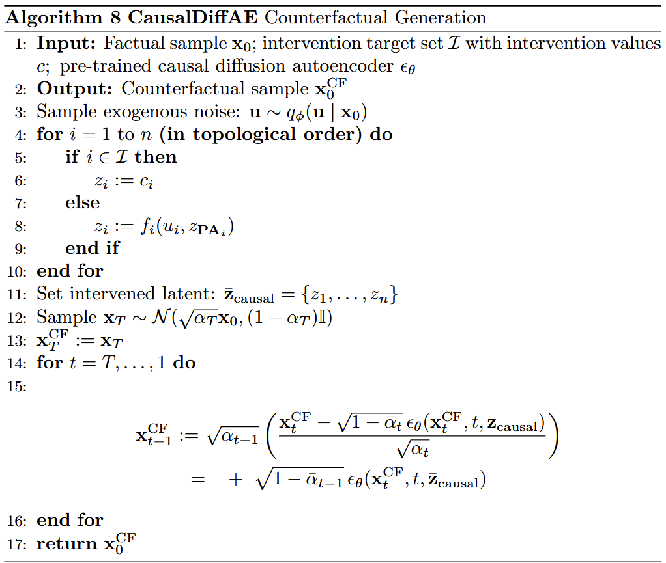
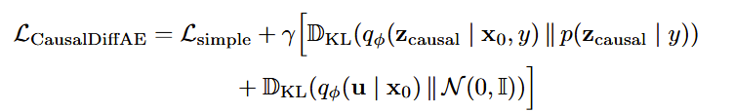
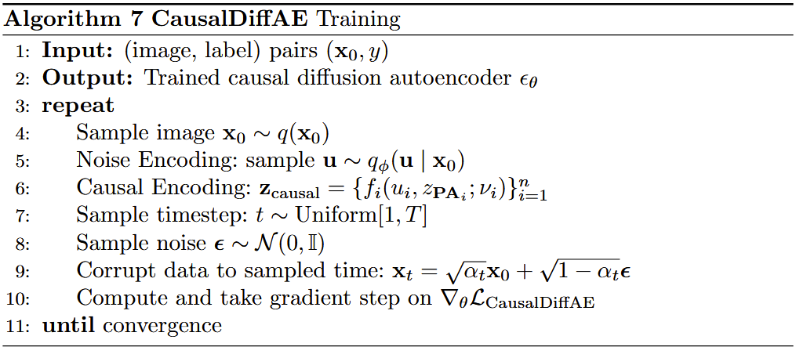
Causaldiffae
Notes:
These are the loss function, training, and counterfactual generation pseudocodes for CausalDiffAE.

Slide 11
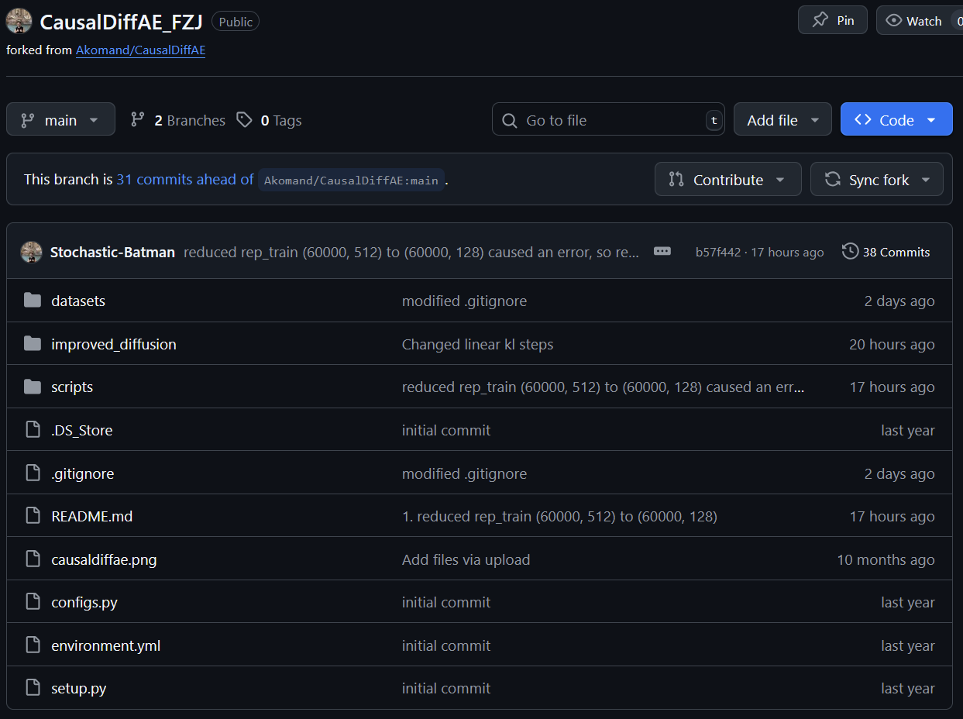
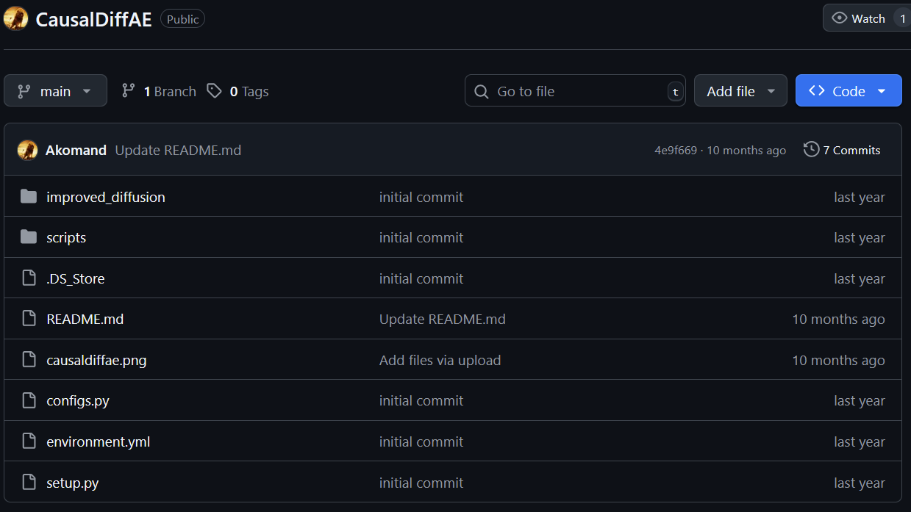
Source Code
Source code of CausalDiffAE paper (not working):
https://github.com/Akomand/CausalDiffAE.git
Source code of my fork (working only for MorphoMNIST):
https://github.com/Stochastic-Batman/CausalDiffAE_FZJ.git
Notes:
After I finished understanding the theory, I returned to the GitHub repository of the paper’s author, only to see that the issue I had opened was not answered at all. There are 3 examples that the code is supposed to test: one is a simple pendulum, where you have a light source and pendulum and want to see how the shadow changes; another is about the CausalCircuit dataset from Qualcomm, which is used for robotics; and the last one is the MorphoMNIST dataset, which is basically the MNIST dataset with morphometrics. I had to choose between them, as even the dataset generation did not work from the original author’s code, and there was no documentation, nor was it clear in README.md how to generate data. I chose the latter for its widespread use, as almost everyone knows about the MNIST dataset.

Slide 12
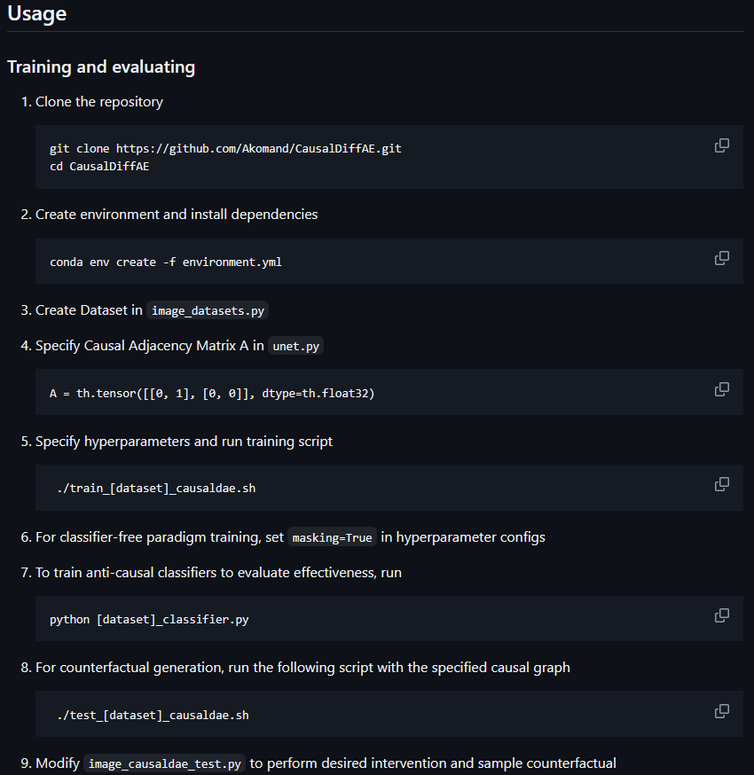
WHy fork it?
The original source code from the author has:
No instructions regarding data generation
LOTS of bugs
Redundant code
A minimal README.md that is more confusing than if you were to figure out how the code is supposed to work on your own
It uses other repositories for appropriate data generation, but there is no mention of that; you have to figure it out on your own
At one point in time, I thought it was better to just write the entire code from scratch... But Dr. Cao recommended trying to fix it, and it worked more and more, bit by bit.
Notes:
As the issue was not answered weeks after it was opened, I had to fork it and correct, improve, and document the changes. The image you see right now is all there is from the original repository, and it simply does not work. The original source code from the author has no instructions regarding data generation, lots of bugs, and redundant code. At one point, I thought it was better to just write the entire code from scratch... but Dr. Cao recommended trying to fix it, and it worked more and more, bit by bit.

Slide 13
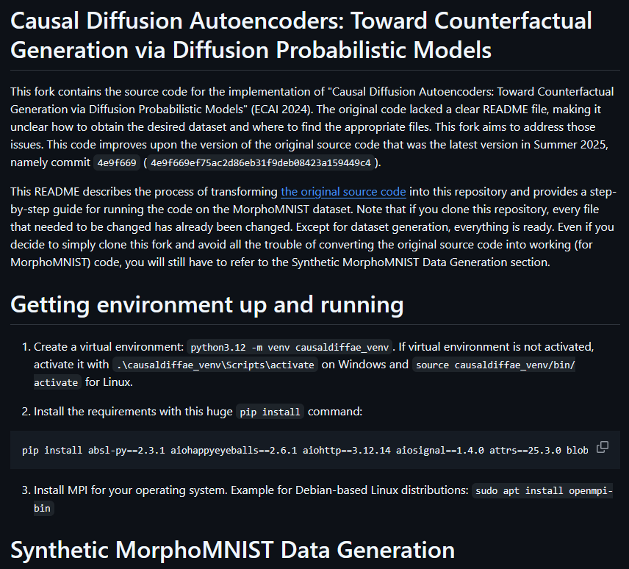
Why use my fork?
Clear README.md that transitions from original source code to working code (for MorphoMNIST).
Detailed walkthrough of every step, including data generation, code replacements, and parameter correction.
Except for data generation, if you clone the fork, you have everything already available.
Additional logging statements that are not included in README.md (as they are not crucial but desirable).
A little too long README.md, but it is what it's supposed to be.
Notes:
My fork has a clear README.md that transitions from the original source code to working code (for MorphoMNIST), a detailed walkthrough of every step - including data generation, code replacements, and parameter correction - and, except for data generation, if you clone the fork, you have everything already available.

Slide 14
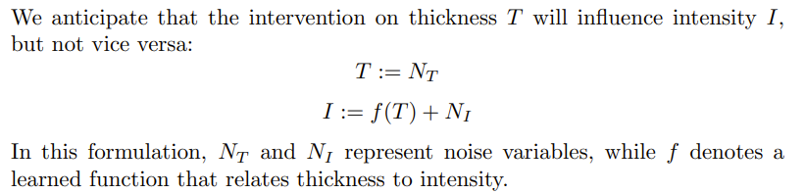
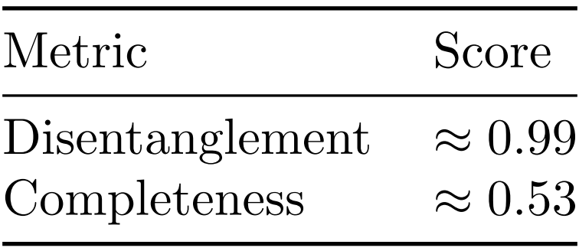
Experiments
Expectation and metrics
Intuitively, the disentanglement score measures how well each latent variable captures an individual generative factor, and completeness quantifies to what extent each generative factor is predominantly explained by a single latent variable. The higher the disentanglement score, the better; the same goes for completeness. However, since we only have thickness and intensity, a score of 0.53 is acceptable.
Notes:
Now, for the MorphoMNIST dataset, we experiment with thickness and intensity, where thickness T influences intensity I, but not vice versa. The stats are from a model trained for 210 400 steps with a batch size of 128. The model is evaluated with disentanglement and completeness scores, which are mathematically described in my research paper. Intuitively, the disentanglement score measures how well each latent variable captures an individual generative factor, and completeness quantifies to what extent each generative factor is predominantly explained by a single latent variable. The disentanglement score of 0.99 means the representation is highly interpretable, with minimal mixing between factors of variation. The completeness score of 0.53, however, reveals that while each latent cleanly maps to one factor, the reverse is less true - information about a single factor is distributed across several latents. In our case, the dependency from thickness to intensity likely contributes to this, as correlated factors are harder to isolate into individual latents.

Slide 15
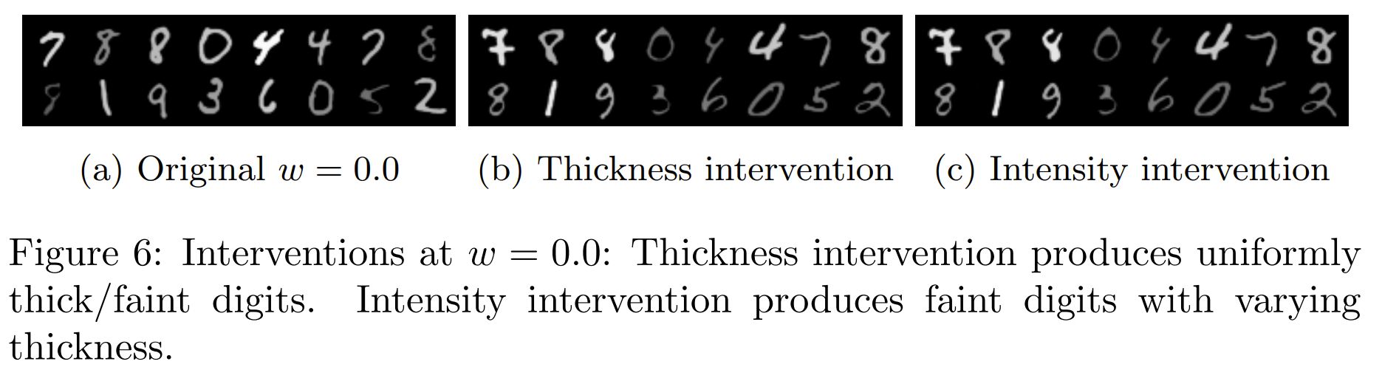
Experiment run for...
W = 0
Notes:
As for the experiments, the model has been tested with 3 values of guidance weight w, namely 0, 0.5, and 1. w and 1-w are convex coefficients of conditional and unconditional model predictions, respectively. Due to the sampling technique, the original images on which we intervene differ for all three values of w. Experiments show that for w = 0, thickness intervention produces uniformly thick digits. Intensity intervention produces faint digits with varying thickness.

Slide 16
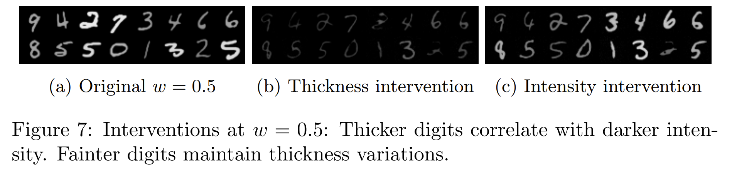
Experiment run for...
W = 0.5
Notes:
For w = 0.5, thicker digits correlate with darker intensity, and fainter digits maintain thickness variations.

Slide 17
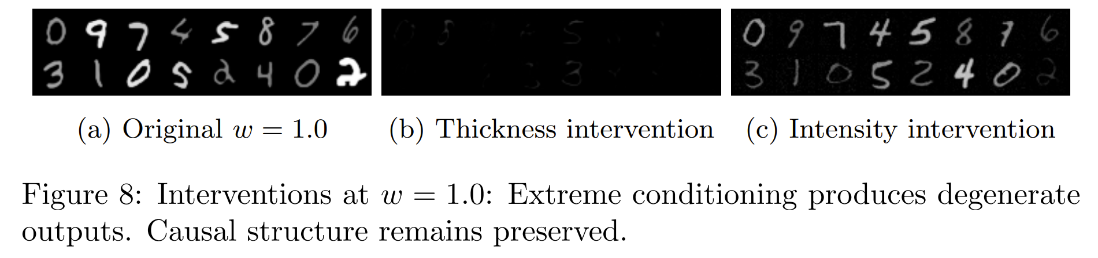
Experiment run for...
W = 1
w = 1 results in degeneration as latents exceed the training distribution support!
Notes:
w = 1 is an edge case, where extreme conditioning produces degenerate outputs.

Slide 18
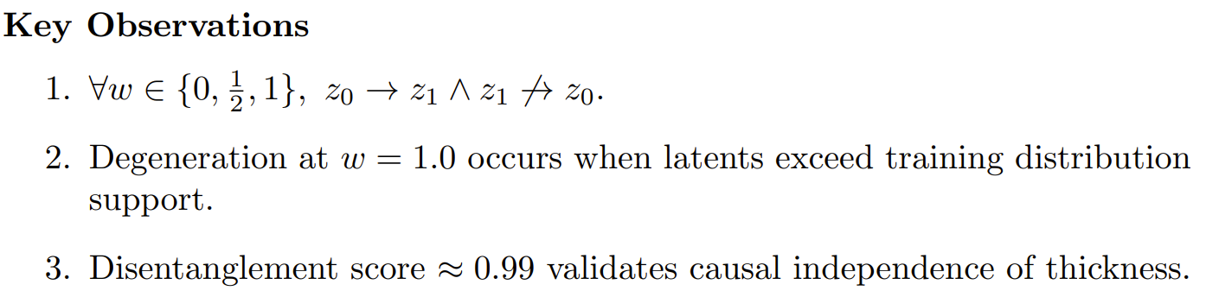
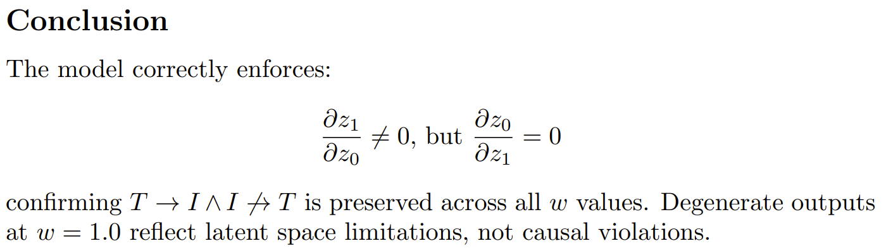
Key observations and conclusion
Notes:
So we conclude that the model correctly enforces "thickness implies intensity" and not the other way around.
Thanks for your attention!

