Slide 1

MQL5 Graphic Panel Contest by Investeo

Slide 2
Introduction
Pure MQL5 solution, no DLLs
Friendly tabbed animated interface
Click and hide panel and tabs
Animation video available at
http://www.youtube.com/watch?v=1qz8Gb--Y68

Slide 3

Graphic Panel modules
DT single click trading panel
Trading planner tab
MTF pivot calculator
MTF indicator monitor

Slide 4
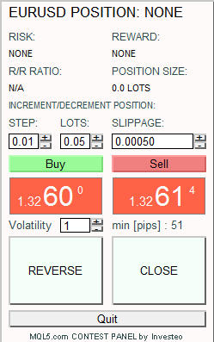
DT Trading Panel
One click trading: increase/decrease position, reverse position, close position, show last n minutes volatility, risk and reward of open position
Demo:
http://www.youtube.com/watch?v=ztVCPwnrUlQ

Slide 5
Trading Planner
Interactive browsing through all found Fibo retracement levels and PIVOTs
TP/SL setting by simply dragging a line up and down
Trade plane available as ListBox (implemented CChartObjectListBox class)
In could be used as sequential trading plan

Slide 6
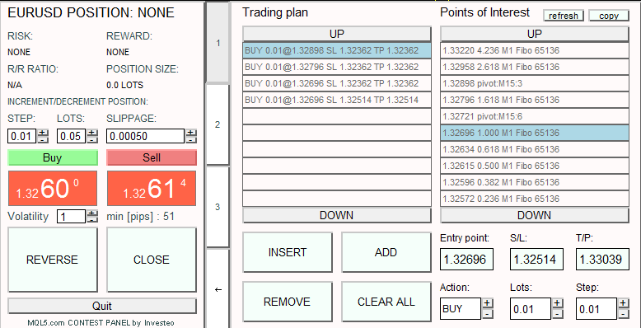
Trading Planner [2]
Demo available at http://www.youtube.com/watch?v=amKnompBZTc

Slide 7
MTF Pivot calculator and browser
Interactive pivot calculation and display,
MQL5 version of web-based pivot calc:
http://www.mypivots.com/calculators/pivot-point-calculator.aspx
Three formula sets: Classic, Woodie, Camarilla
Visible pivot lines can be used by Trading Planner module

Slide 8
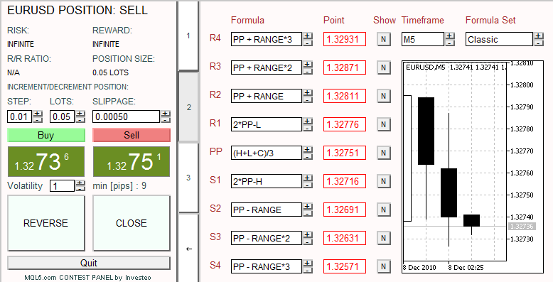
MTF Pivot calculator and browser [2]
Demo at http://www.youtube.com/watch?v=Iv84l6eq6Rk

Slide 9
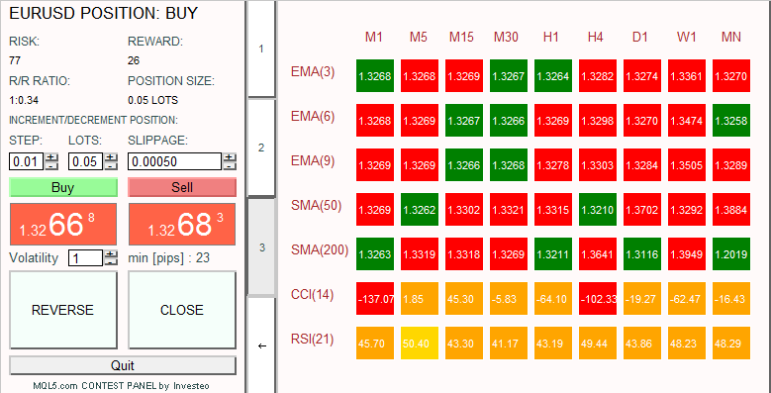
MTF Indicator monitor
2D table showing indicators and moving averages, demo at http://www.youtube.com/watch?v=BDzjKK4ixzk

Slide 10

Thank you for attention :-)

