Slide 1

STEMO: Steganography with Language Models
Levin Ahrens, Dominic Stöcker, Facundo Talamonti | STEMO Project | Wave 1 | 11. Dezember 2023

Slide 2
Outline
Hider
Restorer
Detector
Dynamic Arithmetic Encoding

Slide 3
Hider
Input
Secret message (e.g., „The cake is a lie“)
News feed containing 30 articles (~500 words each)

Slide 4
Hider
Input
Secret message (e.g., „The cake is a lie“)
News feed containing 30 articles (~500 words each)
Encoding
Binary encoding of the secret message (“01010100...00001010”)

Slide 5
Hider
Input
Secret message (e.g., „The cake is a lie“)
News feed containing 30 articles (~500 words each)
Encoding
Binary encoding of the secret message (“01010100...00001010”)
Compression
Reduce the number of bits to be hidden

Slide 6
Hider
Input
Secret message (e.g., „The cake is a lie“)
News feed containing 30 articles (~500 words each)
Encoding
Binary encoding of the secret message (“01010100...00001010”)
Compression
Reduce the number of bits to be hidden
Hiding
Hide compressed secret in articles

Slide 7
Hider
Input
Secret message (e.g., „The cake is a lie“)
News feed containing 30 articles (~500 words each)
Encoding
Binary encoding of the secret message (“01010100...00001010”)
Compression
Reduce the number of bits to be hidden
Hiding
Hide compressed secret in articles
Output
News feed with 30 articles, including the secret message

Slide 8
Hider
Input
Secret message (e.g., „The cake is a lie“)
News feed containing 30 articles (~500 words each)
Encoding
Binary encoding of the secret message (“01010100...00001010”)
Compression
Reduce the number of bits to be hidden
Hiding
Hide compressed secret in articles
Output
News feed with 30 articles, including the secret message

Slide 9
Restorer
Input
Hide secret in articles

Slide 10
Restorer
Restoring
News feed with hidden message
Input
Hide secret in articles

Slide 11
Restorer
Decompression
Loss-less decompression of the binary secret
Restoring
News feed with hidden message
Input
Hide secret in articles

Slide 12
Restorer
Decoding
Decode the binary message
Decompression
Loss-less decompression of the binary secret
Restoring
News feed with hidden message
Input
Hide secret in articles

Slide 13
Restorer
Output
Secret Message („The cake is a lie“)
Decoding
Decode the binary message
Decompression
Loss-less decompression of the binary secret
Restoring
News feed with hidden message
Input
Hide secret in articles

Slide 14
Codecs – Dynamic Arithmetic Encoding
Basic Idea
Fractional Interval encoding:
compresses a message by representing it as a single number within a fractional interval [0, 1)
This number is determined by progressively subdividing the interval based on the probability of each character in the message
Includes character frequency in the subdivision process to achieve higher compression ratio
Basic Idea:
.0011010011110012
A
B
A
C
A
0
a
b
1
001
101
001
111
001

Slide 15
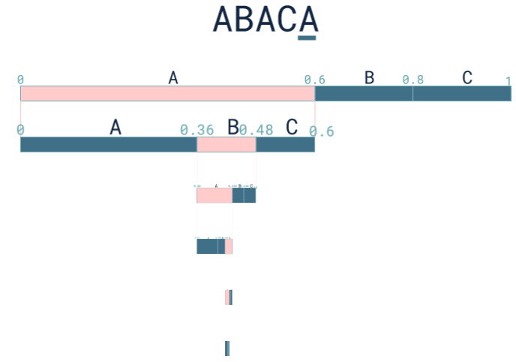
Codecs – Dynamic Arithmetic Encoding - Example String ABACA
Output:
Decimal number which will be converted into binary stream
Binary stream will then be embedded into newsfeed

Slide 16
Detector
1. Rule-based Detector
Simple rule-based analysis of linguistic properties
Hard-coded thresholds for decision making

Slide 17
Detector
1. Rule-based Detector
Simple rule-based analysis of linguistic properties
Hard-coded thresholds for decision making
2. LLM-Property based Detector
Input newspaper article gets tokenized and evaluated in llama llm
Decision based on statistical properties of text (e.g. DetectGPT)

Slide 18
Detector
1. Rule-based Detector
Simple rule-based analysis of linguistic properties
Threshold-based decision
3. ML-based Detector
Features
statistical properties of tokenized and evaluated text
pinguistic properties of text
Possible ML algorithms:
SVM
RFC
2. LLM-Property based Detector
Input newspaper article gets tokenized and evaluated in llama llm
Threshold-based decision considering statistical properties of text (e.g. DetectGPT)

