Slide 1

STEMO: Steganography with Language Models
Levin Ahrens, Dominic Stöcker, Facundo Talamonti | STEMO Project | Wave 2 | December 13 2023

Slide 2
Outline
📥 Hider
📤 Restorer
🔎 Detector

Slide 3
Hider
Input
Secret message (e.g., „The cake is a lie“)
News feed containing 30 articles (~500 words each)

Slide 4
Hider
Input
Secret message (e.g., „The cake is a lie“)
News feed containing 30 articles (~500 words each)
Encoding
Binary encoding of the secret message (“01010100...00001010”)

Slide 5
Hider
Input
Secret message (e.g., „The cake is a lie“)
News feed containing 30 articles (~500 words each)
Encoding
Binary encoding of the secret message (“01010100...00001010”)
Compression
Reduce the number of bits to be hidden with Dynamic Arithmetic Encoding
Notes:
Dyamic Arithmetic Encoding Compression:
compresses a message by representing it as a single number within a fractional interval [0, 1)
This number is determined by progressively subdividing the interval based on the probability of each character in the message
Includes character frequency in the subdivision process to achieve higher compression ratio

Slide 6
Hider
Input
Secret message (e.g., „The cake is a lie“)
News feed containing 30 articles (~500 words each)
Encoding
Binary encoding of the secret message (“01010100...00001010”)
Compression
Reduce the number of bits to be hidden with Dynamic Arithmetic Encoding
Hiding
Prompt the LLM with first few words
Decide on next token based on binary triplets (“010” -> index 2)

Slide 7
Hider
Input
Secret message (e.g., „The cake is a lie“)
News feed containing 30 articles (~500 words each)
Encoding
Binary encoding of the secret message (“01010100...00001010”)
Compression
Reduce the number of bits to be hidden with Dynamic Arithmetic Encoding
Hiding
Prompt the LLM with first few words
Decide on next token based on binary triplets (“010” -> index 2)
Output
News feed with 30 articles, including the secret message

Slide 8
Restorer
Input
News feed with hidden message

Slide 9
Restorer
Restoring
Restore secret by computing next tokens and comparing them with the true next token
Input
News feed with hidden message

Slide 10
Restorer
Decompression
Loss-less decompression of the binary secret
Restoring
Restore secret by computing next tokens and comparing them with the true next token
Input
News feed with hidden message

Slide 11
Restorer
Decoding
Decode the binary message
Decompression
Loss-less decompression of the binary secret
Restoring
Restore secret by computing next tokens and comparing them with the true next token
Input
News feed with hidden message

Slide 12
Restorer
Output
Secret Message („The cake is a lie“)
Decoding
Decode the binary message
Decompression
Loss-less decompression of the binary secret
Restoring
Restore secret by computing next tokens and comparing them with the true next token
Input
News feed with hidden message

Slide 13
Codecs – Dynamic Arithmetic Encoding
Basic Idea
Fractional Interval encoding:
compresses a message by representing it as a single number within a fractional interval [0, 1)
This number is determined by progressively subdividing the interval based on the probability of each character in the message
Includes character frequency in the subdivision process to achieve higher compression ratio
Basic Idea:
.0011010011110012
A
B
A
C
A
0
a
b
1
001
101
001
111
001

Slide 14
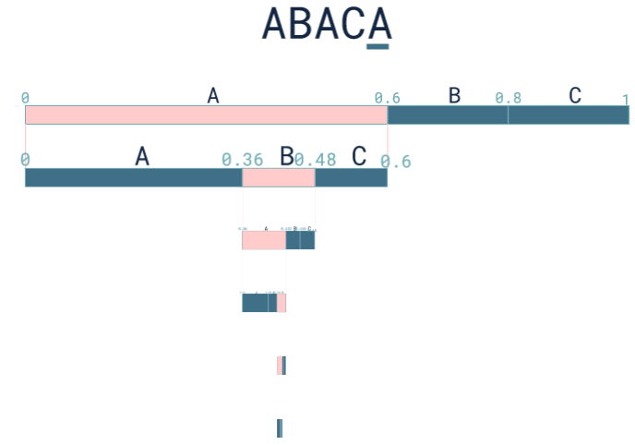
Codecs – Dynamic Arithmetic Encoding - Example String ABACA
Output:
Decimal number which will be converted into binary stream
Binary stream will then be embedded into newsfeed

Slide 15
Detector
1. Rule-based Detector
Simple rule-based analysis of linguistic properties
Threshold-based decision

Slide 16
Detector
1. Rule-based Detector
Simple rule-based analysis of linguistic properties
Threshold-based decision
2. LLM Property-based Detector
Input newsfeed is split into articles
Articles get tokenized and evaluated in llama llm
Threshold-based decision considering statistical properties of text (e.g. DetectGPT)

Slide 17
Detector
1. Rule-based Detector
Simple rule-based analysis of linguistic properties
Threshold-based decision
3. ML-based Detector
Features
Statistical properties
Avg. Token Probability
(DetectGPT, …)
Linguistic properties
Avg. sentence length, vocabulary richness, flesch score, entropy, sentiment, repetition patterns
Possible ML algorithms:
Novelty/Outlier Detection (One-Class SVM)
Binary Classification (Random Forest, SVM)
2. LLM Property-based Detector
Tokenization and evaluation of newsfeed articles in Llama
Threshold-based decision considering statistical properties of text (e.g. DetectGPT)

