Slide 1

STEMO: Steganography with Language Models
Levin Ahrens, Dominic Stöcker, Facundo Talamonti | STEMO Project | Wave 1 | 12. Dezember 2023

Slide 2
Outline
Hider
Restorer
Detector
📤
📥
🔎

Slide 3
Hider
Input
Secret message (e.g., „The cake is a lie“)
News feed containing 30 articles (~500 words each)

Slide 4
Hider
Input
Secret message (e.g., „The cake is a lie“)
News feed containing 30 articles (~500 words each)
Encoding
Binary encoding of the secret message (“01010100...00001010”)

Slide 5
Hider
Input
Secret message (e.g., „The cake is a lie“)
News feed containing 30 articles (~500 words each)
Encoding
Binary encoding of the secret message (“01010100...00001010”)
Compression
Reduce the number of bits to be hidden

Slide 6
Hider
Input
Secret message (e.g., „The cake is a lie“)
News feed containing 30 articles (~500 words each)
Encoding
Binary encoding of the secret message (“01010100...00001010”)
Compression
Reduce the number of bits to be hidden with Dynamic Arithmetic Encoding
Hiding
Hide compressed secret in articles

Slide 7
Hider
Input
Secret message (e.g., „The cake is a lie“)
News feed containing 30 articles (~500 words each)
Encoding
Binary encoding of the secret message (“01010100...00001010”)
Compression
Reduce the number of bits to be hidden
Hiding
Hide compressed secret in articles
Output
News feed with 30 articles, including the secret message

Slide 8
Restorer
Input
Hide secret in articles

Slide 9
Restorer
Restoring
News feed with hidden message
Input
Hide secret in articles

Slide 10
Restorer
Decompression
Loss-less decompression of the binary secret
Restoring
News feed with hidden message
Input
Hide secret in articles

Slide 11
Restorer
Decoding
Decode the binary message
Decompression
Loss-less decompression of the binary secret
Restoring
News feed with hidden message
Input
Hide secret in articles

Slide 12
Restorer
Output
Secret Message („The cake is a lie“)
Decoding
Decode the binary message
Decompression
Loss-less decompression of the binary secret
Restoring
News feed with hidden message
Input
Hide secret in articles

Slide 13
Codecs – Dynamic Arithmetic Encoding
Basic Idea
Fractional Interval encoding:
compresses a message by representing it as a single number within a fractional interval [0, 1)
This number is determined by progressively subdividing the interval based on the probability of each character in the message
Includes character frequency in the subdivision process to achieve higher compression ratio
Basic Idea:
.0011010011110012
A
B
A
C
A
0
a
b
1
001
101
001
111
001

Slide 14
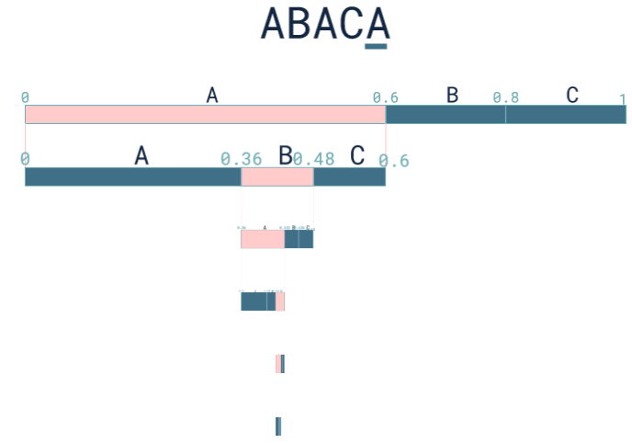
Codecs – Dynamic Arithmetic Encoding - Example String ABACA
Output:
Decimal number which will be converted into binary stream
Binary stream will then be embedded into newsfeed

Slide 15
Detector
1. Rule-based Detector
Simple rule-based analysis of linguistic properties
Threshold-based decision

Slide 16
Detector
1. Rule-based Detector
Simple rule-based analysis of linguistic properties
Threshold-based decision
2. LLM-Property based Detector
Input newspaper article gets tokenized and evaluated in llama llm
Threshold-based decision considering statistical properties of text (e.g. DetectGPT)

Slide 17
Detector
1. Rule-based Detector
Simple rule-based analysis of linguistic properties
Threshold-based decision
3. ML-based Detector
Features
statistical properties
Avg Token Probability
linguistic properties
Avg sentence length, vocabulary richness, flesch score, entropy, sentiment, repetition patterns
Possible ML algorithms:
SVM
RFC
2. LLM-Property based Detector
Input newspaper article gets tokenized and evaluated in llama llm
Threshold-based decision considering statistical properties of text (e.g. DetectGPT)

