Slide 1

STEMO: Steganography with Language Models
Levin Ahrens, Dominic Stöcker, Facundo Talamonti | STEMO Project | Wave 2 | December 13 2023

Slide 2
Outline
📥 Hiders & 📤 Restorers
Probability Order Hider
Arithmetic Encoding Hider
🔎 Detector
Zero-Shot Detectors: DetectGPT & DNA-GPT
Anomaly Detector
Semantic & Statistical Properties Detector
Conclusion and Future Work

Slide 3
Hider
Input
Secret message (e.g., „The cake is a lie“)
News feed containing 30 articles (~500 words each)
Encoding
Binary encoding of the secret message (“01010100...00001010”)
Compression
Reduce the number of bits to be hidden with Dynamic Arithmetic Encoding
Hiding
Prompt the LLM with first few words
Decide on next token based on binary triplets (“010” -> index 2)
Output
News feed with 30 articles, including the secret message

Slide 4
Restorer
Output
Secret Message („The cake is a lie“)
Decoding
Decode the binary message
Decompression
Loss-less decompression of the binary secret
Restoring
Restore secret by computing next tokens and comparing them with the true next token
Input
News feed with hidden message

Slide 5
Hider
Input
Secret message (e.g., „The cake is a lie“)
News feed containing 30 articles (~500 words each)
Encoding
Binary encoding of the secret message (“01010100...00001010”)
Compression
Reduce the number of bits to be hidden with Dynamic Arithmetic Encoding
Hiding
Prompt the LLM with first few words
Decide on next token based on binary triplets (“010” -> index 2)
Output
News feed with 30 articles, including the secret message

Slide 6
Restorer
Output
Secret Message („The cake is a lie“)
Decoding
Decode the binary message
Decompression
Loss-less decompression of the binary secret
Restoring
Restore secret by computing next tokens and comparing them with the true next token
Input
News feed with hidden message

Slide 7
Dynamic Arithmetic Encoding
Basic Idea
Fractional Interval encoding:
compresses a message by representing it as a single number within a fractional interval [0, 1)
This number is determined by progressively subdividing the interval based on the probability of each character in the message
Includes character frequency in the subdivision process to achieve higher compression ratio
Basic Idea:
.0011010011110012
A
B
A
C
A
0
a
b
1
001
101
001
111
001

Slide 8
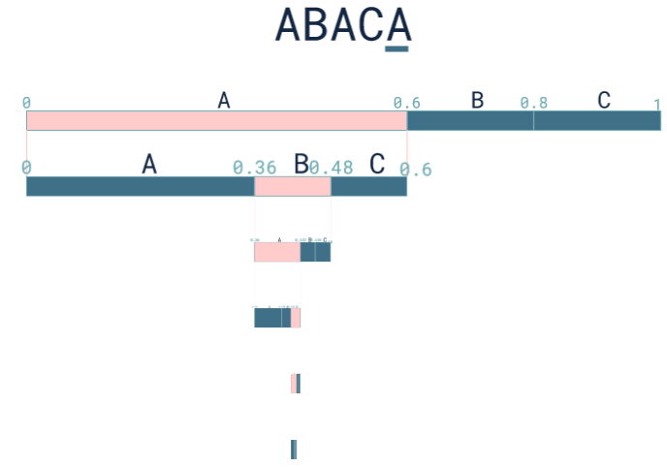
Codecs – Dynamic Arithmetic Encoding - Example String ABACA
Output:
Decimal number which will be converted into binary stream
Binary stream will then be embedded into newsfeed

Slide 9
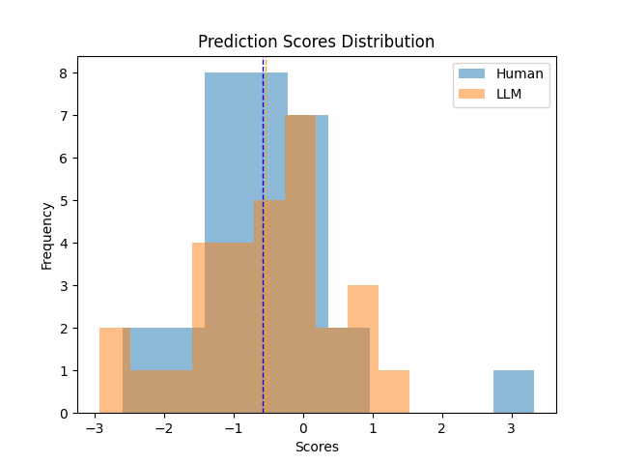
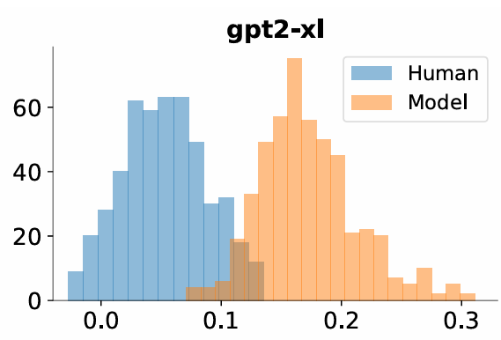
Zero-Shot Detectors
Detect-GPT
Zero-Shot Methods: Methods purely based on specific linguistic properties (e.g., Log probability function) without the need to train a classifier and collecting datasets
Detect-GPT: Hypothesizes that Log-Probability function of LLM-generated text tend to fall in negative regions and human-written text more likely in positive
Log Probability Change (Perturbation Discrepancy)
DetectGPTs:
Ours:

Slide 10
Detector
1. Rule-based Detector
Simple rule-based analysis of linguistic properties
Threshold-based decision
3. ML-based Detector
Features
Statistical properties
Avg. Token Probability
(DetectGPT, …)
Linguistic properties
Avg. sentence length, vocabulary richness, flesch score, entropy, sentiment, repetition patterns
Possible ML algorithms:
Novelty/Outlier Detection (One-Class SVM)
Binary Classification (Random Forest, SVM)
2. LLM Property-based Detector
Tokenization and evaluation of newsfeed articles in Llama
Threshold-based decision considering statistical properties of text (e.g. DetectGPT)

Slide 11
Anomaly Detecor
Basic Overview

Slide 12
Anomaly Detecor
Feature Engineering

Slide 13
Anomaly Detecor
Training

Slide 14
Semantic and Statistic Properties Detector
Basic Overview

Slide 15
Semantic and Statistic Properties Detector
Architecture – Semantic and Statistical Properties

Slide 16
Semantic and Statistic Properties Detector
Architecture – Fusion Component and Classifier

Slide 17
Semantic and Statistic Properties Detector
Architecture – Training and Results

Slide 18
Conclusion

