Slide 1
My dissertation’s first semester demonstration
Student: Stoian Alin-Bogdan
Professors: Truică Ciprian-Octavian, Apostol Elena-Simona

Slide 2
Goals
Study the feasibility of implementing a search on a quantum database ✔️
Study methods for instantiating an arbitrary quantum database ✔️
Study methods for searching through quantum database ✔️
Achieve preliminary results ✔️
Figure out a way to make search useful for real database search ❌

Slide 3
The method - instantiation
Quantum database instantiation is done using the method presented in [1] – creating an equal superposition one qubit less than the bounds of the database and then swapping unused values to values in the first N – 1 qubits to used values in the database which includes the final qubit.
Example: instantiate database which contains the values 00, 01, 10 and 11, and then swap the state for 01 to 110 in order to create the database 00, 10, 11 and 110.
Not ideal, doesn’t cover all cases, can only instantiate a subset of databases

Slide 4
The method - search
Using qiskit’s AmplificationProblem class to implement the Grover iteration – marking a state defined using qiskit’s Statevector class and then composing with the outputted Grover operator.
Not ideal, relies on qiskit’s own classes for defining the Grover iteration.
Hard to define a benchmark!

Slide 5
Future development
Instantiation of actual arbitrary database, perhaps from bit encoded text file
Own implementation of Grover diffusion and amplification steps to compare with a (perhaps optimized) version of qiskit’s GroverOperator class.
Method to encode actual database values in a quantum database (e.g. the keys of a key-value database)

Slide 6
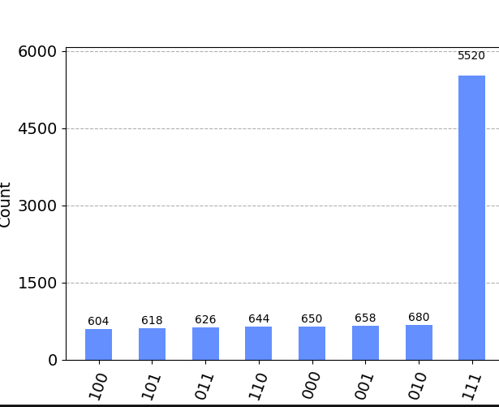
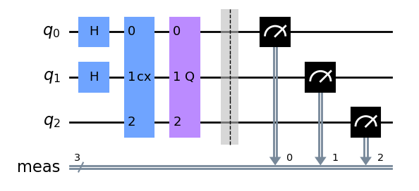
Demonstration 1

Slide 7
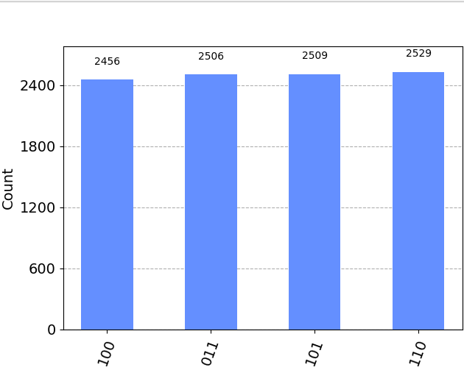
Demonstration 2

