Slide 1
Introduction to Big Data Project – End-To-End pipeline
Students:
- Stoian Alin-Bogdan
-Cuș Cătălin-Alexandru
Professor: Negru CĂTĂLIN

Slide 2
Purpose
The purpose of this project is the design, creation and implementation of an End-to-End Data pipeline.
Our pipeline will include:
Data acquisition through shell scripts
Ingestion & intermediary processing using Apache Kafka
Python implementation of Kafka Producer & Consumer
Pyspark ETL of dataset
Persistence in a MySQL database
Backup and replication of the MySQL database
Dockerization of the entire pipeline

Slide 3

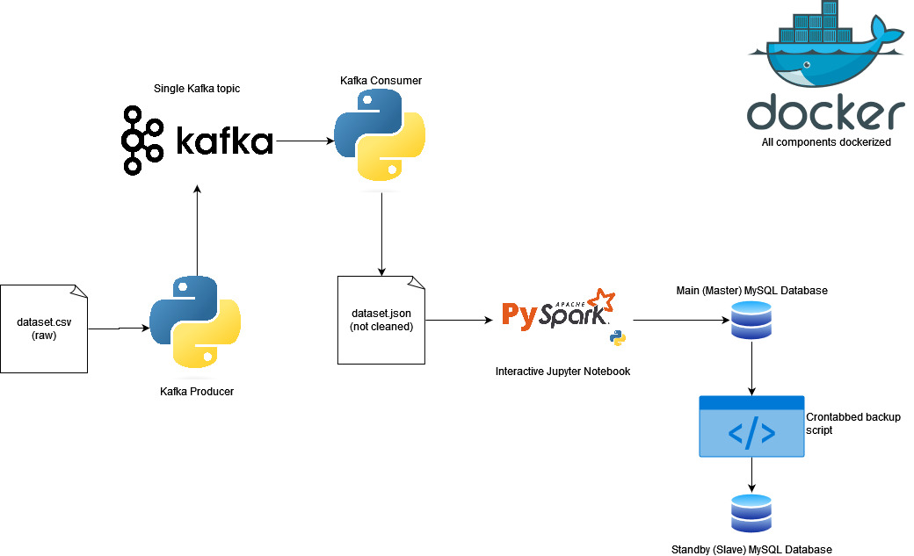
Architecture
This is the architectural /Data Flow diagram of the entire pipeline.
All components are deployed in their own docker container
Kafka Producer, Consumer and PySpark scripts are all in a single jupyter notebook in a docker container containing jupyter and pyspark dependencies.

Slide 4
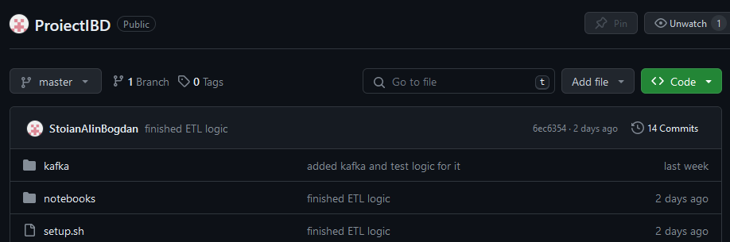
Git
To better coordinate between the members, we have decided to use a GitHub repository.
Contribution to the project was done solely through Git CLI.

Slide 5
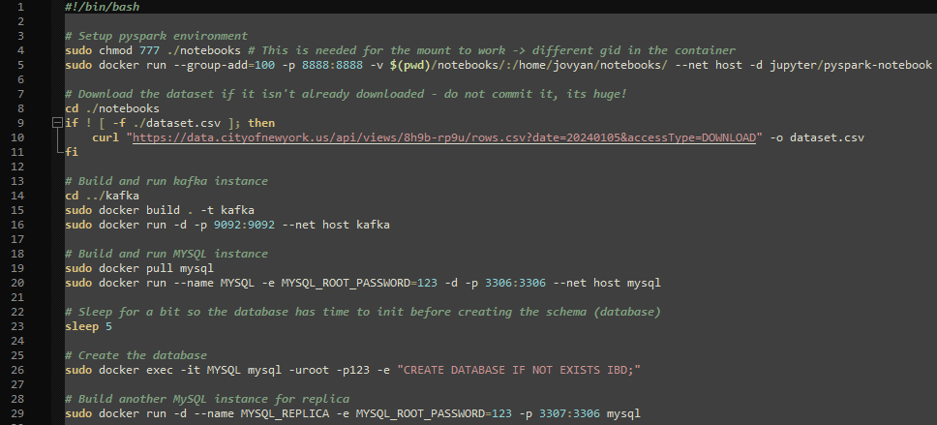
Setup script
To perform dataset acquisition and setup the infrastructure, we have created a bash script.
The script initiates all necessary docker containers and creates a volume mountpoint.
It also creates all necessary databases for the pipeline.

Slide 6
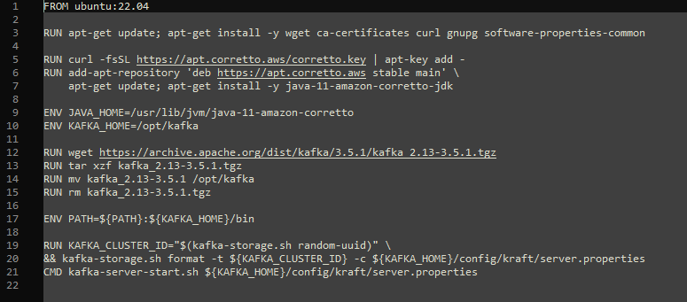
The Docker containers and custom Kafka image
Since we couldn’t identify a Kafka Docker image that uses the new KRaft architecture, we had to create a custom docker image for the Kafka broker. The Dockerfile is presented below:

Slide 7
WSL
As a platform for our project, we have decided to use Windows Subsystem for Linux, running the Ubuntu 22.04 kernel.
Below is the result of executing the setup.sh script.

Slide 8
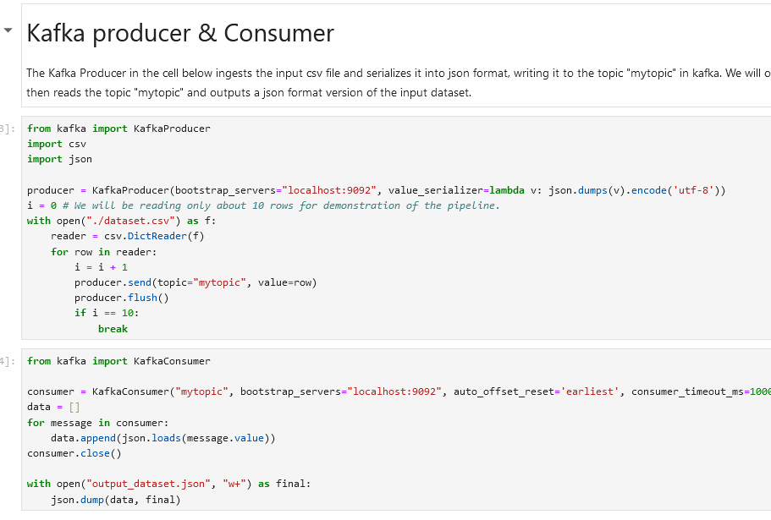
The Kafka Producer & Consumer
All python scripts running in the project are in a Jupyter Notebook.
The effect of using kafka is a conversion from csv to json of the dataset.

Slide 9
The Dataset
The dataset used is the NYPD Arrest Data (Historic) dataset from cityofnewyork.us
The dataset has 19 columns and ~5.5 million rows, resulting in a size of approximately 1.2 GB.
The dataset contains information about perpetrators, laws broken, dates and locations of when and where the arrest took place.

Slide 10
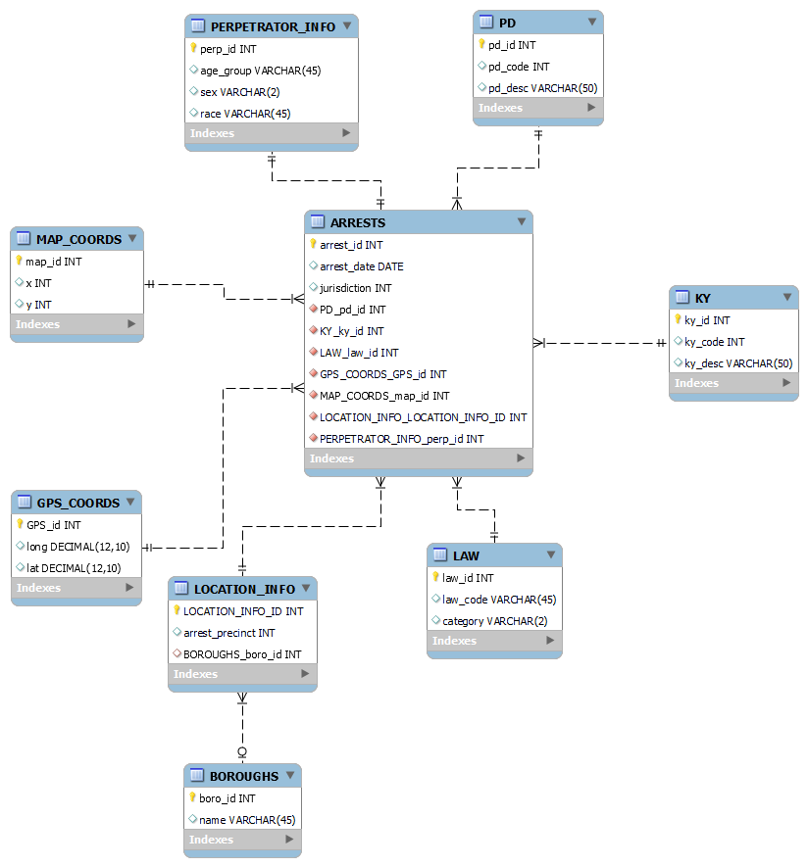
The Database
The normalized form of the database that results from the ETL process is a Data Warehouse with a Star schema, with 1 fact table and 8 (or 7, depending on your definition) dimension tables.

Slide 11

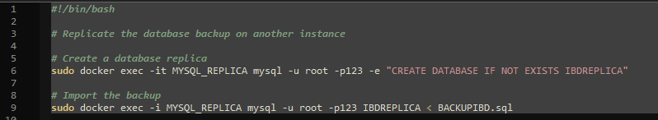
Database backup and replication
Finally, the Database is backed up using mysqldump and replicated asynchronously on a secondary MySQL instance.

