Slide 1


My internship project
Intern: Stoian Alin-Bogdan
27 AUG 2021

Slide 2
Table of contents
Goals
MySQL
DBs & Ingestion w/ Python
Cloud
Reports

Slide 3
Goals
Use as much knowledge from the theoretical part as possible (not directly)
Learn as much as possible (don't focus on only one thing)
Use as much of my previous knowledge as possible

Slide 4
MYSQL
Why MySQL?
See how I adapt to a new DB
Very relevant DB (historically and today) - LAMP stack
Useful for mixed case databases – like mine!
MyISAM vs InnoDB
I like it

Slide 5
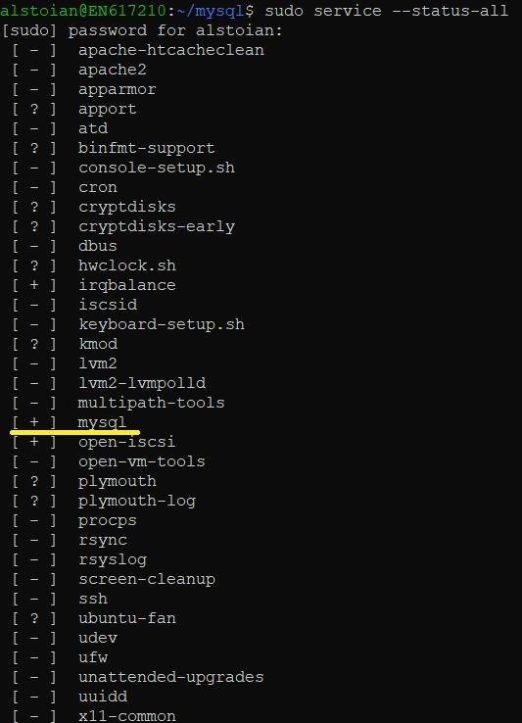
Mysql on linux (wsl)
DB management & administration is
much easier on Linux!
WSL 2.0 (ubuntu 20.04 LTS)
Installation is trivial
(LAMP stack support)

Slide 6
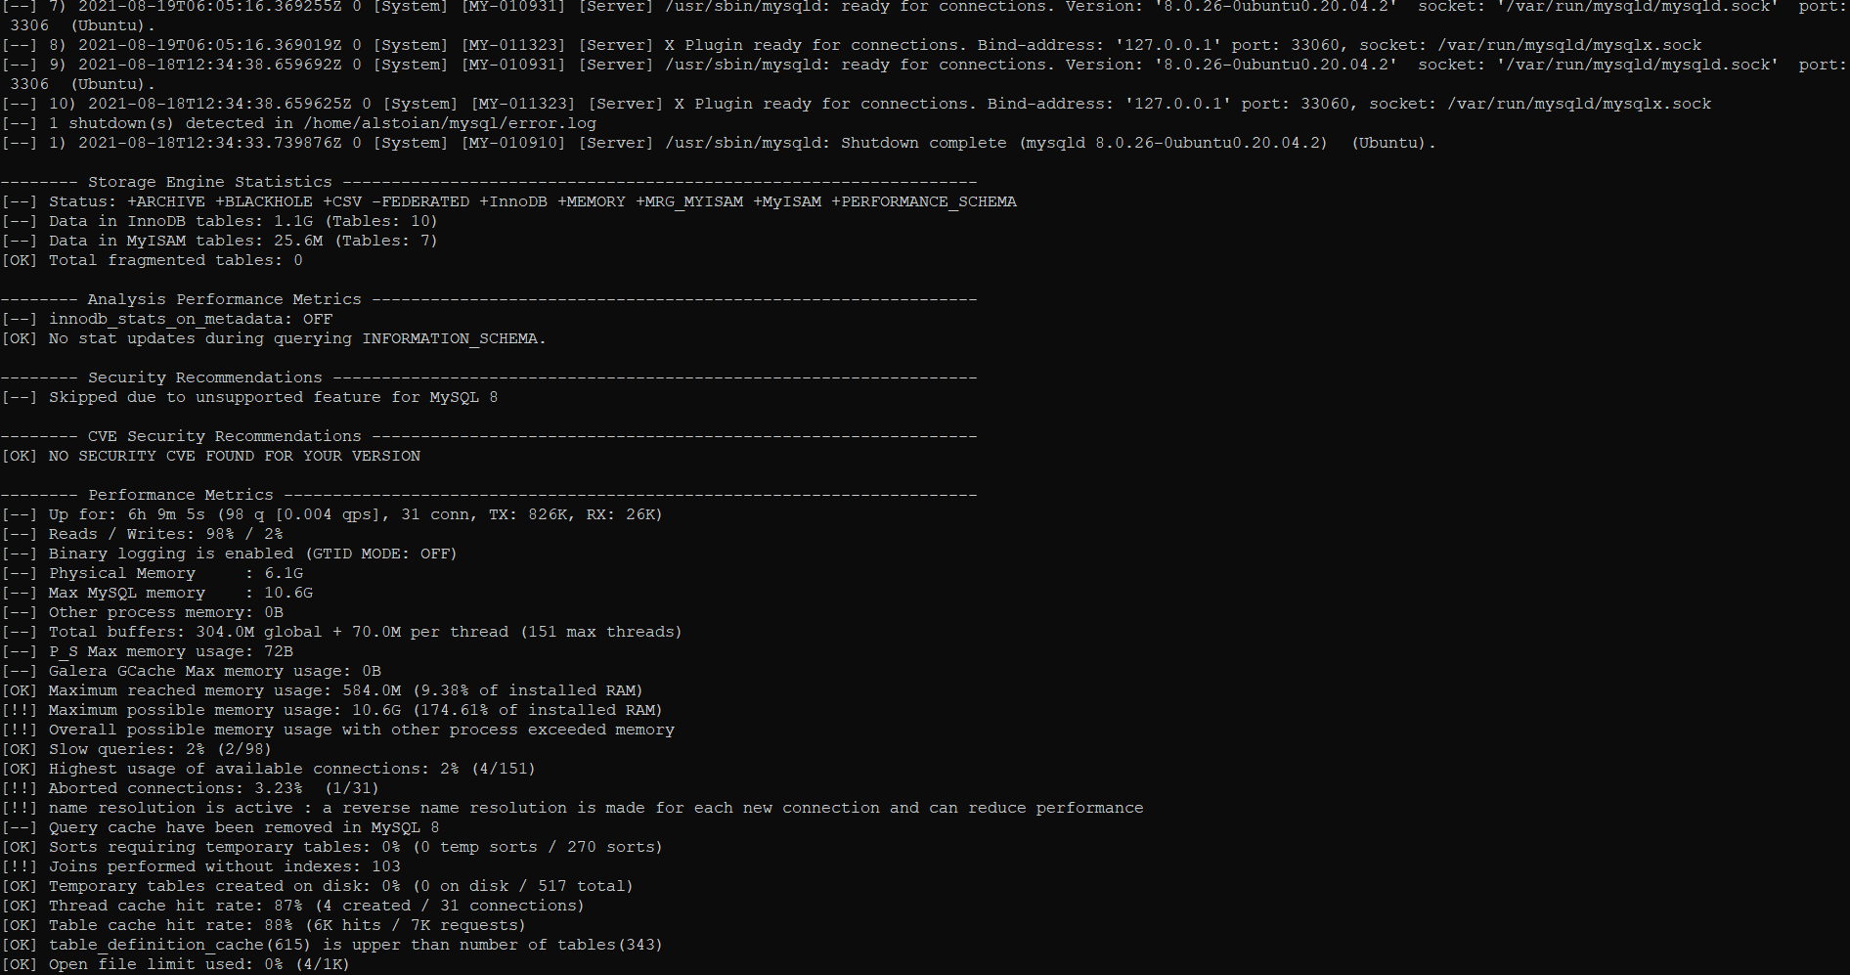
mysqltuner

Slide 7
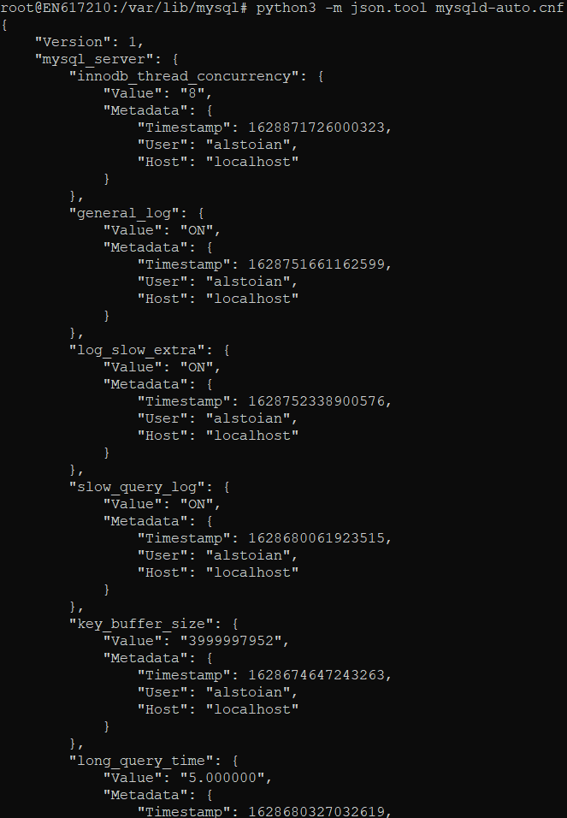
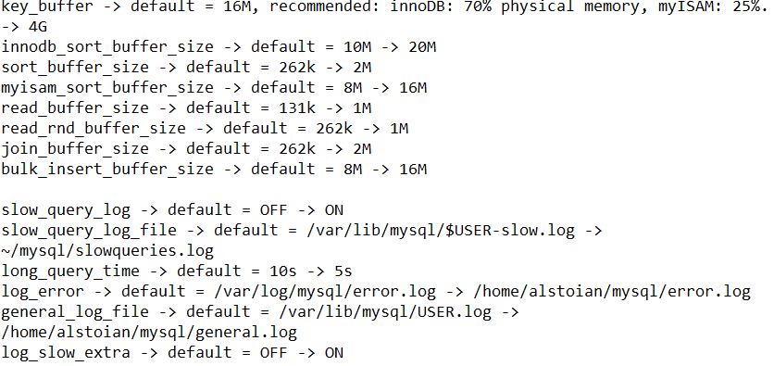

..And many others Persisted vars ->

Slide 8
My dataset
New York arrests 2006-2020
https://data.cityofnewyork.us/Public-Safety/NYPD-Arrests-Data-Historic-/8h9b-rp9u
5.2 million rows, 19 columns -> needs normalization!

Slide 9
DB Design
Why two DBs?
Main, live, Reporting, static – only from the last year (ETL!)
No relations on Reporting?
MyISAM!

Slide 10
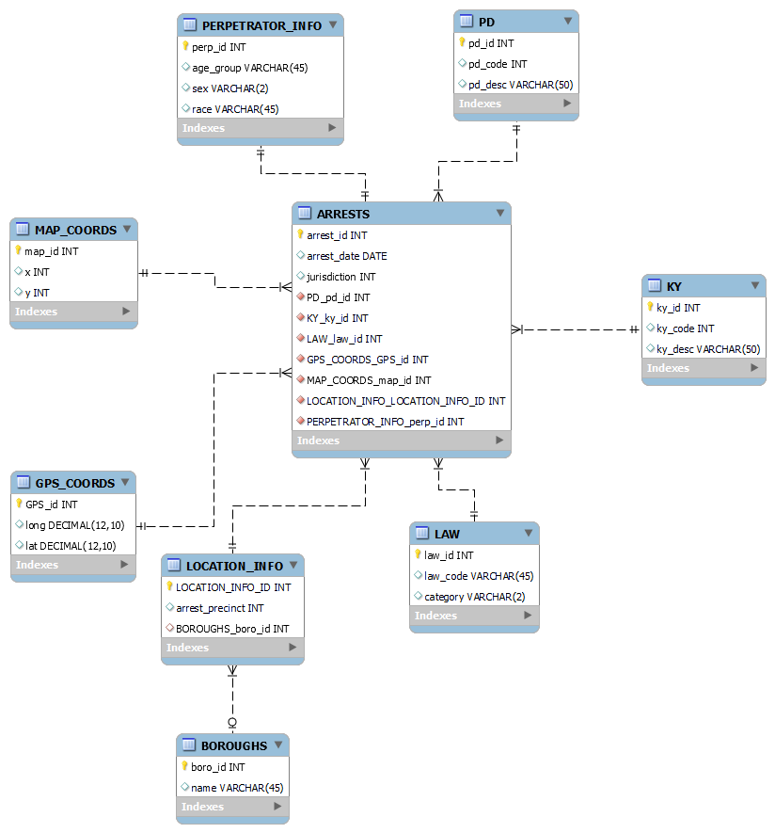
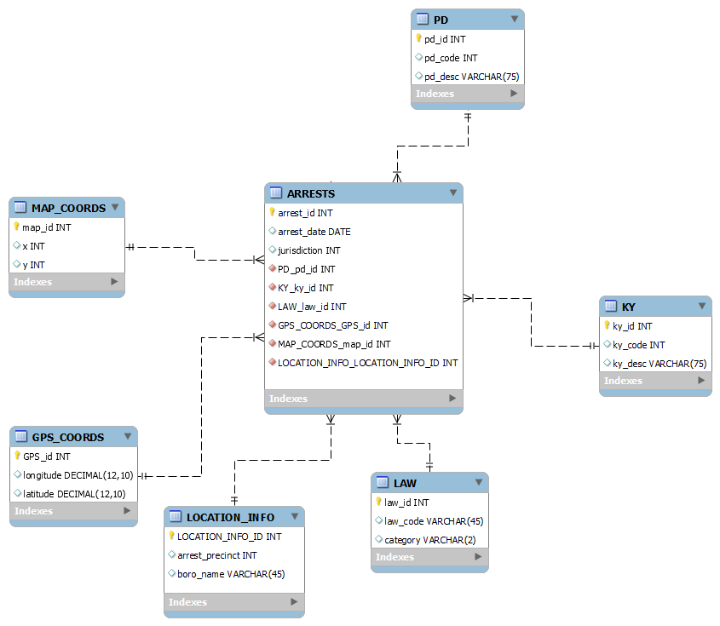

Slide 11
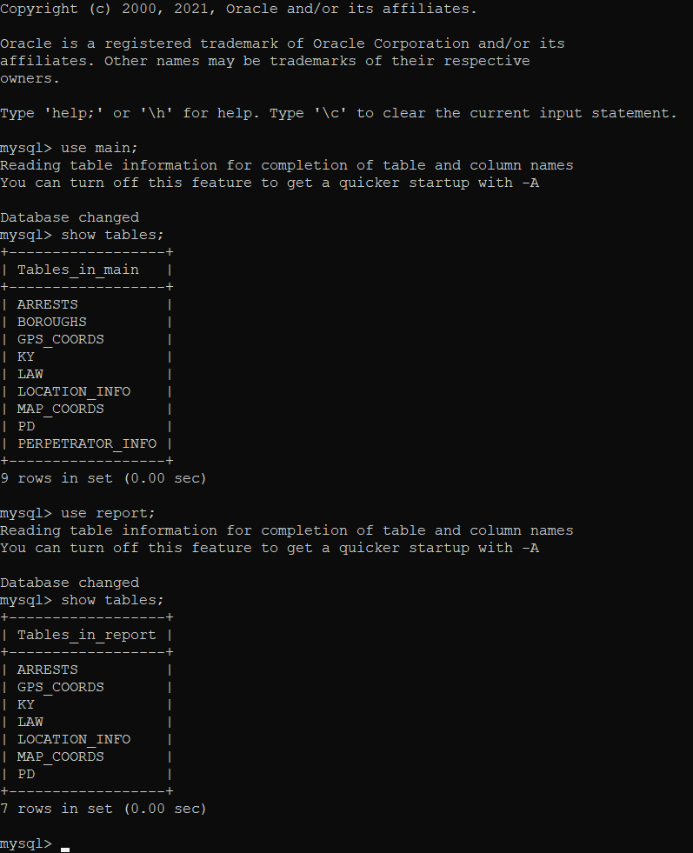
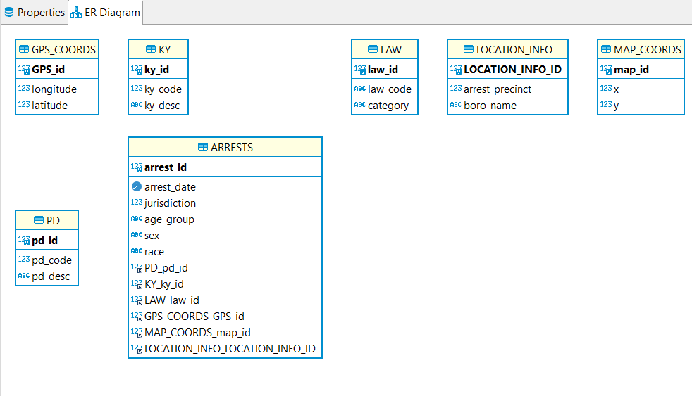
No relations on reporting db because of myisam

Slide 12
Data ingestion
Jupyter notebook
Python
Pandas
Dataframes make it easy to split the massive input .csv
Helper function to generate INSERT statements (for stress testing, curiosity, testing variables, real life performance, etc.)
No direct connection to the database (overhead!)

Slide 13
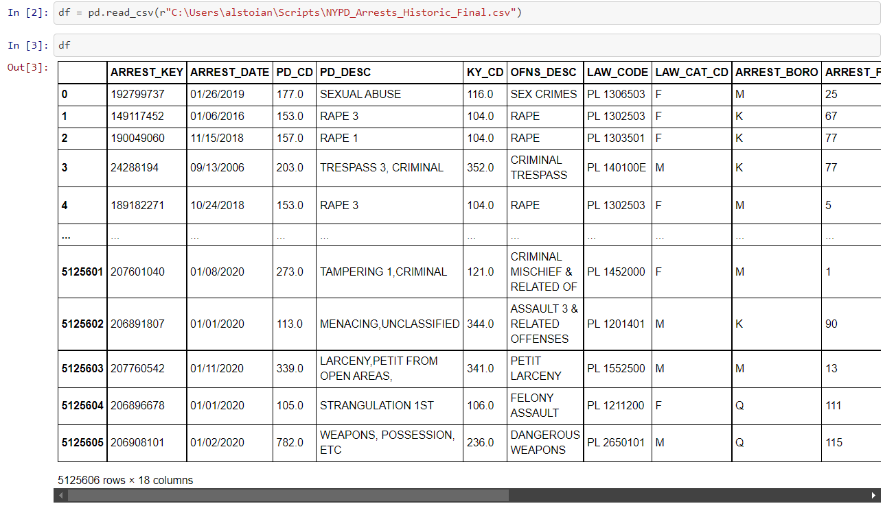
This is what was left after data cleaning

Slide 14
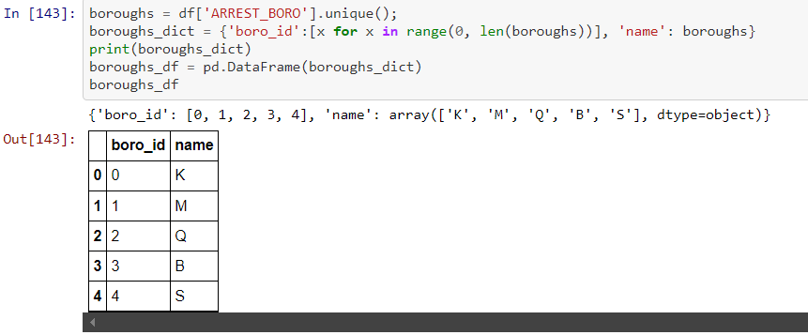
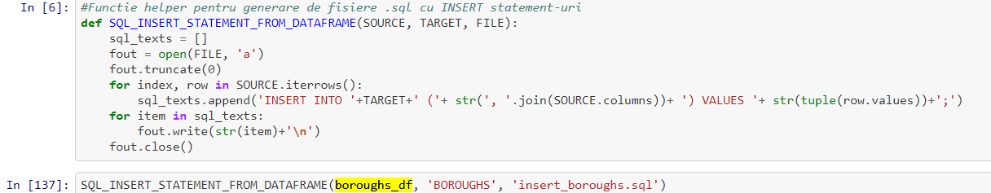
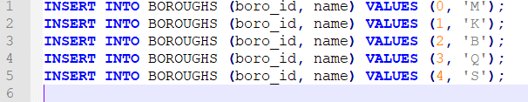

Slide 15
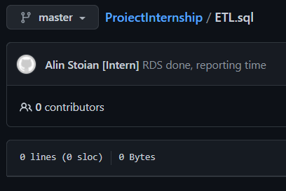
ETL from main to reporting
Mistakes happen...

Slide 16
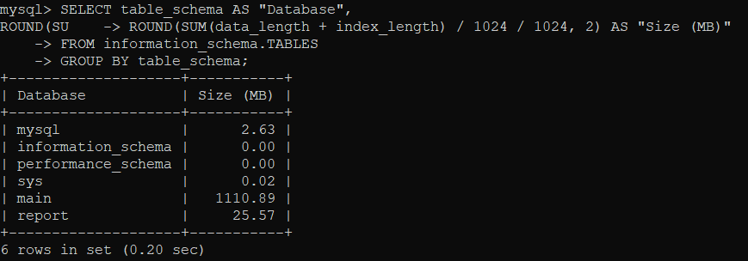
Final result

Slide 17
Cloud
Script to backup reporting database – crontabbed
Backup to EC2 instance
EC2 instance to AWS RDS MySQL - crontabbed

Slide 18
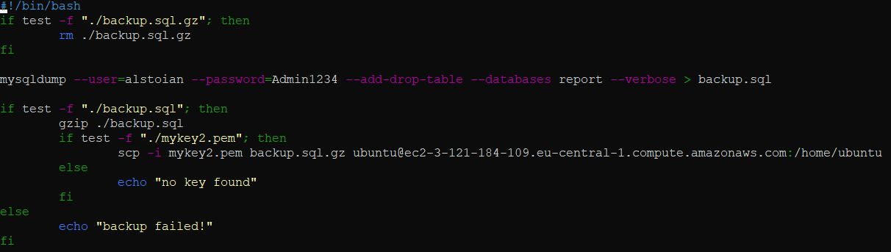
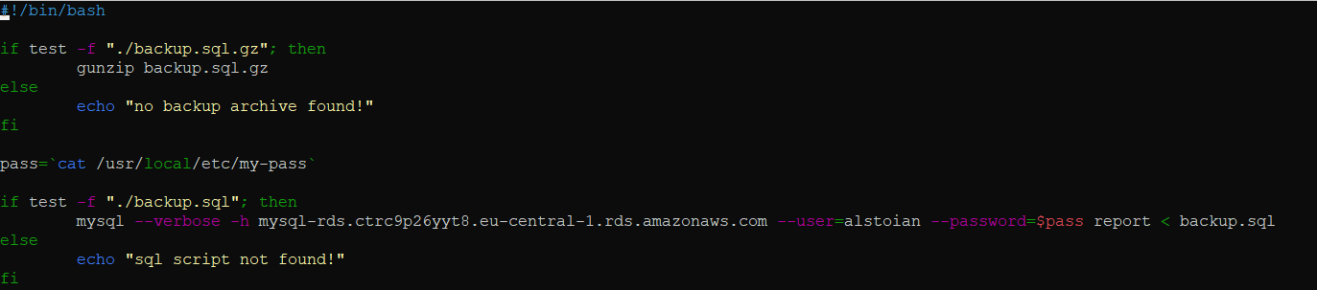
<- on prem <- EC2

Slide 19
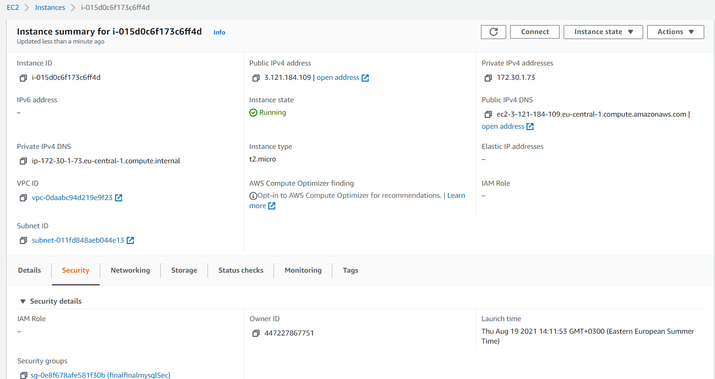

Slide 20
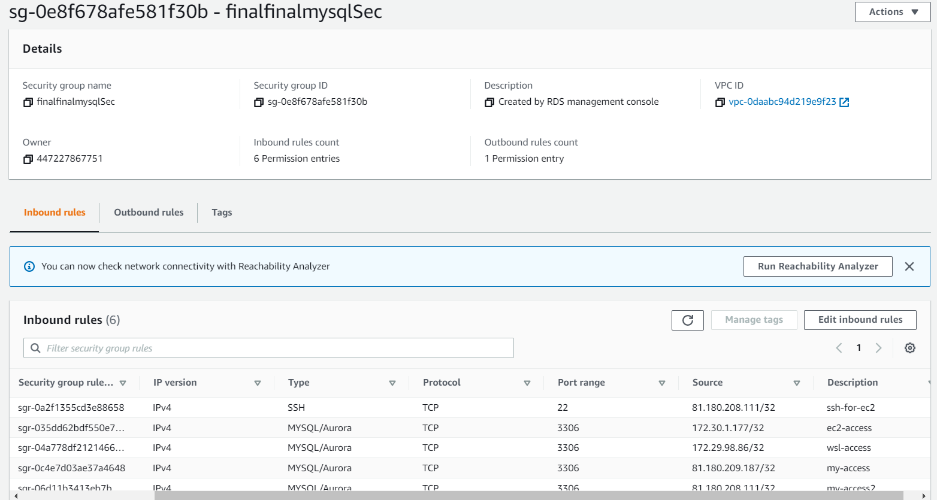

Slide 21
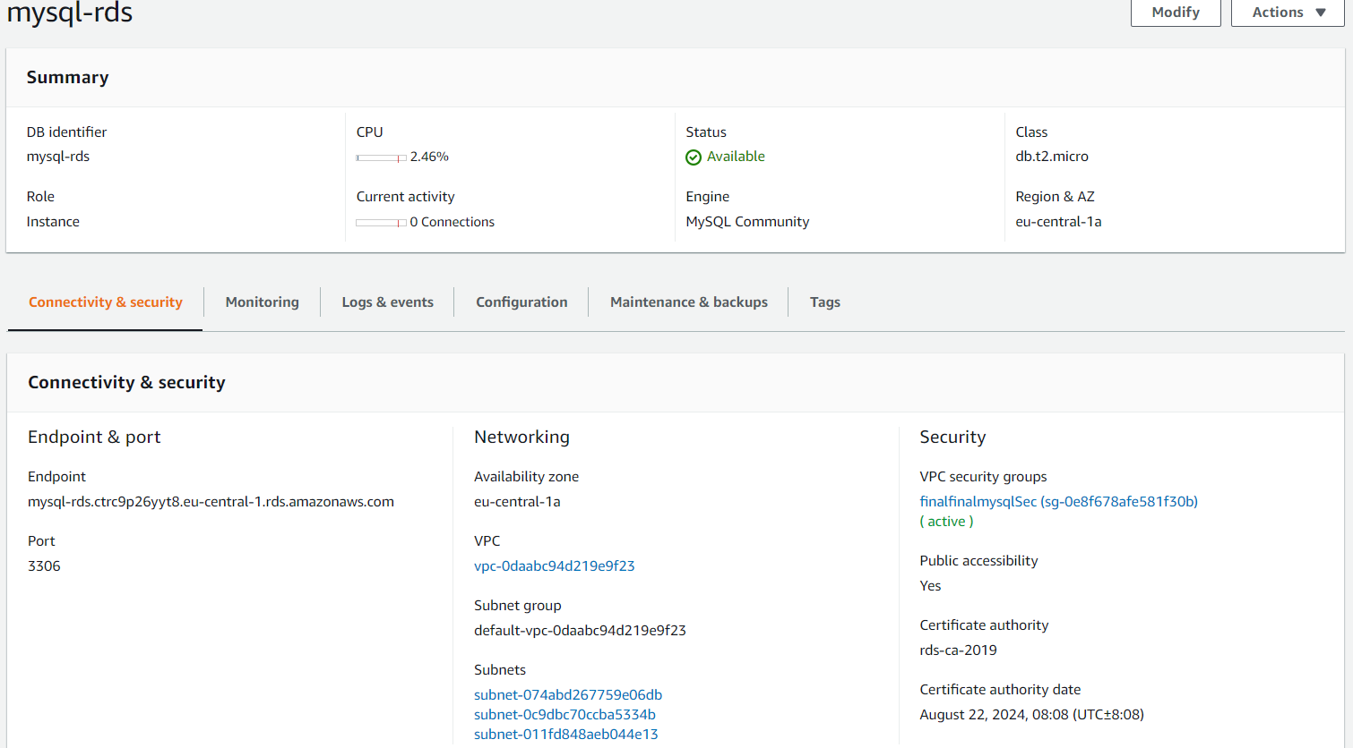

Slide 22
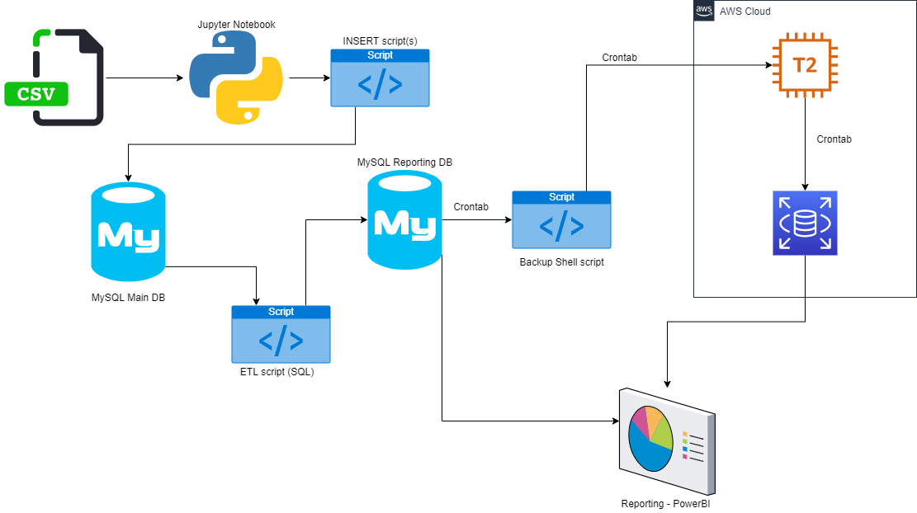
My pipeline

Slide 23
reporting
Powerbi
Dataset was made for analysis
M script & DAX

Slide 24
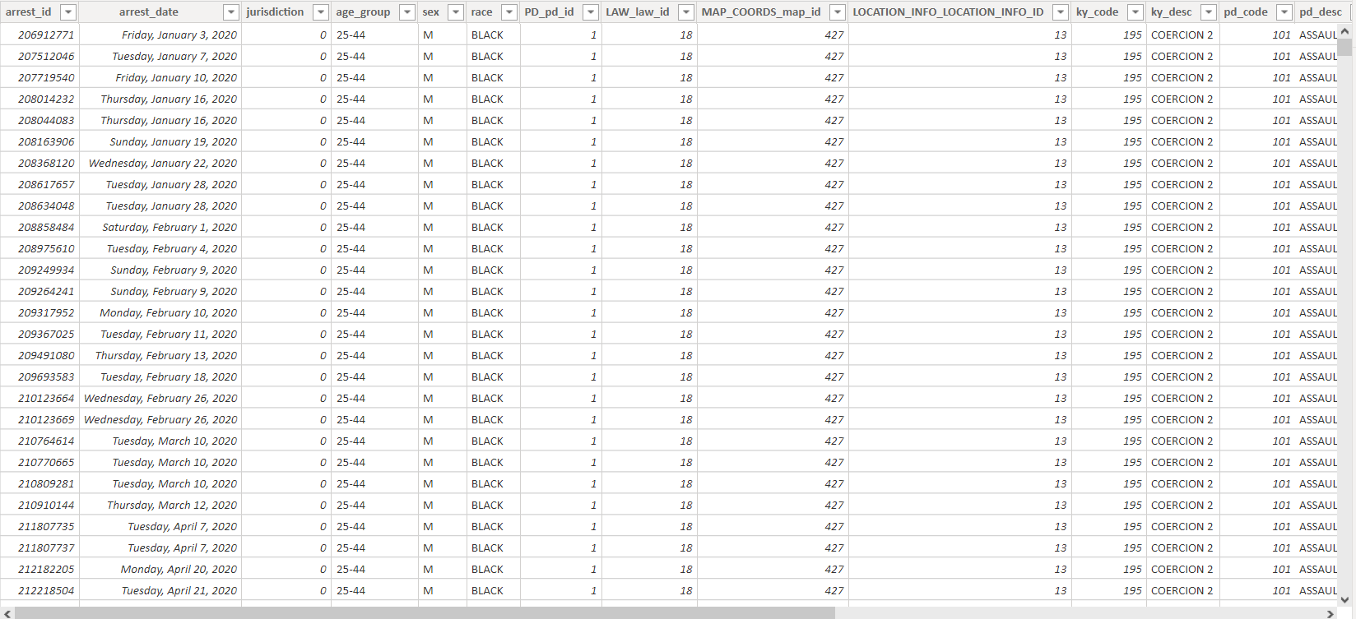
Table after power query

Slide 25
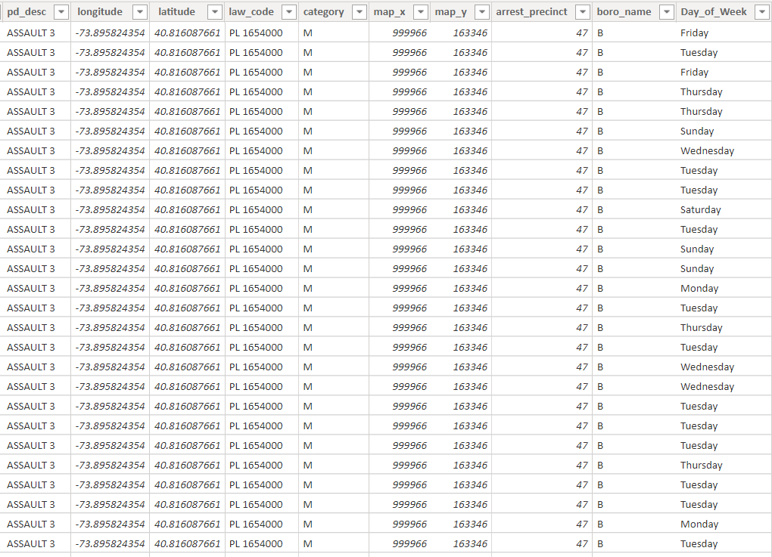
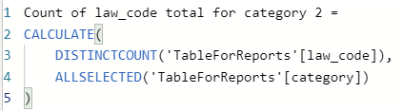
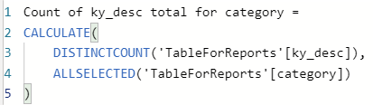
Day_of_week?
And other measures

Slide 26
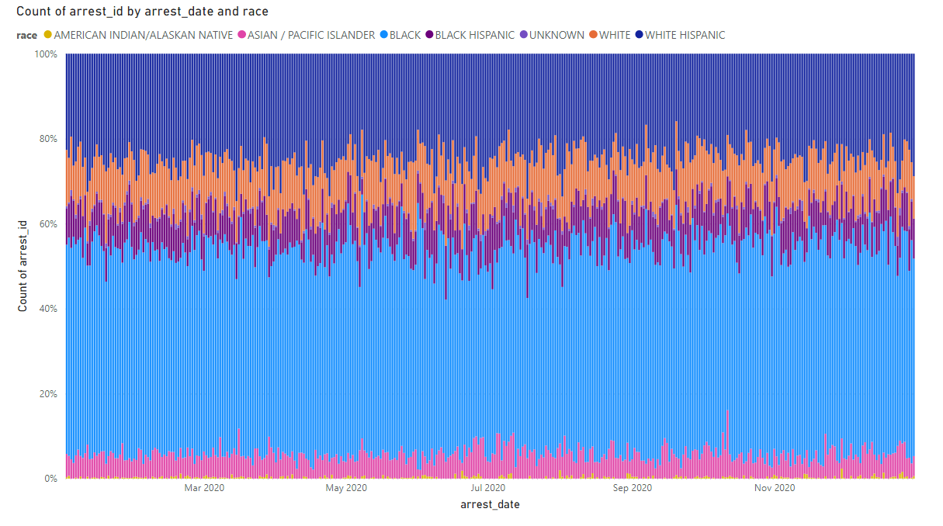

Slide 27
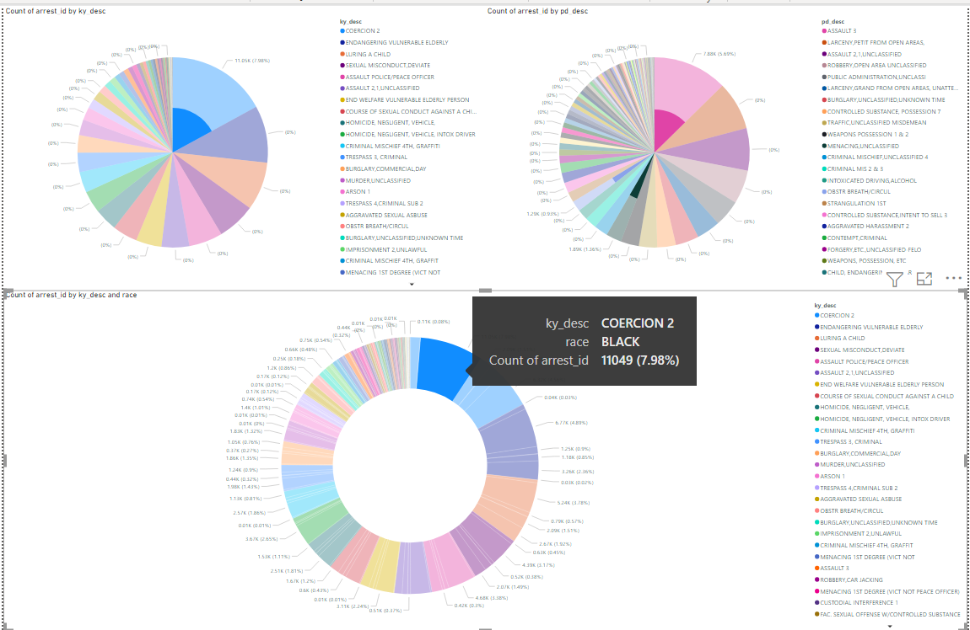
You can click to see breakdown

Slide 28
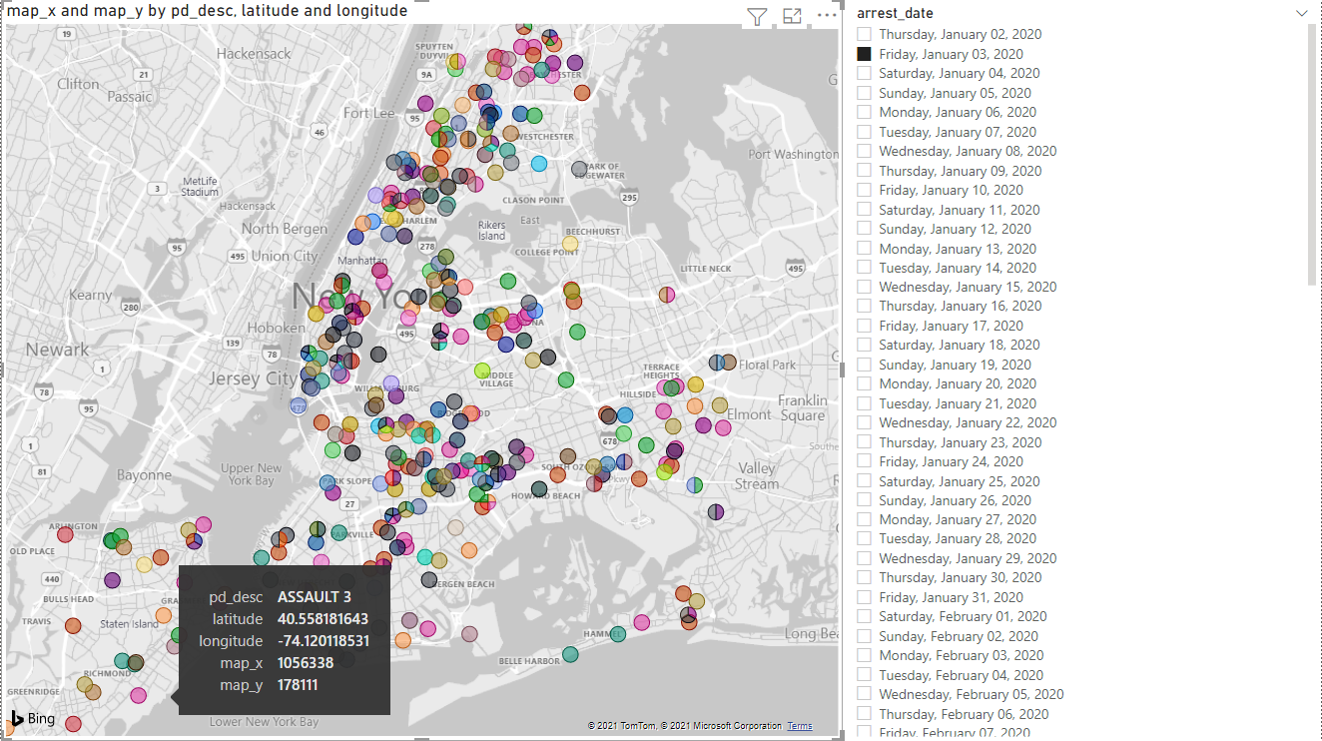
Interactive map w/ date slicer

Slide 29
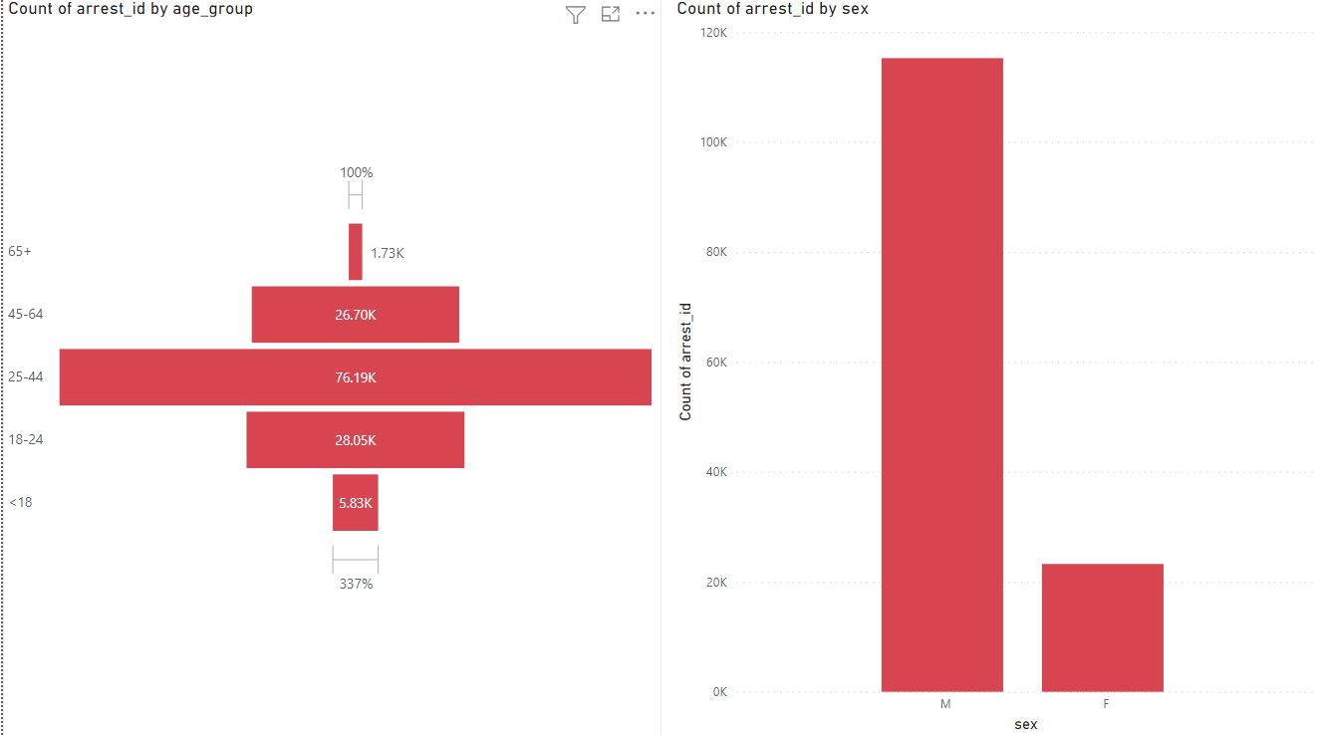
Breakdown of arrests by age & sex

Slide 30
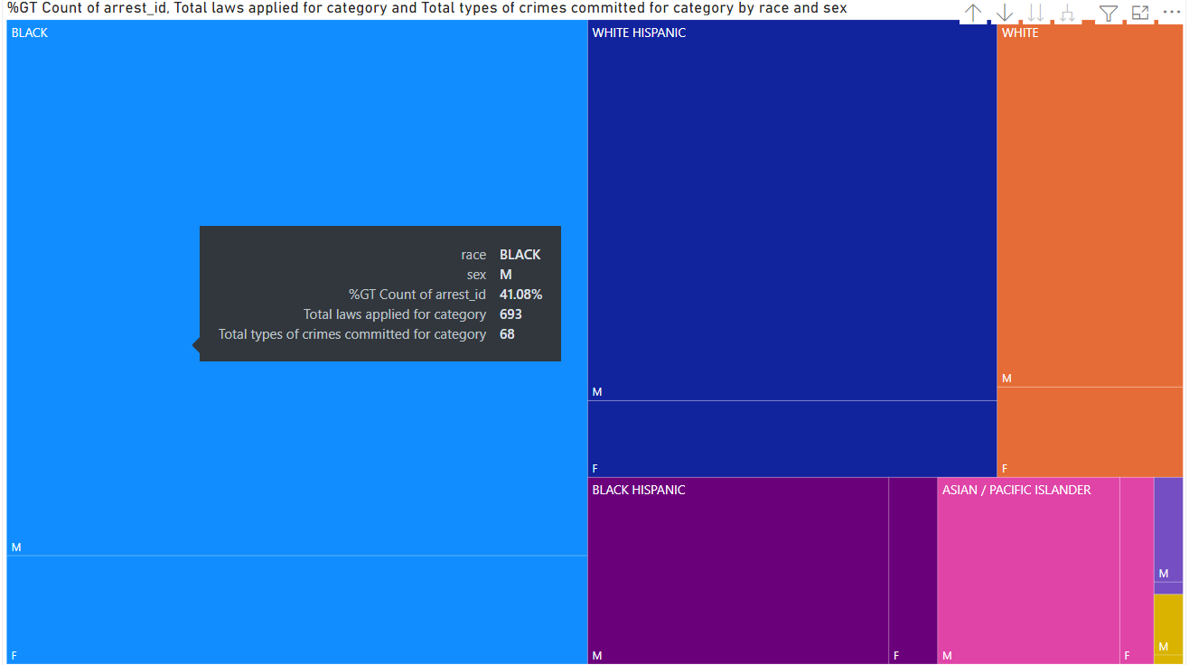
Breakdown by race, sex w/ % of grand total – using measures + total types of laws applied and crimes committed

Slide 31
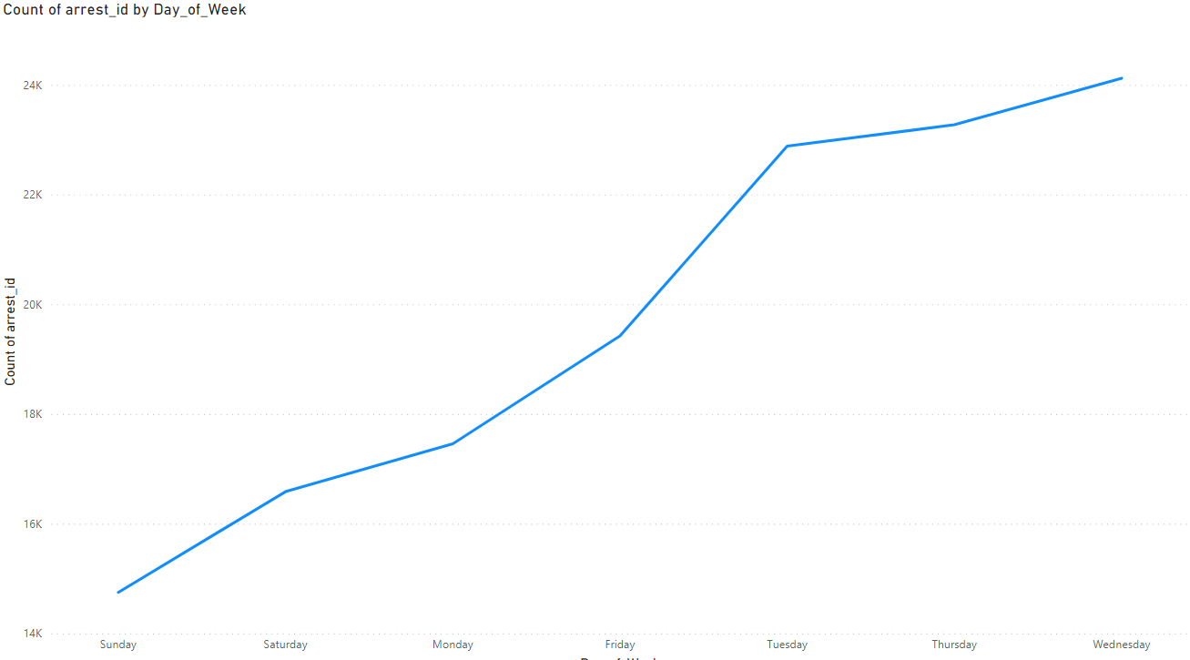
Most arrests are on tuesday, wednesday and thursday

Slide 32
references
https://dev.mysql.com/doc/refman/8.0/en/server-system-variables.html
https://logicalread.com/optimizing-server-settings-mysql-mc13/
https://www.linode.com/docs/guides/how-to-optimize-mysql-performance-using-mysqltuner/
https://github.com/major/MySQLTuner-perl
https://severalnines.com/database-blog/mysql-performance-cheat-sheet
https://docs.aws.amazon.com/AmazonRDS/latest/UserGuide/MySQL.Procedural.Importing.NonRDSRepl.html
https://www1.nyc.gov/site/nypd/bureaus/patrol/precincts-landing.page
https://data.cityofnewyork.us/Public-Safety/NYPD-Arrests-Data-Historic-/8h9b-rp9u
… many others

